Slide 1
Basics of the laparoscopic surgery
Arpad Juhasz MD PhD
surgeon
University of Pécs, Medical School
Dept of Surgical Research and Techniques

Slide 2
Open versus laparoscopic surgery
aim: to reduce the surgical trauma and the postoperative healing
Open surgery
Laparoscopy
Big exposure, more trauma <
Postop pain (large wound) <
Danger of secondary injuries =
Adhesions <
Postop hernia <
Sense of touch >
Small exposure, less trauma
Small wound, less pain
Secondary injuries
Adhesions are uncommon
Uncommon postop hernia
No touch with fingers
Basic of laparoscopic surgery – Pécs, 09.29.2015.

Slide 3
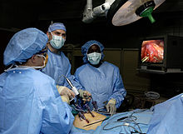
Open versus laparoscopic surgery
first without respect (Mühe, 1985)
special instruments
special surgeon’s attitude, new skill
new surgical aspects
I can see the monitor only, not the tissues
2D
inverse movement
no dominant hand
tremor
I can see what the
cameraman shows me
Basic of laparoscopic surgery – Pécs, 09.29.2015.

Slide 4
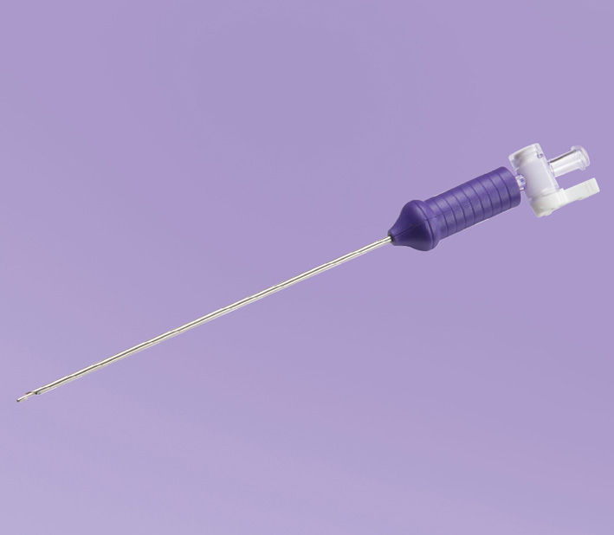
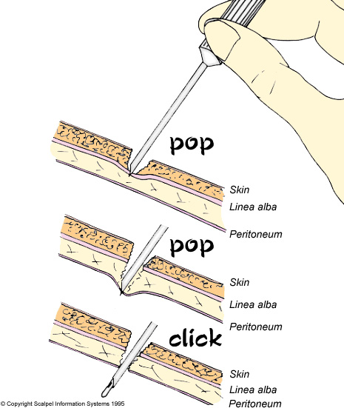
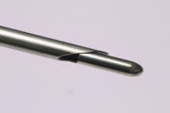
Steps of the laparoscopic surgery
pneumoperitoneum
Insertion of Veres-needle
Basic of laparoscopic surgery – Pécs, 09.29.2015.

Slide 5
Steps of the laparoscopic surgery
pneumoperitoneum
Insertion of Veres-needle
insufflation / insufflator
CO2 gas
absorbed rapidly by the peritoneum
dissolvable in the blood
no danger of explosion
BUT: cardiac arrhytmia
hypercarbia
Basic of laparoscopic surgery – Pécs, 09.29.2015.

Slide 6
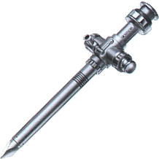
Steps of the laparoscopic surgery
port placement– trocars
external diameter
(2-25mm, mostly: 5-
12mm)
trocar with valve and
holes at the distal part
first port is done in a
blind manner
at the site suction
devide or insufflator
can be placed
Basic of laparoscopic surgery – Pécs, 09.29.2015.

Slide 7
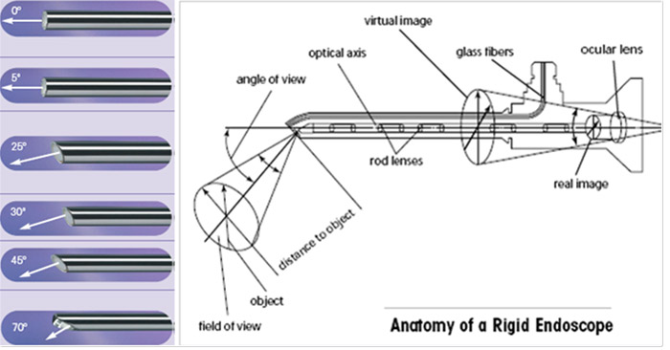
Steps of the laparoscopic surgery
optic
visual angle: straight, 30º, 45º
visual field, focal length, light loss
light source, fiber optic, camera
Basic of laparoscopic surgery – Pécs, 09.29.2015.

Slide 8
Steps of the laparoscopic surgery
optic
visual angle: straight, 30º, 45º
visual field, focal length, light loss
light source, fiber optic, camera
irrigation / suction device
electrocautery devices
hand instruments
Basic of laparoscopic surgery – Pécs, 09.29.2015.

Slide 9
Steps of the laparoscopic surgery
Basic of laparoscopic surgery – Pécs, 09.29.2015.

Slide 10
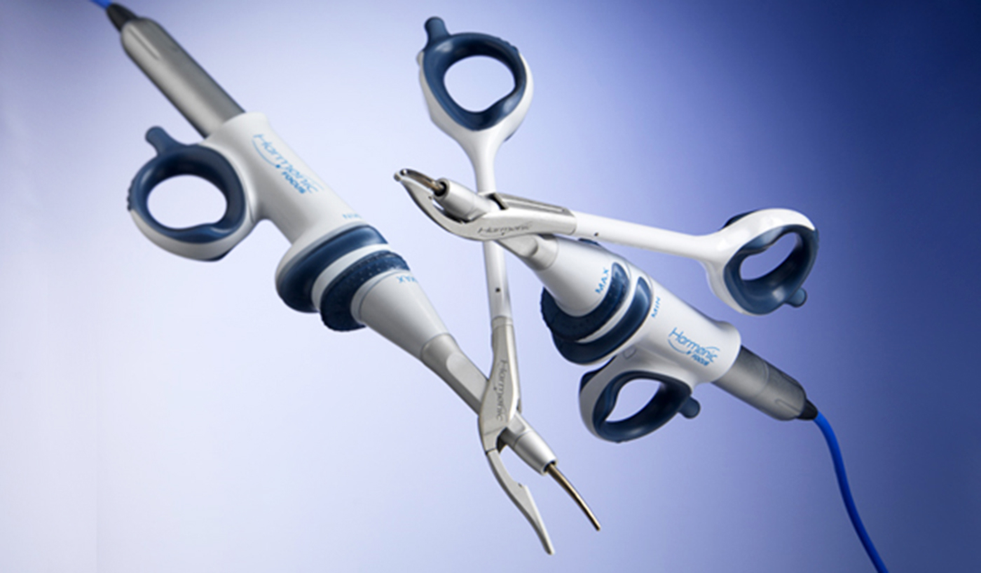
Steps of the laparoscopic surgery
Basic of laparoscopic surgery – Pécs, 09.29.2015.

Slide 11
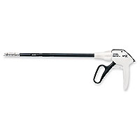
Steps of the laparoscopic surgery
Basic of laparoscopic surgery – Pécs, 09.29.2015.

Slide 12
Steps of the laparoscopic surgery
ideal placement of ports
2D
triangulation
port placed in a bad place = punishment!
Basic of laparoscopic surgery – Pécs, 09.29.2015.

Slide 13
Indications /contraindications of laparoscopy
before 2013.
accepted indications
questionable indications
not accepted indications
2013. SAGES statement:
all the abdominal operations can be managed
using minimally-invasive techniques, when
the technical and individual conditions are suitable
Basic of laparoscopic surgery – Pécs, 09.29.2015.

Slide 14
Indications /contraindications of laparoscopy
routine laparoscopies
diagnostic lapar.
cholecystectomy
appendectomy
abdominal / inguinal hernia repair
hiatus hernia reconstruction
suprarenal tumors
gynecological diagnistic /surgery
Basic of laparoscopic surgery – Pécs, 09.29.2015.

Slide 15
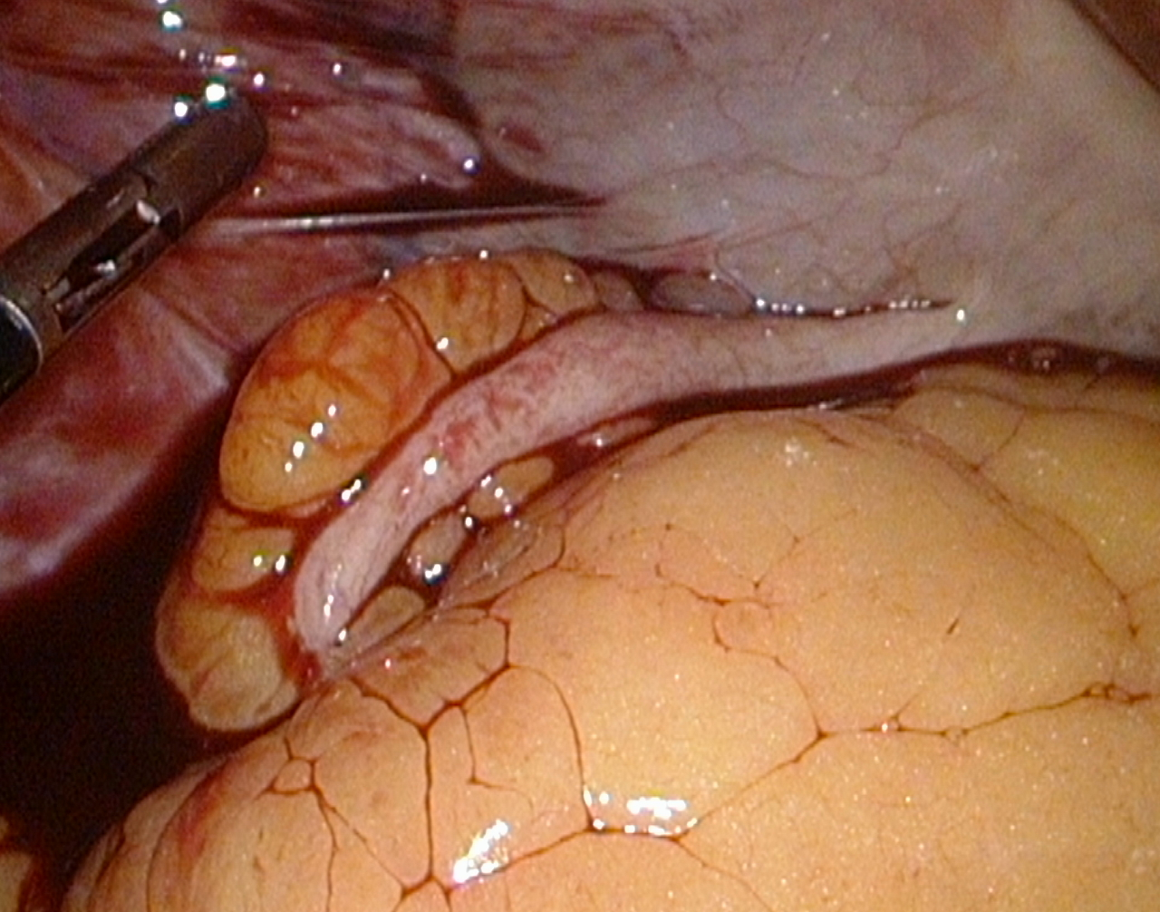

Slide 16
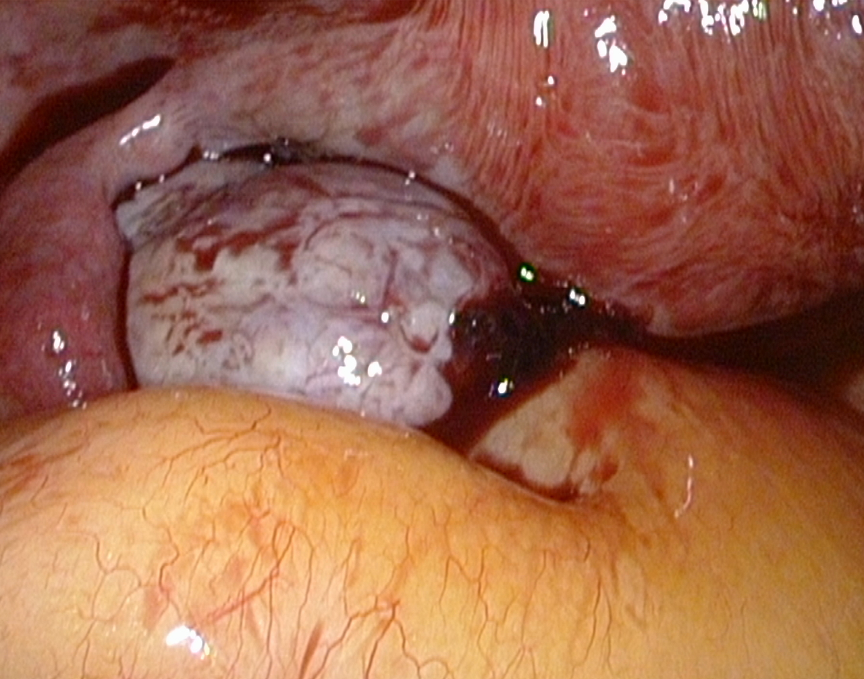

Slide 17
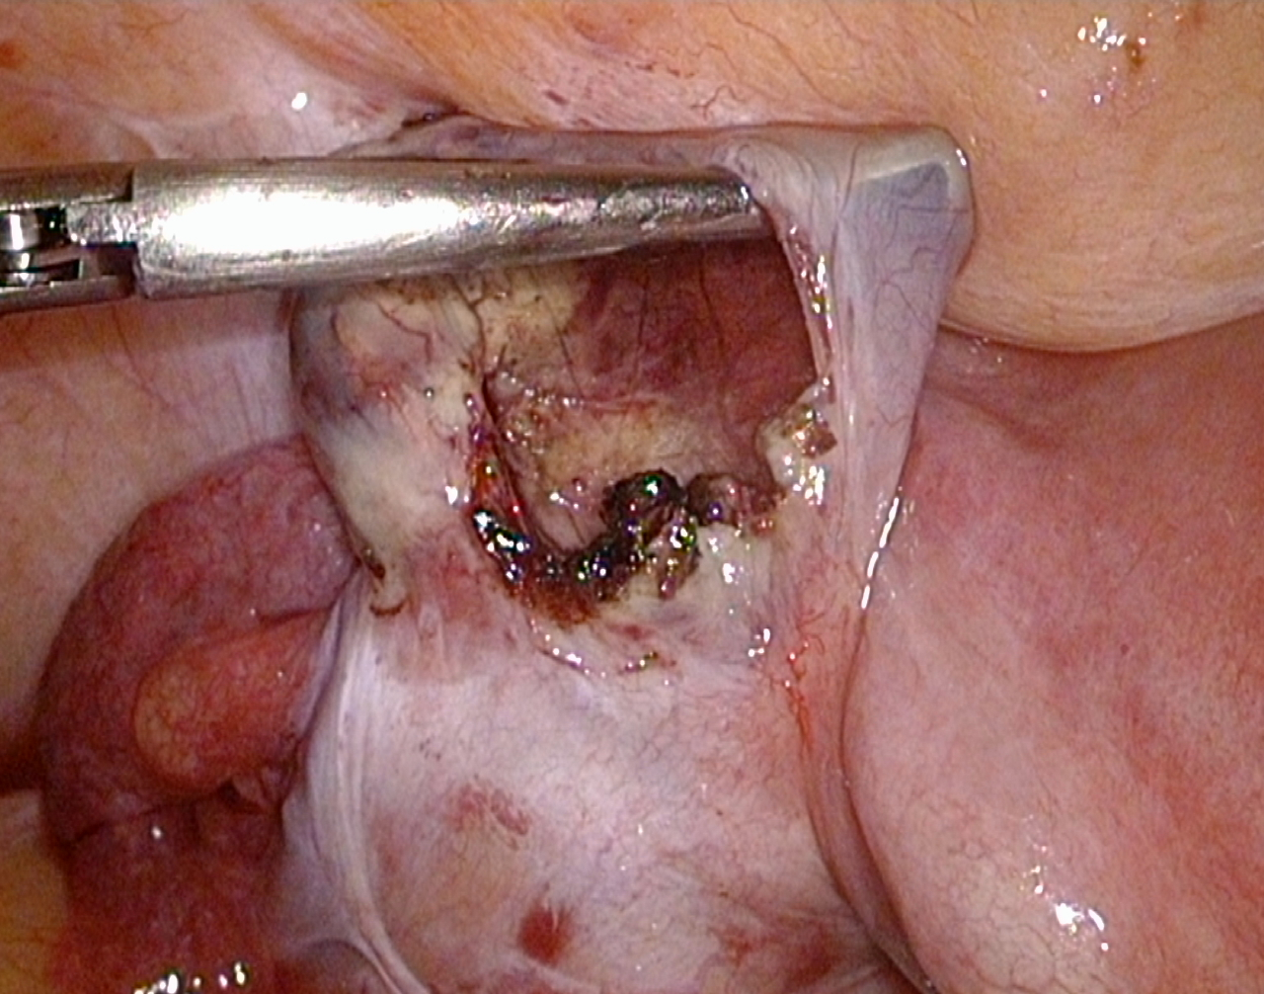

Slide 18
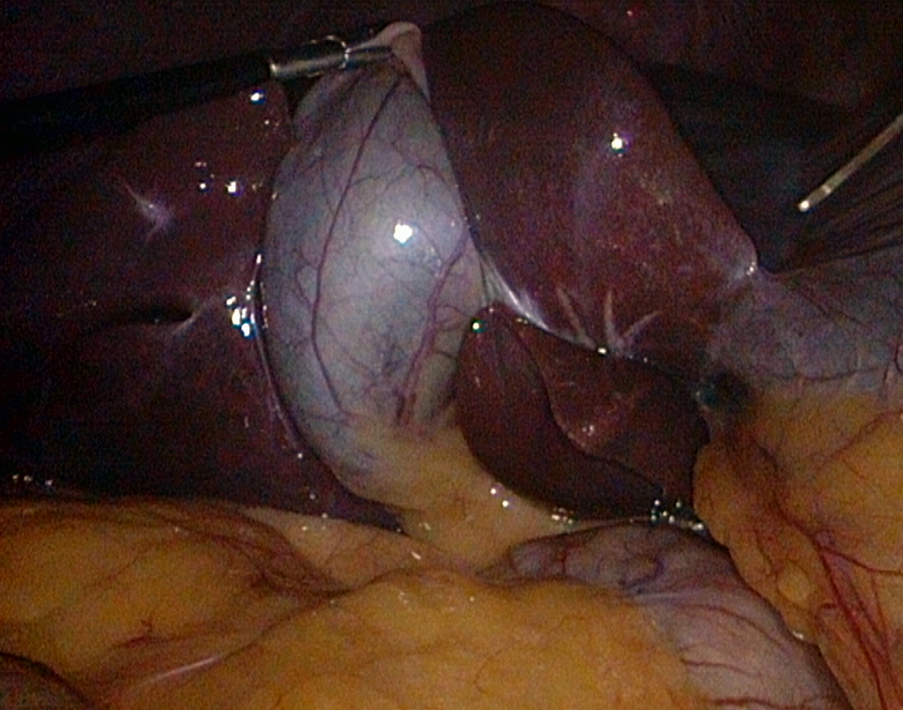

Slide 19
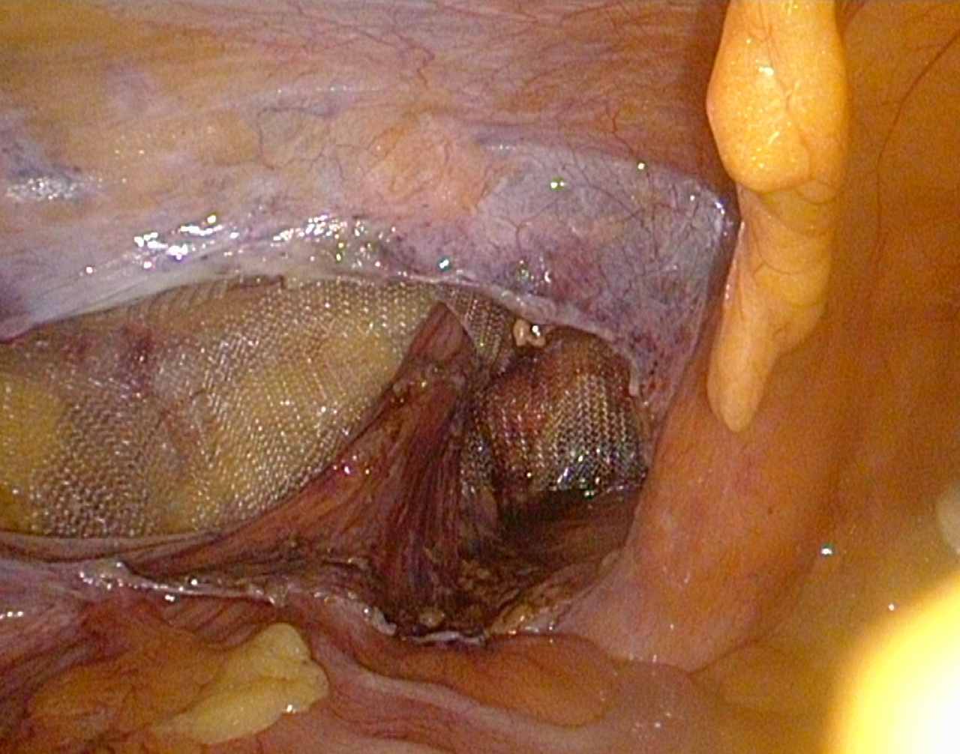

Slide 20
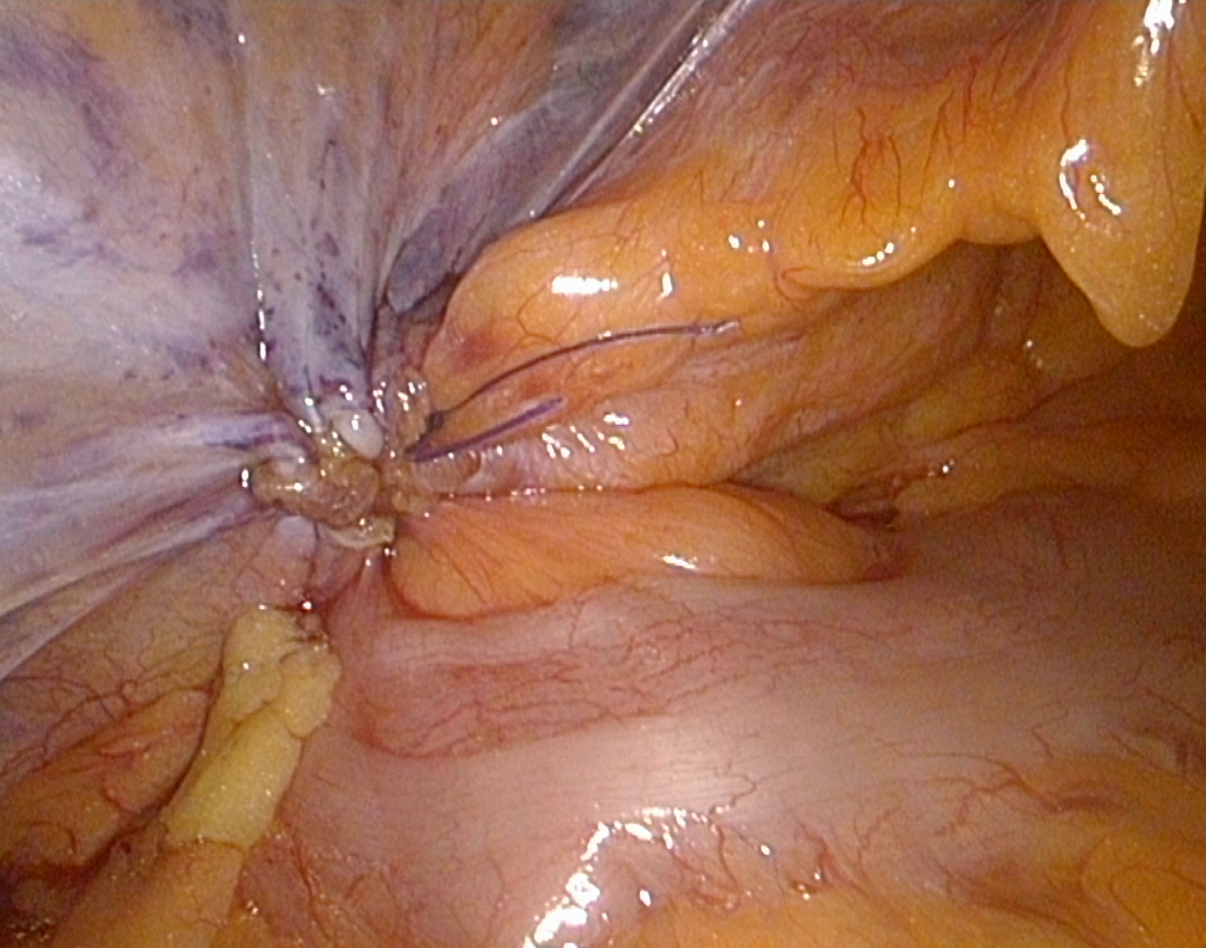

Slide 21
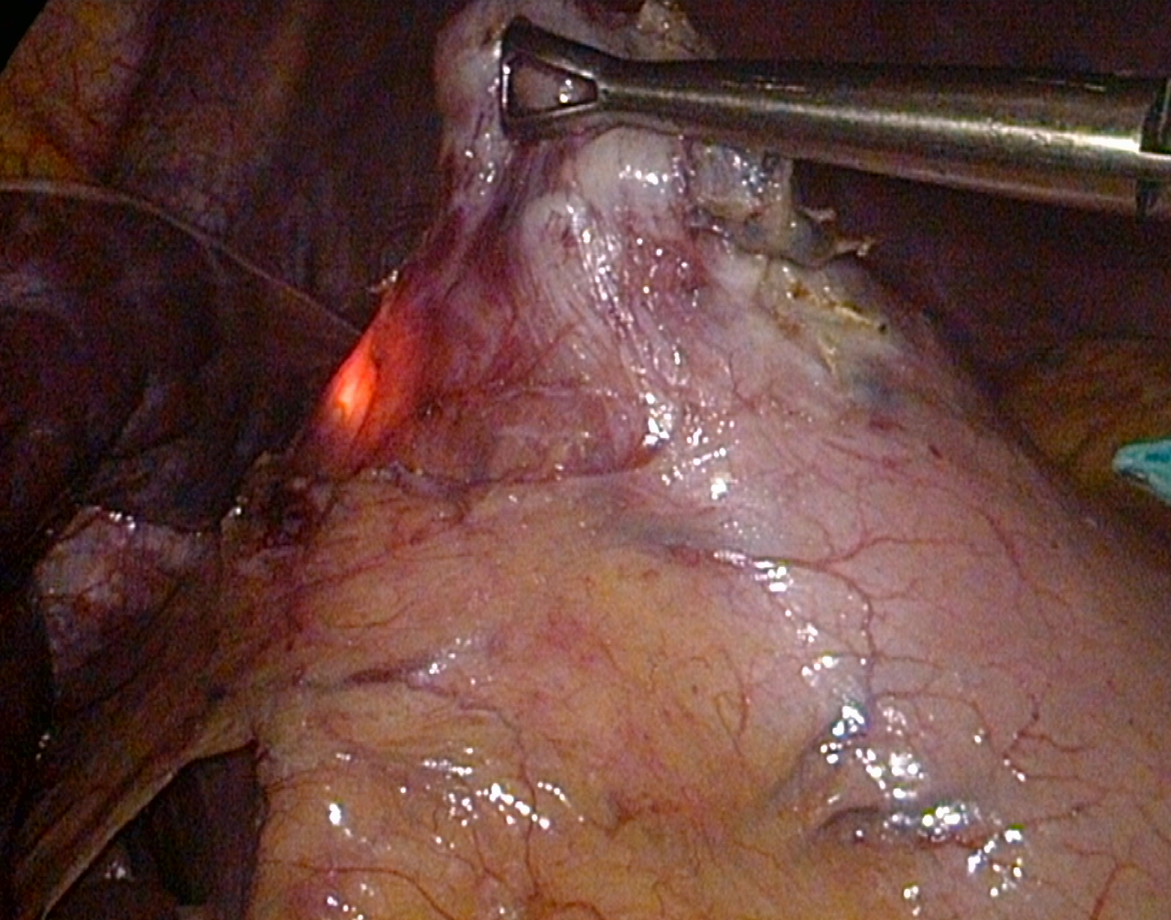

Slide 22
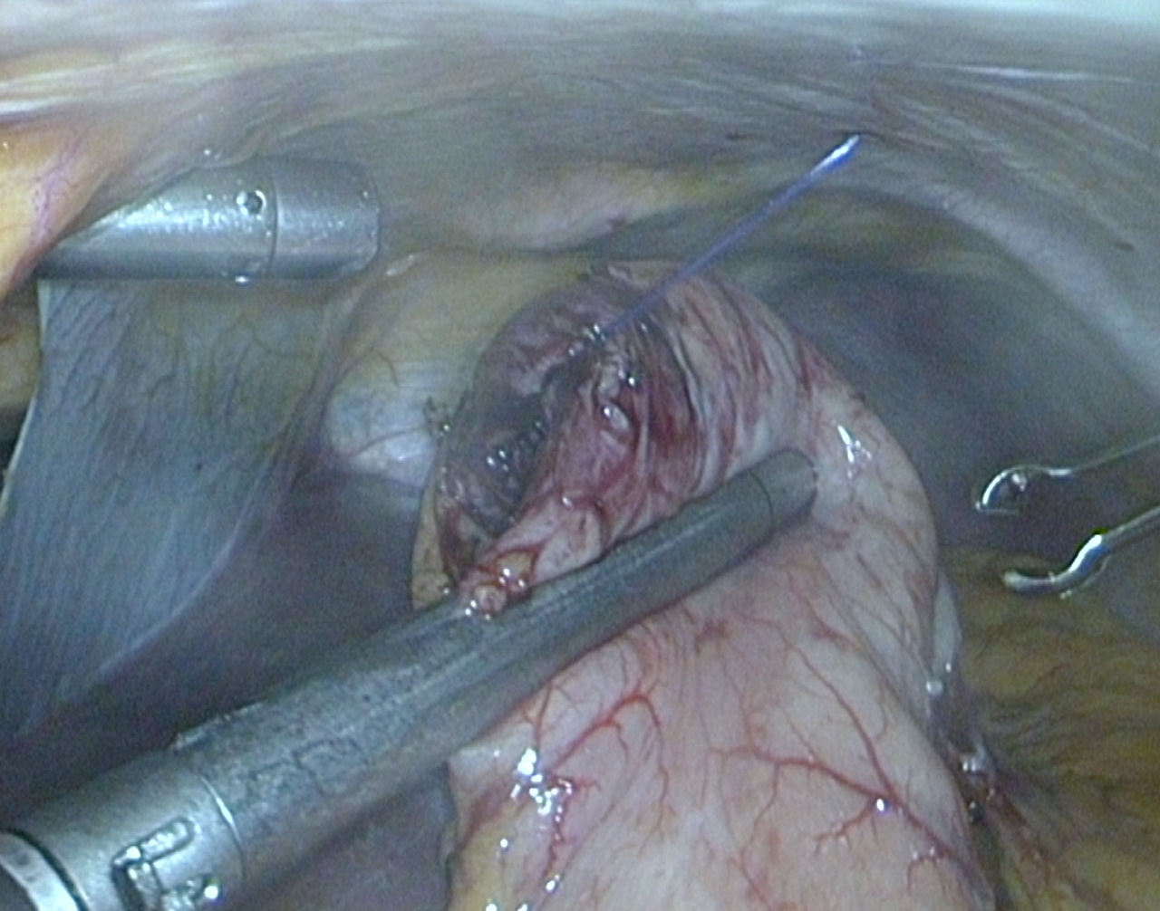

Slide 23
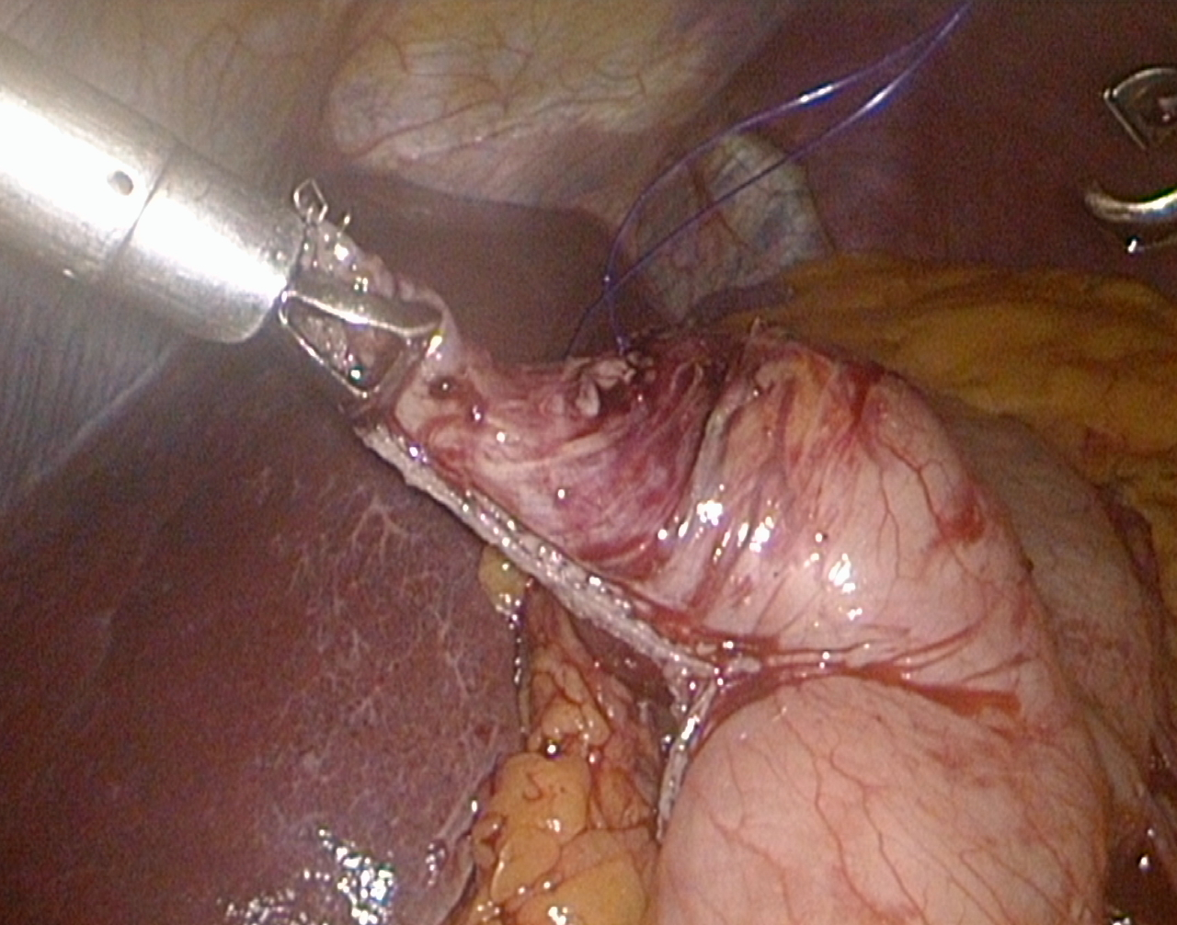

Slide 24
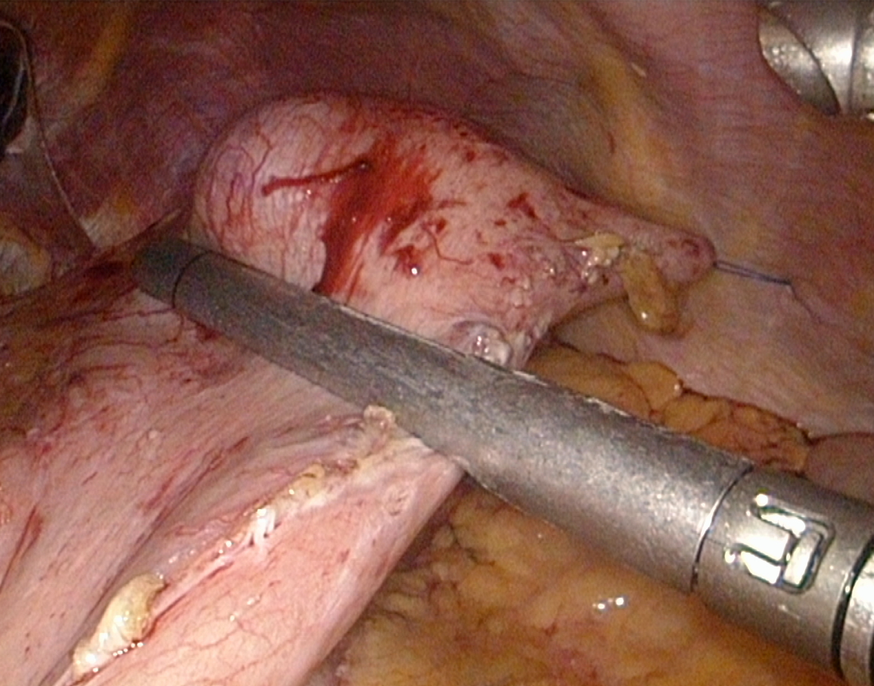

Slide 25
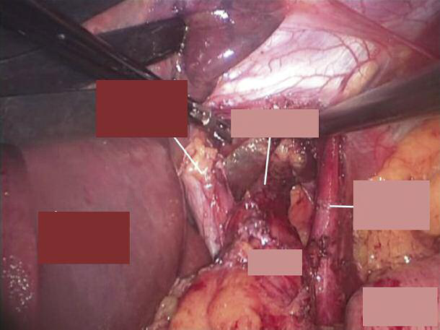
Right cruz
of diaphragm
esophagus
Left cruz of
diaphragm
Left lobe
of liver
cardia
Fundus of
stomach

Slide 26
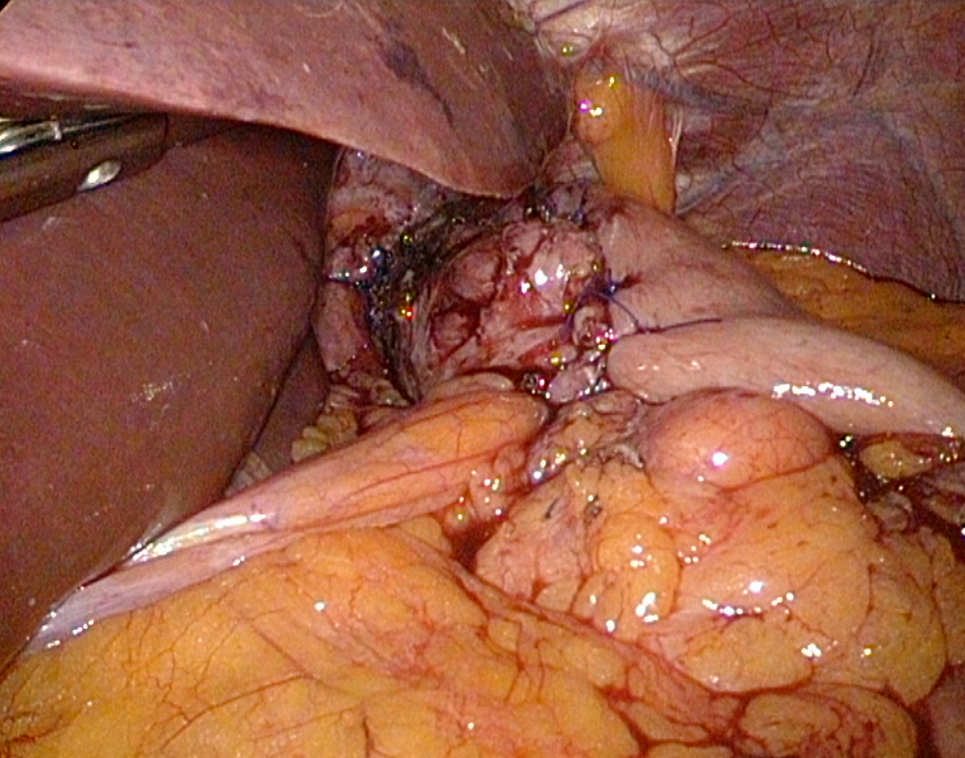

Slide 27
Indications /contraindications of laparoscopy
oncological laparoscopy
radicality
port-site metastasis
bariatric surgery
Basic of laparoscopic surgery – Pécs, 09.29.2015.

Slide 28
Indications /contraindications of laparoscopy
nowdays:
traditions
scepticism
conflict of interest
finantial reasons
Headway of laparoscopy
Basic of laparoscopic surgery – Pécs, 09.29.2015.

Slide 29
Indications /contraindications of laparoscopy
nowdays:
traditions
scepticism
conflict of interest
finantial reasons
Headway of laparoscopy
Basic of laparoscopic surgery – Pécs, 09.29.2015.

Slide 30
Indications /contraindications of laparoscopy
contraindications
patient’s general condition, pneumoperitoneum (?)
in-adequate instruments
in-adequate surgeon’s skill
intraoperative recognized complications requiring
conversion
Basic of laparoscopic surgery – Pécs, 09.29.2015.

Slide 31
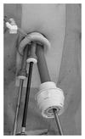
Ways of the future
single-incision laparoscopy
Basic of laparoscopic surgery – Pécs, 09.29.2015.

Slide 32
Ways of the future
single-incision laparoscopy
Basic of laparoscopic surgery – Pécs, 09.29.2015.

Slide 33
Ways of the future
NOTES (natural orifice transluminal endoscopic surgery)
no scar
2007.: first transvaginal cholecystectomy
2007.: first transgastric cholecystectomy
Basic of laparoscopic surgery – Pécs, 09.29.2015.

Slide 34
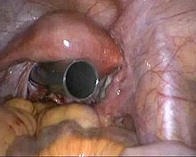
Ways of the future
NOTES (natural orifice transluminal endoscopic surgery
Basic of laparoscopic surgery – Pécs, 09.29.2015.

Slide 36
Ways of the future
robotic surgery - da Vinci
goal: minimally invasive and cheap surgery
minimally invasive: laparoscopy
cheap ????????????
Hungary: expensive instruments
cheap surgeon
rest of the world: expensive instruments
surgeon is more expensive
Basic of laparoscopic surgery – Pécs, 09.29.2015.

Slide 37
Ways of the future
robotic surgery - da Vinci
not necessary to „buy” a surgeon for each OP
each movement is assisted/corrected by the robot
no tremor
extrem precisity
Basic of laparoscopic surgery – Pécs, 09.29.2015.

Slide 38
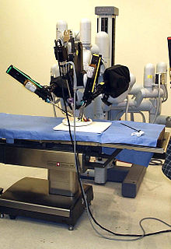
Ways of the future
robotic surgery - da Vinci
Basic of laparoscopic surgery – Pécs, 09.29.2015.

Slide 39
Basic of laparoscopic surgery – Pécs, 09.29.2015.

Slide 40
Thank you the attention!

