Slide 1
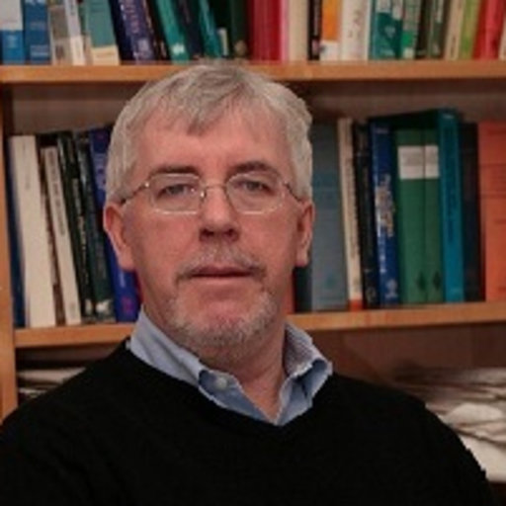

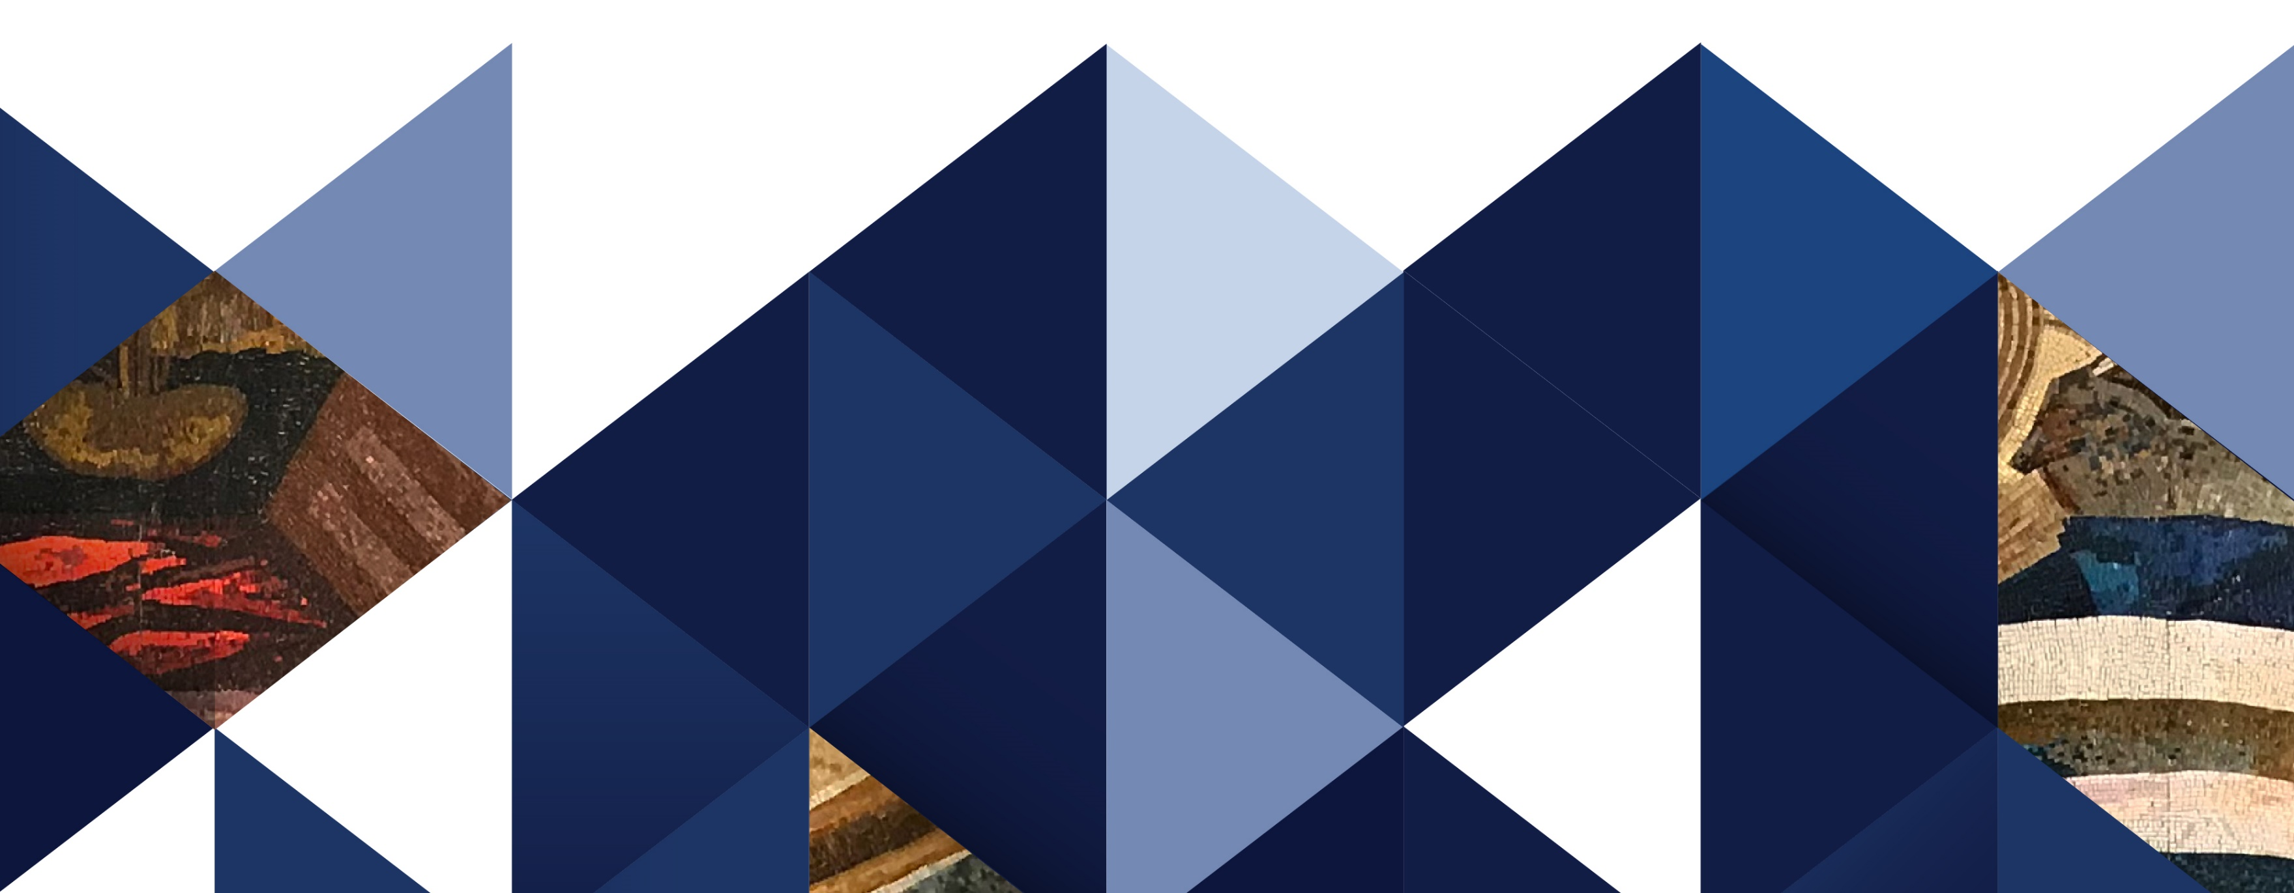
Prof. Michael A. Geeves
Biophysics Lectures
by
Emeritus Professor of Physical Biochemistry
School of Biosciences, University of Kent, Canterbury, UK
both days at 11am
29th November 2022
Molecular mechanisms of biological movement
30th November 2022
Molecular mechanisms of muscle functioning
Lecture Room 1 (Cholnoky-hall)
The lectures fit into the Biophysics curriculum for first-year General Medicine students.

