Slide 1
Chemical introduction
Katalin Kiss, Gergely Berta

Slide 2
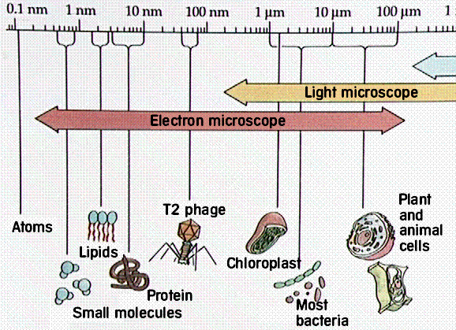
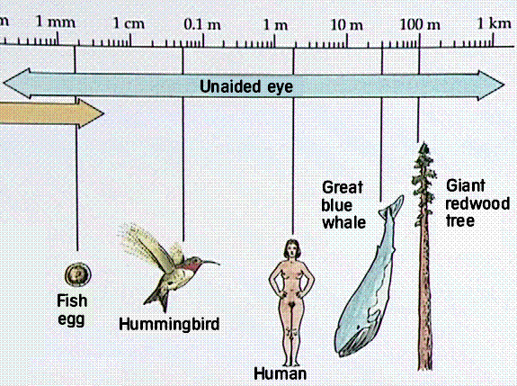
SIZE-SCALE
Metric = in meter/in metre
Millimeter= mm 1 mm=10⁻³m
Mikrometer=μm 1 μm=10⁻⁶m
Nanometer=nm 1 nm=10⁻⁹m
Centimeter=cm 1 cm=10⁻²m
Kilometer=km 1 km=10³m

Slide 3
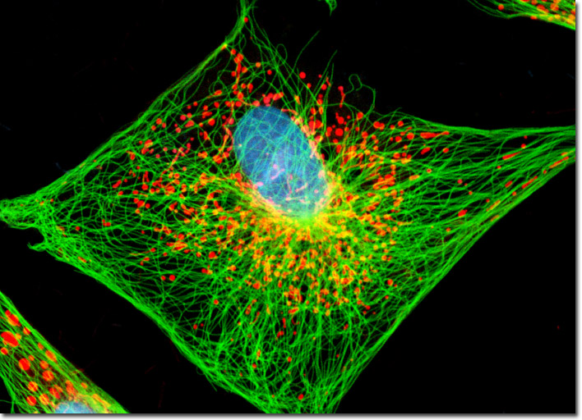
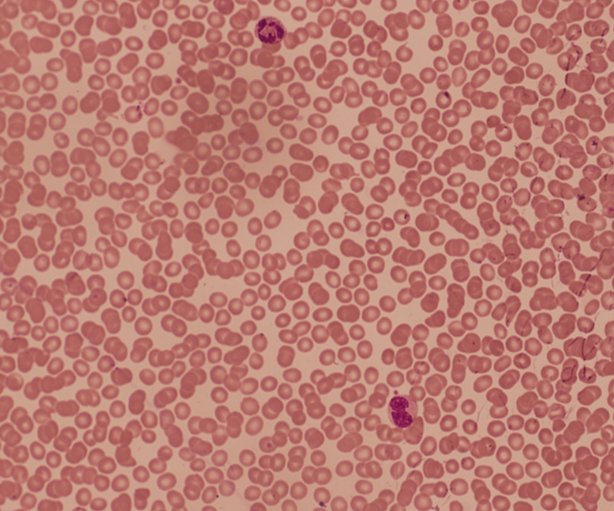
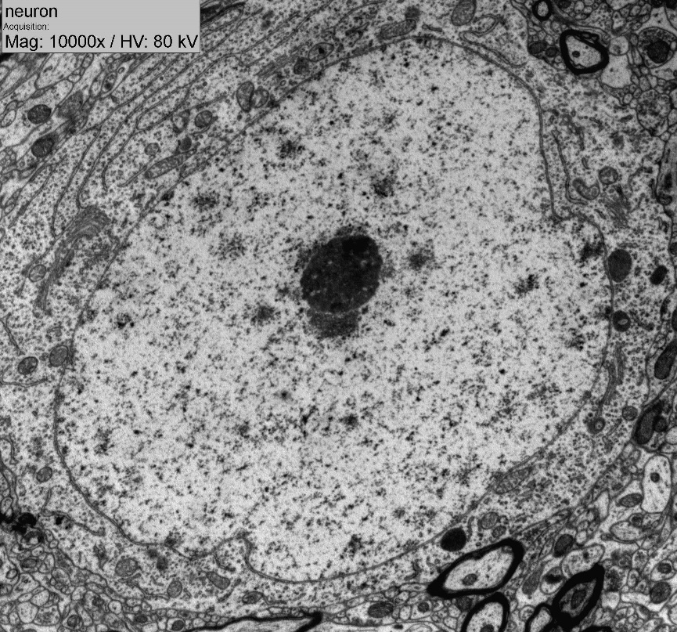
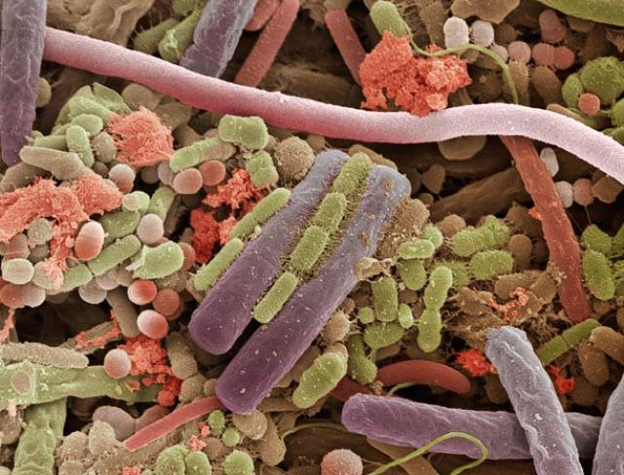
Light microscopy
Electron microscopy

Slide 4
atom, ion, isotope, element, molecule
A substance composed of atoms with the same atomic number; it cannot be broken down in ordinary chemical reactions.
The smallest indivisible particle of matter that can have an independent existence.
Two or more atoms which are chemically combined to form a single species.
An atom that has lost or gained electrons from its outer shell and therefore has a positive or negative charge, respectively; symbolized by a superscript plus or minus sign and sometimes a number, e.g., H⁺, Na⁺, O²⁻ Cl⁻.
Atoms with the same atomic number but different numbers of neutrons; indicated by adding the mass number to the element's name, e.g., carbon 12 or ¹²C.

Slide 5
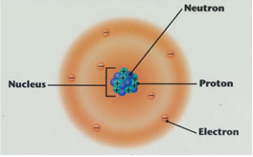
Atom, subatomic particles
www.csmate.colostate.edu
2 parts of an atom: nucleus and electron cloud („1cm/100m”)
Electron orbital: space of one electron
Electron shells
composed of orbitals
determine the size of the atom
4 major shells (K: 2 electrons, L: 8 electrons, M: 18 electrons, N: 32 electrons)
Number of protons=number of electrons
Atom is neutral=uncharged
Atomic number: number of protons
Atomic mass/weight = mass number: number of protons + number of neutrons

Slide 6
Subatomic particles
Dalton = Da = unit of mass/weight (NOT METRIC!)
1 Dalton = mass/weight of 1 Hydrogen ion (H⁺)
1 Dalton = mass/weight of 1/12 Carbon atom
Mass/weight of proteins, eg. 60 000Da=60kDa
Kilodalton (kDa)= 10³ Dalton

Slide 7
Ions
more or less electrons than protons
charged
types:
cation (+ charge) :1st and 2nd groups tend to lose 1 or 2 electrons
eg. Na⁺, Mg²⁺
anion (- charge) : 6th and 7th groups tend to gain 2 or 1 electrons
eg. Cl⁻, O²⁻
ionic bond formation

Slide 8
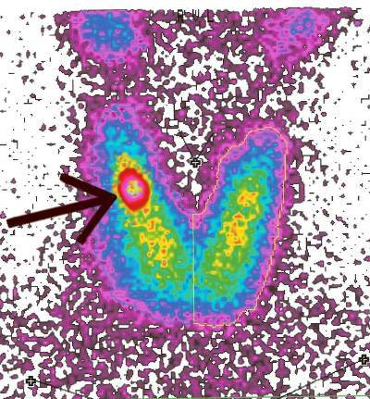
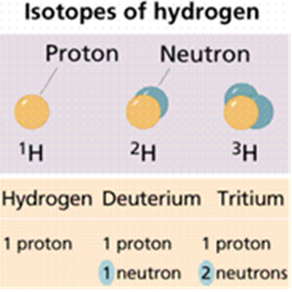
Isotopes
Same number of protons but different number of neutrons =
Same atomic number but different mass number
Types: stable and unstable (radioactive=nuclear splitting)
Role in medicine and research: to trace molecules eg. radioactive iodine
www.csmate.colostate.edu

Slide 9
Periodic table
D. I. Mendeleev
symbols of elements (element: a substance composed of atoms with the same atomic number) carbon:C; nitrogen: N; calcium: Ca etc.
rows=periods: elements with the same major quantum number/same major electron shell (K, L, M, N)
coloumns=groups: elements with the same versatile/unpaired electrons
Size of elements increases from top to bottom and from right to left.
electron affinity
The different elements have a different attraction towards electrons.
Electron affinity of elements increases from bottom to top, and from left to right.
The highest electron affinity is possessed by fluorine (F).
relative atomic mass = molar mass : gram/mole ‚ mole:6*10²³

Slide 10
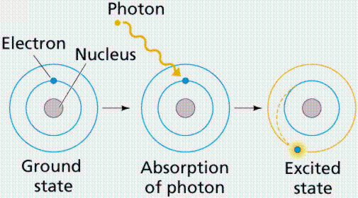
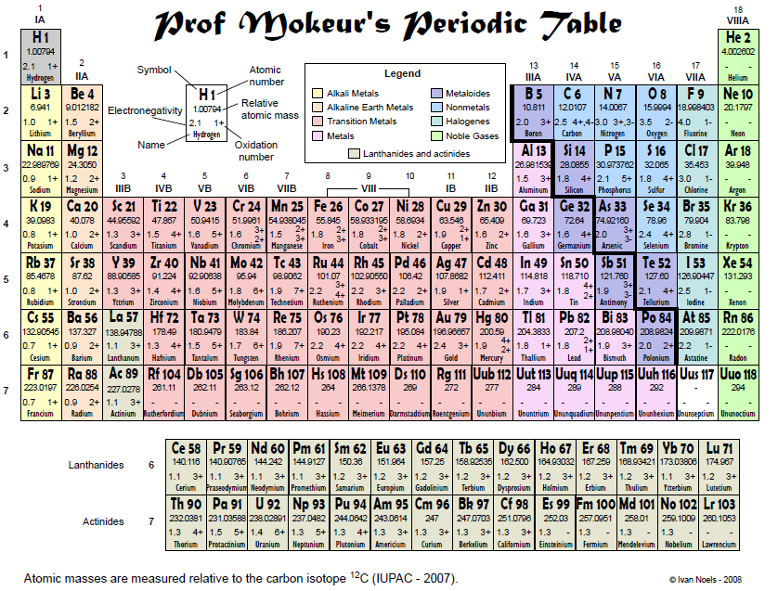
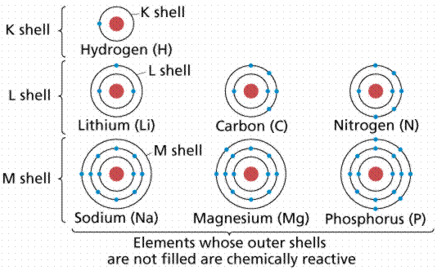
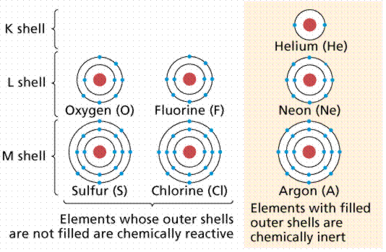
Atoms, subatomic particles, ions, isotopes III.

Slide 11
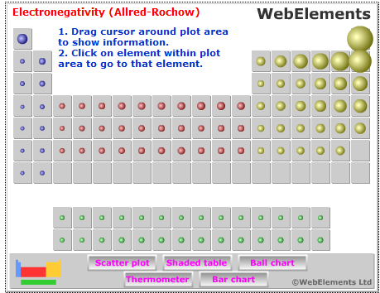
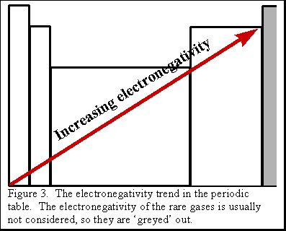
Electronegativity
A chemical property which describes ing
    the tendency of an atom or a functional group to attract electrons (or electron density) towards itself .
    the tendency to form negative ions.
An atom's electronegativity is affected by:
  atomic number and the
  distance that its valence electrons reside from the charged nucleus.
  The higher the associated electronegativity number, the more an element or compound attracts electrons towards it.

Slide 12
Molecules
2 or more atoms bound to each other through covalent bond(s)
central atom
stabile compound
shape determined by electronpairs and the electron attraction by atomic nuclei
eg. Linear (H-H, O-C-O), V-saped (H-O-H)
polarity determined by the electronaffinity of atomic nuclei
apolar (eg. H-H) or polar (eg. H-Cl) molecules

Slide 13
Chemical bonds in organic chemistry
Primary bonds:
  Covalent bond:
Electrons are shared by the bound atoms (bonding electrons)
Strong
Inside molecules=intramolecular
Types:
  Single (H-H, C-C, H-O-H), Double (C=O, C=C), Triple (C=C, N=N)
  Non polarized, polarized
Disulfide-bond/Disulfide-bridge: -S-S- (inside molecules, between molecules)
    Ionic bond: between ions (eg. between Na⁺ and Cl⁻)
2. Secondary/Non-covalent bonds:
electrons are not shared by the bound atoms
Weaker than covalent bonds
Between molecules =intermolecular
Types:
  Van der Waals=London forces (between apolar molecules)
  Dipole-dipole bonds (between polar molecules)
  Hydrogen bond

Slide 14
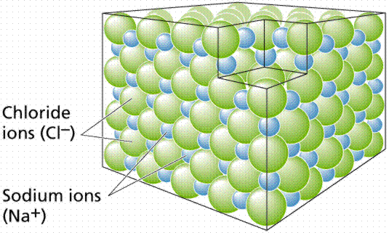
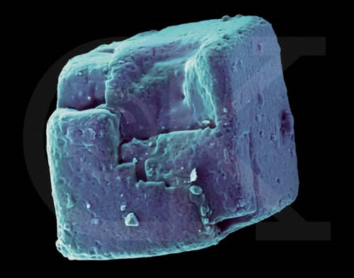
Chemical bonds

Slide 15
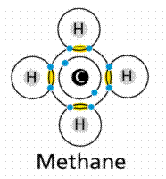
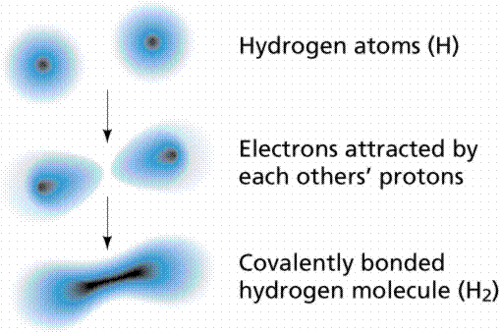
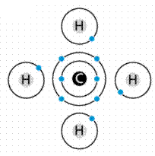
Chemical bonds

Slide 16
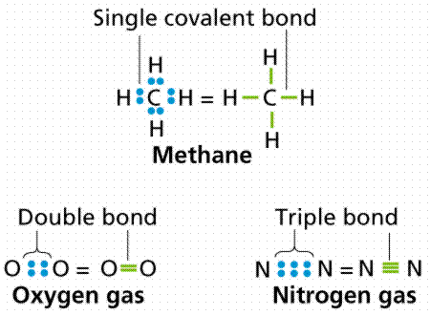
Chemical bonds

Slide 17
Hydrogen bond
is a secondary bond
between a H atom covalently attached to an electronnegative atom (atom with a high affinity for electrons) eg O, N, and an electonegative atom of another molecule or another part of the same molecule
weaker than covalent bonds
between water molecules, inside protein molecules
Figure 2-3. The hydrogen bond in water. http://www.flatworldknowledge.com/

Slide 18
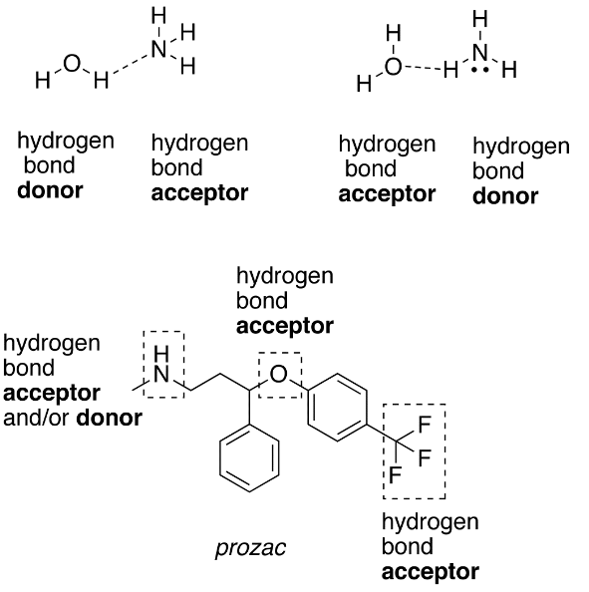
Chemical bonds

Slide 19
Functional groups / chemical groups in organic chemistry
A complex of covalently joined atoms (minimum 2 atoms are coupled to each other).
The group is covalently linked to the carbon backbone (skeleton) of a molecule.
The group is responsible for
the chemical properties of the molecule (eg. solubility, polarity, charge,
acidic/basic feature…)
the chemical interactions (bond forming capability) of the molecule.

Slide 20
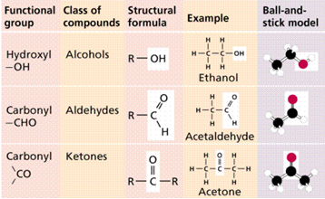
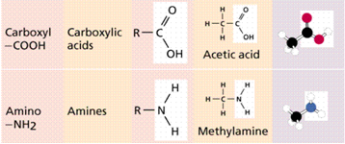
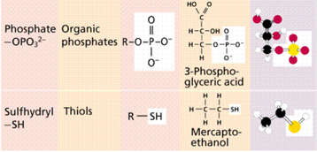
Functional groups in organic chemistry
Water solubility | Acid/Base | Charge | Molecules | Bonds
yes | no | no | carbohydrates | ester
yes | no | no | Carbohydrates eg. glucose
yes | no | no | Carbohydrates eg. fructose
yes | acids | - | Citric acid=citrate Aminoacids | ester peptide
yes | bases | + | aminoacids | peptide
yes | acids | - | Nucleotides Nucleic acids Phospholipids | Ester Phospho- anhydride (macroerg)
yes | no | no | Aminoacids eg. cysteine | disulfide

Slide 21
Biogenic elements
elements present in living systems
appr. 25
types:
primary
secondary
tertiary =trace

Slide 22
„I bring forth acid”
coal
„I form water”
„I form native-soda”
lime
light bearer
pot-ash
yellow
soda
from Magnesia
violet
strong metal, holy metal
yellowish green/ greenish yellow
Moon
flint (a kind of stone)
bitter salt
Oxygen From Greek "ὀξύ γείνομαι" (oxy geinomai), which means "Ι bring forth acid", as it was believed to be an essential component of acids.
Carbon From the French, "charbone", which in turn came from Latin "carbō", which means "charcoal" and is related to "carbōn-", which means "a coal."
Hydrogen From French hydrogène[28] and Latin hydro- and -genes, derived from the Greek, "ὕδωρ γείνομαι" (hydor geinomai), meaning "Ι beget water".
Nitrogen From French "nitrogène",[38] derived from Greek "νίτρον γείνομαι" (nitron geinomai), meaning "I form/beget native-soda (niter)".[
Calcium From Latin "calx", which means "lime". Calcium was known as early as the first century when the Ancient Romans prepared lime as calcium oxide.
Phosphorus From Greek φῶς + -φόρος (phos + -phoros), which means "light bearer", because "white phosphorus" emits a faint glow upon exposure to oxygen "Phosphorus" was the ancient name for "Venus", or Hesperus, the (Morning Star).[18]
Potassium From the English "potash", which means "pot-ash" (Potassium compound prepared from an alkali extracted in a pot from the ash of burnt wood or tree leaves). The symbol K is from Latin name, Kalium, from Arabic "القلي" (al qalīy), which means "calcined ashes".
Sulfur Almost certainly from Arabic "صفرا" (sufra), "yellow", the bright color of the naturally occurring form.
Sodium From the English, "soda", used in names for Sodium compounds such as caustic soda, soda ash, and baking soda. The symbol Na is from Modern Latin noun natrium, derived from Greek "νίτρον" (nítron), "natural soda, a kind of salt" + Latin -ium.[
Magnesium From the Ancient Greek, "Μαγνήσια" (Magnesia) (district in Thessaly), where discovered.
Iodine Named after the Greek, "ἰώδης" (iodes), which means "violet", because of the color of the gas. This word was adapted as the French iode, which is the source of the English iodine
Iron meaning "holy metal" or "strong metal" which in its turn may derive from the Etruscan, aisar, meaning "the god(s)", because the earliest iron to be worked was obtained from meteorites, and meteorites fall from the sky.[31]The symbol Fe is from Latin ferrum, meaning "iron".
Chlorine From Greek "χλωρός" (chlorós), which means "yellowish green" or "greenish yellow", because of the color of the gas.
Selenium From Greek, "σελήνη" (selene), which means "Moon", and also moon-goddess Selene
Silicon From Latin "silex" or "silicis", which means "flint", a kind of stone.
Aluminium Latin alumen, which means "alum" (literally "bitter salt").

Slide 23
Elements of human body primary, secondary, tertiary (trace)
Oxygen (65%)
Carbon (18%)
Hydrogen (10%)
Nitrogen (3%)
Calcium (1.5%)
Phosphorus (1.0%)
Kalium/Potassium (0.35%)
Sulfur (0.25%)
Natrium/Sodium (0.15%)
Magnesium (0.05%)
Copper, Zinc, Selenium, Molybdenum, Fluorine, Chlorine, Iodine, Manganese, Cobalt, Iron (0.70%)
Lithium, Strontium, Aluminum, Silicon, Lead, Vanadium, Arsenic, Bromine (≤0,5%)
Trace elements:
-are elements present in small quantities in living cells, organisms but essential for cells

Slide 24
Elements of human body
oxygen: 2 valences, electronnegative
in water
in CO₂
in all organic molecules, in many functional groups
in H-bond formation
oxygenates H into water during ATP (energy) synthesis
  = oxidant
carbon: 4 valences
formation of carbon backbone=skeleton of organic molecules (central atom)
formation of complex and diverse molecules
formation of single, double, triple bonds
formation of linear, and ring-like backbones
in many functional groups
in CO₂
is oxidized during breadown processes (eg. glucose breakdown)
hydrogen: 1 valence
in water
in all organic molecules, in many functional groups
in H-bond formation
is reduced into water during ATP (energy) synthesis

Slide 25
Elements of human body
nitrogen: 3 valences, electronnegative
in aminoacids and proteins
in nucleotides and nucleic acids (purine, pyrimidine bases)
(in a few lipids, carbohydrates)
in amino group
in H-bond formation
calcium:
bones, teeth (rigidity)
blood coagulation
muscle contraction
phosphorous:
bones, teeth (rigidity)
in nucleotide, nucleic acids
in phosphate functional group

Slide 26
Elements of human body
natrium=sodium and kalium=potassium:
membrane potential, action potential
sulfur:
in thiol functional group
in aminoacids, proteins
magnesium:
in enzyme function
in muscle cell and nervous system function
iodine:
in thyroid gland hormone (thyroxine)
iron:
in haemoglobin (O₂ gas transport in blood)

