Slide 1
DNA, the genetic material
Katalin Kiss

Slide 2
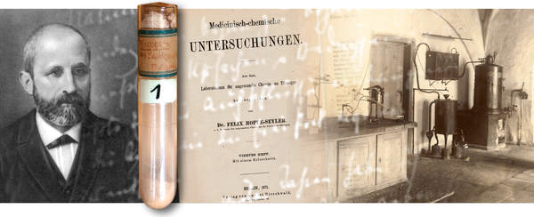
http://www.ralf-dahm.com/index.php?id=61
Friedrich Miescher 1868. : DNA („nuclein”) in the nucleus of white blood cells
  The role of DNA was unknown
  Theory: proteins code for genetic information
First half of 1900’: Experiments proving the „genetic role” of DNA
  Griffith 1928. and Avery and his colleauges 1944. : „bacterium transformation”experiments
  Hershey-Chase 1952.: „bacteriophage infection experiment”

Slide 3
Bacterium transformation experiments
http://biologytb.net23.net/text/chapter11/concept11.1.html
Frederick Griffith:
  Introduction of term „transformation”
  Scientific messages:
    The transforming material is heat resistant
    Proteins do not code for the genetic information
Oswald Avery, Colin MacLeod, and Maclyn McCarty:
  DNA causes transformation
  DNA is the genetic material

Slide 4
Bacteriophage experiment
http://biologytb.net23.net/text/chapter11/concept11.1.html
Alfred Day Hershey és Martha Chase:
DNA is responsible for the viral infection and the reprograming of host cells

Slide 5
Replication
Katalin Kiss

Slide 6
replication= DNA synthesis = making 2 identical copies of DNA
2 double stranded DNA molecules are made from 1 double stranded DNA molecule
point of time in life of cell: before cell division (in eukaryotes in S phase)
significance: to make 2 identical copies of each DNA molecule for the daughter cells
basis of inheritance of genetic information from parents to offsprings

Slide 8
Structure of DNA
Monomers: nucleotides (2’ deoxyribonucleoside-monophosphates in the chain and deoxyribonucleoside-triphosphate at 5’ end)
3’-5’ phosphodiester bonds
5’ and 3’ ends
Double stranded
Antiparallel orientation
Complementary base pairing (A-T, G-C); H-bonds

Slide 9
Process of replication
  Initiation:
    ori is recognized by proteins
    2 strands are separated by cleaving the H bonds
    primer binding
  Elongation: in replication bubble
    complementary nucleotide binds to template strand with H bonds
    DNA polymerase forms 3’-5’ phosphodiester bond
  Termination
    separation of 2 dsDNA molecules from each other

Slide 10
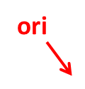
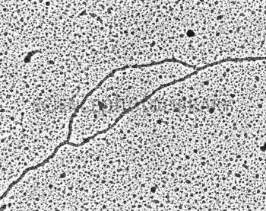
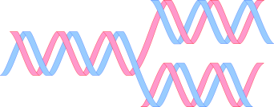
Replication bubble
ori
Replication fork
http://www.sciencephoto.com/media/132241/view

Slide 11

Replication fork

Slide 12
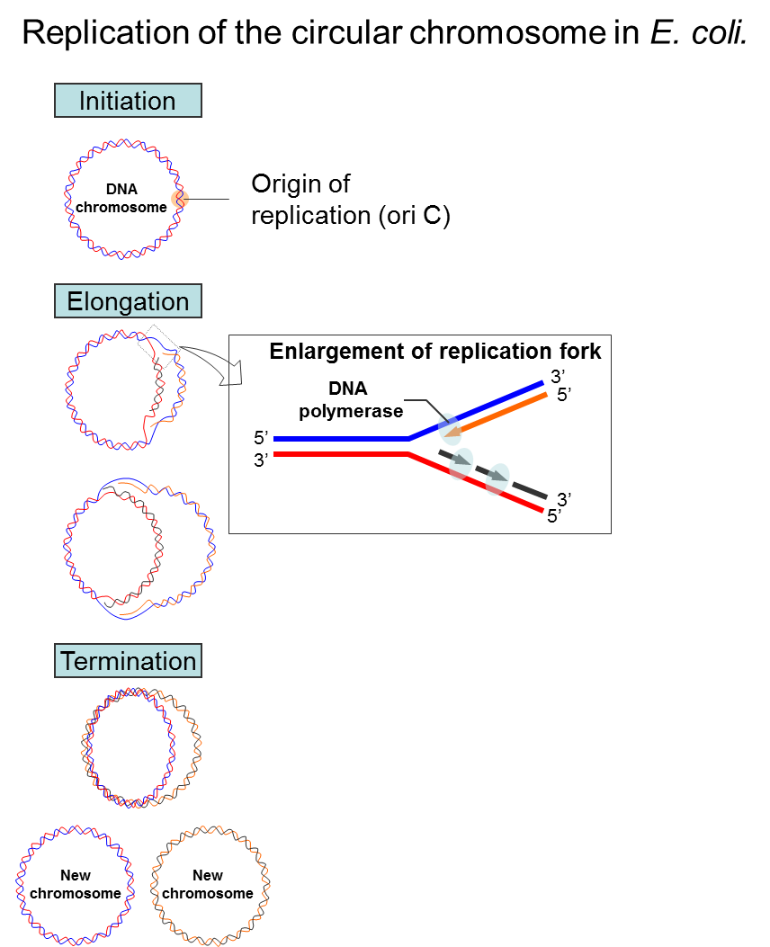
motifolio.com

Slide 13
General features of replication
Multienzyme complex= replisome does replication
starts at Origin =ori site
  in prokaryotes: 1; in eukaryotes: several/ 1 DNA
Bidirectional (in 2 directions from ori)
Semiconservative (1 parental and 1 daughter strand in new DNA)
Semidiscontinuous (2 types of new strands: continuously made leading strand; discontinuously made lagging strand)
DNA polymerase: forms 3’-5’phosphodiester bonds
  Substrates: deoxyribonucleoside-triphosphates
  Template dependent
  Primer dependent
  Energy-dependent (high energy bonds in nucleotides serve energy)
Direction:
  Synthesis of the new strand: from 5’ to 3’ end
  DNA polymerase movement on template: from 3’ to 5’ end

Slide 14
PNAS Vol. 104, pp.1500-1505, 2007
PNAS Vol. 71, No. 1, pp. 135-139, January 1974

