Slide 1
Structure of cells: Pro-and eukaryotic cells, viruses, fungi
Maria Nemeth

Slide 2
Viruses
non-cellular
living and non-living characteristics
obligate intracellular parasites: they can multiply in their host cells only
size: between 20 and 30 nanometers
infect: bacteria, plants and animals

Slide 3
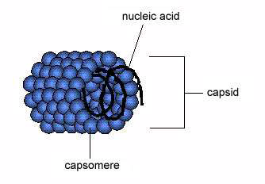
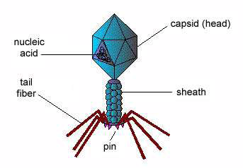
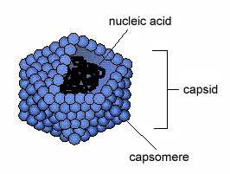
Structure of viruses
outer capsid and genetic material (DNA or RNA)
capsomeres: protein subunits of capsid
helical viruses polyhedral viruses binal viruses

Slide 4
Classification
Structure
Genetic material: DNA virus (Hepatitis B virus, Human papilloma virus), RNA virus (HIV)
Type of host cells: bacteriophage, plant virus (grapevine fan leaf virus), animal virus (Influenza virus, Hepatitis C virus, Human Herpes virus 8)

Slide 5
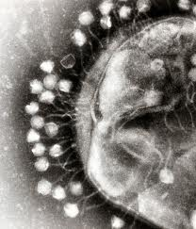
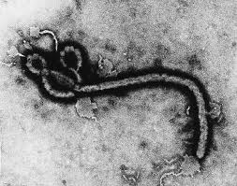
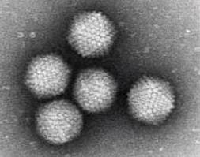
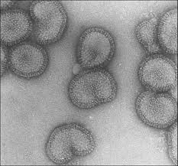

Slide 6
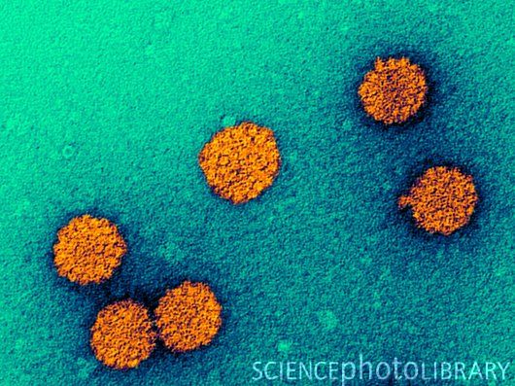
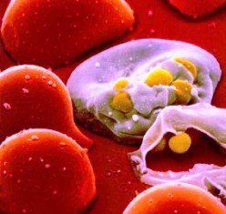
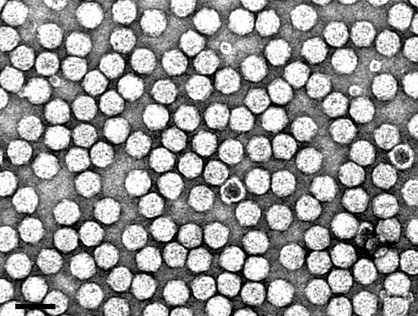

Slide 7
Vaccination
prevent viral infections of humans
stimulate the immune system to recognize the foreign agent
live-attenuated: contain weakened forms of the virus
killed viruses
viral proteins

Slide 8
Prokaryotic cells
lack cell nucleus and other membrane-bound organelles
bacteria and cyanobacteria
size: 1-20 μm
no nuclear envelope
genetic material: DNA (found in the nucleoid region, small, circular, double stranded and mostly coding)
plasmid (extrachromosomal DNA, give selective advantage)

Slide 9
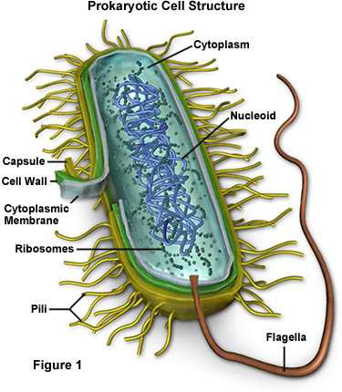

Slide 10
Structure of prokaryotic cells
cell membrane surrounded by a cell wall (peptidoglycan)
capsule (protection)
flagella (hair-like, moving), pili (attaching to host cells)
primitive cytoskeleton system
free and cell membrane bounded ribosomes
transcription and translation is coupled (polysome-chromosome complexes)

Slide 11
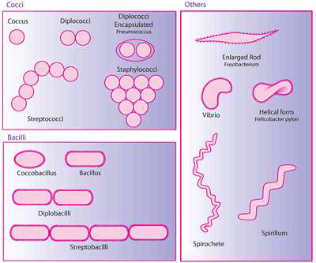
Morphology of bacteria
determined by cytoskeletal elements, and by the cell wall
spherical
rod-shape
vibrio
spirilla

Slide 12
Characteristics of bacteria
reproduced by binary fission
bacteriospores (highly resistant, long viability)
E.g. Bacillus anthracis causing antrax
Endotoxin (causing systemic inflammatory response in the body)
e.g. Neisseria meningitides causing meningitis

Slide 13
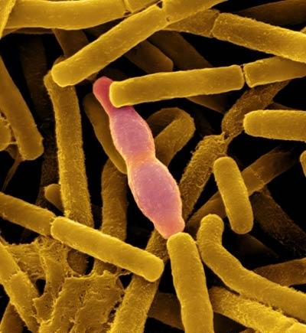
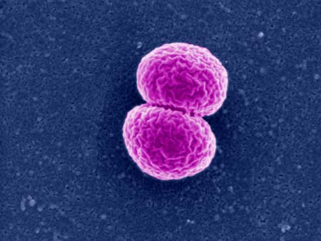

Slide 14
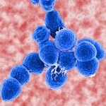
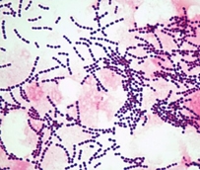
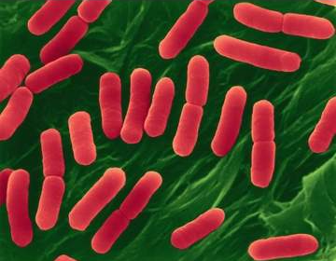
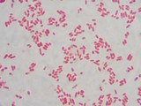
Gram staining
Gram positive bacteria (thick peptidoglycan cell wall)
e.g. Streptococcus causing Pneumonia
Gram negative bacteria (thin cell wall, cannot be stained)
e.g. Escherichia coli causing urinary tract infections

Slide 15
Examples
Pathogenic bacteria:
Bordetella pertussis causing whooping cough
Mycobacterium leprae causes leprosy (skin lesions)
Mycobacterium tuberculosis causing tuberculosis
Non-pathogenic bacteria:
Staphylococcus epidermidis is an inhabitant of human skin
Helicobacter pylori (found in the stomach) causing gastritis and peptic ulcer disease
Lactobacillus (low pH establishment of the vagina)

Slide 16
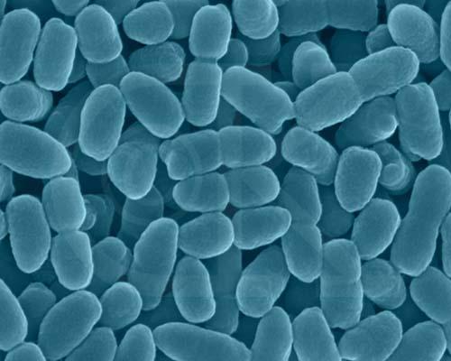
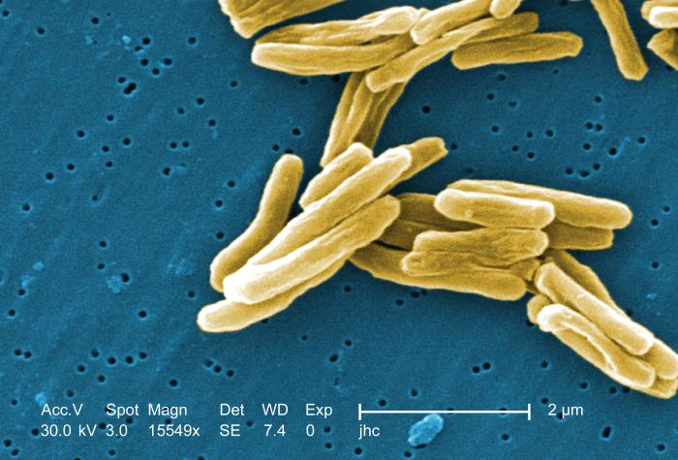
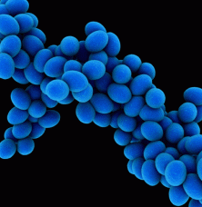
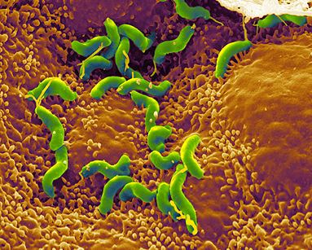

Slide 17
Eukaryotic cells
nuclear envelope and other membrane-bounded organelles (smooth endoplasmic reticulum, rough endoplasmic reticulum, mitochondrion, chloroplast, and lysosome)
huge, linear, double stranded, mostly non-coding (98-99%) DNA
transcription and translation is not coupled
developed cytoskeletal structure (microtubules, microfilaments, intermediate filaments)
flagella, cilia (movement, feeding, sensation)

Slide 18
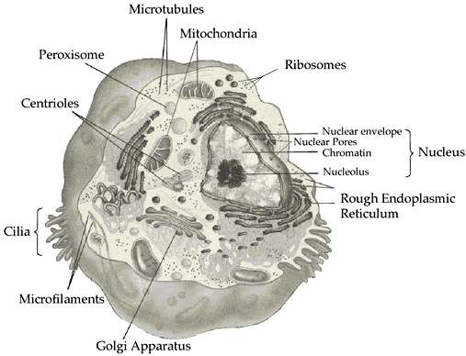
Animal cells

Slide 19
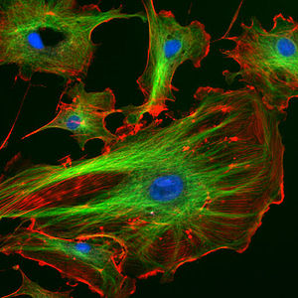
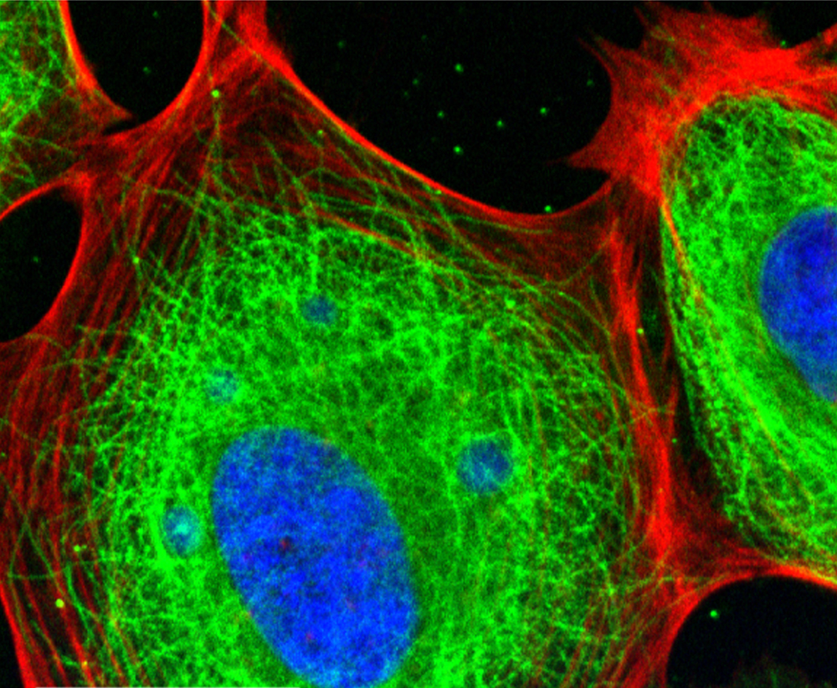
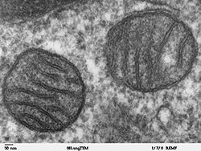

Slide 20
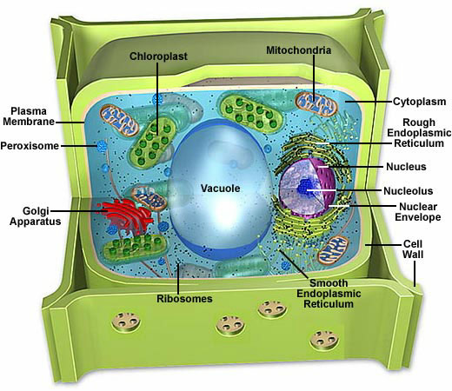
Plant cells
Chloroplast (photosynthesis)
Tonoplast
Cell wall
Plasmodesmata

Slide 21
Fungal cells
cell wall containing chitin
sac fungi (ascomycetes)
E.g. yeast (saccharomyces): in bread and beer production
Brush fungi: production of certain antibiotics
club fungi (basidiomycetes)
Amanita phalloides: amanitine (inhibit the activity of RNA polymerase) and phalloidine (disrupts the function of microfilaments)

Slide 22
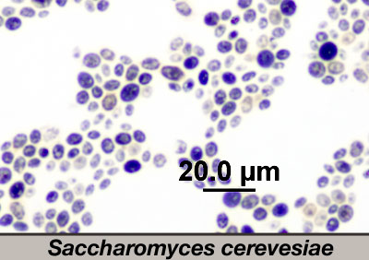
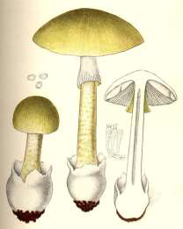
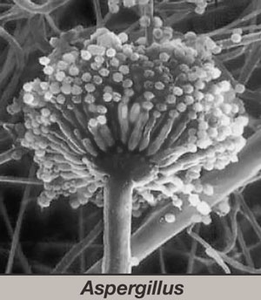

Slide 23
Endosymbiotic theory
Loss of cell wall
Membrane invaginations totally deteached
digestive enzymes form primary lysosomes
Nucleus and endomembrane system formation
Cytoskeletal elements appeared
engulfing primitive aerobe prokaryotes (peroxysomes, mitochondrion)
engulfing autotroph cyanobacteria (chloroplasts)

Slide 24
Endosymbiotic theory

