Slide 1
The cell
Renata Schipp
Medical Biology Department

Slide 2
The cell III
Cell nucleus
was the first organelle to be discovered by Franz Bauer in 1804.
is the largest cellular organelle in animals.
is the control center of the cell and repository of genetic information.
Position: mostly the center of the cell/ depend on the function of the cell
Shape:
round
flat
rod
string
Size: 5-10 μm ( in mammalian 6μm, about 10% of total cell volume)
Number: 1, 2 or more
Function: place of almost all DNA replication, RNA synthesis and RNA processing

Slide 3
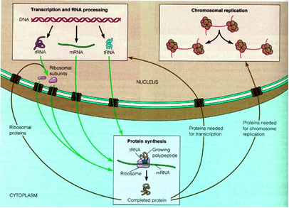
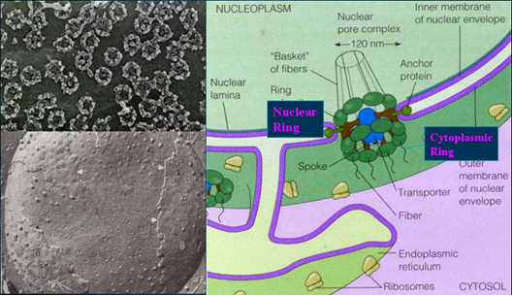
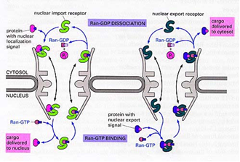
Cell nucleus
Structure: nuclear envelope
-outer membrane
- perinuclear space
- inner membrane
nuclear pores: nuclear transport (RNA export, protein import)

Slide 5
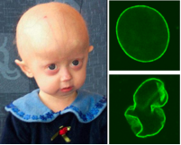
The cell III
Cell nucleus
nuclear lamina: meshwork composed of lamin protein→mechanical support
mutation of lamin→laminopathies
Hutchinson-Gilford progeria syndrome
Lamin A mutation
Early aging, usually have small, fragile bodies, wrinkled skin, atherosclerosis and cardiovascular problems.
Incidence is 1:8 million
Scientists→to research the normal process of aging
(In HGPS patients, the cell nucleus has dramatically aberrant morphology )

Slide 6
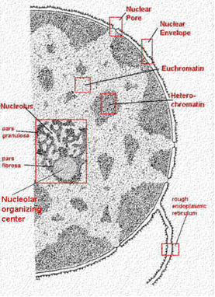
The cell III
Cell nucleus
nucleolus: place of rRNA synthesis and maturation
fibrillar centers
fibrillar component
granular component
nucleoplasm: the material within the nuclear membrane or the fluid content of the nucleus
contains the majority of the genetic material in form of chromosomes
euchromatin→transcriptionally activ
heterochromatin→ transcriptionally inactiv /constitutive, facultative/
types: perinucleolar, peripheral, diffuse

Slide 7
Cytoplasm: the material between the cell membrane and nuclear envelope or the fluid material between the cell membrane and nuclear membrane
Mitochondria: ATP synthesis

Slide 8
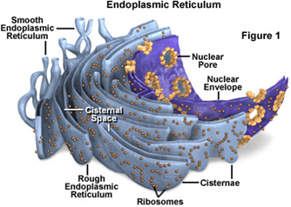
The cell III
Endoplasmic reticulum
is an interconnected network of tubules, vesicles, and cisternae within cells.
is part of the endomembrane system.
Structure
is an extensive membrane network of cisternae held together by the cytoskeleton.
cisternal space (or lumen) enclosed by a phospholipid membrane from the cytosol.
Types
rough endoplasmic reticulum
smooth endoplasmic reticulum /sarcoplasmic reticulum/
General functions
protein translation
folding and transport of proteins
sequestration of calcium
production and storage of glycogen, steroids

Slide 9
The cell III
Endoplasmic reticulum
Rough endoplasmic reticulum
The surface is studded with ribosomes giving it a "rough" appearance
Key functions of RER:
Protein synthesis: proteins of the cell membrane, secretory, lysosomes, Golgi, ER
Stabilization of conformation/folding/: chaperone proteins
Quality control
Glycosylation: attachment of oligosaccharides / N-linked glycosylation/.
Disulfide bond formation and rearrangement

Slide 10
The cell III
Endoplasmic reticulum
Smooth endoplasmic reticulum
There are no ribosomes on the surface
Key functions of SER:
synthesis of phospholipids and steroids
metabolism of carbohydrates
regulation of calcium concentration (Ca²⁺storage )
drug detoxification – biotransformation (cytochrome P450 enzyme system)
Sarcoplasmic reticulum
is a special type of smooth ER
found in smooth and striated muscle
contains large stores of calcium/ sequesters and releases it when the muscle cell is stimulated/
role in the contraction of muscle, by electrical stimulation

Slide 11
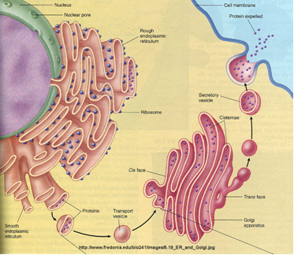
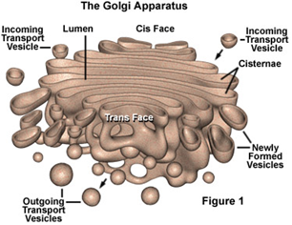
Golgi apparatus
The Golgi apparatus also called the Golgi body, Golgi complex
It was identified in 1898 by the Italian physician Camillo Golgi
Is part of the endomembrane system
Structure
The Golgi is composed of membrane-bound stacks known as cisternae
The cisternae stack has five functional regions: the cis-Golgi network, cis-Golgi, medial-Golgi, trans-Golgi, and trans-Golgi network.
Function
Maturation, packaging and sorting of proteins /lysosomal, membrane, secretory/
Glycosylation: attachment of oligosaccharides/ O-linked glycosylation→ form a signal sequence which determines their final destination, for example: mannose-6-phosphate- lysosomal proteins/

Slide 12
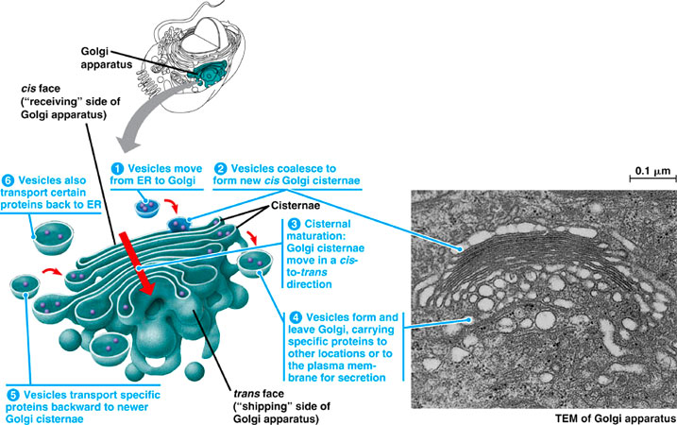
Vesicular transport
The vesicles that leave the rough endoplasmic reticulum are transported to the cis face of the Golgi
apparatus, where they fuse with the Golgi membrane and empty their contents into the lumen. The
proteins move towards the trans face where they are packaged and sent to the required destination.
Each region contains different enzymes which selectively modify the contents depending on where
they reside

Slide 13
The cell III
Vesicle
Structure
Is a small, intracellular, membrane-enclosed sac
Is separated from the cytosol by a phospholipid bilayer/ one phospholipid bilayer, →unilamellar vesicles, more→multilamellar/
Vesicles can fuse with the plasma membrane to release their contents outside of the cell or also fuse with other organelles within the cell.
Functions: store, transport, or digest cellullar products and waste
Types of vesicles:
Transport vesicles
Transport vesicles can move molecules between locations inside the cell, e.g., proteins from the
rough endoplasmic reticulum to the Golgi apparatus.
Secretory vesicles
contain materials to be excreted from the cell
Vesicle coat: clathrin, COPI, COPII

Slide 14
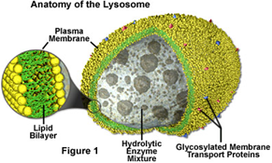
Lysosome
The name derives from the Greek words lysis(destruction) and soma(body)
Lysosomal enzymes are synthesized in the RER, sent to the Golgi, creat the vesicels
They digest worn-out organelles, food particles, and phagocyted viruses or bacteria.
They are found in animal cells, while in plant cells the same organell is the vacuole
Size: varies from 0.1–1.2 μm
Structure: specialized vesicle surrounded by a single membrane
Types:
Primary lysosomes: contain digestive enzymes
Secondary lysosomes: contain digestive enzymes + the digested material
Enzymes: acid phosphatase
Functions: digestion of macromolecules from phagocytosis, endocytosis, autophagy

Slide 15
Peroxisomes: vesicle, often crystalline structure in the middle. Contains many enzymes. involved in production and elimination of hydrogen peroxide. Breakdown and synthesis of different materials (e.g. lipids)

Slide 16
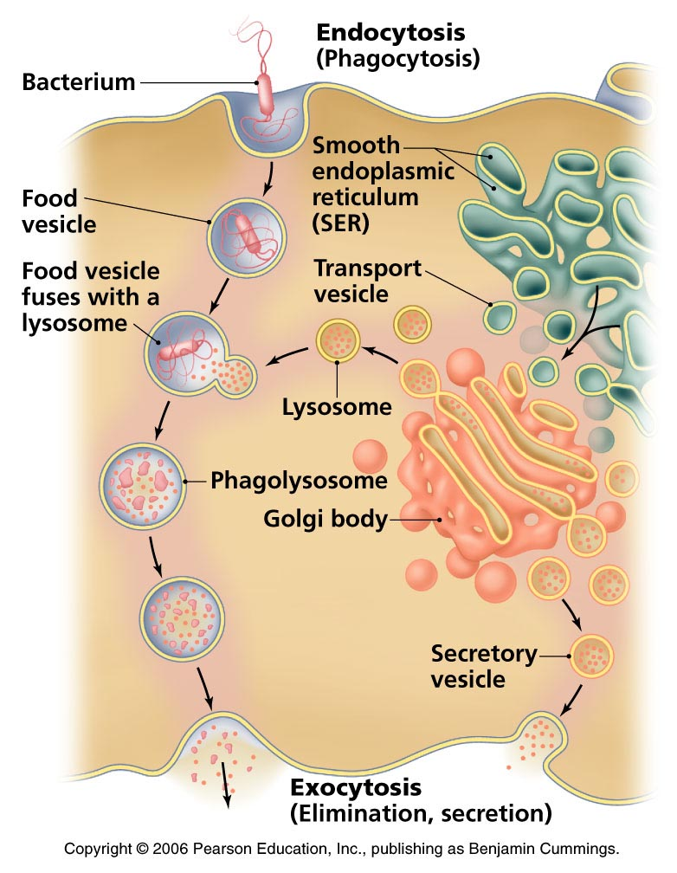
Endocytosis, exocytosis

