Slide 1
Tumours (carcinoma) of the larynx. Treatment of the laryngeal carcinoma
Istvan Szanyi MD, PhD.
Department of Otorhinolaryngology, Head and Neck Surgery
University of Pécs

Slide 2
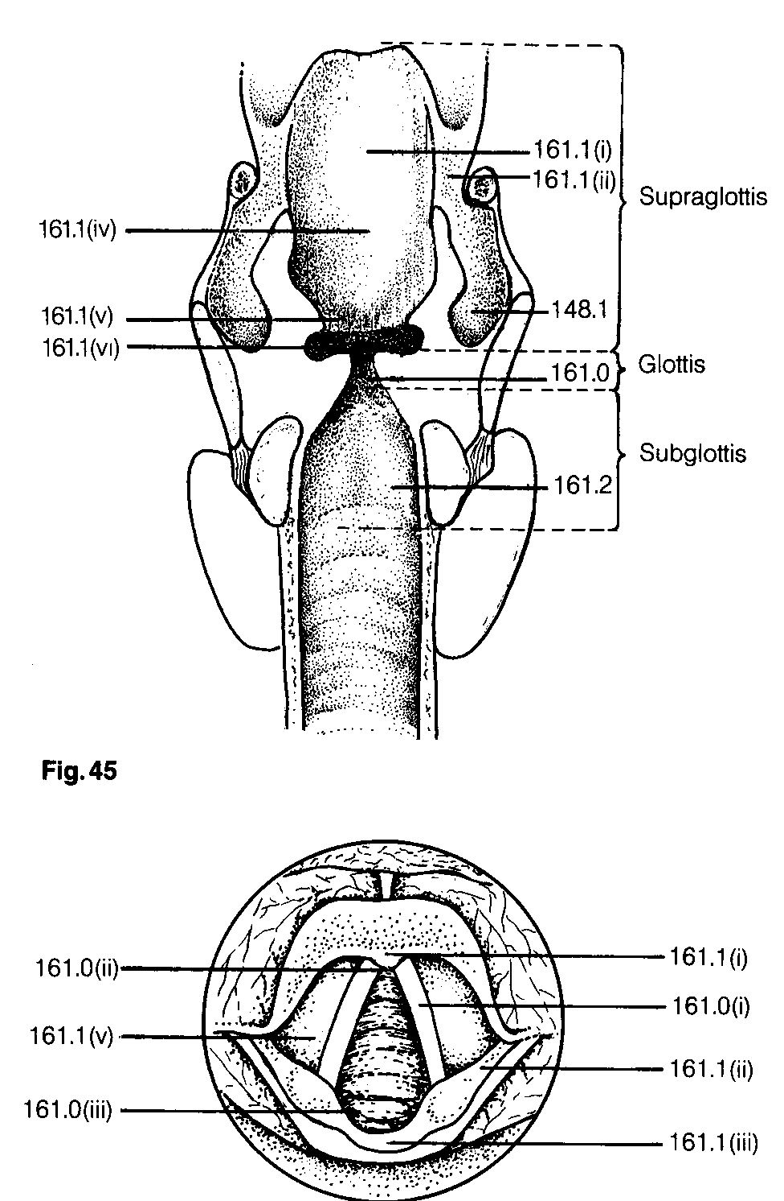
Anatomical regions and subregions
1
Supraglottis
  Epilarynx
    Suprahyoid epiglottis, lingual
    and laryngeal surface
    Aryepiglottic folds
    Arytenoid
  Vestibulum
    Infrahyoid epiglottis
    False vocal cord
    Morgagni sac
2
Supraglottis
4
5
6
1
5
2
1
3

Slide 3
Anatomical regions and subregions
Glottis
  Vocal cords
  Anterior comissure
  Posterior comissure
Glottis
2
1
1
3

Slide 4
Anatomical regions and subregions
Subglottis
Subglottis
1

Slide 5
Carcinoma of the larynx
Carcinoma planocellulare laryngis
Prevalence of the laryngeal tumour: 5.- 6. most frequent of the malignancies in adults.
Predisposition:
Genetic
habits: alcohol consumption, – lesion of the liver-, smoking - tobacco use (abuse), chemicals, feeding, hygiene of the mouth, profession, pollution.
Appearance: age of 50-70 years
Men-women ratio: 20:1 (USA: 5:1)

Slide 6
Pathogenesis
Invasive carcinoma developes from dysplasia and transforms to cancer (in situ).
More than 90% of laryngeal carcinomas are established as non-keratinizing squamous cell carcinoma
Minority of the layngeal tumours: verrucous cancer, adenocarcinoma, carcinosarcoma, fibro- és chondrosarcoma, rhabdomyosarcoma.

Slide 7
Pathogenesis
Spreading pathway: laryngeal cancer represents a local infiltration spreading on the mucosa (submucosa), regional metastasis through the lymphatic chain, lymph nodes (lymphogen) and blood (hematogen)
The supraglottic onset of the tumour (cancer) may show a supraglottic extension to the preepiglottic space or above to the vallecula, root of the tongue and hypopharynx
Glottic cancer rarely spreads to the supraglottic region, subglottic extension is more frequent
Transglottic cancer represents - in our terms - the infiltration of the glottic region, Morgagni-sac and false cord, the onset of the tumour is unknown.

Slide 8
Prognosis of the laryngeal cancer depends on:
Localization (supraglottic, glottic, subglottic, transglottic)
Staging, TNM classification
Differentiation of the tumour
Metastasis formation

Slide 9
Localization
p
r
o
g
n
o
s
i
s
Glottic tumours (about 40%)5 ys.-60-90%
Supraglottic tu. (about 50%)5 ys.- 35-60%
Subglottic tu. (1-3%)5 ys.-25-45 %

Slide 10
Laryngeal Cancer T staging
Glottic Cancers
T1a: Tumor is confined to one vocal cord with normal mobility
T1b: Tumor involves both vocal cords but mobility is normal
T2: Extension of the tumor from the vocal cords to the supraglottic or subglottic larynx or impaired vocal cord mobility
T3: Tumor is confined to the larynx but there is fixation of the vocal cord
T4: There is invasion through thyroid cartilage and/ or other tissues beyond larynx (e.g., trachea, thyroid, pharynx, soft tissue of neck).

Slide 11
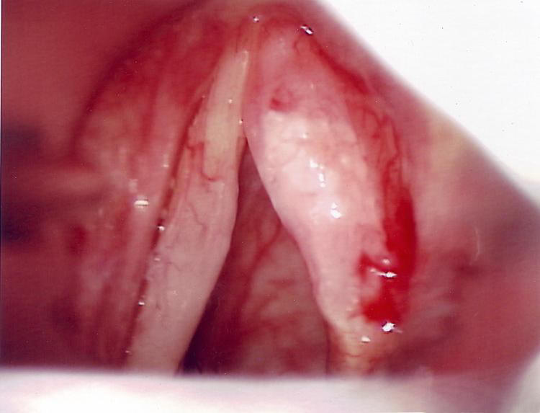
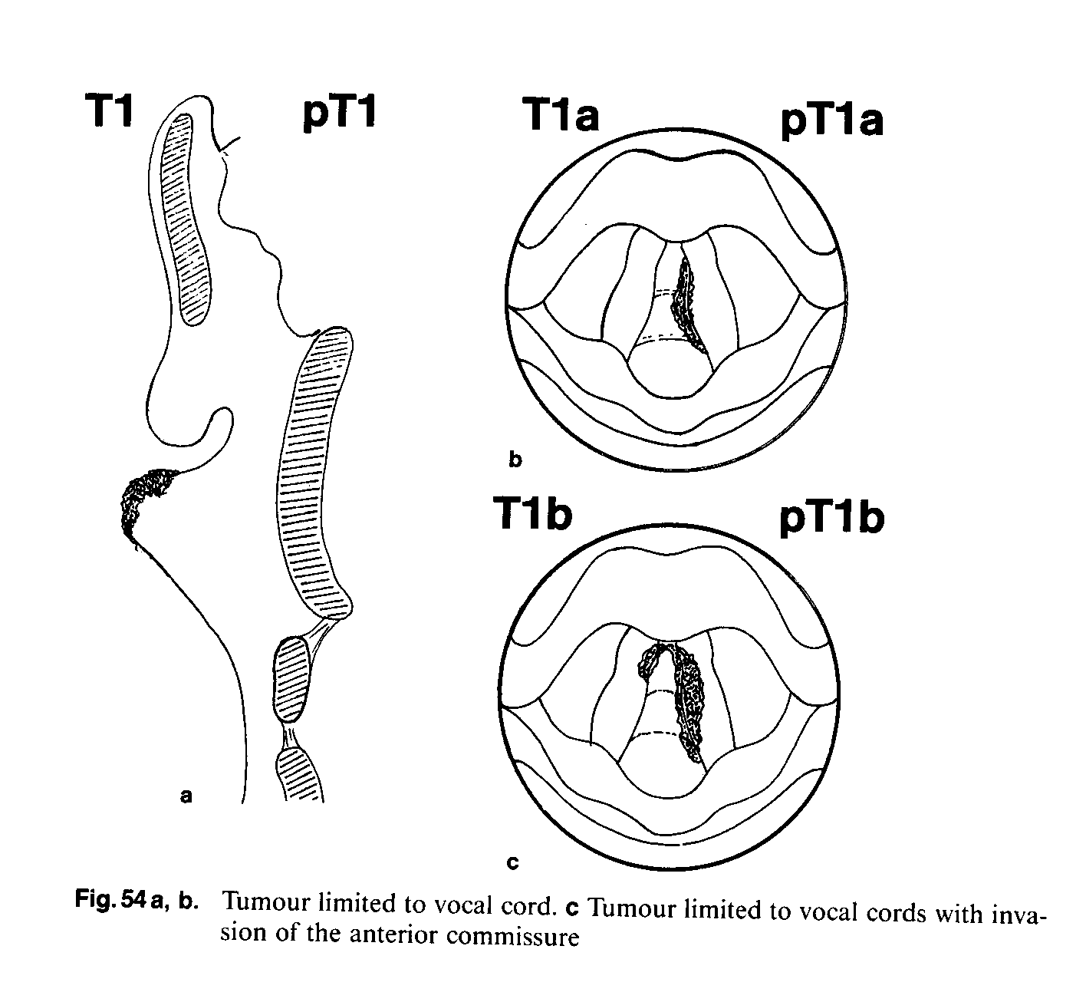
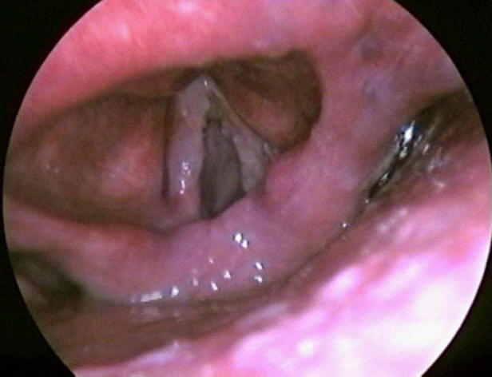

Slide 12
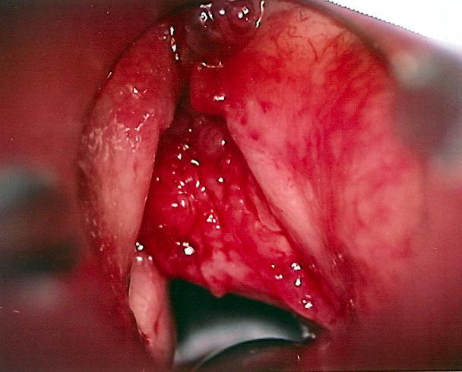
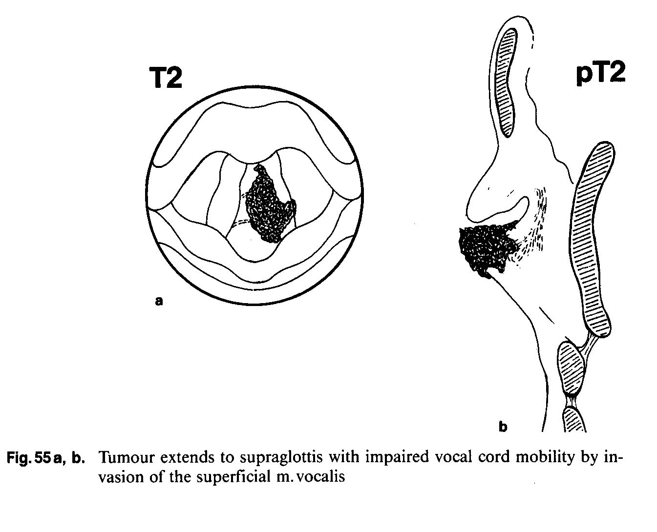
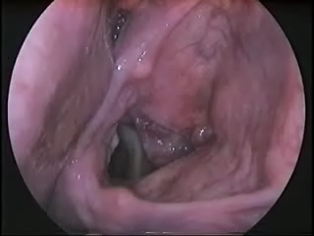

Slide 13
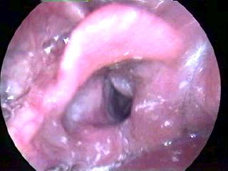
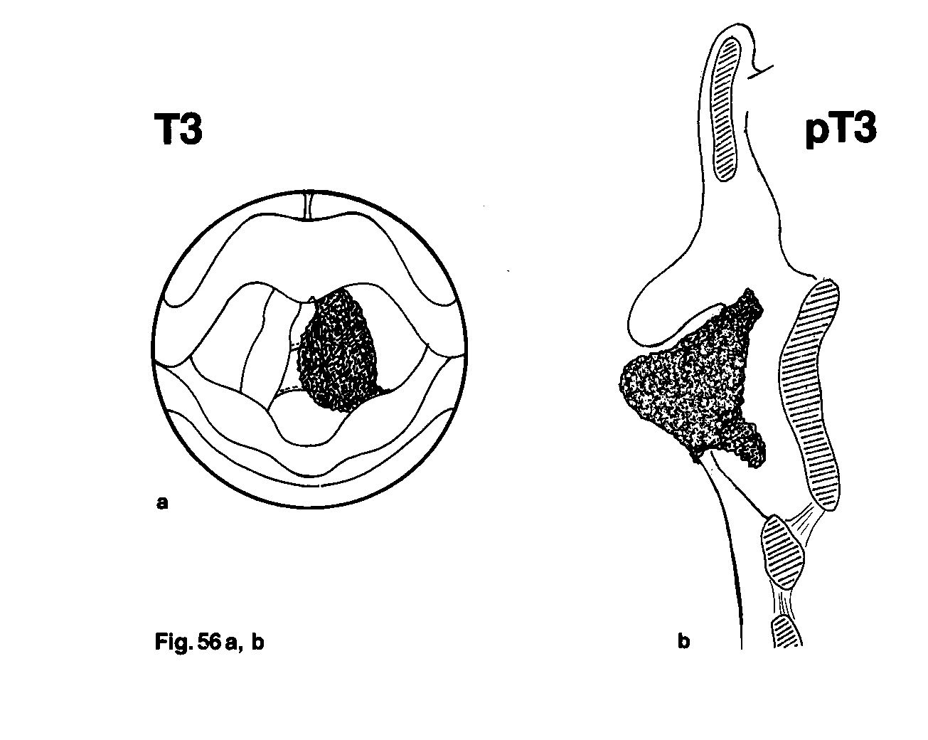
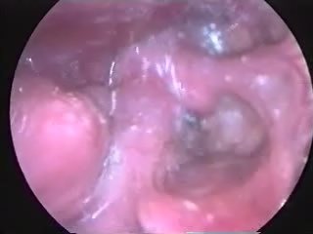

Slide 14
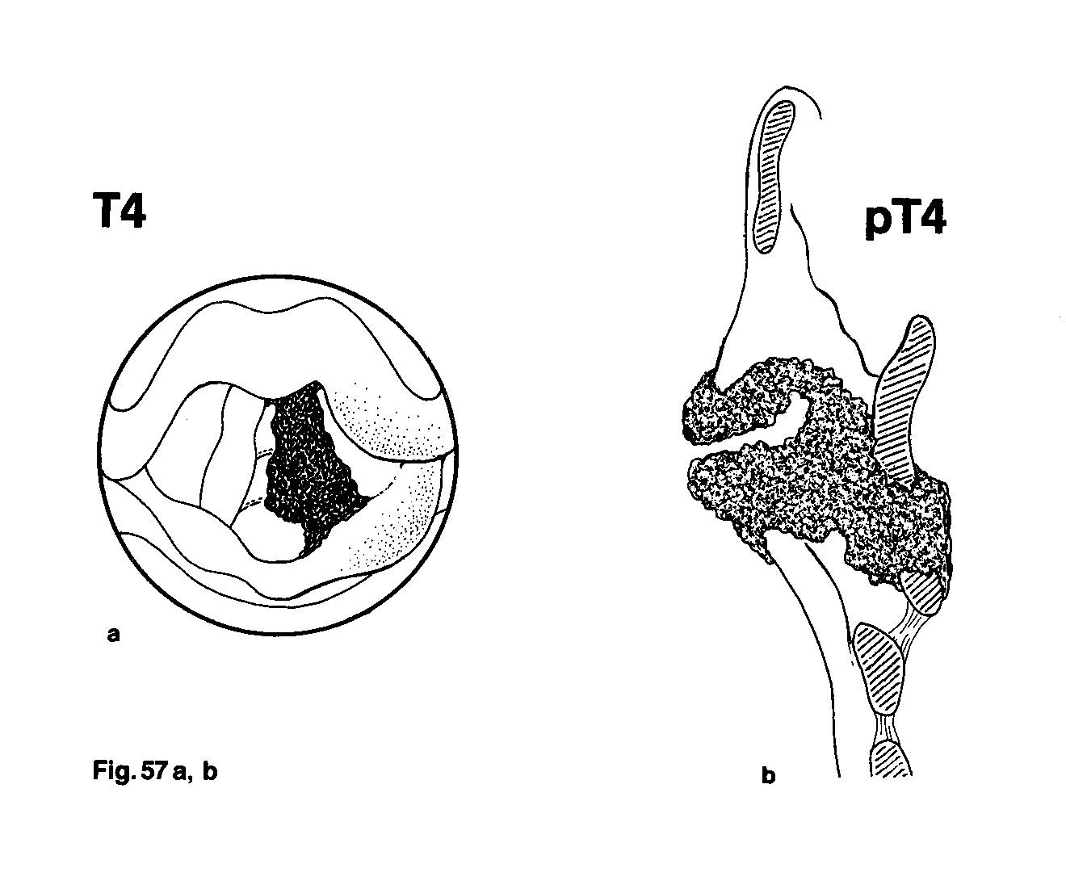

Slide 15
Laryngeal Cancer T staging
Supraglottic Cancers
T1: Tumor is confined to one subsite of the supraglottic larynx and there is normal vocal cord mobility
T2: Tumor invades mucosa of more than one adjacent subsite of supraglottis but vocal cord mobility remains normal
T3: Tumor is limited to the larynx with vocal cord fixation and/or extension to postcricoid area or preepiglottic tissues.
T4: Tumor invades through thyroid cartilage, and/or extends into soft tissues of the neck, thyroid, and/or esophagus
Subglottic cancers
T1:Tumor is confined to the subglottic region
T2: Tumor invades vocal cord(s) with normal vocal cord mobility
T3: Vocal cord fixation
T4: Tu. Invades through the cartilage and/or extends into soft tissue

Slide 16
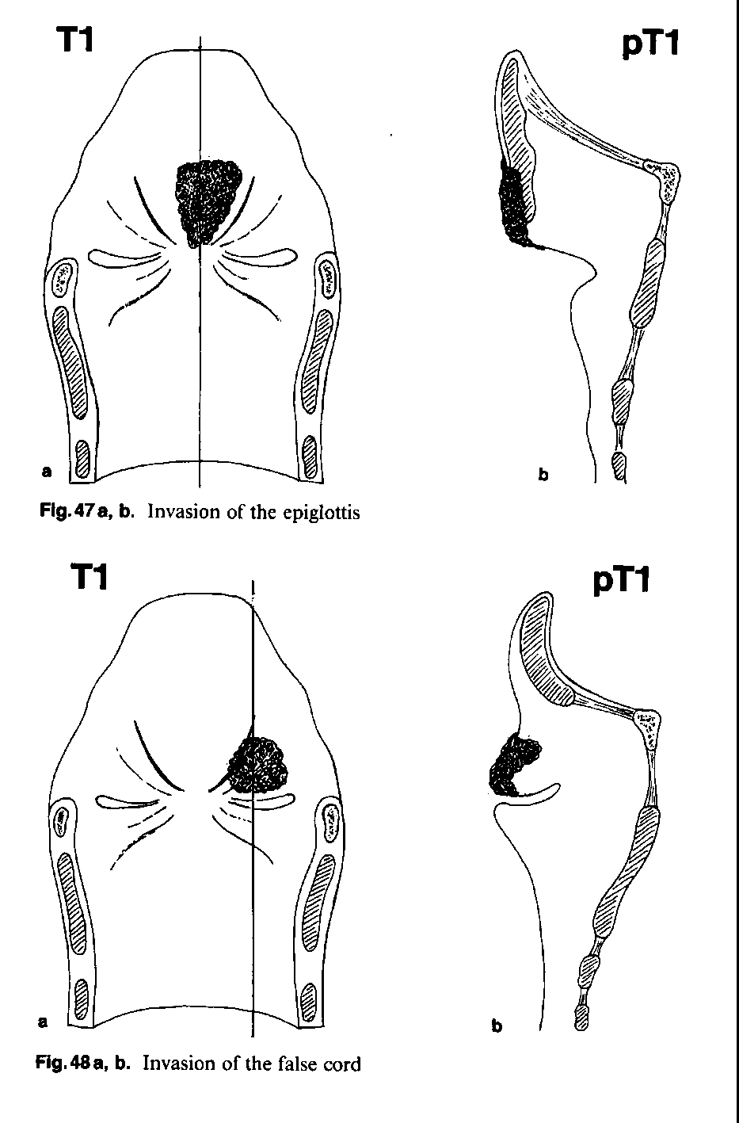
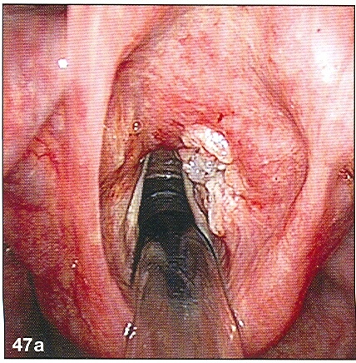

Slide 17
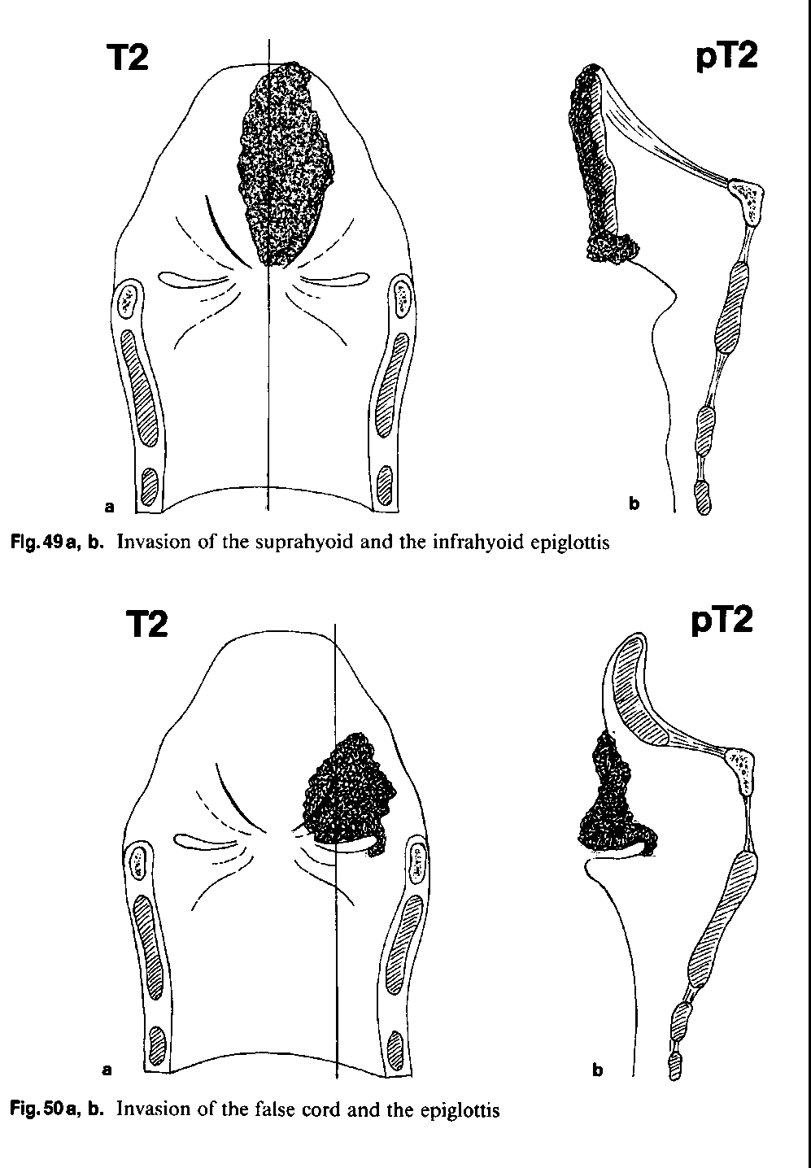
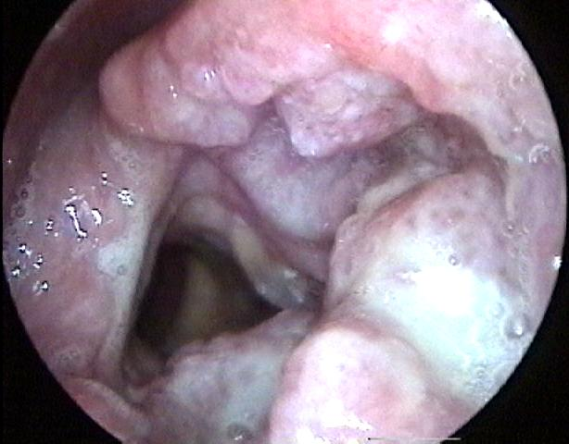
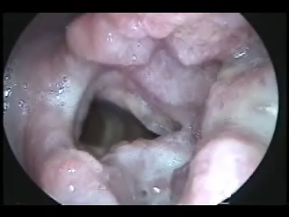

Slide 18
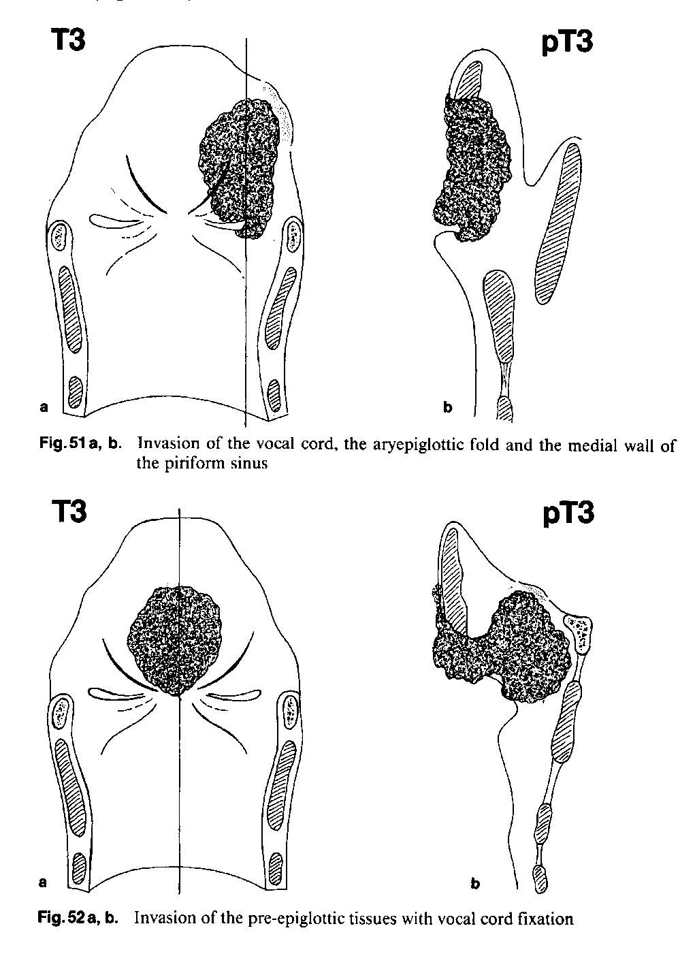
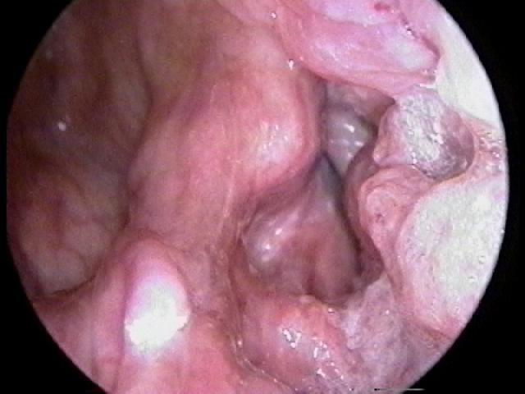
Supraglottic Larynx Cancer - Video WMV

Slide 19
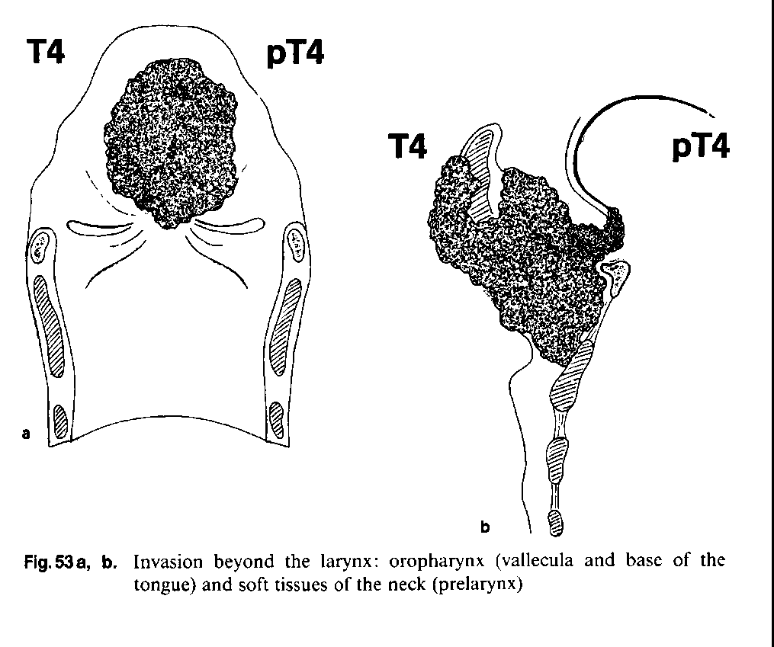

Slide 20
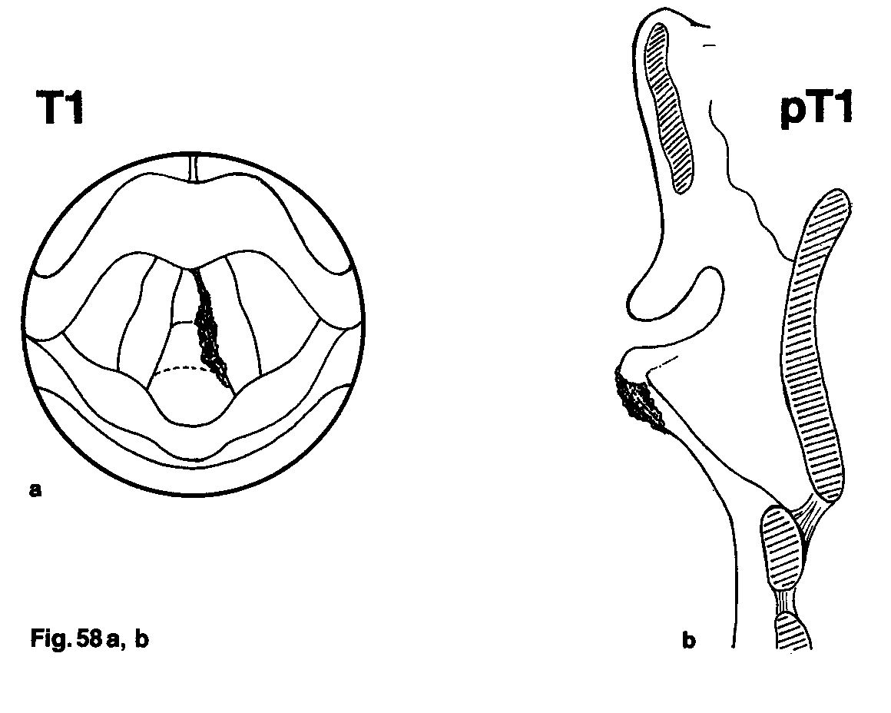
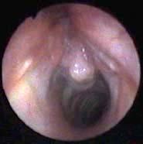

Slide 21
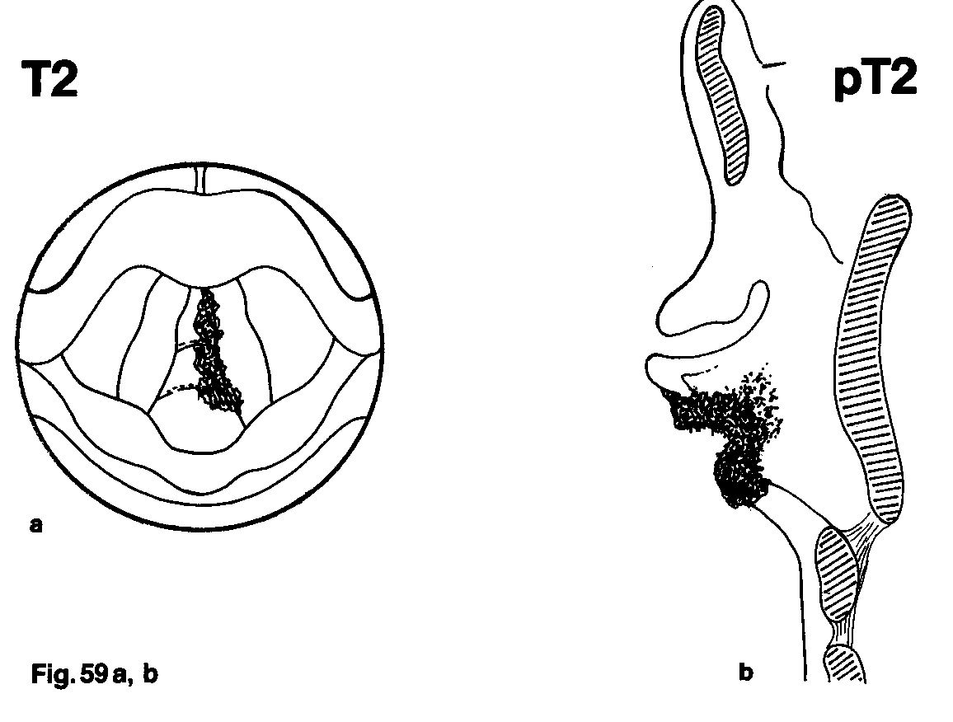

Slide 22
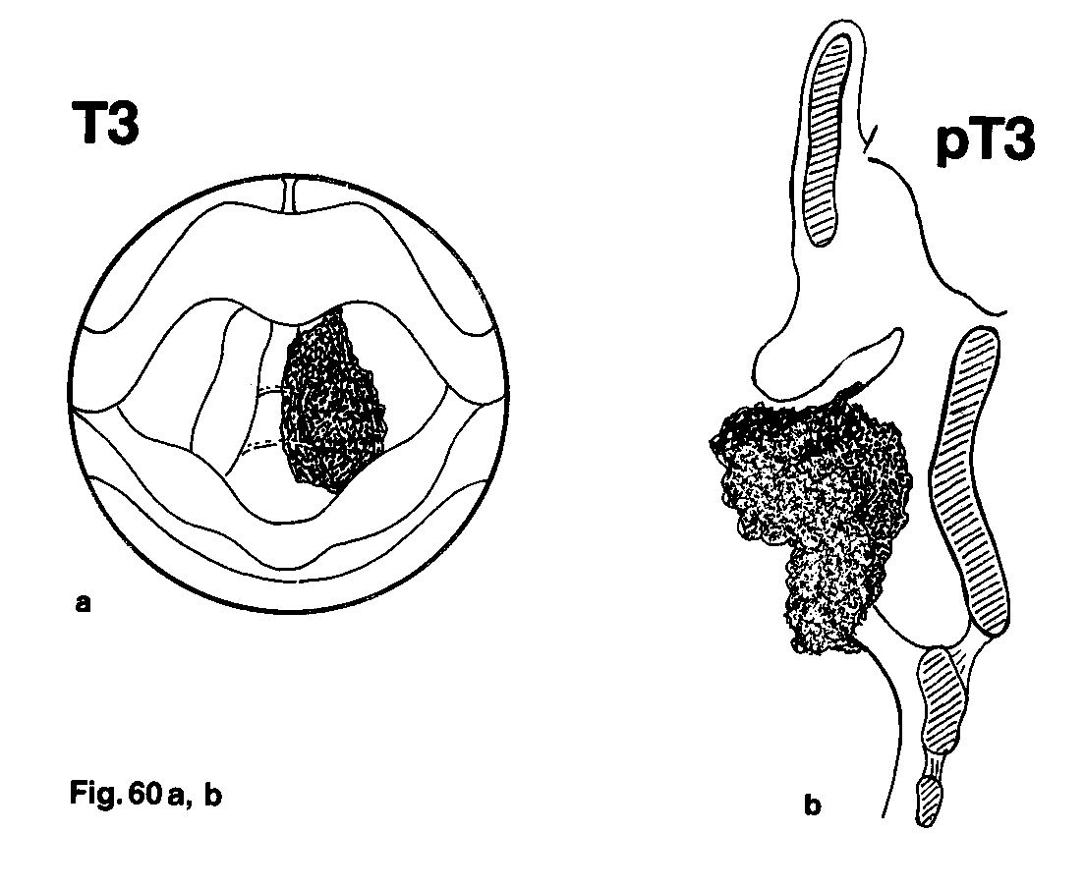

Slide 23
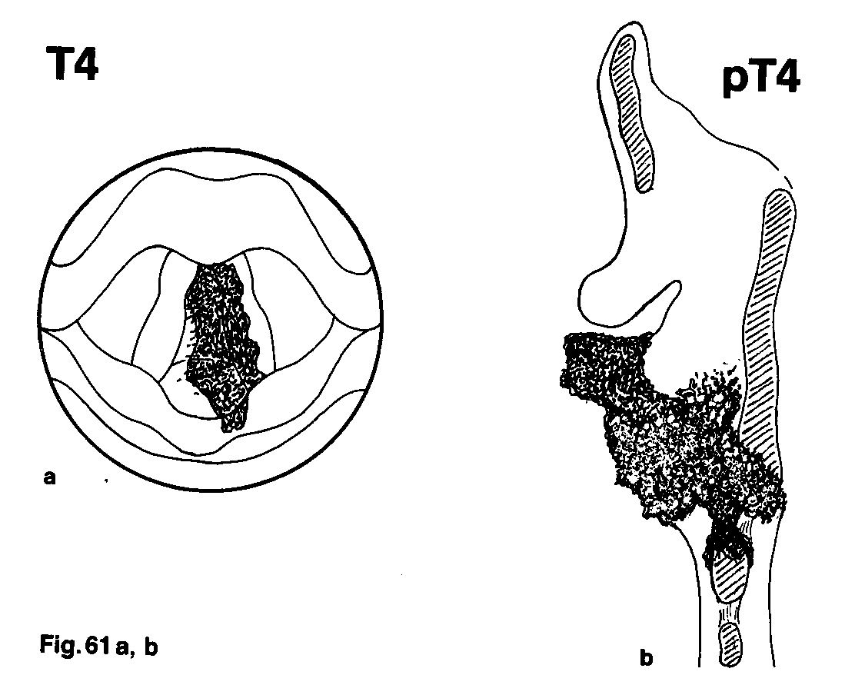

Slide 24
TNM system II.
Nx Regional lymph node cannot be assessed
N0 No regional lymph node metastasis
N1 Metastasis to a single ipsilateral lymph node, 3 cm or less in diameter
N2a Metastasis to a single ipsilateral lymph node more than 3 cm, but not more than 6 cm
N2b Metastasis multiple ipsilateral lymph nodes, none more than 6 cm
N2c Metastasis in bilateral or contralateral lymph nodes, none more than
6 cm
N3 Metastasis to a lymph node, more than 6 cm.

Slide 25
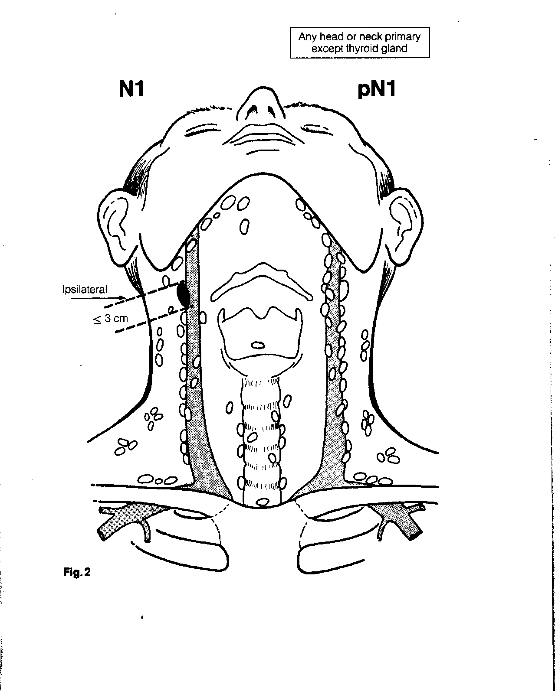

Slide 26
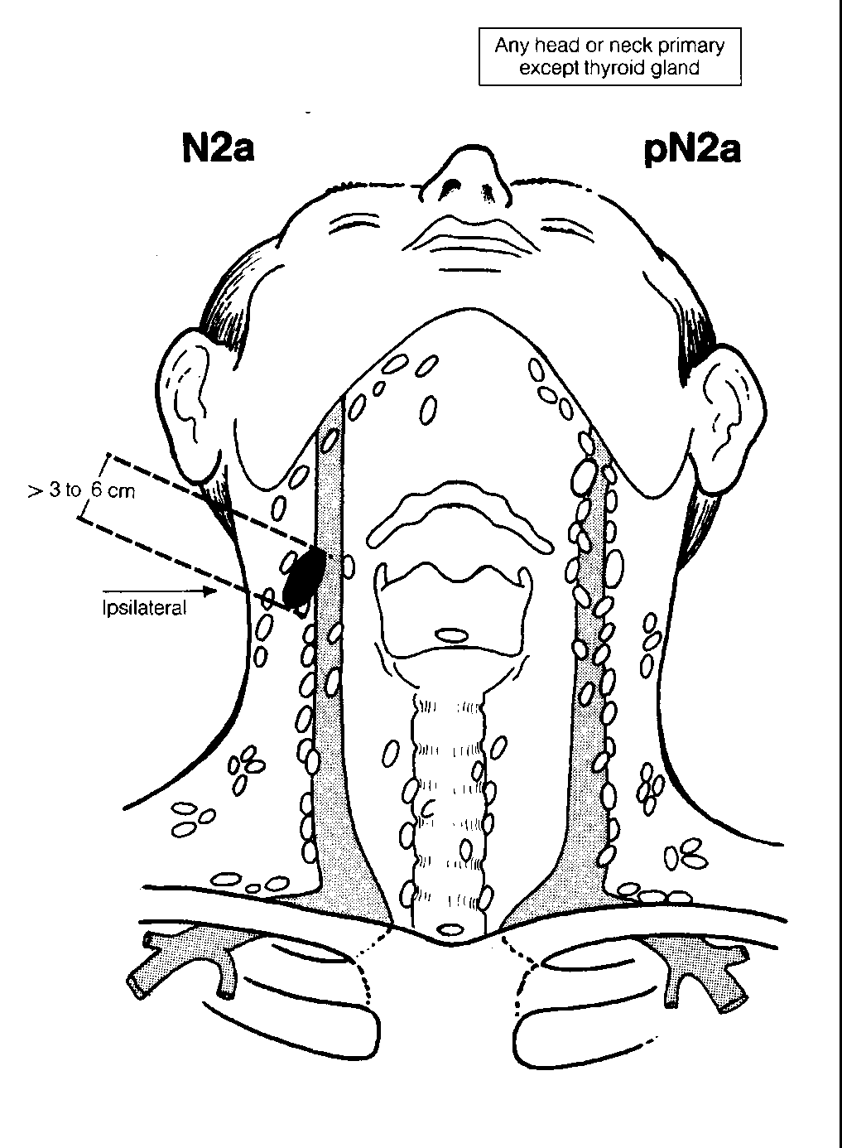

Slide 27
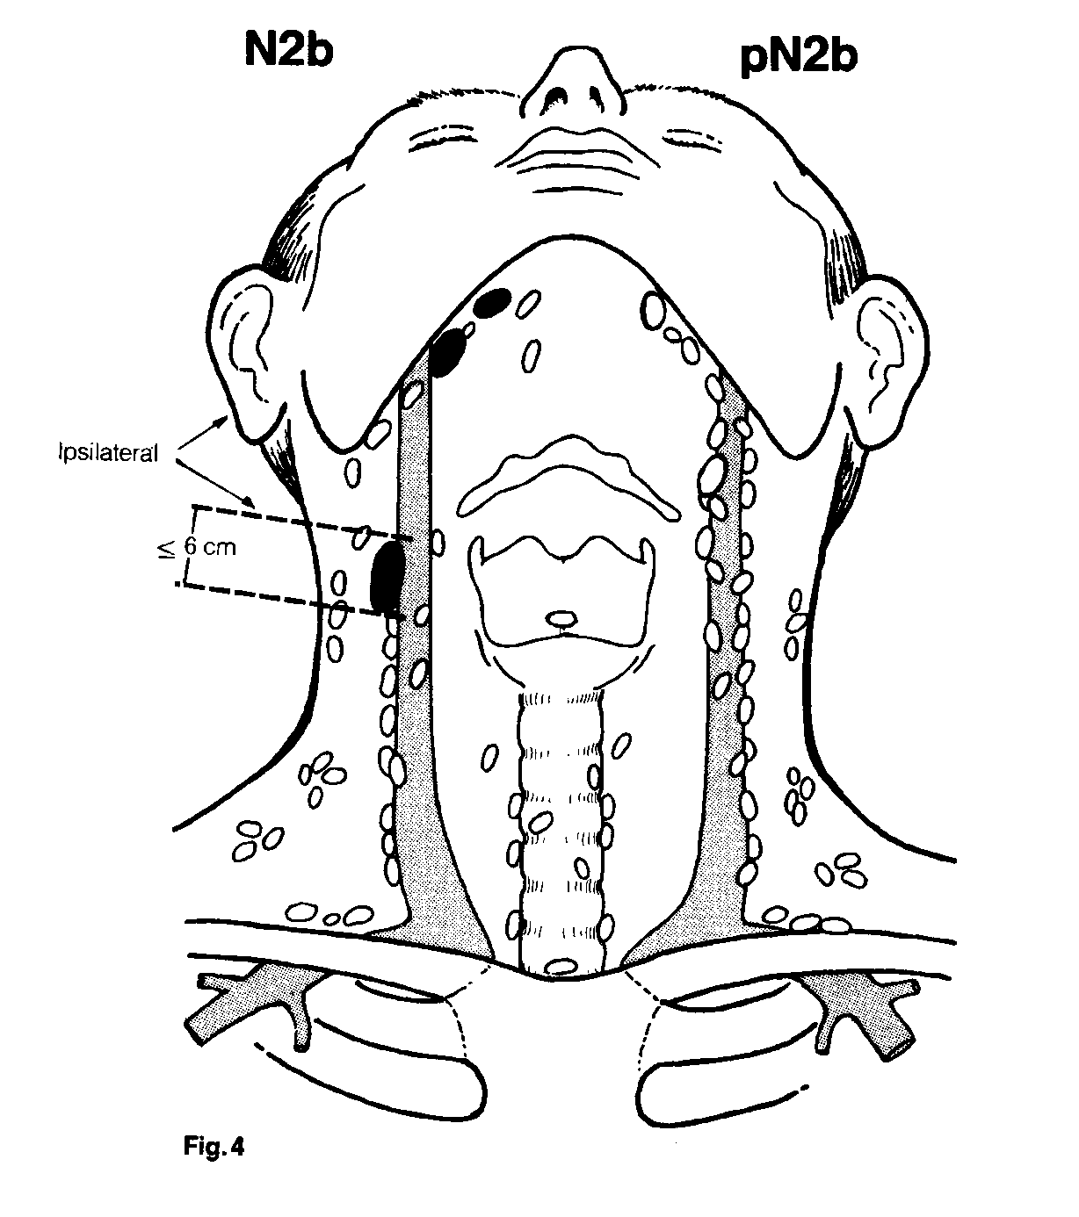

Slide 28
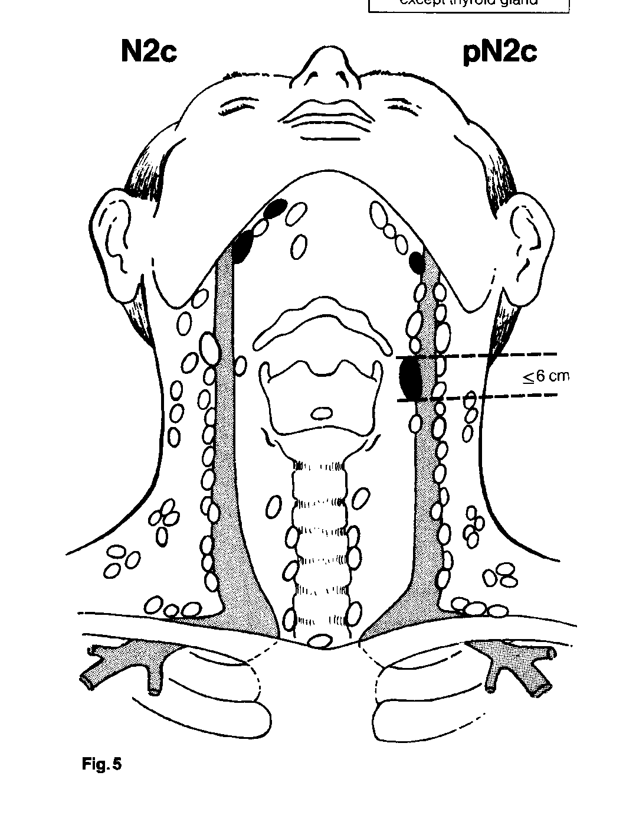

Slide 29
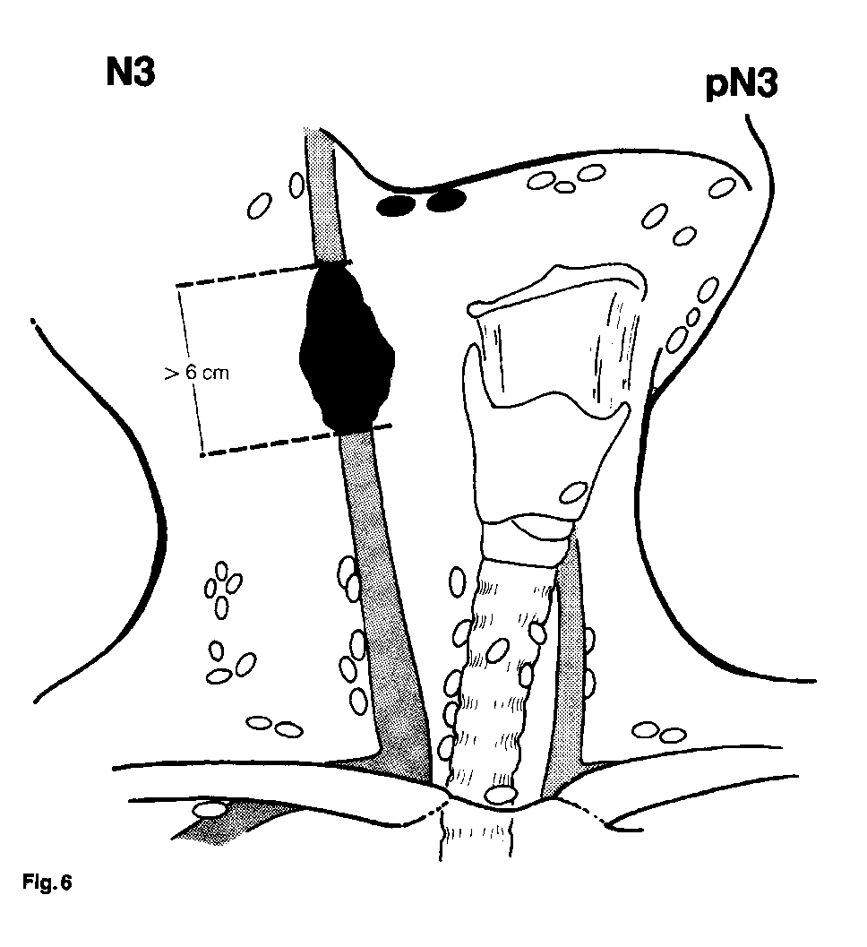

Slide 30
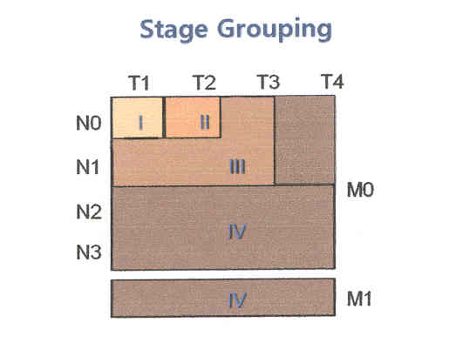
Tumor Staging:
1. Aids the clinician in the planning of treatment
2. Gives some indication of the prognosis
3. Assist in the evaluation of treatment results
4. Facilitate exchange of information between treatment centers
Notes:
As you can see, the Staging categories are only usefull if you are talking about T1, to T3, and N0 to N1. All the other possibilities fall into group IV , by definition with the worst prognowsis.

Slide 31
Symptoms
Vocal cord cancer hoarseness, later dyspnoe
Supraglottic cancer dysphagia
pain in the ear - otalgia irradiata
dyspnoe
hoarseness, lymph node metastases on the neck
Subglottic cancer voice disorder
dyspnoe

Slide 32
Clinical diagnostics
Case history
Staging
Laryngology: laryngoscopy - indirect examination, direct laryngoscopy, palpation
Imaging diagnostic (CT, MRI, sonography)
Pathological finding: biopsy, fine needle aspiration

Slide 33
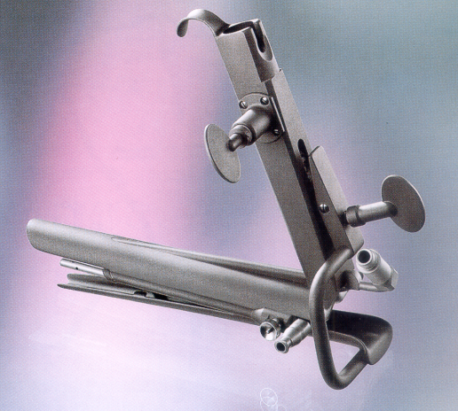
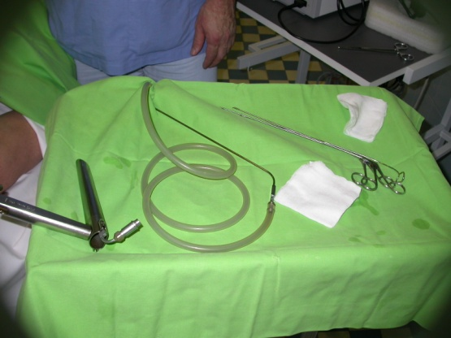
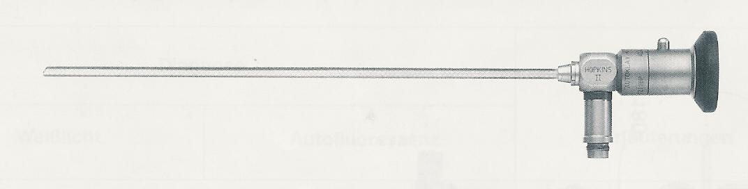
Application of instruments, optics and laryngoscopes for laryngoscopy
Outpatient: indirect laryngoscopy - rigid optic 70° and 90º, flexible optics - fiberoscop
General anaesthesia: direct laryngomicroscopy (Kleinsasser or Weerda-type laryngoscopes) + rigid, long optic 0° and/or 30º, flexible optic - fiberoptic

Slide 34
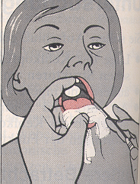
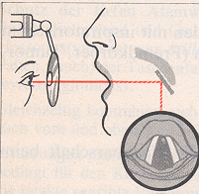
Indirect laryngoscopy with laryngeal mirror

Slide 35
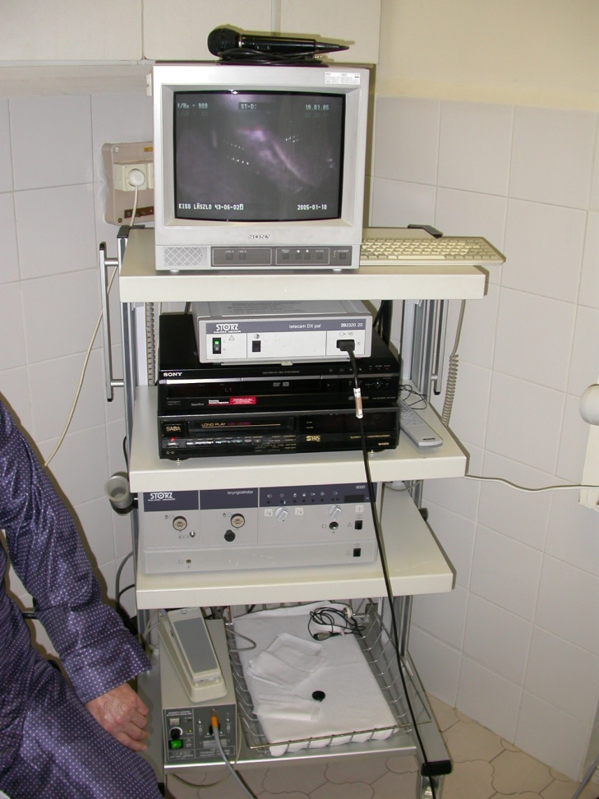
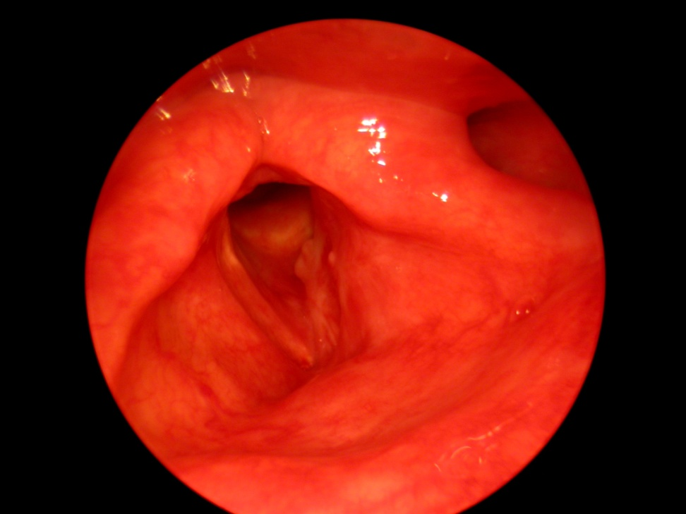
Endoscopy of the larynx (70º optic)

Slide 36
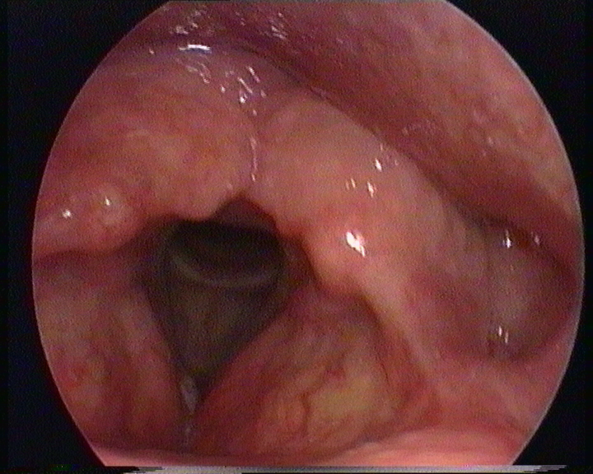
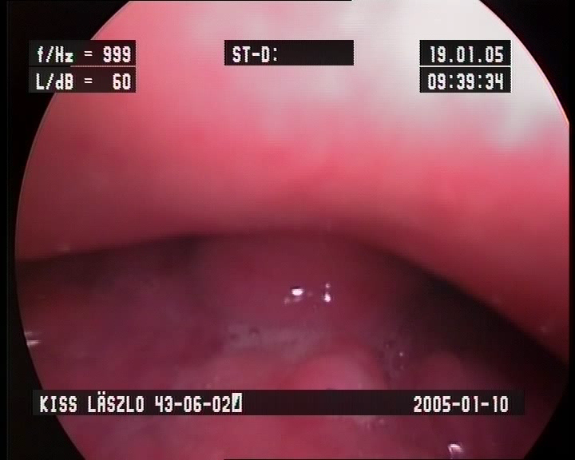
Endoscopy of the larynx

Slide 37
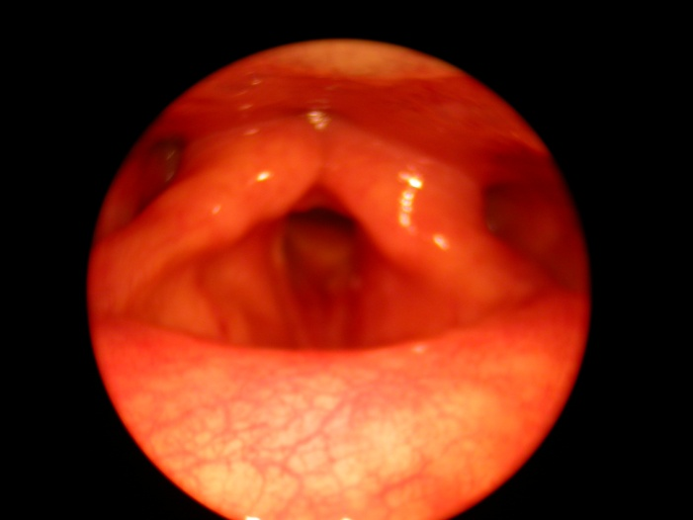
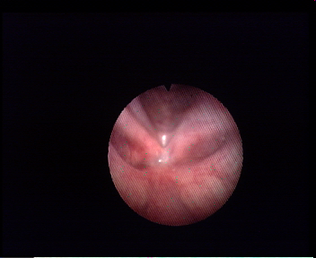
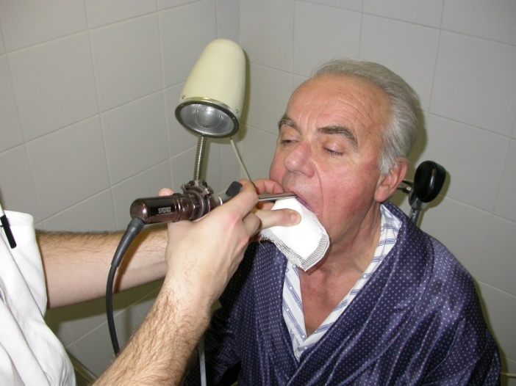
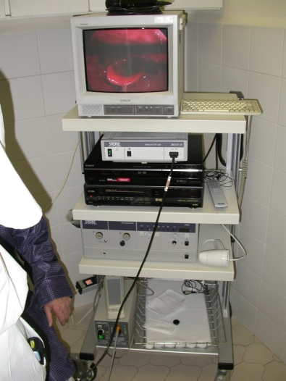
Laryngoscopy
70° rigid optic and fiberoscopy

Slide 38
Imaging: sonograpy, CT, MRI, PET-CT

Slide 39
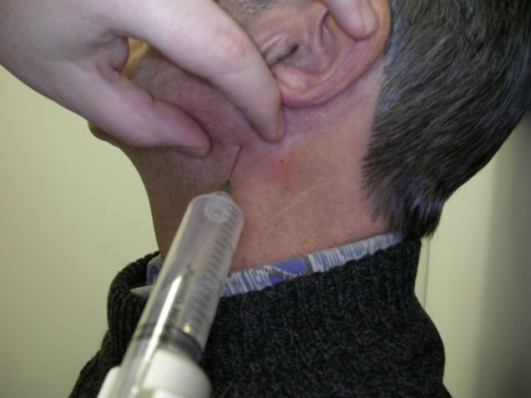
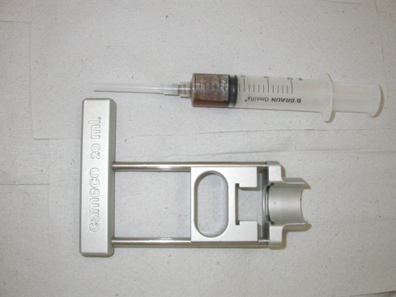
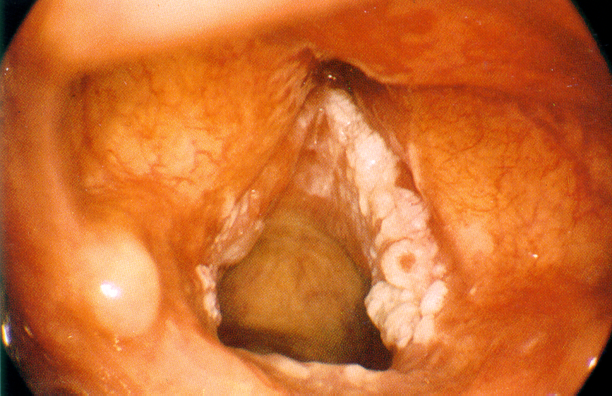
Pathological findings
Fine needle aspiration
Biopsy

Slide 40
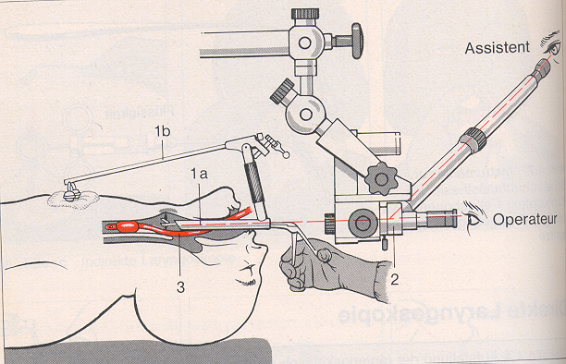
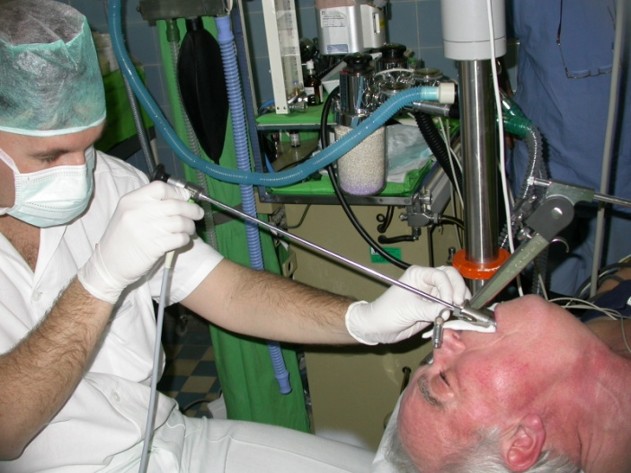
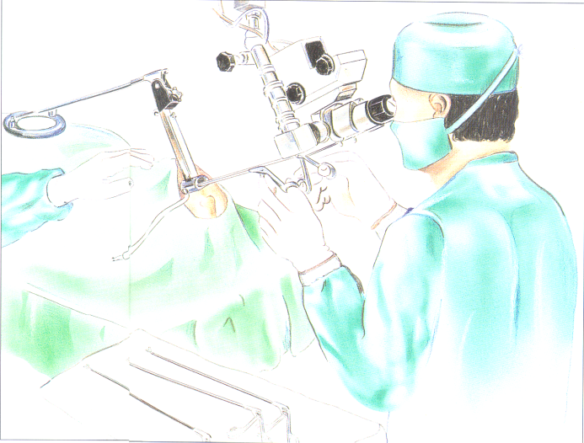
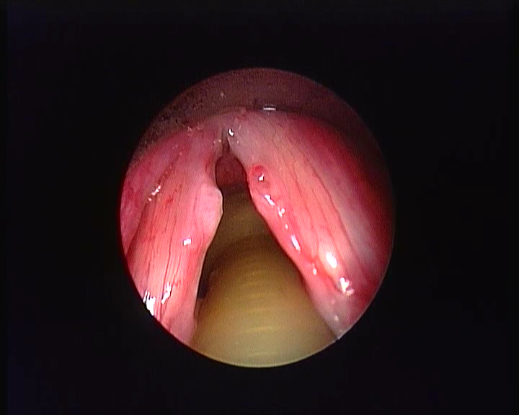
Laryngomicroscopy – ITN or JET narcosis

Slide 41
Treatment of the malignancies of the larynx - surgery
Surgical interventions: transoral (endoscopic) and open approach including partial and total laryngectomies
Goals to achieve:
1. good oncological result
2. preserving the larynx (vocal cord), voice, swallowing with a residual larynx (aspiration)
3. Aesthetic, functional results: voice, no scar, without definitive tracheostoma
4. Excisional biopsy/pathological findings

Slide 42

Treatment options for vocal cord carcinoma
Therapy
Radiation
Chemo-therapy
Surgical
Radiation therapy reveals a 80-90% success in the treatment of early T1,(T2) vocal cord cancer.
Transoral surgical treatment represents a similar or better oncological result, shorter hospialization, less side effect, but the quality of the voice is worse.
Recurrent tumour after endoscopic surgery and radiation therapy can still be treated with salvage surgery.

Slide 43


Carcinoma of the vocal cord
Surgical treatment: Transoral laser excision
Endolaryngeal laser-cordectomy T1a
  Indication: T1and T2 tumours without the infiltration of the posterior comissure and the thyroid cartilage, no deep infiltration of the Morgagni-sac, mobile vocal cords.
Fronto-lateral resection(Leroux–Robert) T1b
Fronto-anterior resection (Leroux–Robert) T1b
  Indication: infiltration of the anterior comissure and vocal cord
Resection: unilateral vocal cord, anterior comissure and a part of the thyroid cartilage.

Slide 44


Tumour of the vocal cord
Hemilaryngectomy
Vertical partial laryngectomy
T2 glottic tumour
Indication: tumour extends to the anterior and posterior comissure, subglottic, supraglottic spread, limitation of the mobility of the vocal cord
Removal of affected vocal cord, false cord, anterior comissure and the arytenoid cartilage

Slide 45




Supraglottic tumour
(over the level of glottis)
Surgical treatment
Endolaryngeal laser epiglottectomy (free edge) (T1)
- transoral laser supraglottic resection + ND
Supraglottic, horizontal resection of the larynx
+ mRND/RND (T1-T2, N1-N2)
Indication: infiltration of epiglottis. lingual or laryngeal surface, aryepiglottic fold, false cords, Morgagni-sac (superior part).
Removal of the entire epiglottis, both false cord, thyroid cartilage upper third, preepiglottic space, body of the hyoid bone

Slide 46




Surgery: supraglottic carcinoma
Endoscopic laser resection
Open approach surgery – supraglottic, horizontal laryngectomy

Slide 47




Open approach surgery: horizontal supraglottic laryngectomy + mRND

Slide 48


Open approach surgery: horizontal supraglottic laryngectomy + mRND
Reconstrucion

Slide 49
Management of the neck (metastasis of supraglottic cancer)
N0 neck: sel ND (II, III, IV region) bilateral
N1 neck: mRND bilateral
N2a: (m)RND + mRND
N2b, c,
N3: RND + mRND
Additional radiotherapy
Chemotherapy

Slide 50

The zones of the neck
Notes:
Levels and zones

Slide 51
Treatment of neck metastasis
Radical neck dissection (RND)
Modified radical neck dissection (mRND)
Selective neck dissections
Notes:
51

Slide 52

Radical neck dissection (RND)
RND is defined as removal en bloc of everything of the neck except carotid artery, Vagus, Phrenic and Hypoglossus nerves.
The indications for RND include treatment of metastatic disease of the neck.
Notes:
What we remove include: adipose tissue which contains all the lymph nodes and vessels which are contained between the mandible and the clavicle and between the superficial and deep cervical fascia; this removal also includes the sternocleidomastoid muscle, the internal jugular vein, and the Accessory nerve. Inclusive of Zones I–V.

Slide 53

A modified radical neck dissection (MRND)
A MRND is essentially the same as the RND, but as not as aggressive, and either/or the sternocleidomast muscle, the internal jugular vein, or the accessory nerve preserved.
The indications MRND is the removal of metastatic disease of the neck where the three previous sructures have not been infiltrated.

Slide 54
Treatment of neck metastasis II.
A selective neck dissection involves the preservation of one or more zones that are typically removed in a radical neck dissection. This procedure is performed when the risk of occult metastasis to the cervical lymph nodes is greater than 20%.
A supraomohyoid neck dissection involves Zones I–III. We use it in oral cavity tumors and N0 neck disease
A lateral compartment dissection includes Zones II–IV we use it in the surgical resection of tumors of the oropharynx (larynx, hypopharynx)
Notes:
54

Slide 55


Selective neck dissection
selective neck dissection I-III zones
(supraomohyoid diss.) cc .of oral cavity
selective neck dissection I-IV zones (lateral diss.) cc. of oropharynx

Slide 56



Postoperative photo, vertical skin incision, resection (larynx), temporary canule,

Slide 57
Results after supraglottic laryngectomy
Transoral laser resection (selected patients)
5 years survival: 75%-90%
No significant swallowing problem, minimal aspiration
Open approach
5 years survival: 90%
Temporary tracheostoma and feeding tube
Acceptable late postoperative deglutition, aspiration, good voice

Slide 58



Transglottic, subglottic carcinoma
(T3-T4)
Surgical treatment: total laryngectomy + RND
Indication: extension to more regions of the larynx, fixation (immobility) of the vocal cord, significant stenosis of the glottis, infiltration or breakthrough the cartilage of the larynx.
Removal of the entire larynx with the hyoid bone.

Slide 59



Total laryngectomy

Slide 60



Management of the neck

Slide 61
Results after total laryngectomy
5 year survival
Combined treatment, neck management, distant metastasis
Transoral feeding
Definitive tracheostoma
Canule
Speech therapy: esophageal speech, voice prosthesis, sound generator
Social care

Slide 62



Communication after laryngectomy
Esophageal speech
Voice resonator
Voice prosthesis

Slide 63
Follow up
Indirect laryngoscopy / endoscopy monthly in the 1st year, in every 2 month in the 2nd year…..
Palpation of the neck
Sonography
CT, MRI, PET-CT

Slide 64
II
Hypopharyngeal cancer

Slide 65

Malignancies of hypopharynx Carcinoma planocellulare
One of the most aggressiv tumours is the hypopharynx carcinoma,
superiorly malignant and has the worst prognosis of the head and neck tumours.
men : women= 8 : 2
The role of smoking and alcohol.

Slide 66

Pathogenesis
Hypopharynx is well supplied by lymphatic a blood vessels, submucosa provides an unlimited spread for the cancer cells and there is no structural barrier of the extension of cancer cells.
Histology: frequently low differentiated squamous cell carcinoma.

Slide 67

Localization
Piriform sinus
Posterior wall, pharynx
retrocricoid region
Most frequent localization of the hypopharyngeal cancer: 1. piriform sinus, 2. posterior wall and 3. rarely seen at the retrocricoid region

Slide 68

Symptoms
Dysphagia
Otalgia irradiata (pain in the ear)
Dypnoe
Hoarseness
Bloody discharge (spit)
Lymph node neck metastasis

Slide 69

Diagnostic
Case history
ENT examination (indirect laryngoscopy, direct laryngoscopy, palpation)
Imaging (CT, MRI, sonography of the neck)
Pathological examination
Staging

Slide 70
Therapy
Depends on the extension of the tumour and neck status Radiation therapy, combined with cytostatic treatment, surgical treatment, for small tumours even endoscopic laser treatment.
Literature recommends a combined treatment (surgical + radiation therapy) provides the best oncological result, that is also poor.

Slide 71

Posterior wall of the HYPOPHARYNX
Transoral laser excision + postoperative radiation therapy

Slide 72


Therapy
Surgical therapy of the tumours of hypopharynx: partial resection of pharynx and total laryngectomy.
Lateral wall of the pharynx and retrocricoid extension beside the radiation therapy and chemotherapy, partial surgical resections and combined treatments are introduced.

Slide 73

Extended hypopharyngeal tumours (T3-T4): total laryngectomy and partial pharynx resection. Primary closure of the entrance of oesophagus. The pharynx defect is replaced with circuferencial formed myocutan flap.

Slide 74

Pectoral major myocutanius flap
Notes:
We cut a myocutanious flap of skin .

Slide 75

Pectoral major myocutanius flap
Notes:
Lift up the muscle pedical which contains a vein and an artery

Slide 76

Pectoral major myocutanius flap
Notes:
We burrow a tunnel over the clavicule and under the skin.

Slide 77
Prognosis
5 years survival: 27–33%

Slide 78


Thank you for your attention!

