Slide 1
The operation
Árpád Juhász MD PhD
surgeon
University of Pécs, Medical School
Dept of Surgical Research and Techniques

Slide 2
Surgical indications / contraindications
why is operation necessary?
can the operation help the patient?
do we know all the alternatives of the operation?
- consultation
„ It is not necessary everybody to operate who we can
or because of the traditions!”
Gábor Petri
Basic surgical techniques – Pécs, 09.22.2015.

Slide 3
Surgical indications / contraindications
why is operation necessary?
can the operation help the patient?
do we know all the alternatives of the operation?
- consultation
riscs
  advantages /disadvantages
  general condition of the patient
types of indication:
  vital indication
  absolute indication
  relative indication
Basic surgical techniques – Pécs, 09.22.2015.

Slide 4
Surgical indications / contraindications
contraindications
  based on the level of indication
  claim of human dignitary (????)
risc of the operation
  preoperative examination
  low / medium / high risk surgery
Basic surgical techniques – Pécs, 09.22.2015.

Slide 5
Surgical indications / contraindications
influencing factors which increase the surgical risk
  acute surgery
    no enough time to prepare the patient
    no enough information about patient history
Basic surgical techniques – Pécs, 09.22.2015.

Slide 6
Surgical indications / contraindications
influencing factors which increase the surgical risk
  acute surgery
  duration is more than 2 hours
    slow-down of circulation
    accumulation of drugs
    hypotermy
    risc of infection
Basic surgical techniques – Pécs, 09.22.2015.

Slide 7
Surgical indications / contraindications
influencing factors which increase the surgical risk
  acute surgery
  duration is more than 2 hours
  age over 65
    biological age – calender age
    interactions bw drugs
      used for a long period of time – given during
      perioperative period
    cardiopulmonary deficiency
Basic surgical techniques – Pécs, 09.22.2015.

Slide 8
Surgical indications / contraindications
influencing factors which increase the surgical risk
  acute surgery
  duration is more than 2 hours
  age over 65
  pregnancy
    two patiens !!!!
    anatomical alterations
    anaesthetical drugs can be teratogen (i.e. N2O)
Basic surgical techniques – Pécs, 09.22.2015.

Slide 9
Surgical indications / contraindications
influencing factors which increase the surgical risk
  acute surgery
  duration is more than 2 hours
  age over 65
  pregnancy
  malignancy, oncotherapy
    decreased function of the immune system
    radiotherapy (local inflammation)
    wrong general status
Basic surgical techniques – Pécs, 09.22.2015.

Slide 10
Surgical indications / contraindications
influencing factors which increase the surgical risk
  acute surgery
  duration is more than 2 hours
  age over 65
  pregnancy
  malignancy, oncotherapy
  malnutrition, obesity
    diffuculty with intubation
    accumulation of drugs in fat
    respiratory disturbancy
    wrong wound healing
Basic surgical techniques – Pécs, 09.22.2015.

Slide 11
Surgical indications / contraindications
influencing factors which increase the surgical risk
  acute surgery
  duration is more than 2 hours
  age over 65
  pregnancy
  malignancy, oncotherapy
  malnutrition, obesity
  smoking / alcohol consumption
Basic surgical techniques – Pécs, 09.22.2015.

Slide 12
Surgical indications / contraindications
influencing factors which increase the surgical risk
  organ alterations
    cardio-respiratory
    hypertension
    diabetes
    cirrhosis …
Basic surgical techniques – Pécs, 09.22.2015.

Slide 13
Surgical indications / contraindications
influencing factors which increase the surgical risk
  organ alterations
  hypovolaemy / shock
  acute / chronic inflammations
    respiratory, urinary, GI
Basic surgical techniques – Pécs, 09.22.2015.

Slide 14
Surgical indications / contraindications
influencing factors which increase the surgical risk
  organ alterations
  hypovolaemy
  acute / chronic inflammations
  thrombosis
  acute organ insufficiencies
    heart, lung, kidney, liver …
    acute endocrine disorders
Basic surgical techniques – Pécs, 09.22.2015.

Slide 15
Preoperative examinations
preparation before elective surgery – acute surgery
examinations
  communication with the patient, informed consent
  physical examination
  lab
  radiology
  semiinvasiv / invasiv instrumental examinations
preop hyperalimentation
fasting at least 6 hours prior to surgery
purge – empty intenstinal tract
urinary catheter, G-tube, stabil vein
thrombosis prophylaxis
Basic surgical techniques – Pécs, 09.22.2015.

Slide 16
Surgical approaches
goal:
  ideal and easy approach of affected organs
  small and esthetic scar
  „CICATRIX OPTIMA”
  surgeons have to operate using
  plastic surgical principles!
Basic surgical techniques – Pécs, 09.22.2015.

Slide 17
Surgical approaches
opening of the abdominal cavity– laparotomy
opening of the chest – thoracotomy
thoracolaparotomy
Basic surgical techniques – Pécs, 09.22.2015.

Slide 18

Surgical approaches
laparotomy: vertical / transverse / oblique
  vertical
    median
    paramedian
    transrectal
    pararectal
    lateral transmuscular
  transverse
    transrectal
    Pfannenstiel
    (can be muscle-splitting)
Basic surgical techniques – Pécs, 09.22.2015.

Slide 19
Surgical approaches
laparotomy
  oblique
    inguinal transmuscular
    paracostal
    subcostal
  muscle-splitting incisions
  (McBurney)
  Bergmann-Israel incision
Basic surgical techniques – Pécs, 09.22.2015.

Slide 20
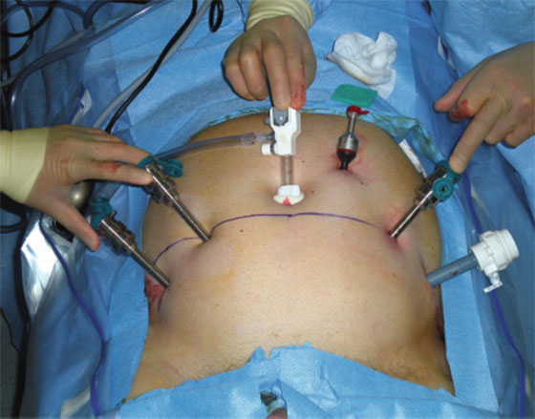
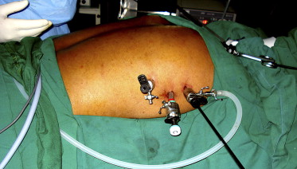
Surgical approaches
laparoscopy
thoracoscopy
Basic surgical techniques – Pécs, 09.22.2015.

Slide 21
Thank you the attention!

