Slide 1
Basic research in Parasport
(Importance of the scientific health background in Parasport)
Dr. Dömse Eszter
Specialist in Ortopedics-Traumatology
PTE Sportmedicine Center
Notes:
Today I would like to introduce you to the health beckground and science background of parasport regarding it’s regipnal and international aspect. I will focus onthe importance and possibilities of sportspecific injury prevention methods and possibilities .fontosságáról.
We ask you to give short feedback, on POTECHO platform at the end of each class , and the longer feedback at the end of last course. And we would ,like to finish the course with final test.

Slide 2
1. Basic Definitions

Slide 3
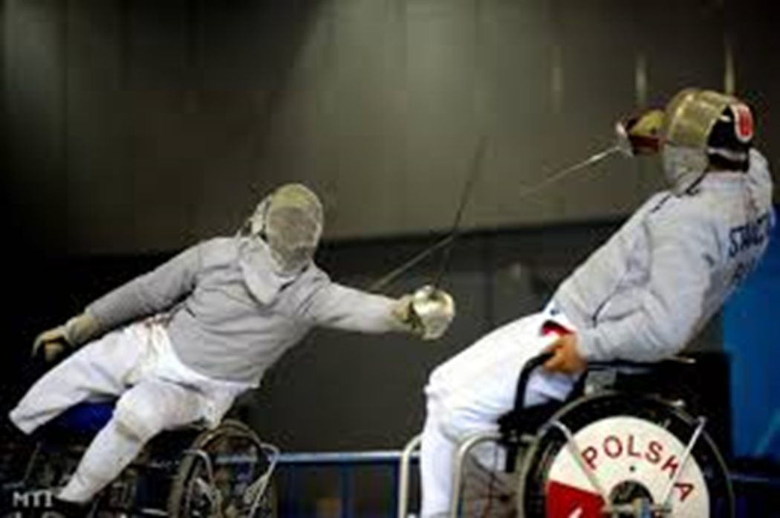
1. Basic Definitions
Sport injury prevention:
It is widely known in which all methods deemed beneficial are used to aptly research the nature regarding sport injuries, while unveiling risk factors attributed to sport-specific injuries, and developing strategies to reduce the possibility of sport-specific injuries.
3
Parasport
Notes:
Let us see, Let me talk about…, Let me introduce, you can see the next picture

Slide 4
2. Disadvantages of sport-injuries involving paraathletes
Notes:
Last time we have talkd about, sport injuries could have a serious outcome for paraathlets it may be decrease their qualitiy of life.
So that’s why now i would like to talk about the disadvan

Slide 5
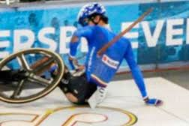
2.Disadvantages of sport-injuries involving paraathletes
on an individual level: a. Injury of tissues or organs
b. Psychological trauma
on a team level: a. injured paraathletes influence the whole team’s
potential for success,
b . Financial burden (therapy and rehabilitation costs)
3
Parasport

Slide 6
3. The levels of sport-injury prevention in parasport

Slide 7
3. The levels of sport-injury prevention in parasport
5.1. The exploration of the type, severity, and the frequency of a sports-specific injuries
5.2. The exploration of etiology and pathomechanism of the sport-specific injury
5.3. Developing and adapting injury-prevention methods
5.4. The evaluation regarding these methods
3
Parasport

Slide 8
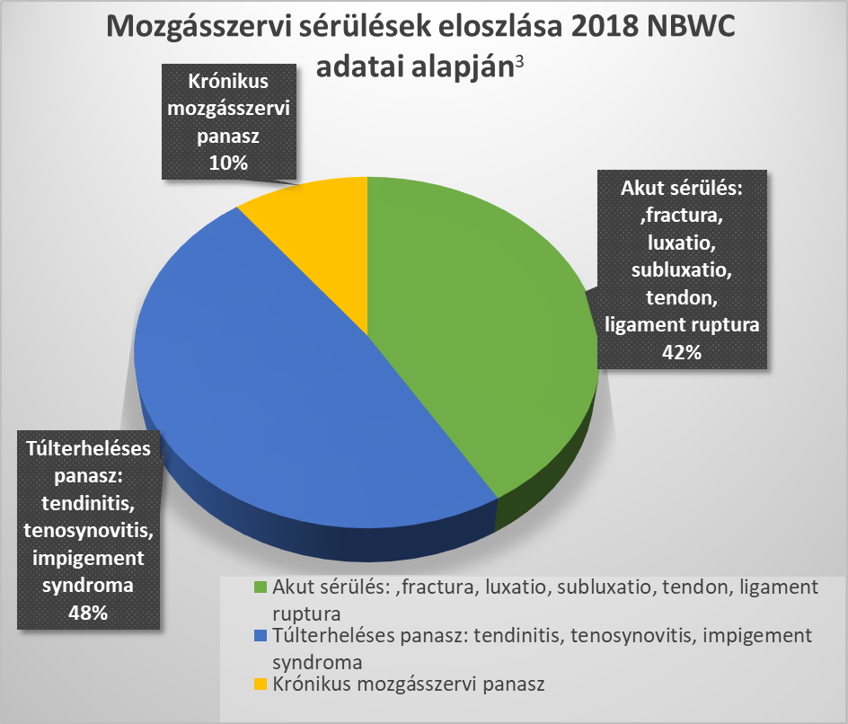
3. The levels of sport-injury prevention in parasport
3.1. The occurrence, type, frequency of various sport-specific injuries
3
Parasport

Slide 9
3. The levels of sport-injury prevention in parasport
3.2. Etiology and pathomehanism of sport-specific injuries:
3.2.1.: Internal factors:
- Sex and age
- Bodyform, muscle performance and muscle binding
- Skills, range of motion and motor coordination
- Joint and ligament instability
- Self-knowledge and spiritual factors
- Previous injuries
3
Parasport

Slide 10
3. The levels of sport-injury prevention in parasport
3.2. Etiology and pathomehanism of sport-specific injuries :
3.2.2. External factors:
- Sport-specific rules
- Training load
- Sports environment, various equipment and uniforms/clothing
- Sports specialists’ backgrounds (Fitness Trainer, Rehabilitation Trainer, physiotherapist, Sports Masseuse, Sports Dietetician, Team Doctor
and a Sport Psychologist)
- Medical and sports medicine background
- Social conditions: diet , alcohol consumption, nicotine use , anabolic
steroids and potentially other drug use
3
Parasport

Slide 11
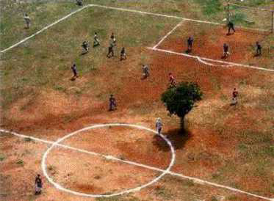
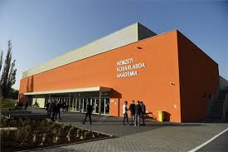
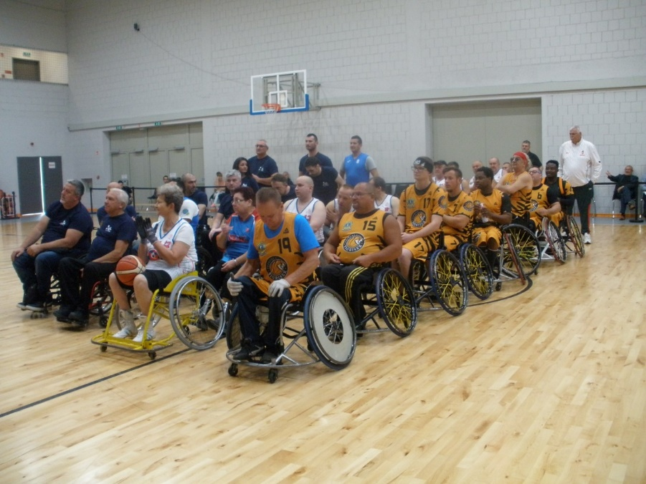
3. The levels of sport-injury prevention in parasport
Sports environment
3
Parasport

Slide 12
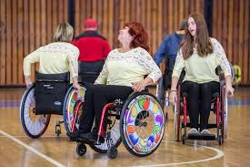
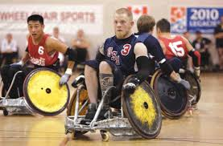
3. The levels of sport-injury prevention in parasport
Sports equipment, uniforms and sports fashion
3
Parasport

Slide 13
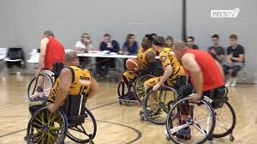
3. The levels of sport-injury prevention in parasport
Sports equipment, uniforms and
sports fashion
3
Parasport

Slide 14
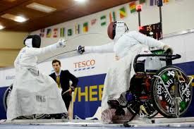
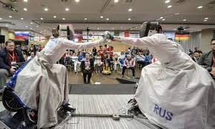
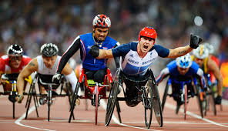
3. The levels of sport-injury prevention in parasport
Sports equipment, uniforms
and
sports fashion
3
Parasport

Slide 15
3. The levels of sport-injury prevention in parasport
3.3. The develepomnet of the Sport-specific injury preventive(prevention) methods:
3.3.1. Performance of physiology and performance of diagnostics in parasport:
- Regular training causes(creates) change in the operation of several organs system, while the
physiological functions regarding the human body undergoes development and adapts to the
perfomance
- Adaptating(adaptation) appears in: the neuromuscular system,
the human motoric system,
the cardiorespiratory functions,
and, muscle metabolism
3
Parasport

Slide 16
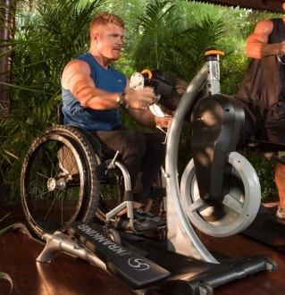
3. The levels of sport-injury prevention in parasport
Ergometric measurement:
measures currently or in real time, accurately
the amount regarding the physical performance.
Types: treadmill ergometer
bicycle ergometer
crankcycle ergometer
Spiroergometric measurement: we can acquire information regarding muscle metabolism in the form of spiroergometric measurements. Today, using spirometry, we can also measure correct muscle and respiratory performance among athletes.
3
Parasport

Slide 17
4. The advantages of sport-specific injury prevention methods

Slide 18
4. The advantages of sport-specific injury prevention methods
Can measure
Current muscle perfomance
Training performance
Current traning status
Current health condition
Which is the most important in among paraathletes?
Possibilities
- Strategic planning regarding training perfomance
- Improved competition results
- Evaluation of intensity of load capacity
3
Parasport

Slide 19
5. The sport health background of parasport in our region

Slide 20
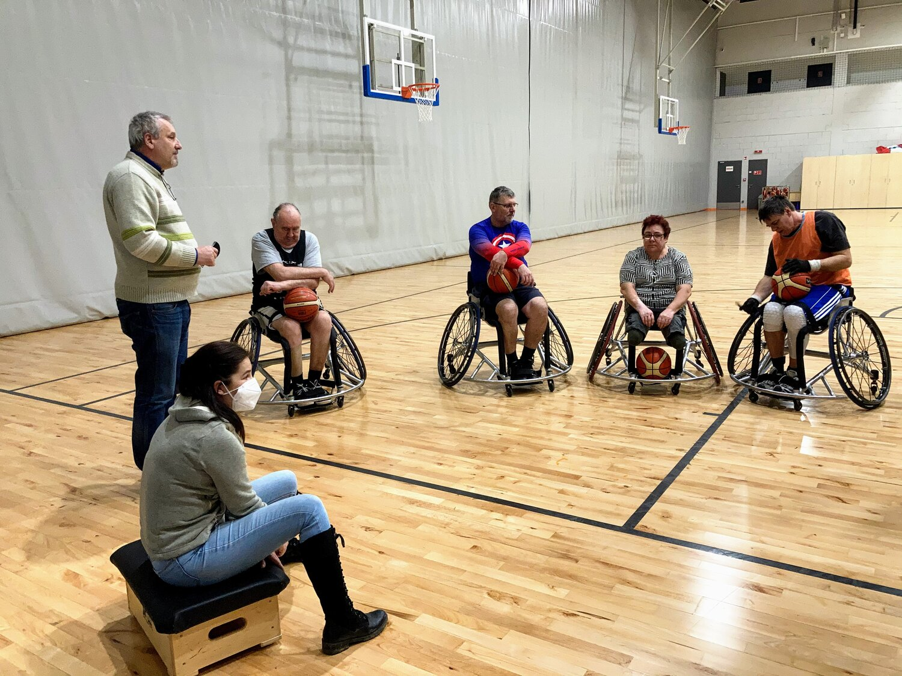
5. The sporthealth background of parasport in our region
PTE Sportmedicine Center:
• Ensures both the proper sportscience and sporthealth background for all
paraathleetes of PEAC Parasport section, ensure screening examination connecting with locomotor system, and also we doing the diagnostic end an operating therapy of sport injuries and the rehabilitation therapy for paraathleetes
Cooperating with PTE Sports- and Physical Education Center.
Health Care connecting with Covid pandemic:
testing, presentation about vaccination,
post- Covid examinations
Parasport
Notes:
What organizations ensure, Our duties, were limited to testing..

Slide 21
PTE KK Rheumatology and Immunology Department
-Early Locomotor rehabilitation section-
Dr. Varjú Cecilia (head of department) –associate professor, deputy medical director
The locomotorrehabilition of disabled people should include parasport
PARASPORT=Therapy
Parasport
Notes:
We cooperate with varjú cili, the main of our cooperation how to include parasport he locomotorrehab. Dis. people , subdepartment
It doesn’t work well so

Slide 22
Reality:
-the complex locomotor rehabilitation of paraathletes?????
: Austria- Hungary-Pécs (Budapest-Sopron „Tiger”)
the health background of championship of paraathletes, and parasport events??? (in the national basketball championship usually there’s no medical support except in Pécs)
the appropiate financial support of paraathletes??????
(pl. PVSK, PEAC szerződése van a PTE ÁOK –val) PVSK and PEAC has a working contract with the University of Pécs, medical School
Parasport
Notes:
In relation to, about,.. Is not existent, in the national basketball championship there is no medical stuff in present usually except in
pécs,teams those teams which got in corporated into big sportclub get appropriate health care support through the club

Slide 23
6. The sport scientific background of parasport in our region

Slide 24
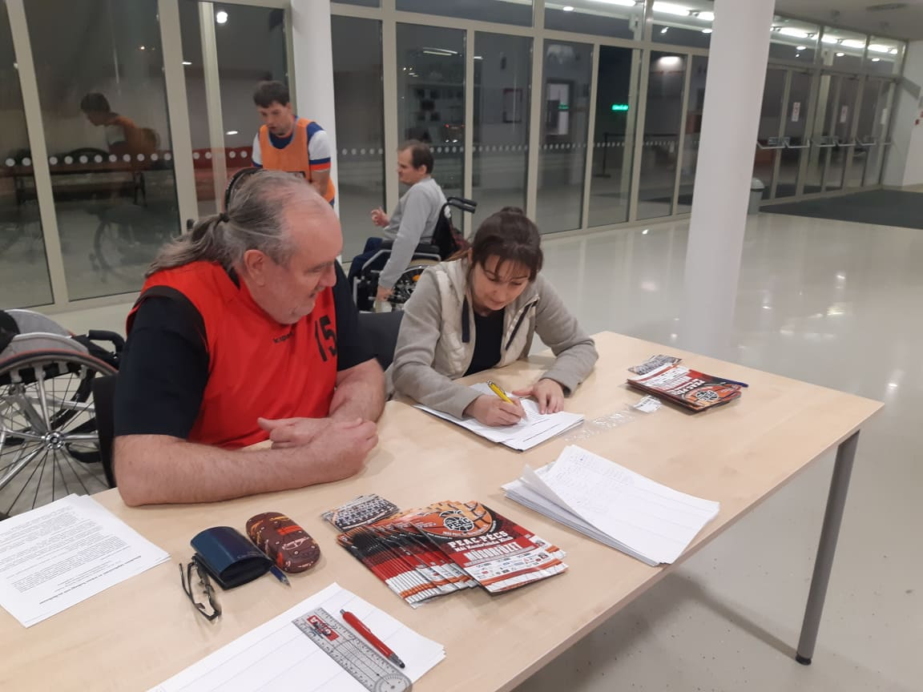
6.The sportscientific background of parasport in our region
PTE Sportmedicine Center:
We developed protocols, by adapting wheelchair basketball players to measure general and
maximum physical perfomance, and overall health status
6.1. Questionnaire and physical examination : can be possible to know the general health status, and the case
history of paraathletes
6.2. sport specific track tests
6.3. measurements of the performance of physiology : ECG without muscle
performance, ECHO, crankcycle ergometry, spiroergometry ,
DEXA-Dual energy X-ray absorptiometry
Parasport
Notes:
Now let me introduce what kind of scientific research we do in our department. We collaborate closely the PEAC.. ,
We have already used …..,

Slide 25
6.1.Questionnaire and physical examination

Slide 26
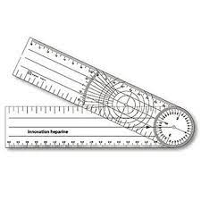
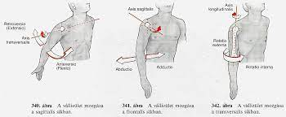
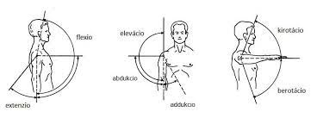
6.1. Questionnaire and physical examination:
general health status and physical examination
measure the range of motion of big abled joints
measure the muscle power of the upper limbs
3
Notes:
Többek között lemérjük

Slide 27
6.2. The sport -specific track tests(basketball players)

Slide 28
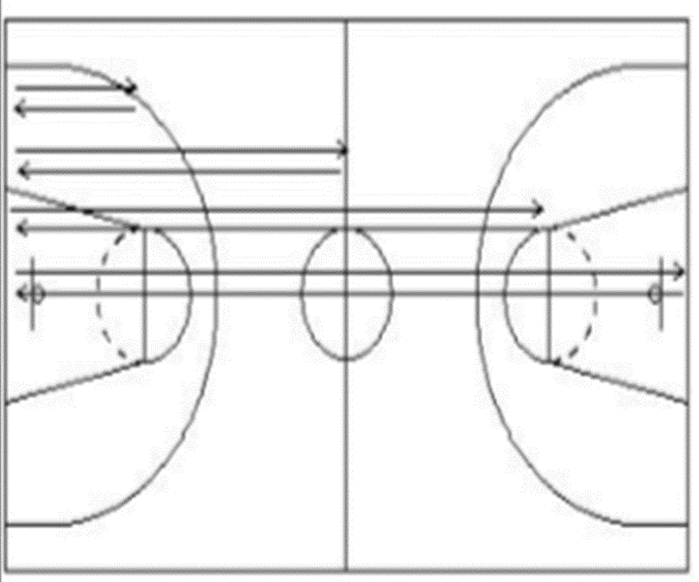
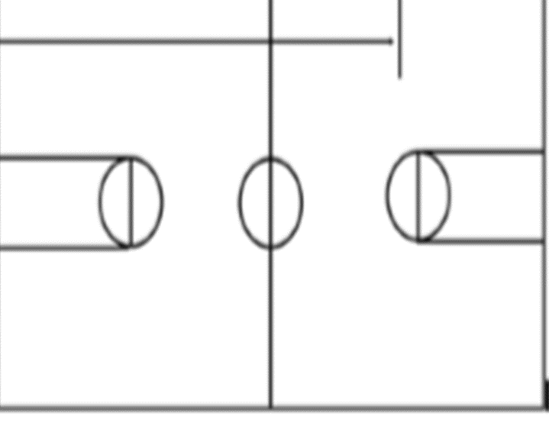
6.2. Sport specific track tests (adopted wheelchair basketball players):
Suicides test, 20 m sprint with ball,…..
3
Notes:
I will list some of them.. Labdakezelés, gyorsaság ,robbanékonyság, kerekesszék használatot szolgál, Theese test maesure ball handling, explosivity, use of wheel chair, speed

Slide 29
3

Slide 30
3
Notes:
Let me share some pohotos, how we survey theese skills

Slide 31
6.3. The measurements of performance of physiology

Slide 32
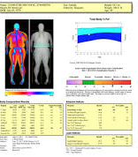
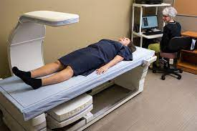
6.3. measurements of the performance of physiology( the measurement of physiological performance) :
EKG without muscle performance, ECHO,
crankcycle ergometry, spiroergometry ,
DEXA-Dual energy X-ray absorptiometry
3
Notes:
You know already what they do, so i don’t have to explain, I would like to talk about in more details,and allow me to share a video how works

Slide 33
PROTOCOLS
individual-sport-specific training plan, and rehabilitation plan
optimal training performance, better results, sport-injury prevention methods
3
Notes:
As a summary, with this protocol we can create a proper, it is possible to achieve

Slide 34
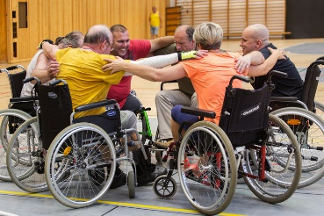
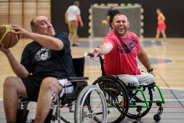
4. The Future
The aims of parasport: maintain and, or improve their quality of life and their state of health .
Maintain state of health, improved health
and longer life expectancy
Injury= Life Quality Failure
Injury Prevention
Importance of scientific background = changing approach in PARASPORTS
3
Parasport
Notes:
By maintaining state of can prolong life expectancy and reach improved state of haelth,thazs why we need a change in paradigm
Should be improved.

Slide 35
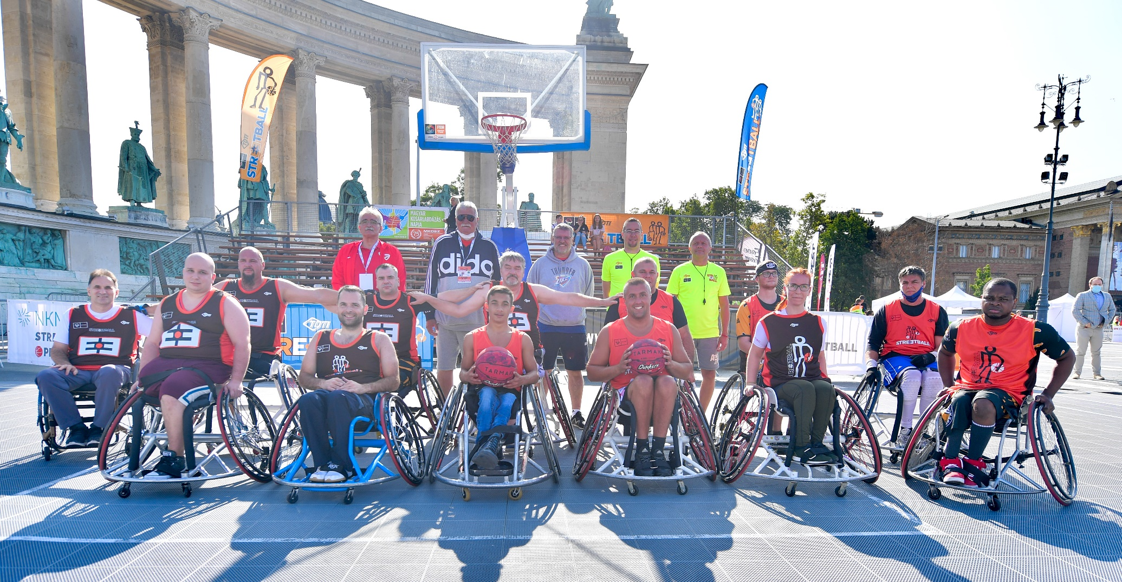
Thank you for your attention!
Pécs, 2021. március1..

