Slide 1



Mental Health Prevention and
Rehabilitation of Sport Related Injuries
Pécs, 2024.09.

Slide 2

The psychology of sports injuries

Slide 3

Injury= crisis
  CRISIS= danger and opportunity (Greek)
  Some kind of decision, turning point
  It carries the potential for growth and change
  Two types:
1. psychosocial/developmental crisis- unavoidable (natural to happen), PREVENTION is key (e.g. career ending)
2. accidental/situatinonal crisis- unexpected, external event (e.g. injury)
  Response to crisis depends on: 1) severity of injury 2) possible consequences 3) timing 4) personality 5)environment
  5 stages of a crisis:
confrontation
alarm
solution- seeking
decision-making
balance or exhaustion
3
Notes:
1. Confrontation
The perception of the situation, a sudden impact, or even denial.
2. Alarm
Anxiety symptoms may arise (What will happen to me? What will happen to my career?), leading to increasing emotional vulnerability.
3. Solution Seeking
An active phase where previous coping strategies intensify, and the need for new strategies arises.
4. Decision-making
Making a decision about the solution, such as surgery or treatment.
5. Balance or exhaustion
Successful rehabilitation or a breakdown of psychological balance, potentially lasting for years.
3

Slide 4
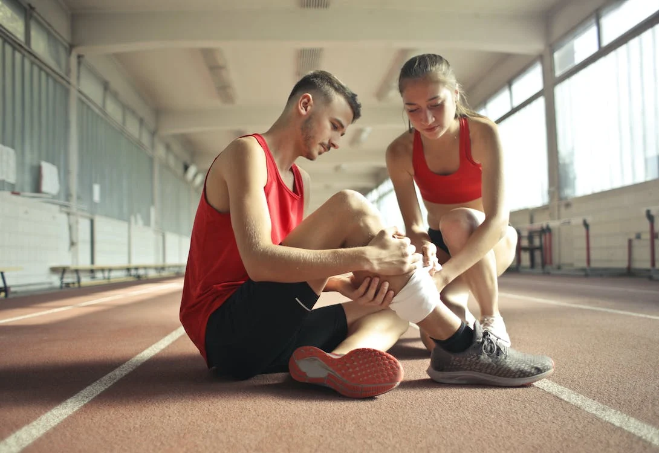
An injured athlete may experience...
  Restricted attention (focusing on the problem)
  Reduced mental capacity (challenges in evaluating of the situation)
  Decreased emotional control and self-regulation (extreme behaviors, aggression)
  Changed relationships (egocentrism, increased need for support)
  Regression (blaming others, denial)
Notes:
4

Slide 5
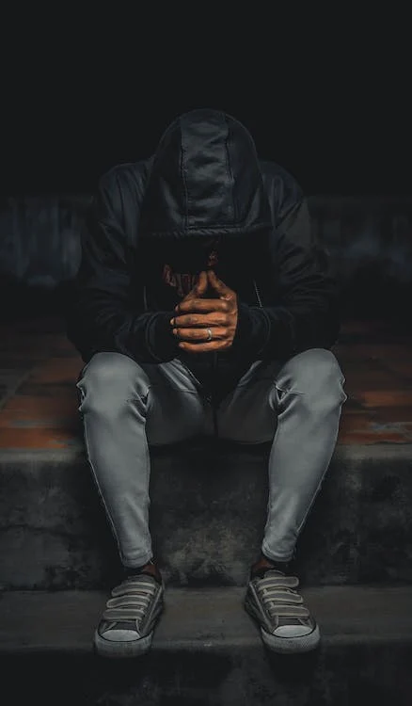
Negative psychological consequences
  Stress and anxiety
  Anger
  Issues related to compliance
  Depression
  Concentration and attention problems
  Exercise addiction
5

Slide 6
The role of stress

Slide 7
Stress I.
  body’s non-specific response to regain balance through adaptation (Selye, 1976)
Positive (eustress) – helps to focus, achieve flow
Negative (distress) – can lead to anxiety, sense of threat (higher risk of injury)
  STRESS RESPONSE: physiological and biochemical changes for coping (if unable: anxiety appears)
  Stress level is influenced by: importance of the event, number of uncertain factors, personality traits
  Increased sensitivity and strong reactions caused by elevated stress
->VULNERABITY! (risk of injury)
7
Notes:
1. szembesülés
helyzet észlelése, sokkszerű hatás, vagy akár tagadás
2. megrettenés
szorongás tünetek jelentkezhetnek (Mi lesz velem? Mi történik a karrieremmel?), ezáltal fokozódó érzelmi sérülékenység
3. Kiútkeresés
aktív szakasz, eddigi megküzdési stratégiák felfokozódnak, új stratégiákra is szükség van
4. döntés meghozatala
dönt a megoldásról pl. műtét, kezelés
5. egyensúly vagy kimerülés
sikeres rehabilitáció vagy pszichés egyensúly megbomlása miatt akár évekig
7

Slide 8
Stress II.
  Personalities, who perceive the situation as more stressful -> higher psychological activity
  Increased muscle tension -> exhaustion, reduced flexibility, motor coordinaton problems, muscle functioning difficulities (strain, sprain, tear)
  Narrowing of the visual field
  feelings related to pain are natural, IN FACT! part of the rehabilitation process
8
Notes:
1. szembesülés
helyzet észlelése, sokkszerű hatás, vagy akár tagadás
2. megrettenés
szorongás tünetek jelentkezhetnek (Mi lesz velem? Mi történik a karrieremmel?), ezáltal fokozódó érzelmi sérülékenység
3. Kiútkeresés
aktív szakasz, eddigi megküzdési stratégiák felfokozódnak, új stratégiákra is szükség van
4. döntés meghozatala
dönt a megoldásról pl. műtét, kezelés
5. egyensúly vagy kimerülés
sikeres rehabilitáció vagy pszichés egyensúly megbomlása miatt akár évekig
8

Slide 9



Cognitive evaluation model
Injury
Severity of injury?
Reaction to stress= evaluation, processing
How dangerous is the situation?
What resources are avaliable?
Selection of coping strategies
Adaptive or maladaptive strategies?
9

Slide 10
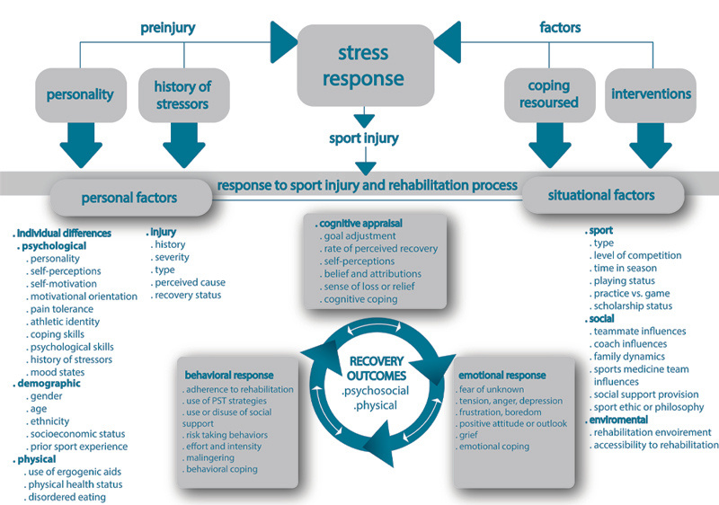
10

Slide 11
Anxiety

Slide 12

Anxiety I.
  Anxiety: negative emotional state, when a situation perceived as threatening + without specific object (e.g. fear of injury)
  Signs: muscle tension, rapid breathing, sweating, nausea, mental symptoms such as decreased concentration
  State anxiety: temporary emotional reaction to a specific situation (e.g. the starting moments of a competition)
  Trait anxiety: a “predisposition” to anxiety, „general characteristic” (e.g. performance anxiety)
12
Notes:
1. szembesülés
helyzet észlelése, sokkszerű hatás, vagy akár tagadás
2. megrettenés
szorongás tünetek jelentkezhetnek (Mi lesz velem? Mi történik a karrieremmel?), ezáltal fokozódó érzelmi sérülékenység
3. Kiútkeresés
aktív szakasz, eddigi megküzdési stratégiák felfokozódnak, új stratégiákra is szükség van
4. döntés meghozatala
dönt a megoldásról pl. műtét, kezelés
5. egyensúly vagy kimerülés
sikeres rehabilitáció vagy pszichés egyensúly megbomlása miatt akár évekig
12

Slide 13

Self-concept
  Much of an athlete’s life revolves around sports -> self-image and personality can merge with the athlete role
  Injury-> IDENTITY IS AT RISK
  The more they focus solely on sports in their life, the more likely they will experience it as a trauma -> can affect their entire life
  Depression, anxiety, hopelessness
  Increased attention from professionals is essential!
  Encouragement: develop themselves in multiple areas
  Goal setting
13

Slide 14
Rehabilitation

Slide 15

Rehabilitation I.
the mental aspects are receiving more attention in healthcare.
Return to play: often, athletes not mentally ready -> tension, anxiety, which can lead to:
  Re-injury
  Injury to another body part
  Low self-confidence, decreased performance
  General depression
  Fear of injury
  Decreased motivation
15

Slide 16

Rehabilitation II.
  help to process the emotions and thoughts related to the injury
  Social support is primary!
  TECHNIQUES
Relaxation
-reduces tension, enhances blood circulation
-provides a sense of control
-combined with visualization and imagination
Negative self-talk – reframing
- helps to change negative thought patterns into more positive ones
Goal setting
-clear, achievable goals can enhance motivation and focus

Slide 17

Remington- University of North Carolina
17

Slide 18
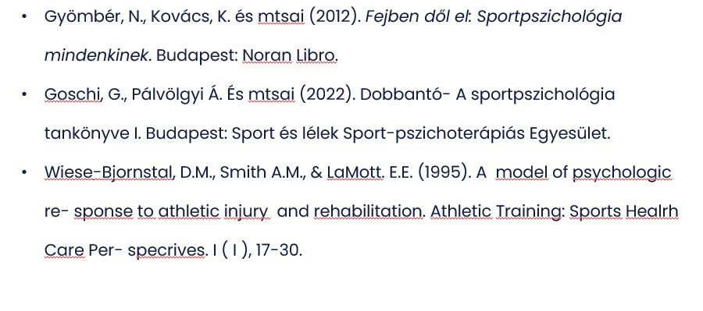
Literature
18
Notes:
19

Slide 19
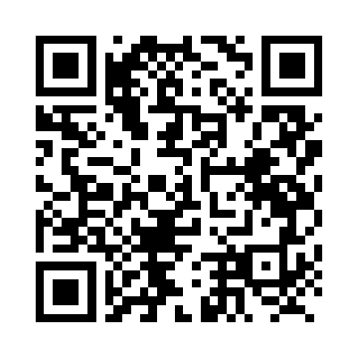
Thank you for your attention!
potecho: PTE580
Pécs, 2024. 09.

