Slide 1
POTECHO: PTE692
Sportinjuries
Situation practise
Dr. Dömse Eszter
ortopéd- traumatológus szakorvos
PTE ÁOK Sportmedicina Tanszék
2025.03.10.

Slide 2
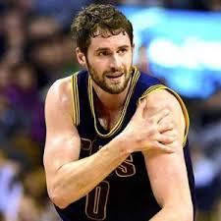
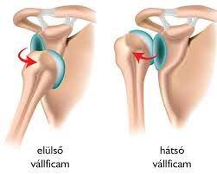
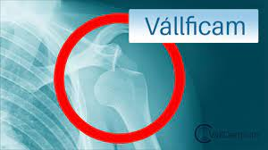
1. TEAM: Luxatio humeri (anterior-inferior)
3
Dopping

Slide 3
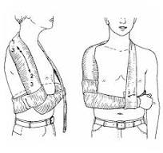
TEAM: Luxatio humeri ( shoulder luxation)
Aetiology: 50% total luxations, common in sport: horse riding, ice skating, ice hockey, handball, skiing, wrestling
Types: anterior, posterior, inferior, anterior-inferior,
Mechanism: falling on the outer edge of the shoulder, colliding with another athletes, falling when arm and shoulder is in abductio-anteflexio- outer rotation position
Anamneis, physical examintation:
Symptoms: pain, elastic fixation, deformity, haematoma, limited mobility of shoulder joint,
Therapy (on the scene, on the field): strictly forbidden!!!!, call ambulance- emergency department, proper posation, relief the patientient’s pain, check neurovasc. system (plexus brachialis laesio, a. rad. pulse, Gilchrist bandage
3

Slide 4
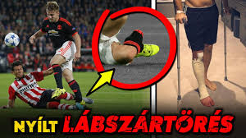
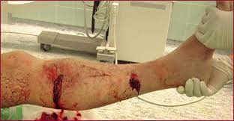
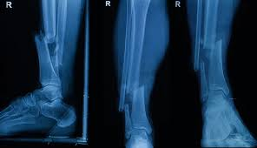
2. TEAM: (Fract. Cruris ap. G.III.)
3

Slide 5
Types: Gustillo-Andersen classification (I-III)
Mechanism. :high energy force can cause it directly or inderectly
Anamnesis, physical examination:
Symptomes: heavy pain, deformity, crepitatio, open bleeding wound,we can see the bone, limited or no mobility of cruris, maybe neurovascular disorders( co-injuries , vessels, nerves,)
Therapy (on the scene, on the field): take patient to the safe place, main purpose is to prevent suppuration, disinfection of the wound, sterile bandage to stop bleeding, fixation of the limb, call ambulance to care to ER department, until controlling neurovasc. co-injuries, adminiter painkillers, ask some question patient about: medications, sensitivities, diseases
3

Slide 6
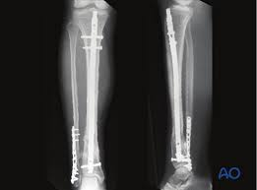
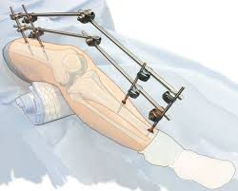
In the Hospital
Diagnostic method: RTG, CT, MR, MR-agngiographia (neurovasc. injuries)
Therapy: operation- fixateur externe, nail, plate
3

Slide 7
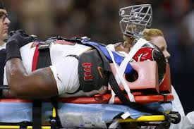
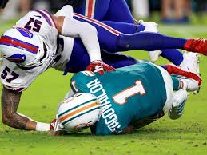
3. TEAM: (Commotio, contusio, concession)
Anamnesis, physical examination:
Pateint in proper safe scene, safe position:head –neck stabilisation stif neck
take of the helmet,
Glasgow Coma Scale,
Symptoms: headache, nausea, vomiting, dizziness, pupillary reflex,confusion,
Call ambulance- ER Department
Concussio-CTE
The significance of mild cranial injuries: are beginning to recognize its
significance, involving a much larger population (15-30x)!!!
3

Slide 8
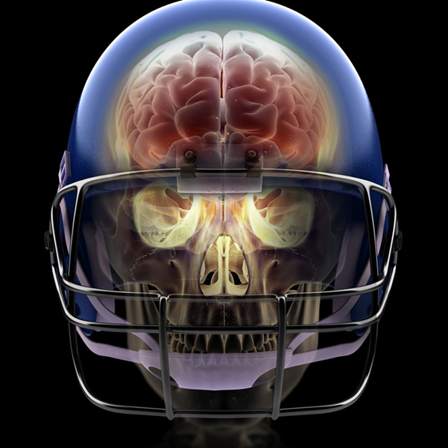
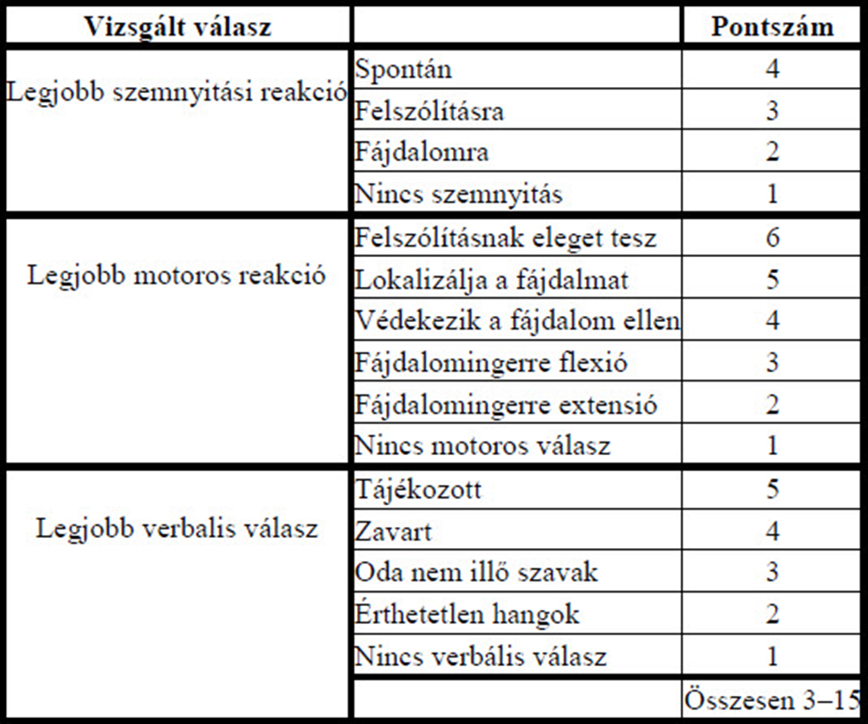
3
Notes:
Az enyhe traumatikus agysérülések az összes traumatikus agysérülések 80-90%-át teszik ki, míg a maradék 10-20%-ba a középsúlyos/mérsékelt és súlyos esetek tartoznak.

Slide 9
Incidence of traumatic brain injury in sports
Concession is a closed head injury that affects the head as a result of some sudden external force (s), during which the brain hits the inner surface of the skull, leading to its damage and dysfunction.
Concession may occur
without visible symptoms (asymptomatic subconcession)
or accompanied by a number of symptoms (symptomatic concession).
3
Notes:
Now we ,focus on closed skull injuries

Slide 10
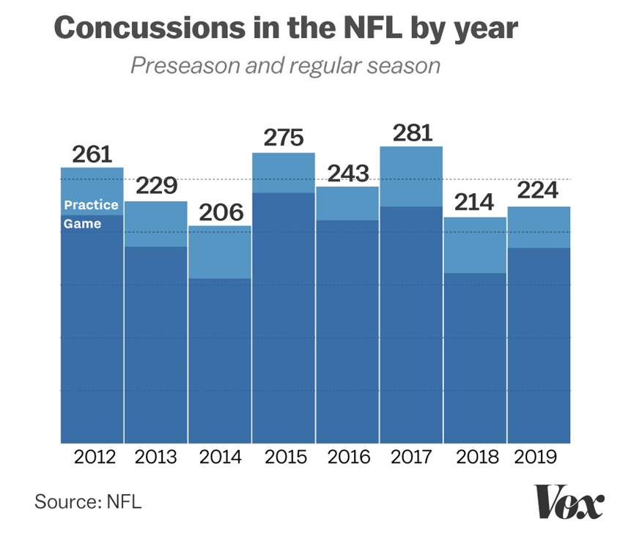
Concession is common in contact sports:
american football
rugby
ice hockey
boxing / kick-boxing
lacrosse
wrestling
karate
3
Notes:
Now which are the contact sport most common for concession?

Slide 11
Neuropsychological consequences:
neuro-psychological deficits
cognitive dysfunction
concentration disorder
memorial and attention deficit disorder
3
Notes:
Now what are the

Slide 12
Chronic traumatic encephalopathy:
dementia pugilistica / parkinsonism pugilistica
punch-drunk syndrome
chronic traumatic encephalopathy
3
Notes:
is one of the possible potential consequences this syndromes causes

Slide 13
Progressive neuro-degenerative disease
Cognitive deficits (eg. memory, attention, language impairment)
Emotional disorders (eg. depression, anxiety)
Behavioral disorders (eg. impulse control disorder, aggression)
Musculoskeletal disorders (eg symptoms of parkinsonism: tremor, stiffness, slowness)
Personality change
Social difficulties
Suicide (suicide attempts)
3
Notes:
Additional consequences of closed skull injuries pnd including

Slide 14
Prevention:
control and screening
using appropriate imaging techniques
emphasizing a multidisciplinary approach
Protective equipments and clothes
3
Notes:
Tell me some equipments, clothes which protect.. , For motorcycling drivers it is very important to wear protective clothing and gear, because if they don’t wear it they can pay wtih their own live. It is very important too, to wear a protective helmet during scootering, electric scootering, cycling for adults, and for children as well.

Slide 15
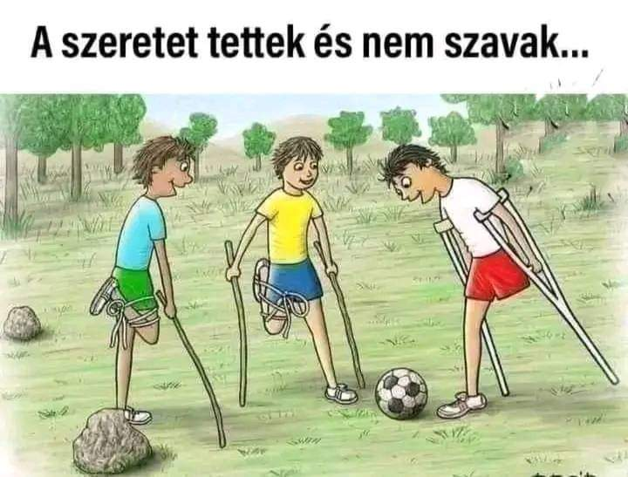
Thank you for your attention!
Pécs, 2021. szept.20.

