Slide 1


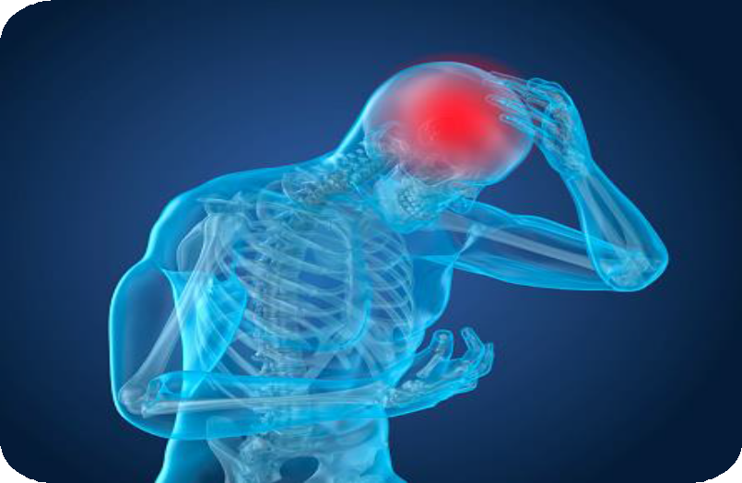

Skull and brain injuries:
intervention options
Dömse Eszter dr.
PTE-ÁOK Sportmedicine Center

Slide 2
Definition

Slide 3
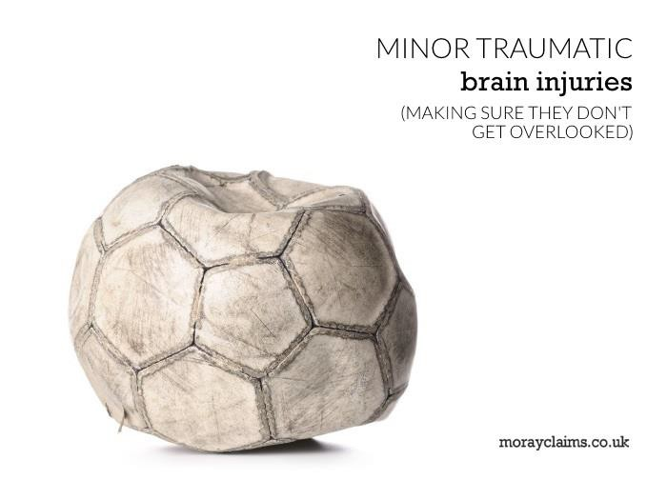
Definition 1.:
Traumatic brain injury:
is a global health problem
high incidence
common long-term consequences

Slide 4
Definition 2.:
The significance
of mild
cranial
injuries:
are
beginning to recognize its
significance
involving a much larger population
(15-30x)

Slide 5
Age and gender distribution:
common in the young age group
twice as common among men
a high proportion of the elderly
population

Slide 6
Incidence:
USA: approx. 1-2 million people / year
United
Kingdom: approx. 1 million
people / year
Europe: 2.5 million people / year

Slide 7
The most common causes
of skull injuries:
Traffic accidents
Physical violence, abuse
falls from a height
gunshot wounds, stab wounds
Sports and recreation activities
Explosions, attacks in war zones
3

Slide 8
Risk factors for traumatic
brain injury:
Drug and alcohol intoxication
Violation of traffic rules
Lack of protective clothing or improper use
3

Slide 9
Classification of skull
injuries

Slide 10
Classification of skull injuries :
open or closed (anatomical classification)
focal or diffuse or mass lesions (pathological classification)
severe, moderate / moderate or mild (severity)
Speed of force application
Pathobiology: primary / direct damage, secondary
damage
3

Slide 11
1. Anatomical Classification:
Open injuries:
Injuries through the skull and meninges
or skull base fractures
3

Slide 12
1. Anatomical Classification:
Open injuries:
Consequences:
  impression fracture,
  foreign body,
  haematoma,
  oedema,
  secondary infection,
  pneumatocele (air tumor)
3

Slide 13
1. Anatomical Classification:
Closed injuries (dura mater intact):
Consequences:
  contusion,
  axon injury,
  oedema,
  epidural and subdural haematoma
3

Slide 14
2. Pathological classification:
focal:
  subdural bleeding,
  epidural bleeding,
  contusion (mainly in the frontal and
temporal lobes)
  diffuse
3

Slide 15
3. Types of head mechanical forces
static / slow force: multiple cranial fractures or cerebral compression due to adequate compressive force.
dynamic / fast force:
  impulsive (sudden movement of the skull due to force on the body)
  impact (direct impact / impact on the
skull)
3

Slide 16
4. severe, moderate / moderate or mild
(severity)
Glasgow Coma
Scale(GCS):
≤ 8 - severe
9-12 - moderate / moderate
❖ 13-15 - mild
3

Slide 17
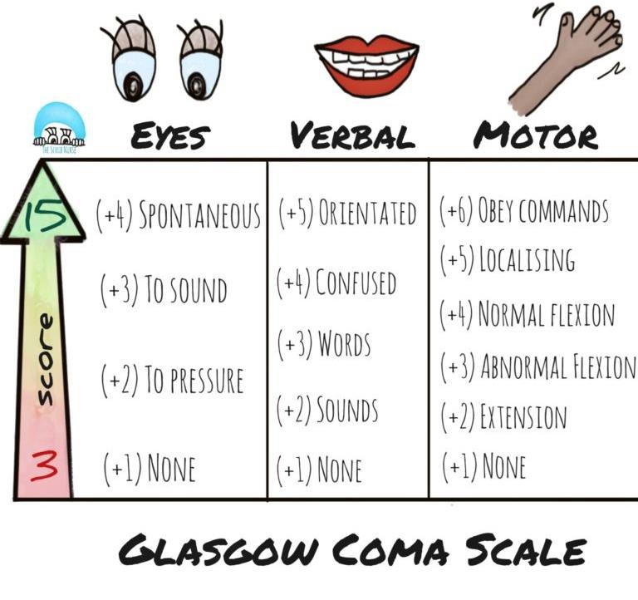
4. severe, moderate / moderate or mild
(severity)
3

Slide 18
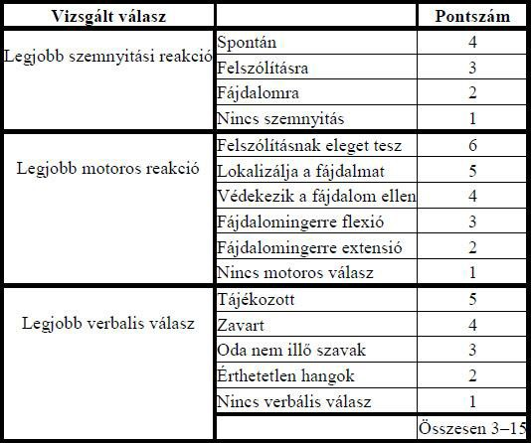
4. severe, moderate / moderate or mild
(severity)
Glasgow Kóma Skála (GCS):
3

Slide 19
5. Pathobiology:
primary / direct damage: damage that occurs at the time of injury;
  intracranial haemorrhage,
  cerebral haemorrhage,
  diffuse axonal damage,
  fracture, etc.
secondary damage: secondary abnormalities occuring immediately following trauma as a result of a combination of different complicating processes.
3

Slide 20
Diagnosis of traumatic
brain injuries :

Slide 21
Laboratory tests:
Ongoing research biomarkers
Imaging tests:
  Focal lesions, cerebral contusions could
relatively easily be identified by CT scan
  Magnetic resonance (MR) examination
3

Slide 22
Incidence of traumatic brain injury
in sports
Concession (konkusszió) is a closed head injury that affects the head as a result of some sudden external force (s), during which the brain hits the inner surface of the skull, leading to its damage and dysfunction.
  Concession (konkusszió) may occur
  without visible symptoms (asymptomatic subconcession)
or accompanied by a number of symptoms (symptomatic concession).
3

Slide 23
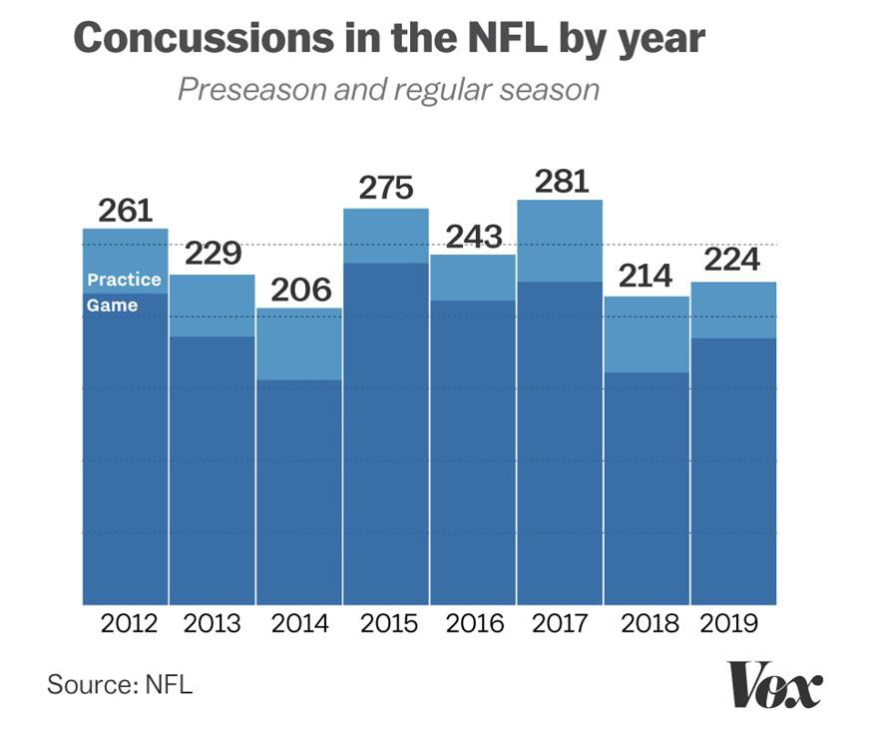
Concession is common in
contact sports:
3
american football
rugby
ice hockey
boxing / kick-boxing
lacrosse
wrestling
karate

Slide 24
Concession in other
sports:
the horseback riding
skiing,
parachuting
3

Slide 25
Neuropsychological
consequences:
neuro-psychological deficits
cognitive dysfunction
concentration disorder
memorial and attention deficit disorder
3

Slide 26
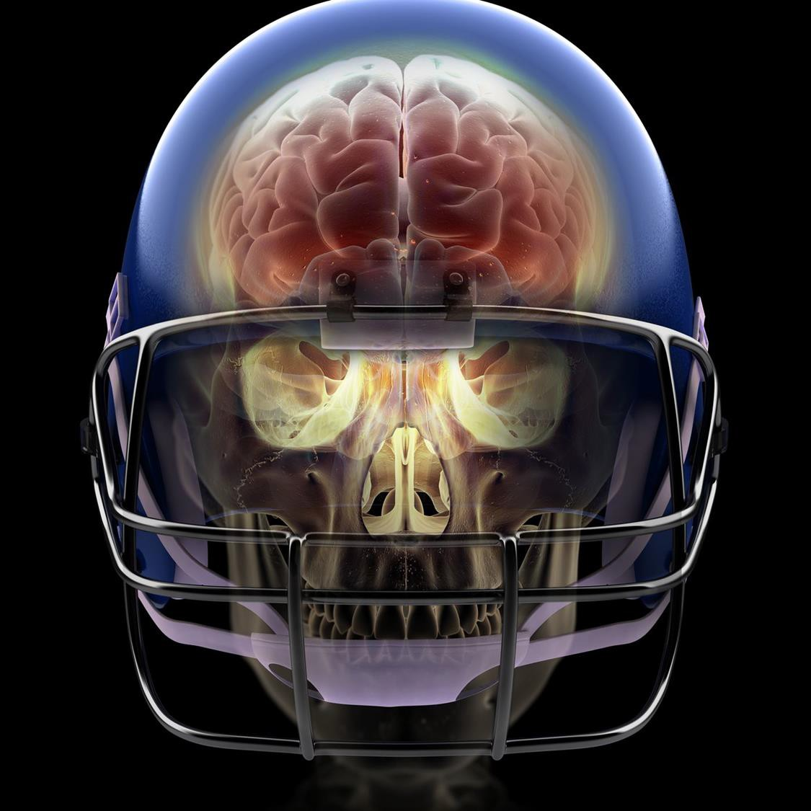
Chronic traumatic
encephalopathy:
3
dementia pugilistica / parkinsonism pugilistica
punch-drunk syndrome
chronic traumatic encephalopathy

Slide 27
Progressive neuro-degenerative disease
Cognitive deficits (eg. memory, attention, language impairment)
Emotional disorders (eg. depression, anxiety)
Behavioral disorders (eg. impulse control disorder, aggression)
Musculoskeletal disorders (eg symptoms of parkinsonism: tremor, stiffness, slowness)
Personality change
Social difficulties
Suicide (suicide attempts)
3

Slide 28
Prevention:
control and screening
using appropriate imaging techniques
emphasizing a multidisciplinary approach
Protective equipments and clothes
3

Slide 29

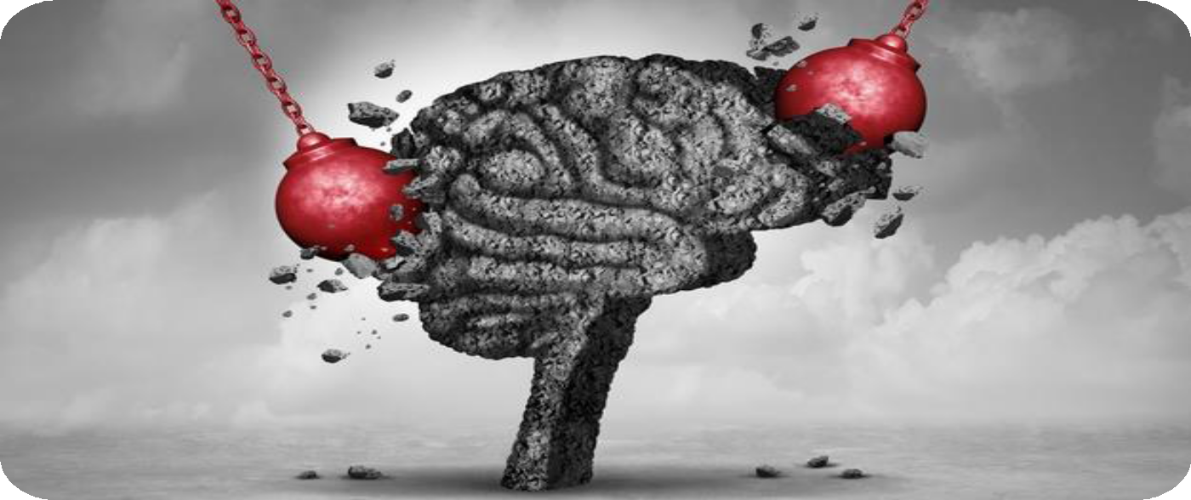


Köszönöm a megtisztelő
figyelmet!

