Slide 1



2026.03.10
Introduction to
PARASPORT
Notes:
Közös kurzushoz szöveg:
Before we begin my presentation, let me introduce myself. My name is..
I graduated at the Univ. of Medicine of Pécs. I work as an ortopedics-traumatologist, and I work at Sportmed. Center in partail time. My position at the department to ensure the health- and science background of the parasport in our region and in our Univ. With this presentation I would like to give a small insight into the worl of parasport, and I would also like to slightly shape your attitude toward people with diabilities
Parasportkurzus:
Good afternoon, before we begin with the presentation, let me introduce myself. my name is…….…………………
First we will fill out the attendance sheet, i will call your name, if you hear your name please put your hand up, and please share with me why you chose this course?
Goal .
1. My goal with this course to keep it closer to you the parasport, i would like to introduce some kind of parasport, and paraathlets, .
Second presenter, physiotherapist,fill out sg., upload to neptun, You can miss max. of 20% of the classes.

Slide 2

1. Basic Definitions
Notes:
Firstly let’s talk about some basic definitions. Before we are gon in more details let’s talk about some basic definitions

Slide 3
1. Basic Definitions
Definition of disability:
physical or mental condition, that limits a person’s movements, senses, or activities, such as physical impairment, sensory impairment, cognitive impairment, intellectual impairment, mental illness, and various types of chronic diseases
PARA SPORT
Definition of sport:
all forms of competitive, physical activities or games which, through casual or organized participation, aim to use, maintain or improve physical ability and skills while providing enjoyment to participants, and - in some cases- a form of entertainment for the spectators
3
Parasport
Notes:
Video about disabled people, this is an perfect example how we should handle people with disabilities

Slide 4
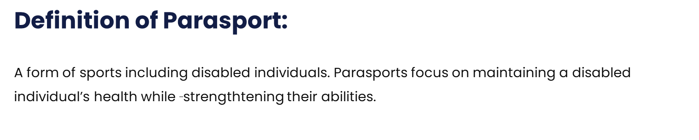
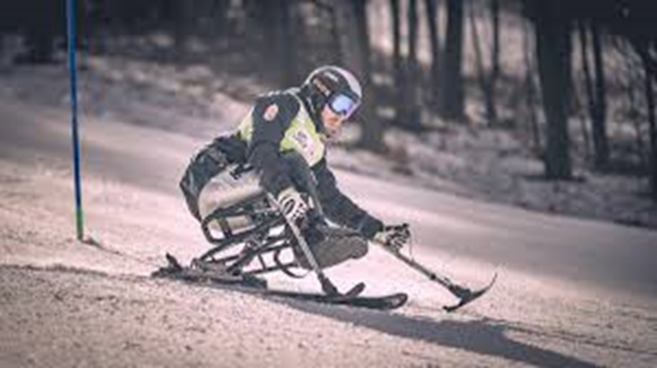
1. Basic Definitions
3
Parasport /video
Notes:
How would you define Para sport? How the Parasport variable is, how paraathletes variable are, they varieble i their abilities

Slide 5
2. The health benefits of sport and physical activity for healthy individuals
Notes:
Let us see, what the health benefits are of sport and physical activities

Slide 6

2. The health benefits of sport and
physical activity
Positive physiological effects: inrease the ox. transp. cap. of the blood, heart and lung function will be better
increases physical capacity
it enhance locomotor system,
It increase the metabolism, it helps controll bg, col. level, and
body wieght
It helps to balance the daily physical and mental strains
It refreshes, reenergizes
It facilitates self- improvement
great for stress release
3
Parasport
Notes:
It increases the oxygen transport capasity of the cell, such as it improves theheart and lung capacity

Slide 7
3. The health benefits of sport regarding paraathletes

Slide 8
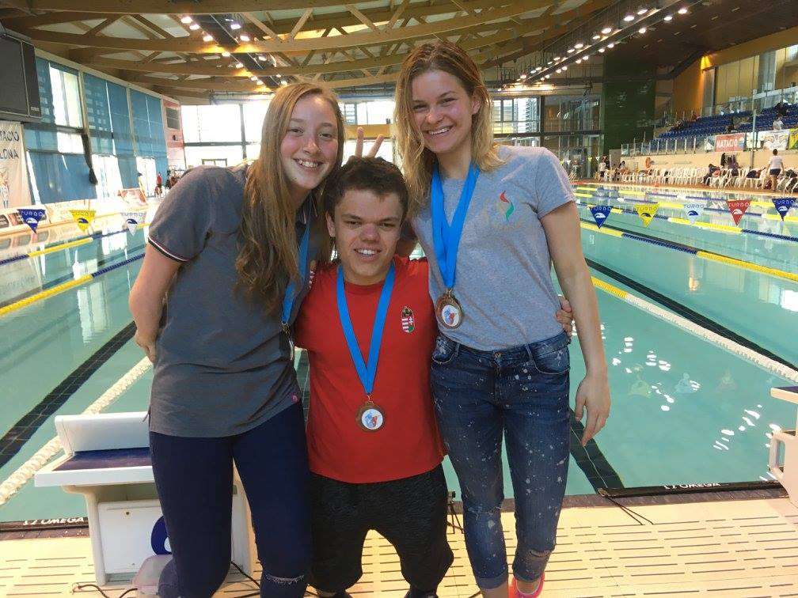
3. The health benefits of sport regarding paraathletes
positive physiological effect
stronger muscular system: increased muscular performance, increased stamina, allowing for robust physical activity
improved metabolism: reduces the effects regarding osteoporosis
Physical activities heal the body and mind: enhances psychosocial function
Improved motorskills, range of motion, and cognitive functionality
Prevention of diseases
Healthy lifestyle
3
Parasport
Notes:
The health benefits create skill to maintain healthier lifestyle and help them in their day to day life

Slide 9
4. The psychosocial benefits of sport regarding paraathletes
Notes:
Now let us look at the…

Slide 10
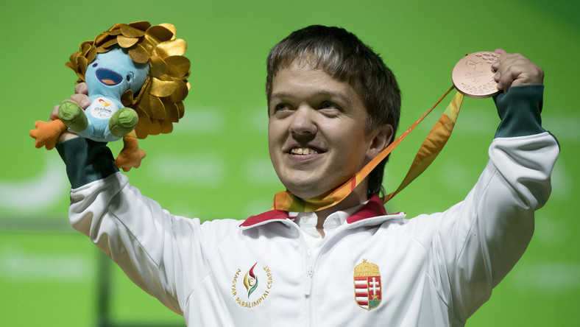
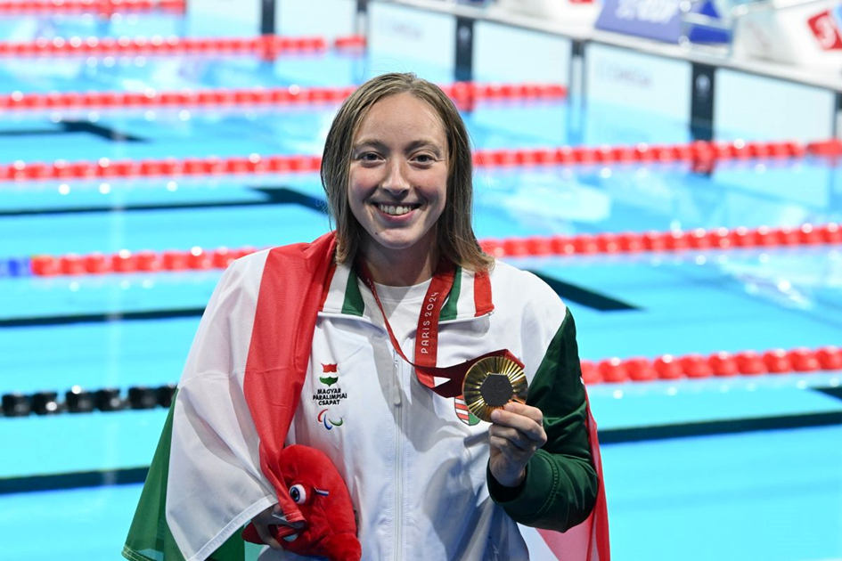
3. The psychosocial benefits of sports regarding paraathletes
It ushers in many social experiences and assures a longing or desire regarding the experience
It offers a stable background in the paraathlete’s life
This is a tool regarding to achieve self assessment and self respect
They learn pride what they have achieved
the emphasis is on skills, not on disability
Parasport
3
Notes:
Through parasport

Slide 11
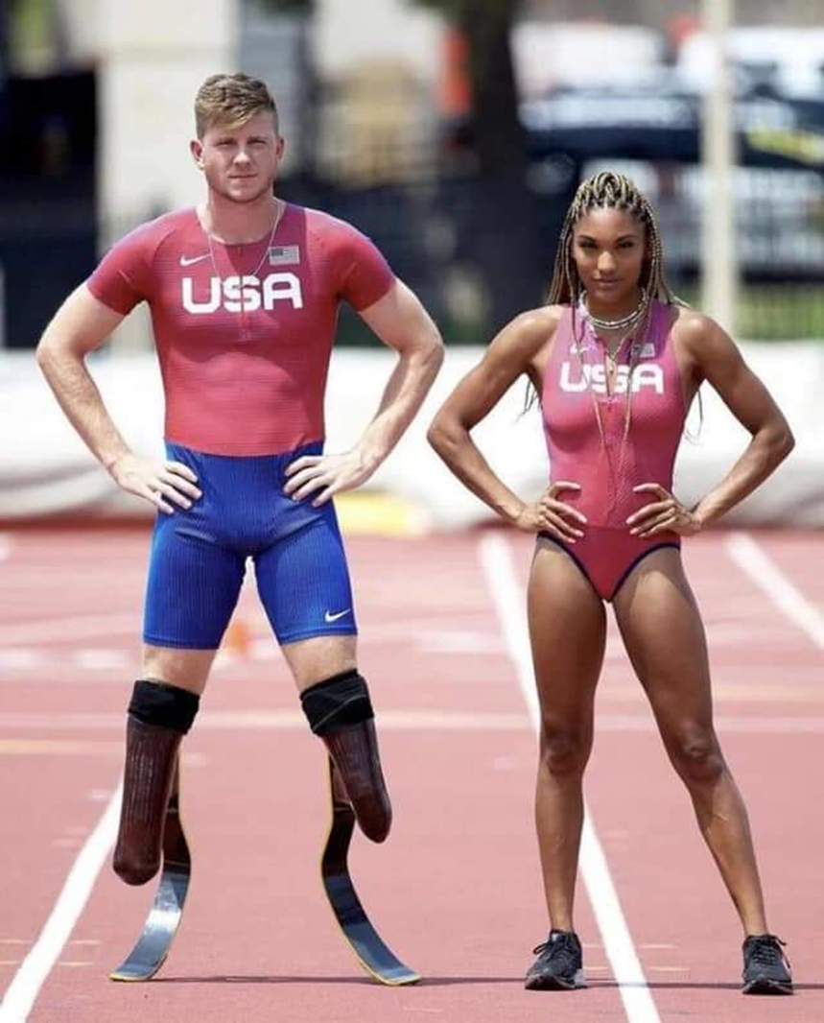
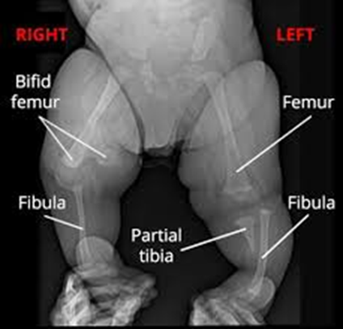
3. The psychosocial benefits of sports regarding paraathletes
3
Parasport/video
Notes:
Through parasport:. The beutiful love story of this couple is a perfect example , what could give parasport to paraathlets. You can see a couple in this picture, an able athlet woman and paraathlet men they are married. Tara and Hunter woodhall . Tara is an able athlet highjumper, and Hunter is a flatrunner paraathlet. They met on mix parasport and able sport champion and they fall in love. Hunter was born with tibia hemimaelia Tibial hemimelia (also known as tibial deficiency) is a condition in which a child is born with a tibia (shinbone) that is shorter than normal or missing altogether. This creates a difference in the length of the child’s legs. The condition is extremely rare, occurring in only about 1 out of every 1 million births. Hunter’s leg was necessary cuted when he was baby.
they know with each other before several years on parasport champion and fall in love. And this summer they became rapidly famous because Tara won a gold medal in Paris on Olympic games and after two weeks Hunter won a gold medal too on paralympic games.I think the summary of this strory: parasport can give to Hunter love and family and new life

Slide 12
5. Paralympics

Slide 13
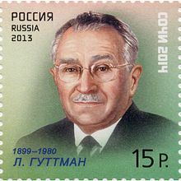
5. Paralympics
5.1. Definition of Paralympic games:
Is a major international multi-sport event involving athletes with disabilities. There are winter and summer games. Since the 1988 Summer Games in Seoul, Paralimpics are held almost immediately following the respective Olympic Games. All Paralympic Games are governed by International Paralympic Committee(IPC)
3
Parasport
Notes:
Firstly, let us look at one of my favorite topics

Slide 14
5. Paralympics
5.2. The story of paralympic games
1948 Sir Ludwig Guttmann:-He was the father of Parasport
(he was neurologist- neurosurgeon in England,he was born in
Germany, as a Jew, during the WW 2. he and his family escaped
to England)
He established the National Spinal Injuries Center in Buckinghamshire, called Stoke Mandeville Hospital:
(he organized a sport competitions for British war veterans with spinal cord injuries
this was the first time, when sport was applied in rehabilitation -Stoke Mandeville Games- International Wheelchair Games-
His motto was: to use sport for locomotor system rehabilitation of disabled people
3
Parasport
Notes:
Now what is the story behind paralympic games

Slide 15
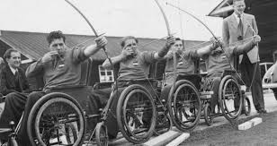
5. Paralympics
5.2. The story of paralimpics:
Stokes Mandeville Games: were held annually
(Parlaplegic Games = ParalympicGames)
3
Parasport
Notes:
This was the forerunner of Paralimpic Games

Slide 16
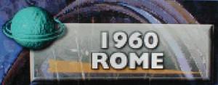
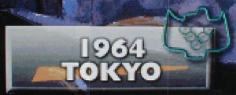

5. Paralypics
1960 Rome I. Paralympic Games:
• The Stokes Mendeville games were held in Rome . This was the first Paralimpic Games, it was called: Olympic Games of disabled people
• aim: social integration, rehabilitation, high quality of competition
• 400 wheelchair athletes from 23 countries
1964 Tokyo
• the Olympic village was built, with own flag, and own anthem
• the international society of disabled people was established here: Sir Ludwig Guttmann(president)
1984 New York, Stoke Mandeville
Ronald Reagan opened..
Seoul:
the Paralympic Summer Games were held directly after the Olympic Summer Games, in the same host city, and using the same facilities
3
Parasport
Notes:
Some interesting facts about the M games: in 1960 the Paralympic Games were not held in B. S. but in Rome instead. Attended, Symbolic significance : the olympic torch was used to light to paralympic torch

Slide 17
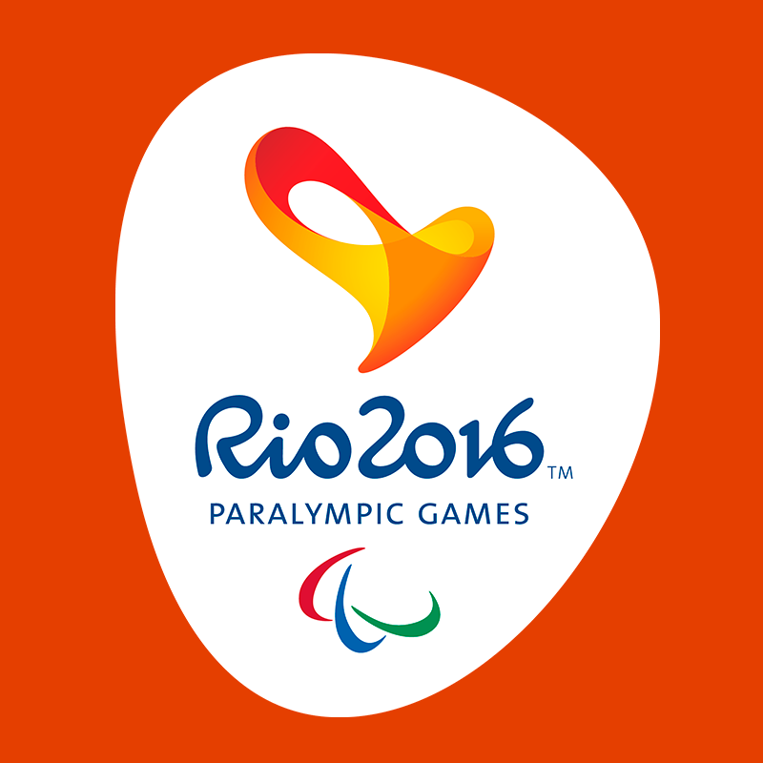
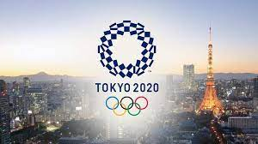
5. Paralympics
2016 Rio de Janeiro
• 162 countries took part
• Hungarian Paralympic teams won 18 medals
• it was first reported by Hungarian media
2020(2021) Tokio
This was the most successful for the Hungarian Paralympic Team
(16 medals - 7 gold, 5 silver amd 4 bronse)
3
Parasport
Notes:
By 2016 .. Countries took part,this had the highest number of participating countries,

Slide 18
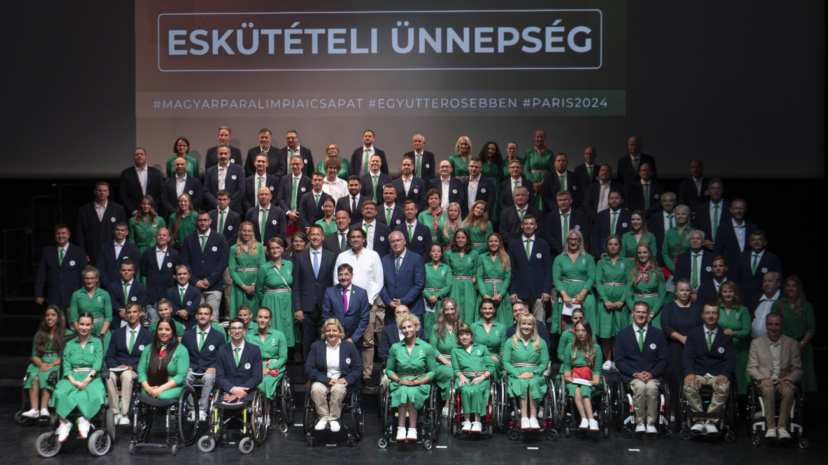
4. Paralimpia
Paris 2024
XVII. Paralympic games
The hungarian team include 39 paraathlets
Nation | 169
Paraathlets | 4463
Type of parasport | 22 sportág, 549 sportevents
3
Parasport
Notes:
Paralimpia video

Slide 19
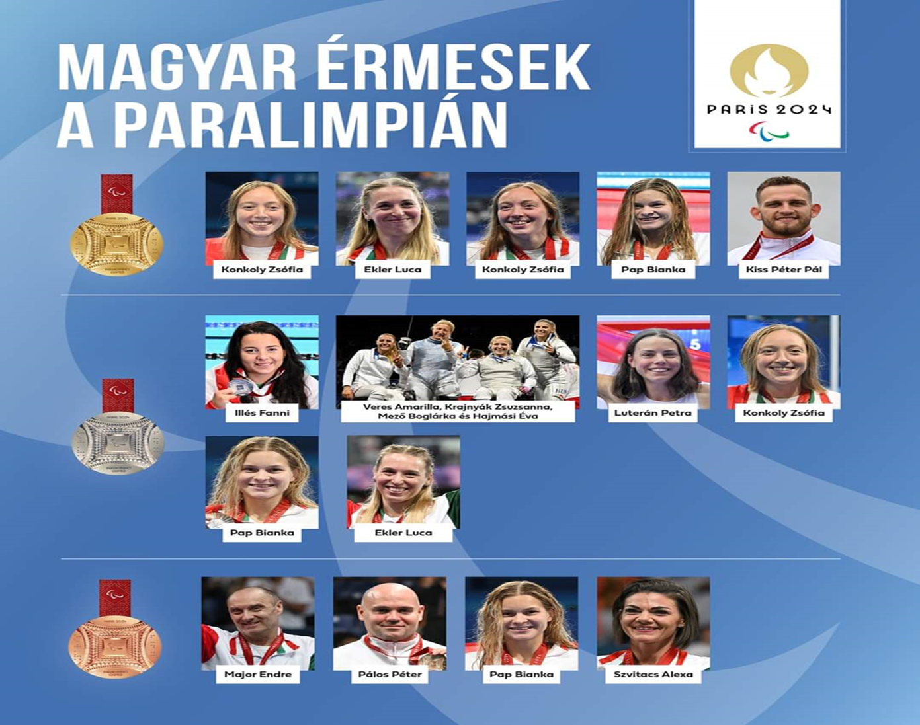
4. Paralimpia
Párizs 2024 XVII. Paralypic games
13 sport events 15 medals (5 gold-, 6 silver- és 4 bronzmedals)
Konkoly Zsófia (2 arany) úszás
Ekler Luca (arany) atlétika, távolugrás
Pap Bianka (arany) úszás
Kiss Péter Pál (arany) kajak
Illés Fanni (ezüst) úszás
Hajmási Éva, Krajnyák Zsuzsanna, Mező Boglárka, Veres Amarilla (ezüst) női csapat párbajtőr
Luterán Petra (ezüst) atlétika
Konkoly Zsófia (ezüst) úszás
Pap Bianka (ezüst) úszás
Ekler Luca (ezüst) atlétika
Major Endre (bronz) asztalitenisz
Pálos Péter (bronz) asztalitenisz
Pap Bianka (bronz) úszás
Szvitacs Alexa (bronz) asztalitenisz
3
Parasport

Slide 20
5. Paralympics
5.3. The story of Hungarian Parasport:
1903 in the national home for disabled children in Budapest teachers and doctors started to use sports for their rehabilitation
In 1927 the first sport club was developed for disabled athletes.
1927-1970 no development happened
1970 Halassy Olivér Sport Club was developed
(the first Hungarian amputee water polo player and freestyle swimmer who competed in the 1928, 1932 and 1936 Summer Olympics)
1972-2016 the Hungarian paraathletes won 144 medals, 31 gold, 49 silver, 64 bronze.
3
Parasport
Notes:
Then a breakthrough happened, between

Slide 21
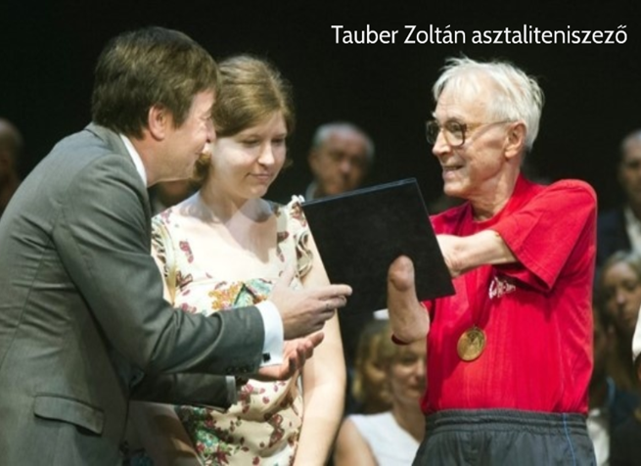
4. Paralympics
5.3. The story of Hungarian Parasport:
Remarkable (politics-parasport):
•1976 Toronto this was the first time that the Hungarian team took part in the V. Paralympic Games.
• 12 hungarian paraathletes had to leave the Paralympic Games on the third day –
•(Tauber Zoltán table tennis player had to give back his gold medal back, Oláh József-another athlete had to his bronse medal back)
3
Parasport
Notes:
In 2016 Tauber Laszló got his medal back in Rio, he died in 2018. This is a noteworthy example of how politics and parasport intertwine,…because according to hungarian socialist government, blacks and whites shouldn’t compete together in the same games ,in T.Z: in 2016 Tokio actually received his medal,

Slide 22
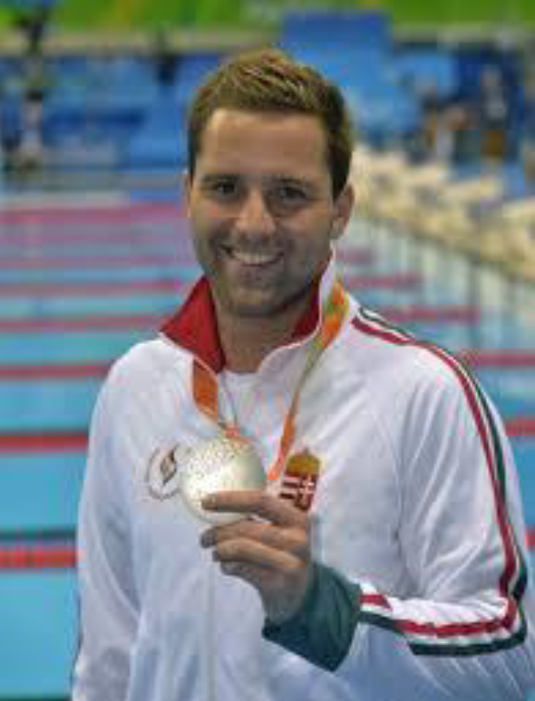
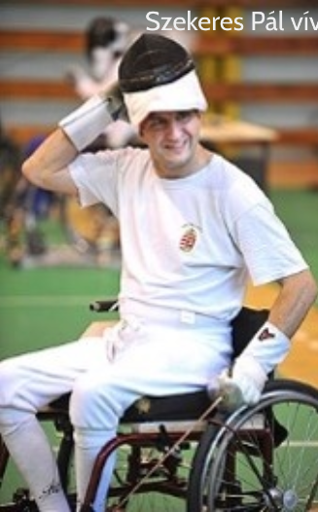
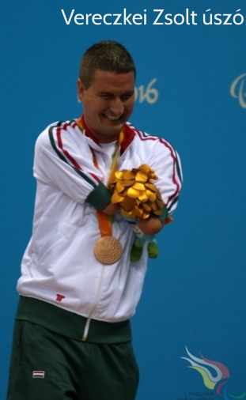
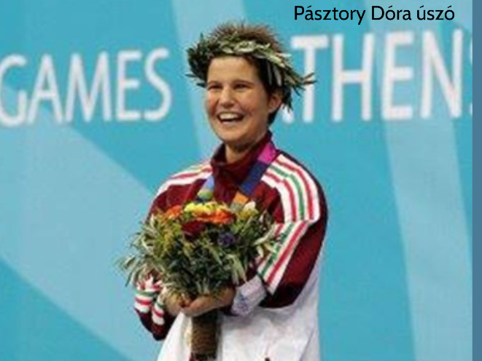
The famous Hungarian Paralimpic Athletes
Notes:
Paralimpic winner in swimming,

Slide 23
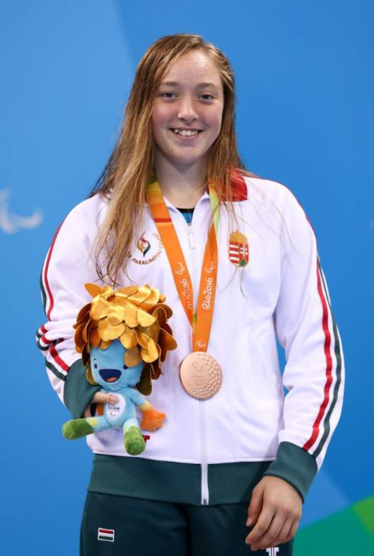

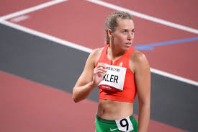
6. A parasport helyzete régiónkban (egyetemünkön)
2020 TOKYO gold medal winners:
Notes:
She studies at our university,

Slide 24
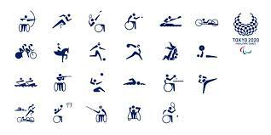
6. A parasport helyzete régiónkban (egyetemünkön)
2020 TOKYO:
Notes:
Paralympic sports

Slide 25
Hungarian Paralympic Committee 1997
3
Notes:
President, since

Slide 26
6. The classification of Paralympic Athletes
Notes:
Let’s look into the classification pr. Ath. It’s very difficult to classify the par. Ath. due to the fact that they have a big varity of disabilities and it’s hard to equalize the different disabilities

Slide 27
6.The classification of paralímpic athletes
Through the classification we can measure their perfomance ,and ensure equal oppurtunities for every athlete depending on their abilities
The purpose of Classification is to define who is eligible to compete in a Para sport and groups athletes with an eligible impairment into sports classes, according to how much their impairment affects their ability to carry out the fundamental activities in a specific sport.
It is very complicates each class google
To become qualified to classify as a doctor it is very complicated process
3
Parasport
Notes:
Passing the exam is not enough, IPC has to assign the doctor making the classifications

Slide 28
7. Parasport in our region, and University
Notes:
Let’s see what parasport is like in our region and in our uni

Slide 29
7. Parasport in our region and our Univesity
Parasport’s possibilities in PTE:
4.1. The Athletic Club of University of Pécs (PEAC) , Parasport Section
4.2. PTE Sports and Physical education center,
4.3. Sport Club of Pécs(PSN Zrt.)
Sporthealth and Sportscientific background:
4.4. PTE Sport Medicine Center
4.5 PTE Immunology and Reumatology Department
Other orginsations in Pécs which support parasport :
4.4. PTE supporting service(to ensure the social bacground)
3
Parasport
Notes:
Secondly let’s look at the various parasport organisations in our region, later i will highlight these in more detail.

Slide 30
PTE Sportmedicine Center:
Head of our department: Mintál Tibor
it is founded in 2016 autumn
our mission: to apply the results of our research, and the up-to-date knowledge of the sport science for developing the human physical capacity
our team includes: orthopedic-traumatology doctors, sport doctor, physio,-manual therapist, psychologist
They cooperate closely with the PEAC parasport section, by giving them a proper sportscientific, and sporthealth background.
•
Parasport
Notes:
Let1s take a look, allow me

Slide 31
6. A parasport helyzete régiónkban (egyetemünkön)
https://www.youtube.com/watch?v=Xj7cn9l6zYA
Parasport

Slide 32
PTE Support Service
since 1999 the University of Pécs has been paying attention to disabled students, staff with a special needs
head of this service: Magdali Csaba
Parasport

Slide 33
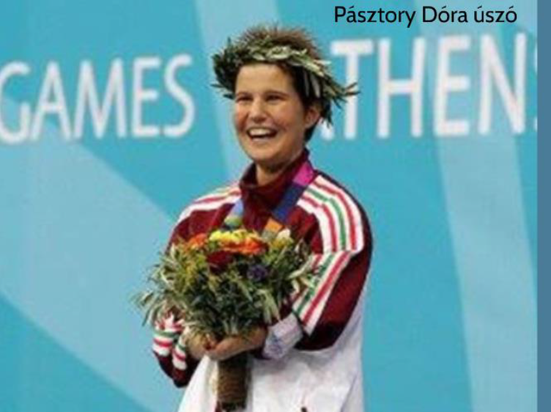
4.3. Sport Club of Pécs(PSN Zrt.) Paraswimmer- Olympic champions
Parasport

Slide 34

7. Parasport in our region and our University
4.1. PEAC, Parasport section :
it was founded in 2015
the first section was goal ball
(this team wan the national championship in 2016)
now the parasport section includes near 100 persons
the following sports are involved in this section:
table- tennis
goalball
boccia
wheelchair basketball
bowling
3
Parasport
Notes:
Let’s look in to these organizations in more detail. This section has been improving over the years and this improvement shows in their performance results

Slide 35
Notes:
This was the first to be founded, and in this sport the players are usually blind or some of them have a visual impairments, so their eyes are covered in order to equalize the differences to ensure equal opportunities

Slide 36
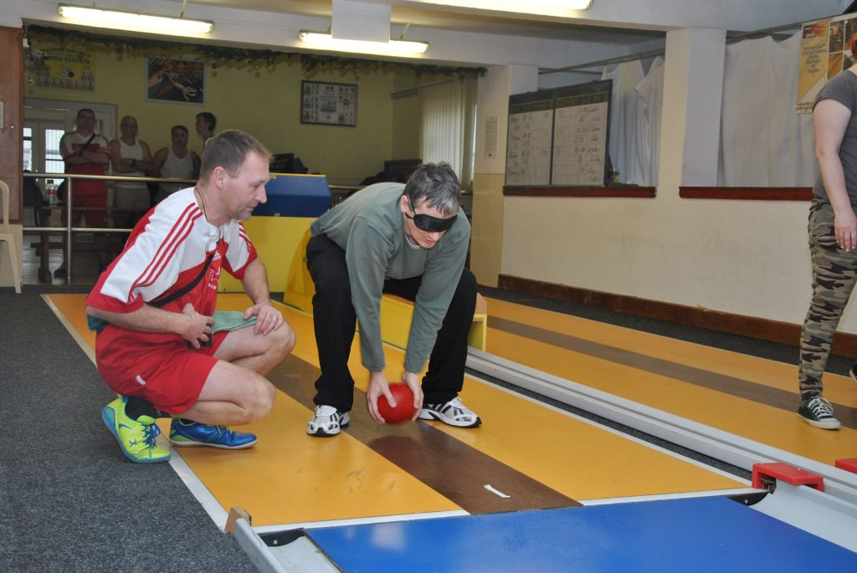
Notes:
Blind bowling is a perfect example that even older and physically weaker people have the opportunity to play para-sport

Slide 37
PARA BOCCIA
The Athletic Club of University of Pécs
The head of the Parasport Section:
HÁRI JÓZSEF
Parasport
Notes:
The boccia game is similar to petang, later on during this course the boccia team visit to introduce themselves

Slide 38
Wheelchair Basketball
rollingbasket.hu
Parasport
Notes:
The basketball association for Baranya region support them professonailly and financially, this team will introduce themselves later as well

Slide 39
Parasport

Slide 40
Parasport

Slide 41
8. Main problem with parasport in our region
Notes:
Now what could be the main problem with parasport in our region?

Slide 42
No athletes!!!
Notes:
With new athletes even the smallest injuries could significantly decrease their quality of lives

Slide 43
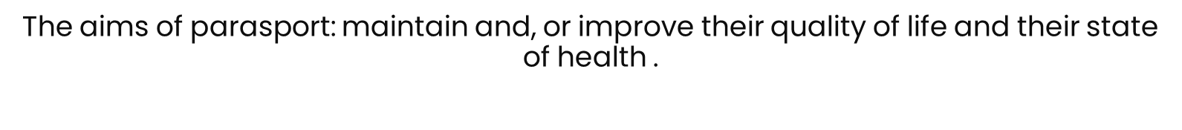
8.The future
The perfect, ideal society: where the disabled people as equal as the abled people on all fields of the society
Future: changing paradigm=paraathletes supply
32
Parasport
Notes:
Now let’s look at what these organisations can do, so the biggest help would be a change of paradigm in terms of parasport for the future

Slide 44
5. Future
Sport possibility (sport clubs):
Sportscience and sporthealth beckground support:
PTE Sportmedicine Center ( appropiate sporthealth care)
PTE KK Early Locomotor rehabilitation Department
( The locomotorrehabilitation of disabled people includes parasport)
PARASPORT=THERAPY
Solve the problem:
PARASPORT= mantaining haelth quality , bettering quality of lifestyle
INJURY = decrease of quality of lifestyle
Social background supportion
PTE Supporting Service
Future: changing paradigm=recruiting and training the new generation
Parasport
Notes:
The goal for the sport organizations the health organization and social-support system is to all work together
To tell the truth,……… honestly
Őszintén szólva tuljadonképpen=well as a summary, we can conclude that,

Slide 45
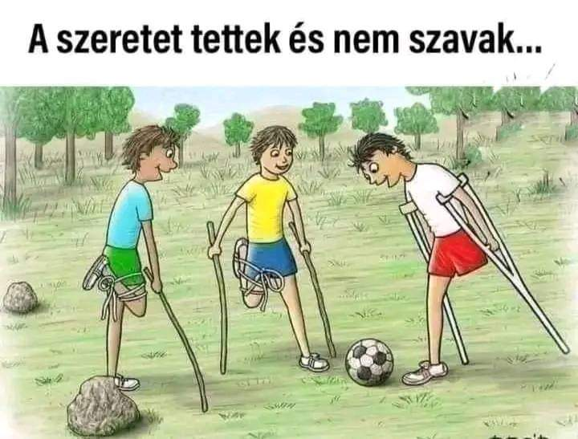
Thank you for your attention!
Pécs, 2021. szept.20.

