Slide 1
Gondolatok a gyógyszeres kezelésről
Biztonságosság
Hibák
Különbségek
Evidenciák
Dr. Habon Tamás
Pécsi Tudományegyetem KK
I. sz. Belgyógyászati Klinika

Slide 2
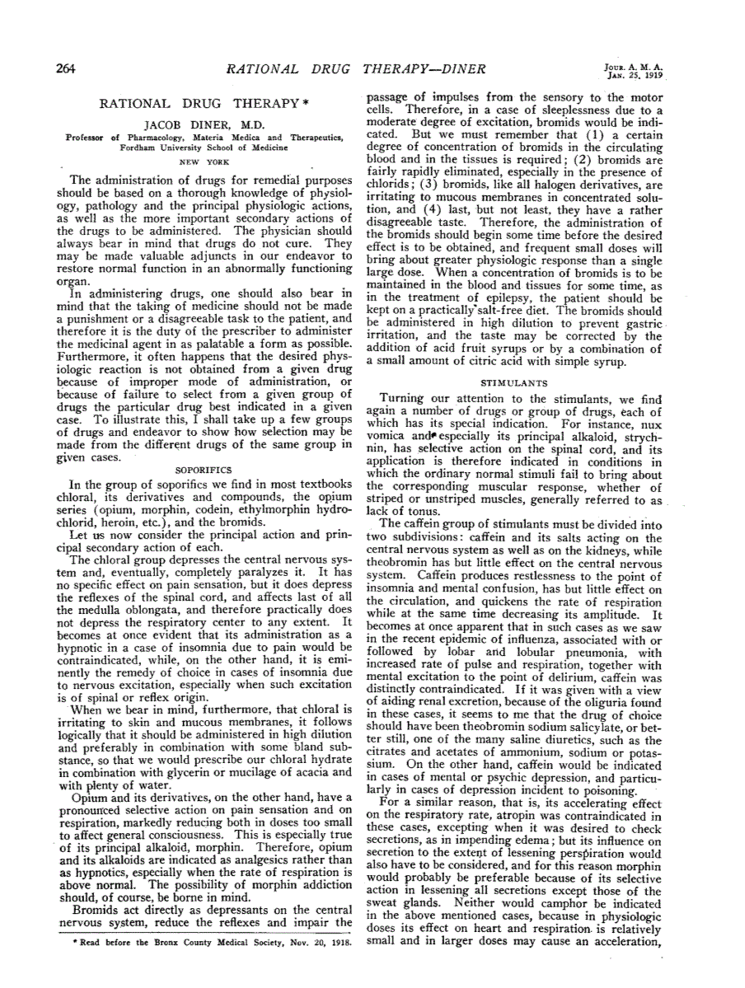

Slide 3
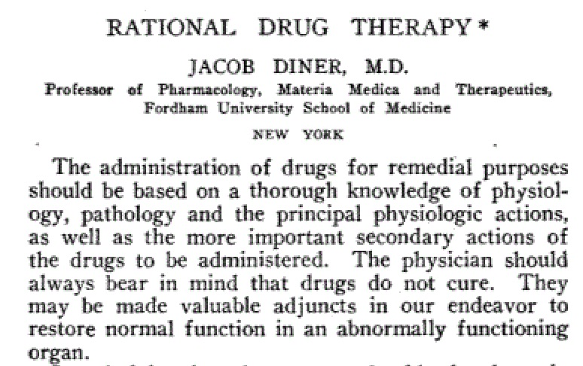
JAMA 1919

Slide 4
RATIONAL DRUG THERAPY
Drug selection while treatment must be based on the following.
1. Relevance to disease - Indicated in the treatment of prevalent diseases.
2. Efficacy and safety - Based on the objective results from adequate pharmacological studies including at least expanded phase (II). clinical trials and / or additional phase (III). studies.
3. Quality.
4. Cost-of treatment regime (not just the unit cost).
5. Appropriateness to the capability of medical personnel at different levels of health care. The level of expertise required to prescribe, administer and monitor safety and adverse effects of single drug or group of drugs in the therapeutic category must be considered. Consideration should be given to the to the competence of local personnel in making the correct diagnosis.

Slide 5
6. Local health problems. The influence of concomitant, locally prevalent diseases or conditions on pharmacokinetic and pharmacodynamic parameters modifying therapeutic response have to be considered in making the selection eg. malnutrition, liver disease.
7. Benefits / Risk ratio - when several comparable drugs are available for the same therapeutic indication it is necessary to select the one which provides the most favorable benefit/risk ratio.
8. Preferential factors for evaluating therapeutically equivalent drugs - when two or more drugs are therapeutically equivalent preference should be given to :-
(A) The drug most thoroughly investigated and therefore the best understood with respect to its beneficial properties and limitations.
(B) The drug which is clinically appropriate for more than one disease.
(C) The drug with the most favorable pharmacokinetic properties eg., to improve the compliance to minimize risk.
(D) The drug that are in a dosage form that is easy for the health staff to dispense easily and safely administer to the patient.
(E) The drugs that are easy for the patient to take or with the broadest acceptability.
(F) The drugs, pharmaceutical products and dosage forms with favorable stability under anticipated local conditions for which storage facilities exist.
(G) The drugs for which reliable local manufacturing facilities exist.

Slide 6
9. In the majority of cases the drugs should be formulated as single compounds. Fixed-ratio combination are only acceptable when-
(A) The clinical value of simultaneous use of more than one dose is documented.
(B) The therapeutic benefit of the combination is greater than the sum of each of the individual components.
(C) The combination is safer than the use of an individual drug.
(D) The cost of the combination product is less than or equal to the total cost of the individual products.
(E) The compliance is improved.
(F) The combination must be such that sufficient quantities to meet the needs of the majority of the population can be maintained.
10. Periodic review of druglist - Yearly or whenever necessary to incorporate significant new therapeutic advances and selected drugs.
(A) Generally new drugs should be introduced only if they offer distinct advantages over previously selected drugs.
(B) If on the basis of new information, drug already on the list are found to no longer posses a favorable benefit / risk ratio, they should be replaced by drugs with the higher benefit/risk ratio.
11. International Non-proprietary names (INN ; generic names) should be used for drugs.

Slide 7
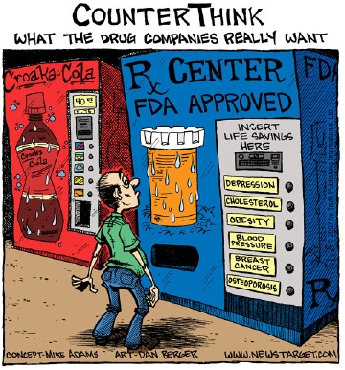

Slide 8
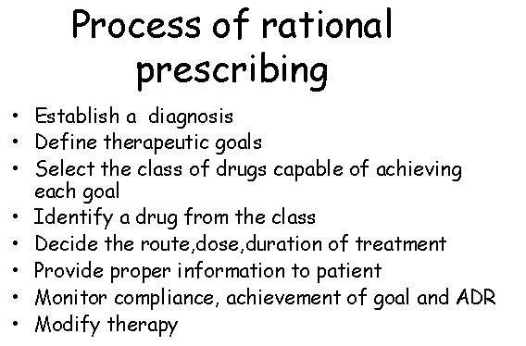

Slide 9
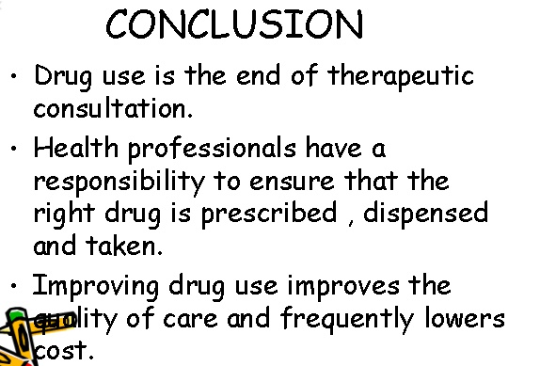

Slide 10
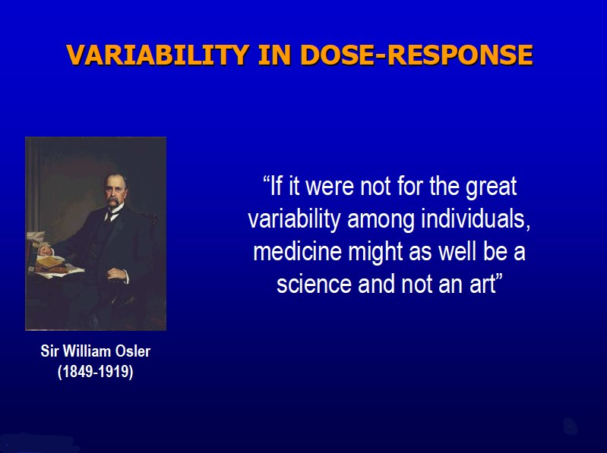

Slide 11
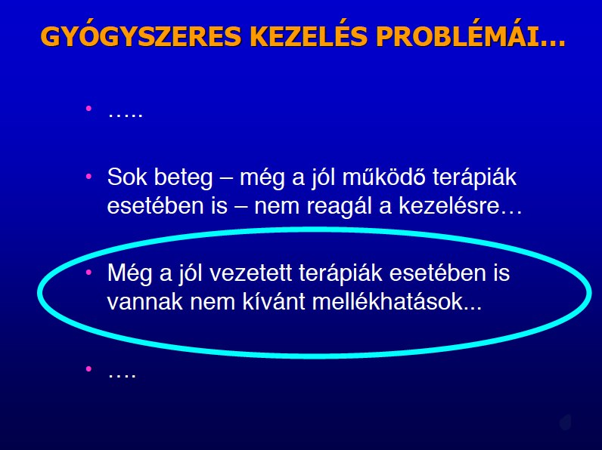

Slide 12
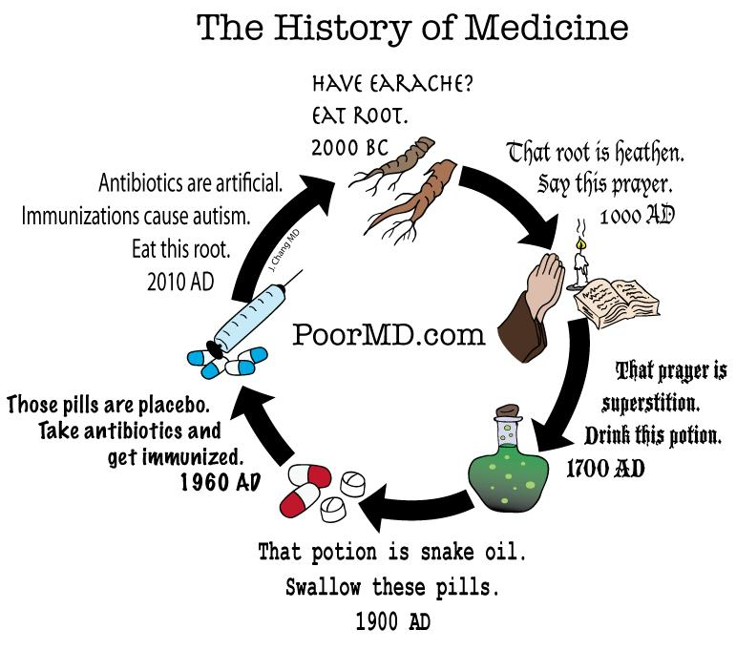

Slide 13
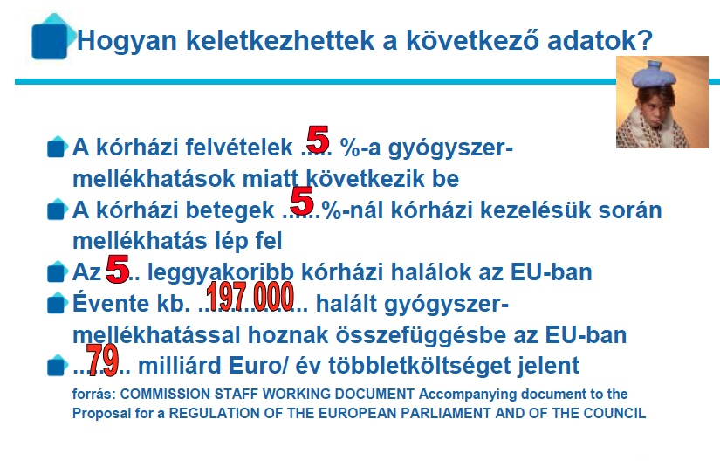

Slide 14
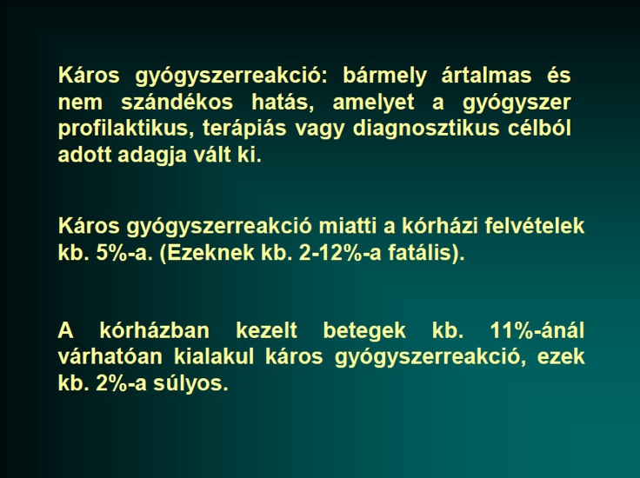

Slide 15
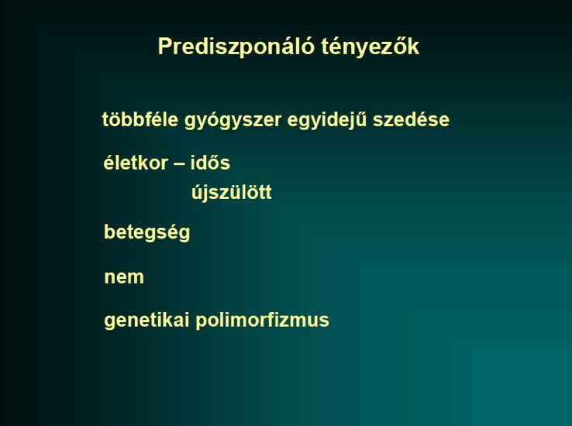

Slide 16
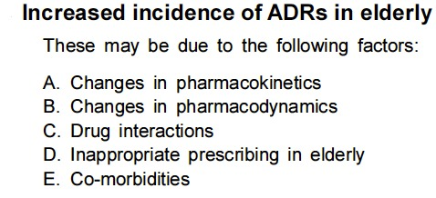

Slide 17
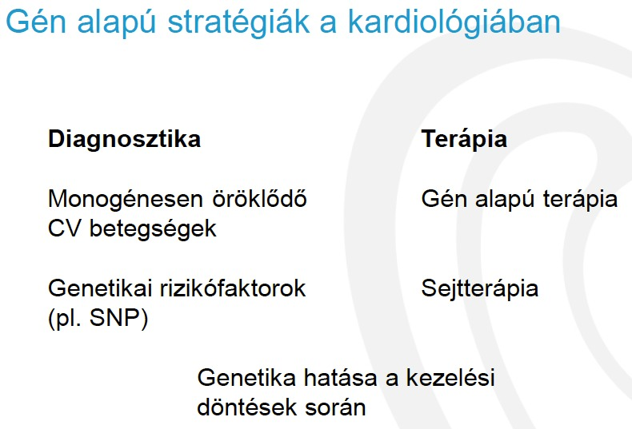

Slide 18
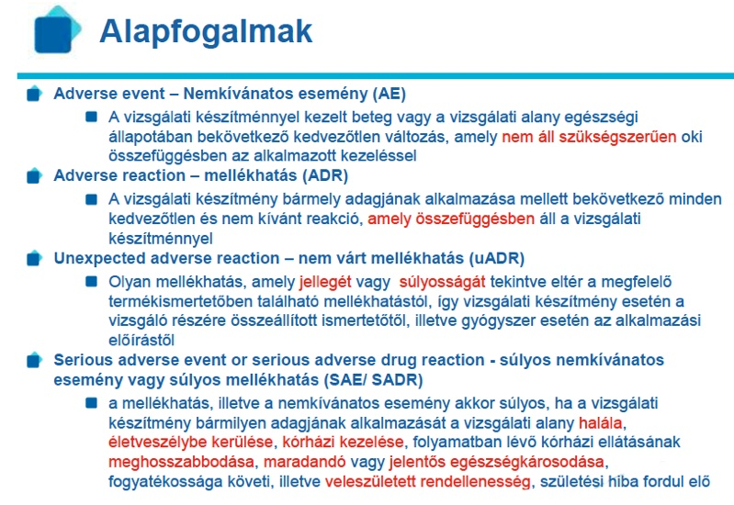

Slide 19


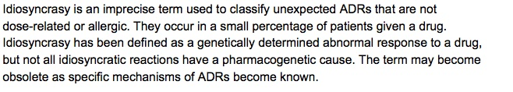
ADR - etiology

Slide 20
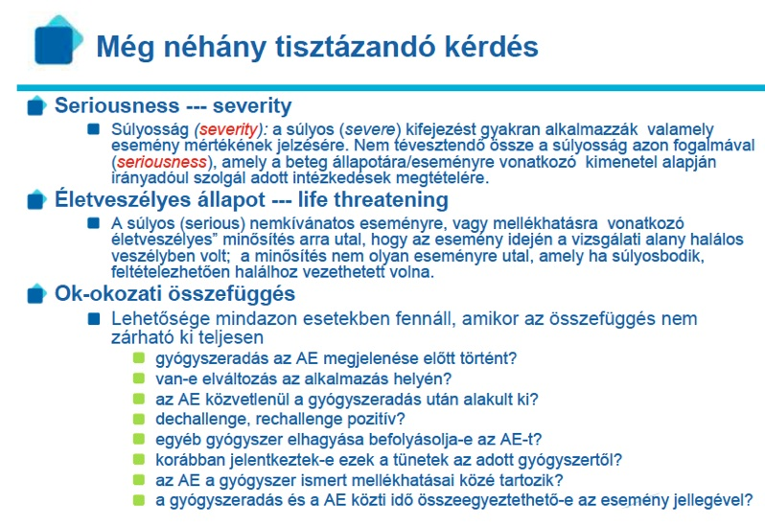

Slide 21
ADR - etiológia

Slide 22
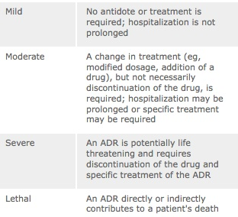
ADR – osztályozás - súlyosság

Slide 23
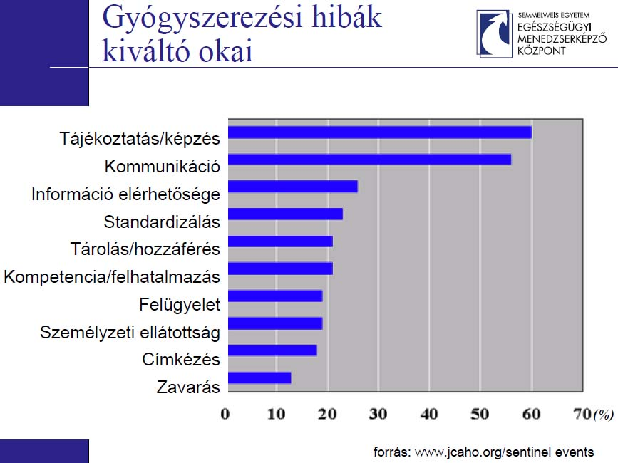
Dr Habon Tamás PhD.
A Helyes Klinikai Gyakorlat irányelvei-GCP

Slide 24
Where Do Errors Occur?
Prescribing 39%
Transcribing 11%
Dispensing 12%
Administering 38%
Notes:
Where do errors occur?
Leape and colleagues³ reported in 1995 that medication errors occur at different concentrations depending on the stage of the medication or prescribing process. Most medication errors occur during physician ordering (39%) and medication administration (38%).
Prescribing
Transcribing
Dispensing
Administering
39%
11%
12%
38%

Slide 25
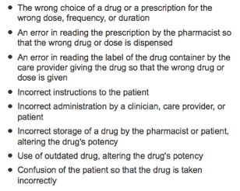
Drug error

Slide 26
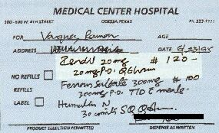
Notes:
Jurors blamed this illegible prescription for the death of a Texas man. Although it allegedly calls for Isordil, the pharmacist misread it and filled it as Plendil. The jury’s $450,000 judgement, finding both the cardiologist and pharmacist negligent, is believed to be the first of its kind nationwide to focus solely on bad handwriting.

Slide 27
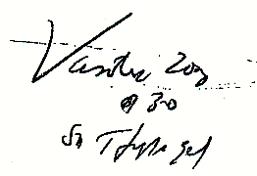
Notes:
A hypertensive patient accidentally received Vasotec 20 mg instead of Vantin 200 mg when a pharmacist misread this prescription.

Slide 28
Look-alike And Sound-alike Drug Names
Accupril®
Accutane®
Alprazolam
Lorazepam
Cardene®
Cardura®
Flomax®
Fosamax®
Lamisil®
Lomotil®
Nizoral®
Neoral®
Plendil®
Prilosec®
Zantac®
Zyrtec®
USP Quality Review. www.usp.org/reporting/review/qr66.pdf accessed on February 6, 2001.
Notes:
This is a list of some look-alike and/or sound-alike drug name pairs that have been reported to the United States Pharmacopeia Medication Error Reporting Program. These names may not sound alike when they are read or look alike in print; however, when handwritten or communicated verbally they can be confused.
A more complete list of these drug name pairs can be obtained at www.usp.org/reporting/review/qr66.pdf.¹¹

Slide 29
Notes:
Here are two examples of look-alike drug names which, when combined with unclear handwriting, can lead to serious medication errors.
In the first case, is this an order for the flouroquinolone antibiotic Tequin (gatefloxacin) or Tegretol (carbamazepine), a drug used in epilepsy? In the other prescription order, is it the anticoagulant Coumadin (warfarin) or Avandia (rosiglitazone), used in the treatment of diabetes? Imagine the harm to a patient who received the wrong medication in either of these cases.

Slide 30
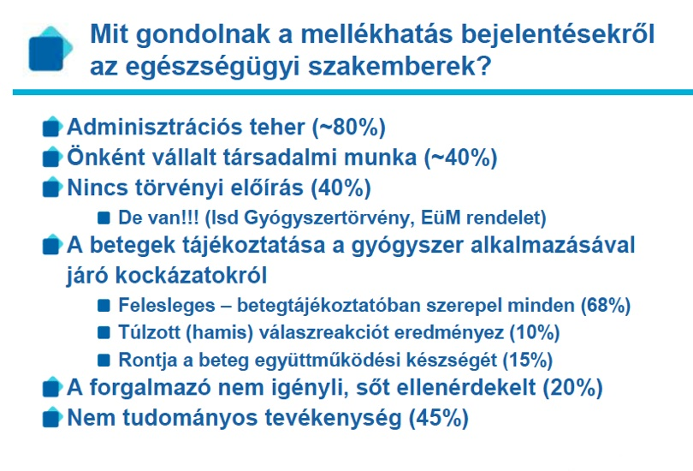

Slide 31
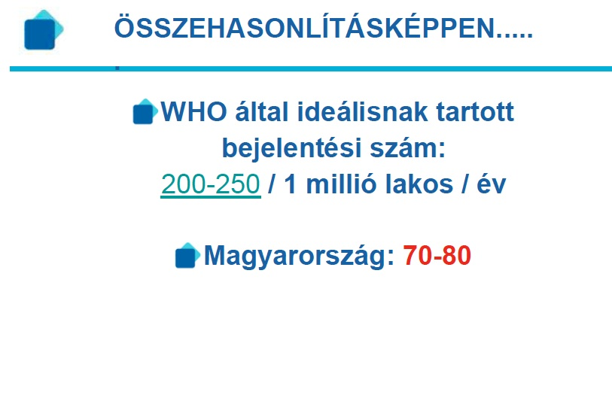

Slide 32
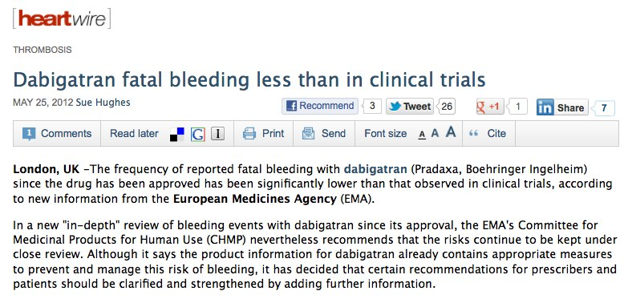

Tények és tévhitek

Slide 33
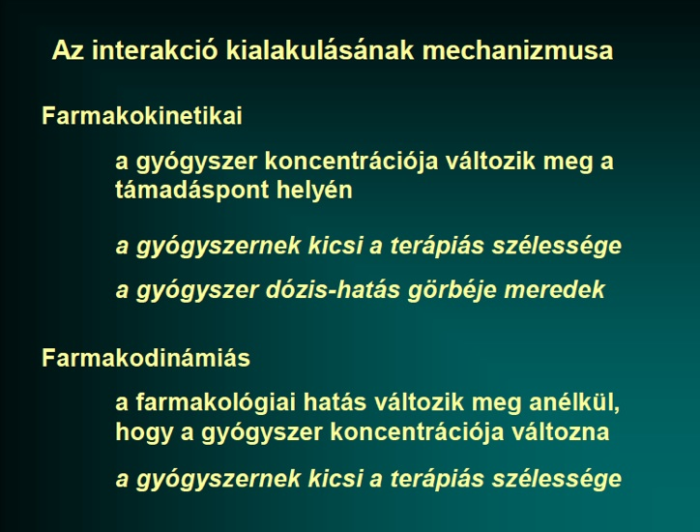

Slide 34
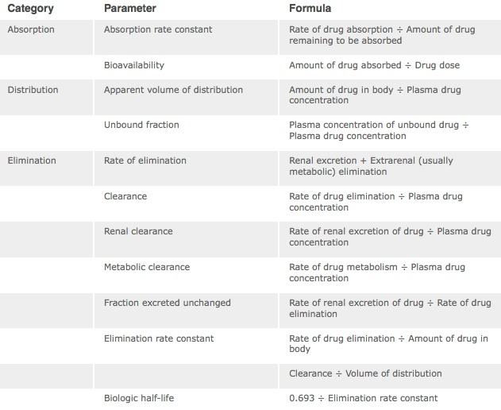
Farmakokinetika

Slide 35
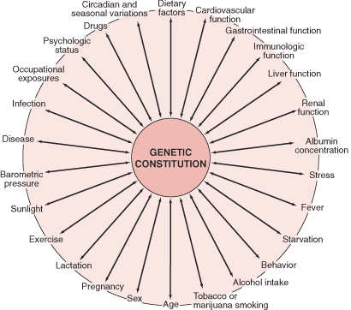
Farmakogenetika

Slide 36
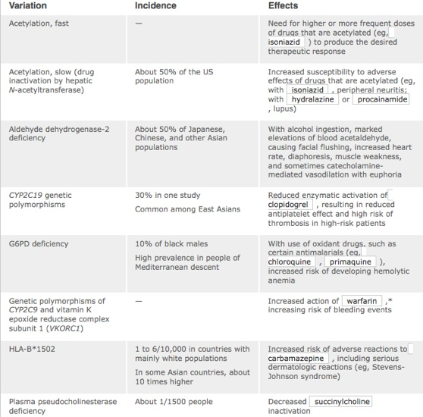

Slide 37
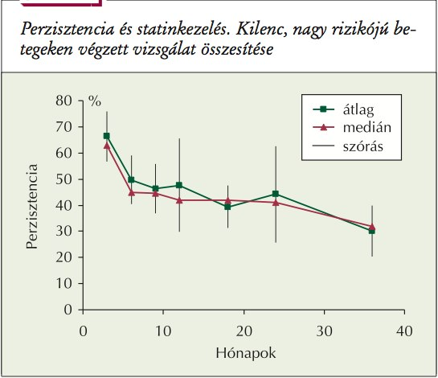
LAM 2007;17(6–7):403–410.Nagy: A gyógyszerszedési attitûd jelentôsége a lipidszintcsökkentô kezelésben

Slide 38
A vérnyomáscsökkentők dózis-hatás és dózis-mellékhatás görbéje
vérnyomáscsökkenés
Hatás
mellékhatások
Dózis
Mancia G. et Grassi G. Cardiovasc Drug Therapy, 1997.

Slide 39
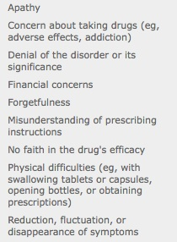
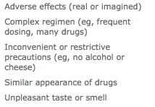
Non-adherencia okai

Slide 40
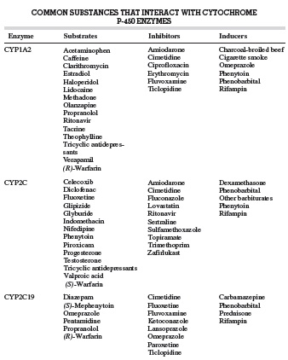
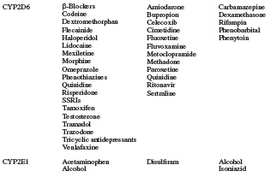
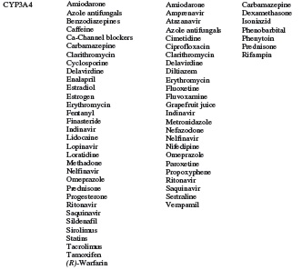

Slide 41
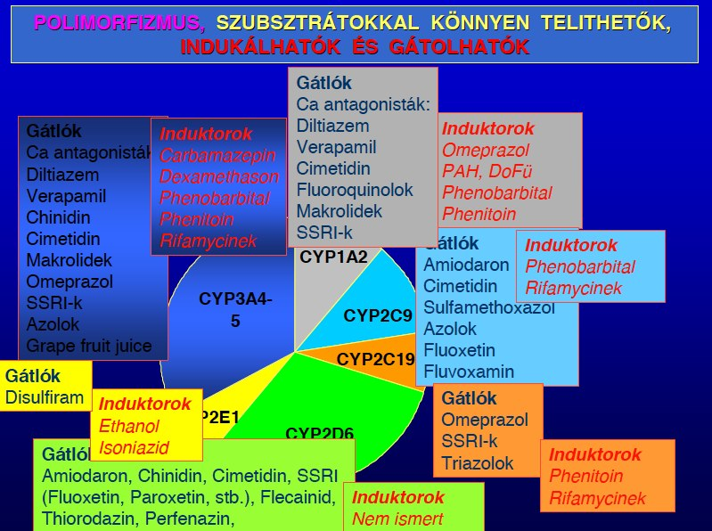

Slide 42
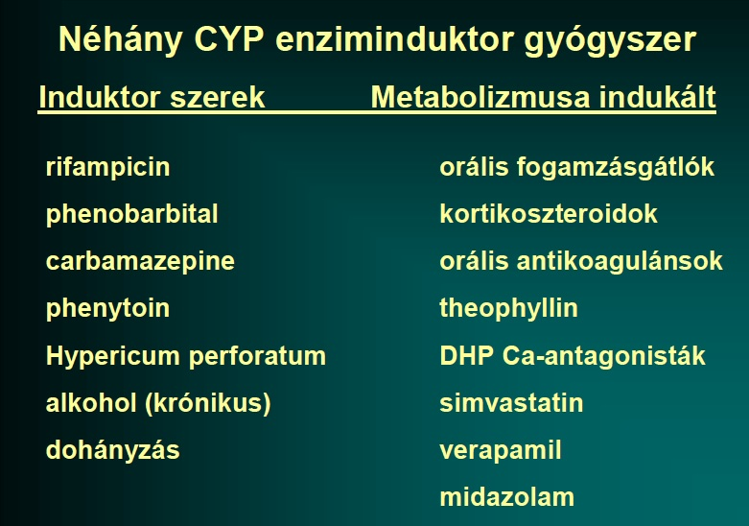

Slide 43
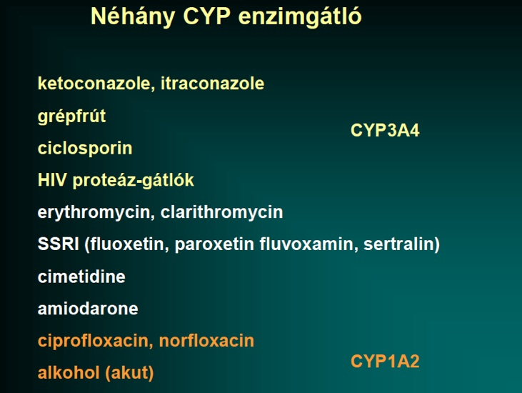

Slide 44
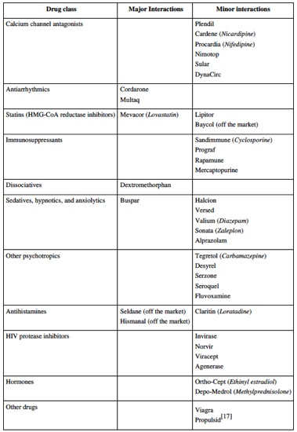
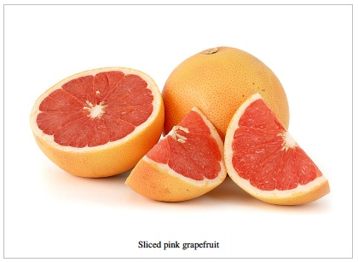
Grapefriut
interakciók

Slide 45
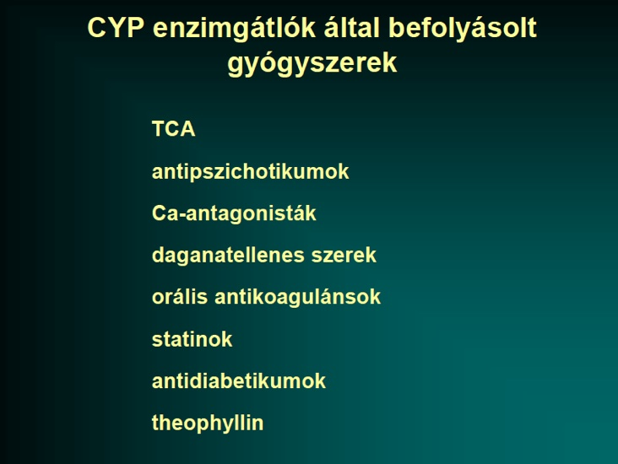

Slide 46
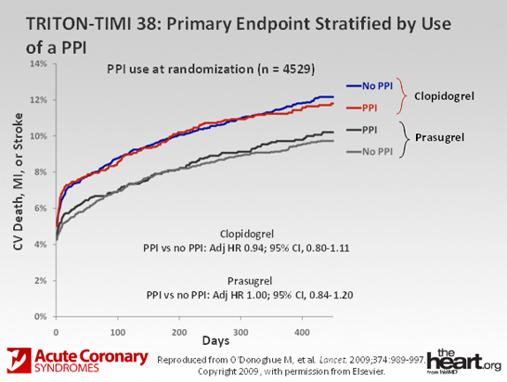
PPI és thienopyridinek
TRITON – TIMI38 -PPI

Slide 47
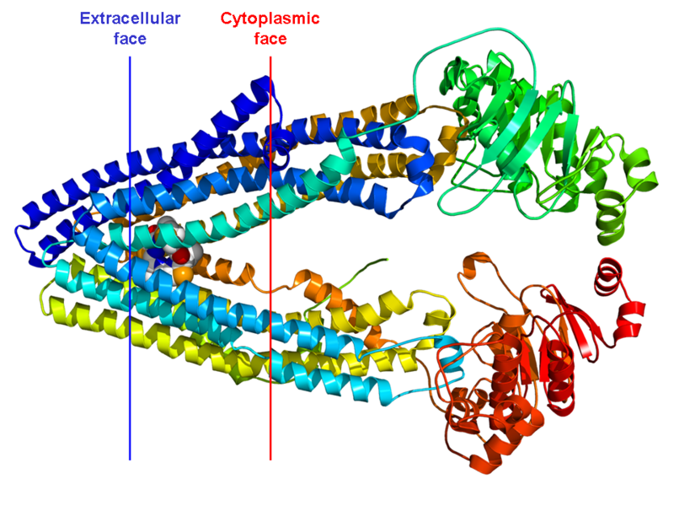
Gyógyszerkölcsönhatások és kontraindikációk
P-glikoprotein 1
(permeabilitási glikoprotein, rövidítve P-gp vagy Pgp)

Slide 48
Gyógyszerkölcsönhatások és kontraindikációk
Gyógyszer | Hatás | Javallat
Verapamil | ↑ 20–150% | Használjon alacsonyabb dózist (110 mg BID)
Kinidin | ↑ 50% | Alkalmazza körültekintően és értékelje a vérzéses kockázatot
Amiodaron | ↑ 60% | Alkalmazza körültekintően és értékelje a vérzéses kockázatot
Clarithromycin | ↑ 19% | Alkalmazza körültekintően és értékelje a vérzéses kockázatot
Dronederon | ↑ 100% | Nem javasolt
Rifampicin | ↓ 67% | Nem javasolt
Carbamazepin | ↓ %-t nem jelentettek | Nem javasolt
Proteáz inhibitorok | Expozíciót nem jelentettek | Nem javasolt
A dabigatran alkalmazása kontraindikált szisztémás ketoconazolt, itraconazolt, tacrolimust és cyclosporint szedő betegeknél
BID = naponta kétszer
Huisman M et al. Thromb Haemost doi:10.1160/TH11-10-0718

Slide 49
A kumarin kezelés korlátai
Kiszámíthatatlan válasz
Gyakori dózis módosítás
A kumarin kezelés nehézségei a klinikai rutin során
Szűk terápiás ablak (INR range 2-3)
Számos gyógyszer-táplálék interakció
Rendszeres labor ellenőrzés
Számos gyógyszer-gyógyszer interakció
Lassú hatás/hatás vesztés
Warfarin rezisztencia
Vonakodás a VKA felírástól
Főként idős betegek esetén, mert a vérzéses szövődmények rizikóját magasnak tartják a lehetséges haszonhoz képest
1. Ansell J, et al. Chest 2008;133;160S-198S; 2. Umer Ushman MH, et al. J Interv Card Electrophysiol 2008; 22:129-137;
Nutescu EA, et al. Cardiol Clin 2008; 26:169-187.
Notes:
Due to the limitations of VKAs, it has been estimated that up to 50% of patients eligible for treatment receive no anticoagulant treatment (Rowan et al. JACC. 2007)

Slide 50
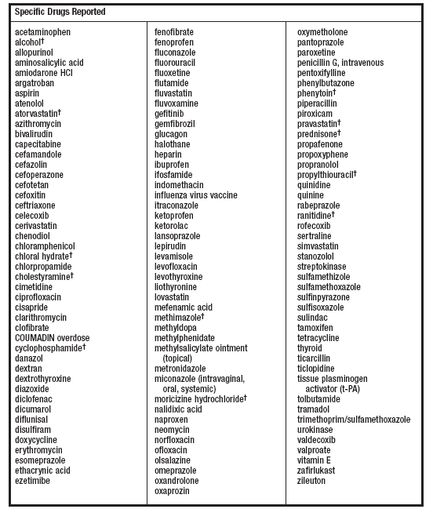
K-vitamin antagonisták: gyógyszer interakciók
Fokozott INR válasz
Csökkent INR válasz
Coumadine Package Insert US revised January 2010
Notes:
The increased INR Response is associated with increased risk of bleeding an the decreased INR response is associated with an increased risk of stroke and other thromboembolic events

Slide 51
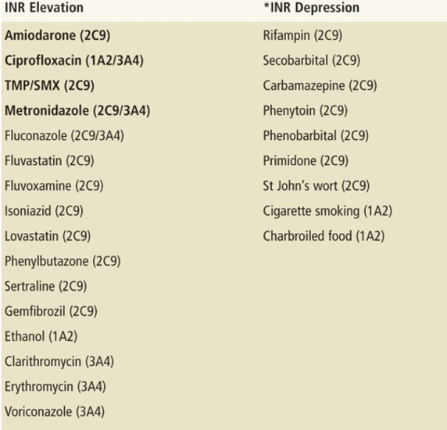
Warfarin interakciók

Slide 52
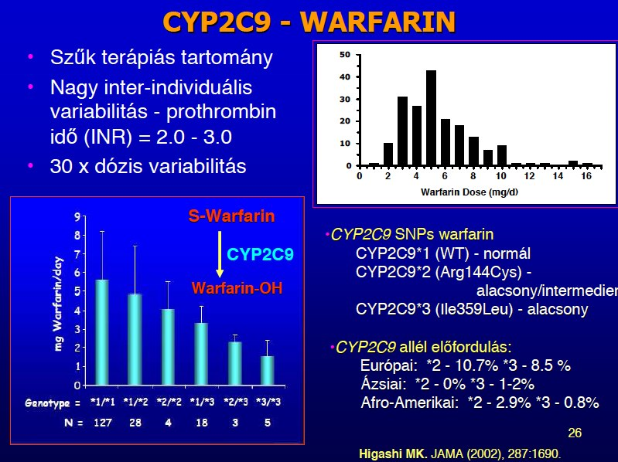

Slide 53
Warfarin genetika
CYP2C9 (warfarin metabolizmust befolyásolja) és VKORC1 (warfarin sensitivitásra van hatással)
Clarification of Optimal Anticoagulation through Genetics (COAG) trial
"Personalized, predictive medicine offers great promise, but we need to carefully examine benefits and understand the cost-effectiveness of such strategies before we spend a lot of money on very expensive tests"
Ann Intern Med. 2009 Jan 20;150(2):73-83.

Slide 55
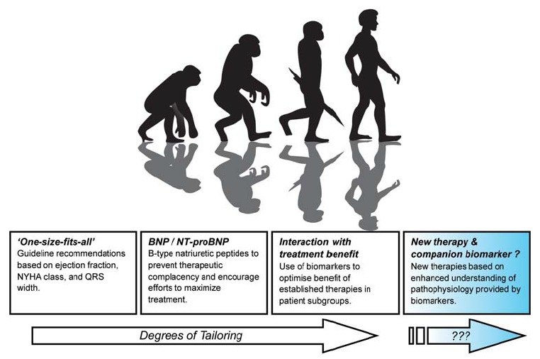
Genetics

Slide 57
Understanding the Need for Evidence in Practice
Systematic Approach to Evaluating New Therapies
Half of what you learn in
your medical apprenticeship
(about therapy) will be correct…
you just don’t know which half.
Joe Greenfield, MD
Former Chair, Medicine
Duke University Medical Center

Slide 59


Slide 62
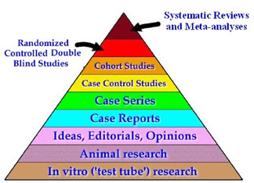

Slide 63
Evidence-based Medicine
Combining quantitative evidence about medical practice with expert judgment in an effort to ensure the provision of medical care with reproducible high quality
Adapted from D Sackett

Slide 64
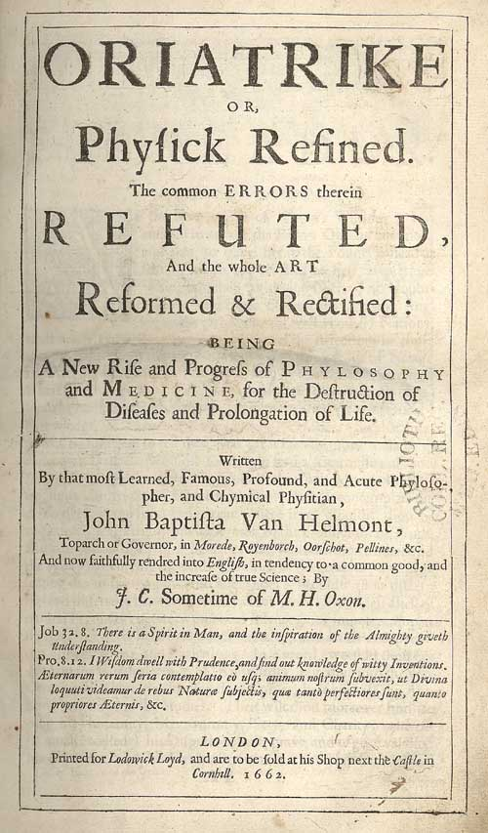
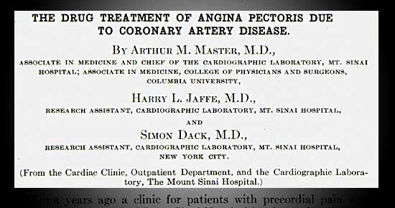
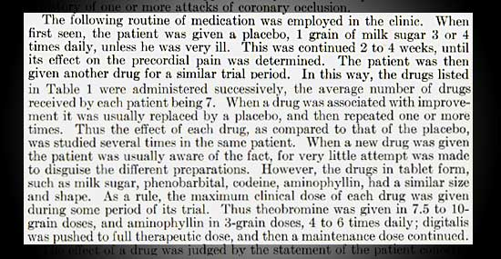

Slide 65


Slide 66
EVIDENCE-BASED MEDICINE (ÉRVEKKEL BIZONYÍTOTT MEDICINA)
Támogató érvek rendszere (ACC/AHA)
"A" szint: Több randomizált, nagy betegszámú klinikai vizsgálat támasztja alá.
"B" szint: Kevés, kisebb betegszámú randomizált tanulmány támasztja alá.
"C" szint: Szakértők konszenzusa, esettanulmányok, klinikai tapasztalatok támogatják.
Indikációk rendszere
I. osztály: Egyértelműen indikált beavatkozás, kezelés.
II. osztály: Nem egységes az álláspont.
a/ inkább javasolt
b/ inkább nem javasolt
III. osztály: Egyértelműen nem indikált.

Slide 67


Slide 68
Using Evidence for Clinical
Decision-making:
Role of the Randomized Clinical Trial
“Statistical methods may be no
substitute for common sense but they are often a powerful aid to it.”
D. D. Reid, commenting on the work of Austin Bradford Hill, father of the randomized clinical trial

Slide 69
Randomization
Eliminates assignment bias
Ensures comparable study groups
Allows for use of valid statistical tests
Requires a predetermined ratio of allocation (usually equal allocation)
Day of week & visit number
(e.g., even gets A and odd gets B)
are NOT random assignments

Slide 70
Simple Randomization
Unequal allocation can occur by chance alone.
  Example of a simple randomization scheme of 18 pts: A A B A B B A B B B B B B B B B A A
  Results in 6 As and 12 Bs
With large numbers of patients, random allocation should yield groups almost equal in size. Problems can arise in studies with small numbers of patients.

Slide 71
Blocked Randomization—Example
Within a block size of 4 patients,
possible blocks would include:
AABB ABBA ABAB BABA BAAB BBAA
The first 12 patients may be:
BABA ABBA BABA
If study was discontinued after 10 patients were enrolled, you would have equal allocation:
B A B A A B B A B A

Slide 72
Factorial Design—Example
ISIS 2 Study
No
Aspirin Aspirin
SK Aspirin No Aspirin
& SK & SK
No SK Aspirin No Aspirin
& No SK & No SK

Slide 73
Crossover Design
A
A
B
B

Slide 74
Blinding
Blinding is the masking of the treatment assignment among particular individuals.
This process helps to control the potential for bias because individuals tend to change their behaviors based on treatment information.

Slide 75
Unblinded
Also known as open-label
May be simpler to execute
Better reflects actual clinical practice
Introduces bias

Slide 76
Single Blind
Patient is blinded to treatment but
investigator is not.
Puts investigators at ease
Easier to administer
May introduce investigator bias

Slide 77
Double Blind
Patient and investigator are blinded
to treatment.
Reduces risk of bias
Requires outside personnel to monitor safety and treatment allocation
May be very difficult to accomplish in studies of some treatments

Slide 78
Triple Blind
Patient, investigator, and monitoring committee
(and/or trial statistician) are blinded to
treatment.
Allows monitoring committee and/or statistician to remain objective
May be difficult to make crucial decisions on trial conduct without information on the treatments
Creates the need for an unblinded statistician for DSMB if the trial statistician is blinded

Slide 79
Phases of a Study
Phase 1: Initial safety study
  Usually performed on a small number of patients to evaluate toxicity and drug pharmacodynamics
Phase 2: Dose finding study
  Smaller study to determine the optimal dose for the efficacy study

Slide 80
Phases of a Study
Phase 3: Efficacy study
  Large(r) study to establish superiority, equivalence, or noninferiority; usually performed for FDA drug indication
Phase 4: Marketing study
  May not include any control arm

Slide 81
Superiority Trials
These trials test for statistically significant and clinically meaningful improvements (or harm!) from the use of the experimental treatment over the results obtained through the use of standard care.

Slide 82
Equivalence
Equivalence studies are designed to evaluate whether the difference in outcomes for the new treatment compared to those obtained with standard care falls within the boundaries of the minimally important difference (MID).
MID is the largest difference one will accept between the outcomes of 2 groups and still consider them clinically similar.

Slide 83
Noninferiority Trials
The results will be evaluated assuming that the experimental treatment will not be worse than the standard of care by a clinically meaningful amount.
Unlike equivalency studies, these studies do not look for small improvements from the experimental drug (one-sided as opposed to two-sided evaluations).

Slide 84
Data Safety Monitoring Boards in RCTs
Purpose
To protect the welfare of patients in clinical trial human experiments, primarily by reviewing accumulating data and overall trial progress

Slide 85
EVIDENCE-BASED MEDICINE (ÉRVEKKEL BIZONYÍTOTT MEDICINA)
Multicentrikus, nemzetközi klinikai tanulmányok
- Randomizáltak
- Kontrolláltak
- Kettős vakok (egyes, hármas, PROBE stb...)
Problémák
- végpontok – kemény, surrogate, kombinált
- placebo – betegszám - megatrial
- study beteg
- statisztika – posthoc analysis, metaanalysis
- comperator – pofozógép
- negatív tanulmányok

Slide 87


Minden nézőpont kérdése ?

Slide 88


Slide 89


Slide 90


Slide 91


Slide 92


Slide 93


Slide 94


Slide 95
TRITON TIMI-38
A Hatékonyság és a Biztonságosság Összevetése
15
Clopidogrel
138
events
CV death / MI / stroke
12.1%
HR 0.81
(0.73 - 0.90)
P = 0.0004
10
9.9%
Prasugrel
NNT = 46
Végpont (%)
5
35
events
TIMI major
Non-CABG bleeds
Prasugrel
2.4%
HR 1.32
(1.03 - 1.68)
P = 0.03
1.8%
Clopidogrel
0
0
30
60
90
180
270
360
450
NNH = 167
Napok
Wiviott SD et al. NEJM 2007; 357: 2001-2015
Notes:
95
Level 1, 2, 3, QC: L Heath, Jan Short, Jan 30
Source: Wiviott SD et al. NEJM 2007; 357: 2001-2015

Slide 96
Stent Trombózis – Bármely típusú stent
(ARC Definitív + valószínű)
3
Any Stent at Index PCI
n=12,844
2.35
Clopidogrel
2
Stent Trombózis (%)
1.13
Prasugrel
1
HR 0.48 RRR:52% (0.36-0.64)
P<0.0001
NNT=77
0
0
30
60
90
180
270
360
450
Napok
ARC=Academic Research Consortium; ARR=Absolute Risk Reduction; HR=Hazard Ratio;
NNT=Number Needed to Treat; PCI=Percutaneous Coronary Intervention;
RRR=Relative Risk Reduction
Wiviott SD et al. Lancet 2008;371:1353-1363
Notes:
THIS SLIDE HAS BEEN THROUGH QUALITY REVIEW
http://dx.doi.org/10.1016/S0140-6736(08)60422-5
Cumulative Kaplan-Meier estimates of the rates of key study end points during the follow-up period.
96
Wiviott SD et al. Lancet 2008;371:1353-1363

Slide 97


Slide 98
Az LDL-koleszterin és az 5 éves major koszorúér események kockázatának kapcsolata
30
4S - Placebo
25
Rx - Statin kezelés
PRA – pravastatin
ATV - atorvastatin
Szekunder prevenció
20
4S - Rx
Eseményráta (%)
LIPID - Placebo
15
CARE - Rx
CARE - Placebo
Proprotein convertase subtilisin/kexin type 9 (PCSK9)
IDEAL – SIM
LIPID - Rx
HPS - Rx
TNT – ATV10
HPS - Placebo
10
IDEAL – ATV
PROVE-IT - PRA
WOSCOPS – Placebo
PROVE-IT – ATV
TNT – ATV80
AFCAPS - Placebo
6
Primer Prevenció
5
AFCAPS - Rx
WOSCOPS - Rx
ASCOT - Placebo
ASCOT - Rx
JUPITER - Placebo
0
JUPITER - Rx
40
(1.0)
60
(1.6)
80
(2.1)
100
(2.6)
120
(3.1)
140
(3.6)
160
(4.1)
180
(4.7)
200
(5.2)
Elért LDL-C mg/dL (mmol/L)
Rosensen RS. Exp Opin Emerg Drugs 2004;9(2):269-, LaRosa JC et al. N Engl J Med 2005;352:e-version,
Ridker PM, N Engl J Med 2008;359:2195- alapján
Notes:
Számos, mérföldkövet jelentő vizsgálat kimutatta, hogy az LDL-C csökkentése statinkezeléssel javítja a cardiovascularis morbiditást és mortalitást mind ismert cardiovascularis betegség esetén, mind anélkül. Nagyobb LDL-C csökkenés esetén nagyobb volt a CV események számának csökkenése mind a primer, mind a secunder prevenciós vizsgálatok során. Jelenleg már széles körben elfogadottá vált, hogy minél alacsonyabb, annál jobb.
Az adatok alapján egyértelmű, hogy akár van CV betegség, akár nincs, és bármekkora a kiindulási LDL-C, ha csökkentjük az LDL-C-t csökkentjük a CV rizikót, és minél alacsonyabb LDL-C-t érünk el, annál jobb. A szűrésre és intervencióra vonatkozó nemzetközi irányelvek ilyen bizonyítékokon és epidemiológiai adatokon alapulnak. Ez alapján feltételezhető, hogy a bizonyítékokon alapuló kezelési irányelvek célértékeinek elérése megfelelően helyettesítheti a klinikai végpontokat, amíg azok rendelkezésre nem állnak.
Hivatkozások
Ballantyne C. Low-density lipoproteins and risk for coronary artery disease. Am J Cardiol 1998;82:3Q-12Q
Heart Protection Study Collaborative Group. MRC/BHF Heart Protection Study of cholesterol lowering with simvastatin in 20,536 high risk individuals: a randomised placebo-controlled trial. Lancet 2002;360:7–22.
Sever, PS et al. Prevention of coronary and stroke events with atorvastatin in hypertensive patients who have average or lower-than-average cholesterol concentrations, in the Anglo-Scandinavian Cardiac Outcomes Trial – Lipid Lowering Arm: a multicentre randomised controlled trial. Lancet 2003;361:1149-58
Rosensen RS. Exp Opin Emerg Drugs 2004;9(2):269-279.
LaRosa JC, Grundy SM, Waters DD et al. N Engl J Med 2005;352:e-version.
Am J Cardiol 1998;82:3Q-12Q alapján, az Excerpta Medica Inc. engedélyével

Slide 99
VASZKULÁRIS ESEMÉNYEK
A KIINDULÁSI LIPIDSZINTEK SZERINT - HPS
Kiindulási érték
SZTATIN
PLACÉBÓ
Rizikóarány és 95% CI
(10269)
(10267)
SZTATIN jobb
SZTATIN rosszabb
LDL (mmol/l)
< 3.0 (116 mg/dl)
602
761
≥
3.0 < 3.5
483
655
≥
3.5 (135 mg/dl)
957
1190
Összkoleszterin (mmol/l)
<5.0 (193 mg/dl)
361
476
≥
5.0 < 6.0
746
965
24%
≥
6.0 (232 mg/dl)
935
1165
csökkenés
(P<0.0001)
Összes beteg
2042
2606
SE 2.6
(19.9%)
(25.4%)
0.4
0.6
0.8
1.0
1.2
1.4

Slide 100
LDL-C csökkentés és atherosclerosis progresszió / regresszió a statin vizsgálatokban
1.8
REVERSAL
pravastatin
R² = 0.97 P<0.001
CAMELOT
placebo
1.2
Atheroma volumen átlagos változása (%)
ACTIVATE
placebo
0.6
REVERSAL
atorvastatin
A-Plus
placebo
Progresszió
0
Regresszió
-0.6
ASTEROID
rosuvastatin
-1.2
50
60
70
80
90
100
110
120
Átlagos LDL-C (mg/dL)
Nissen S et al. NEJM, 2006, 354: 1253-1263. Cardif J et al, Circulation, 110:3372.3377.
Nissen S et al. JAMA 2006; 295: 1556-1565. Nissen S et al. JAMA 2004, 292:2217-2225, JAMA 2004, 291:1071-1080
Notes:
Core slide
This slide shows a linear regression analysis of LDL-C levels achieved and the IVUS progression rates from previous IVUS studies and from ASTEROID. It shows that there is a remarkably high correlation between mean LDL-C achieved in the various studies and the mean progression rate for the most robust IVUS endpoint Percent Atheroma Volume. The results from ASTEROID demonstrate that no apparent LDL-C ‘threshold’ exists beyond which benefits of LDL- reduction apply. To achieve regression, lower is better.
REVERSAL indicates Reversal of Atherosclerosis With Aggressive Lipid-Lowering12; CAMELOT, Comparison of Amlodipine vs Enalapril to Limit Occurrences of Thrombosis14; A-Plus, Avasimibe and Progression of Lesions on Ultrasound13; and ASTEROID, A Study to Evaluate the Effect of Rosuvastatin on Intravascular Ultrasound-Derived Coronary Atheroma Burden.

Slide 101
PRIMARY COMBINED ENDPOINT
16
Összetett CV halálozás, stroke és MI
14
Atenolol
12
10
COZAAR
Betegek első eseménnyel (%)
8
6
4
2
Korrigált kockázatcsökkenés 13.0%, p=0.021
Nem korrigált kockázatcsökkenés 14.6%, p=0.009
0
Veszélyez-
tetettek
száma
Vizsgálati hónap
0
6
12
18
24
30
36
42
48
54
60
66
Lozartán (n)
4605
4524
4460
4392
4312
4247
4189
4112
4047
3897
1889
901
Atenolol (n)
4588
4494
4414
4349
4289
4205
4135
4066
3992
3821
1854
876
Dahlöf B és mtsai Lancet 2002;359:995-1003.
Notes:
Slide 16: LIIFE: Primary Composite Endpoint
For the first time ever a combined cardiovascular morbidity and mortality primary endpoint trial in hypertensive patients has demonstrated the superiority of an antihypertensive agent, Lozartán, over an active comparator that is a current standard treatment for hypertension (atenolol).¹
The primary endpoint of LIIFE was the composite of cardiovascular morbidity and mortality (defined as stroke, MI, and cardiovascular death).
By adjusted intention-to-treat analysis (which was the primary analysis approach of this study), Lozartán was superior to atenolol in reducing the risk of combined cardiovascular morbidity and mortality – a significant 13% relative risk reduction vs. atenolol (p=0.021).¹ The primary result was even stronger, 14.6% (p=0.009), if not adjusted for Framingham risk score and ECG-LVH at baseline.¹ No significant differences in CV death and MI vs. atenolol were observed.¹
The risk reduction in CV events with atenolol was consistent with those in previous studies with beta blocker-based regimens vs. placebo, such as the Swedish Trial in Old Patients with Hypertension (STOP-Hypertension).¹² The superior risk reduction in the primary endpoint (composite of CV death, MI, and stroke) with Lozartán vs. atenolol in the LIIFE study suggests an important role for Lozartán in patients with hypertension beyond the effects of blood pressure reduction alone.

Slide 102
Stroke
8
Végzetes és nem végzetes stroke
7
Atenolol
6
5
COZAAR
Betegek első eseménnyel (%)
4
3
2
1
Korrigált kockázatcsökkenés 24.9%, p=0.0010
Nem korrigált kockázatcsökkenés 25.8%, p=0.0006
0
Vizsgálati hónap
0
6
12
18
24
30
36
42
48
54
60
66
Veszélyez-
tetettek
száma
Lozartán 4605 4528 4469 4408 4332 4273 4224 4166 4117 3974 1928 925
Atenolol 4588 4490 4424 4372 4317 4245 4180 4119 4055 3894 1901 897
Dahlöf B és mtsai Lancet 2002;359:995-1003.
Notes:
Slide 17: LIIFE: Stroke
Lozartán reduced the risk of fatal and non-fatal stroke, a major cause of death and disability, by 25% compared with atenolol. This risk reduction was highly significant (p=0.0010).¹
This cerebrovascular protective benefit in patients treated with Lozartán was greater than has been observed in trials of varying hypertensive patient populations in comparisons of CCB-based therapy with diuretic-based or beta blocker-based therapy.³⁵
The superior risk reduction in stroke with Lozartán vs. atenolol in the
LIIFE study suggests an important role for Lozartán in patients with hypertension beyond the effects of blood pressure reduction alone.¹

Slide 103
NEW DIABETES
0.10
Eredeti besorolás szerinti (intention-to-treat) elemzés
0.09
Atenolol
0.08
Atenolol (N=3979)
Lozartán (N=4019)
0.07
0.06
A végpont gyakorisága
COZAAR
0.05
0.04
0.03
0.02
Korrigált kockázatcsökkenés 25 %, p<0.001
Nem korrigált kockázatcsökkenés 25 %, p<0.001
0.01
0.00
Vizsgálati hónap
0
6
12
18
24
30
36
42
48
54
60
66
B. Dahlöf at the American College of Cardiology, Atlanta, GA, March 17-20, 2002.
Notes:
Slide 23: LIIFE: New-Onset Diabetes
A 25% lower incidence of new-onset diabetes mellitus occurred in patients treated with Lozartán compared to those treated with atenolol in a highly significant between-group difference (p<0.001).¹
Because blood pressure reduction was similar in both treatment arms, this reduction in risk of new-onset diabetes suggests an additional benefit of Lozartán beyond blood pressure control.¹
The LIIFE findings regarding new-onset diabetes are of interest in light of the results of the recent Reduction of Endpoints in NIDDM with the Angiotensin II Antagonist Lozartán (RENAAL) trial in patients with Type 2 diabetes and nephropathy, in which treatment with Lozartán added to conventional therapy significantly reduced by 16% the risk of the primary endpoint of the composite of doubling of serum creatinine, end-stage renal disease, or death vs. placebo and conventional therapy (p=0.02).⁶ RENAAL also demonstrated for the first time a statistically significant 28% risk reduction of end-stage renal disease (p=0.002) and a cardio-protective benefit with Lozartán – 32% risk reduction in first hospitalizations for heart failure (p=0.005) in hypertensive patients with Type 2 diabetes and nephropathy.⁶

Slide 104

A randomised controlled trial of the prevention of coronary heart disease events and other vascular events by blood pressure lowering and by cholesterol lowering in a factorial study design
Professor Peter Sever
Professor of Clinical Pharmacology and Therapeutics at Imperial College London, UK
PRELIMINARY DATA

Slide 105
All cardiovascular events
%
18.0
Atenolol ± thiazide
(No. of events 1602)
16.0
14.0
12.0
10.0
Amlodipine ± perindopril
(No. of events 1362)
8.0
6.0
4.0
HR = 0.84 (0.78­0.90)
p < 0.0001
2.0
0.0
0.0
1.0
2.0
3.0
4.0
5.0
Years
Number at risk
Amlodipine ± perindopril 9639 9277 8957 8646 8353 7207
Atenolol ± thiazide 9618 9210 8848 8465 8121 6977

Slide 106
New diabetes
%
10.0
Atenolol ± thiazide
(No. of events = 799)
8.0
6.0
Amlodipine ± perindopril
(No. of events = 567)
4.0
2.0
HR = 0.70 (0.63­0.78)
p < 0.0001
0.0
0.0
1.0
2.0
3.0
4.0
5.0
Years
Number at risk
Amlodipine ± perindopril 9639 9383 9165 8966 8726 7618
Atenolol ± thiazide 9618 9295 9014 8735 8455 7319

Slide 107

Short and long term benefit of BP lowering

Slide 108

ARB effects - metaanalysis
Angiotensin receptor blockers and risk of myocardial infarction: meta-analyses and trial sequential analyses of 147 020 patients from randomised trials
Bangalore S. BMJ 2011;342:d2234

Slide 109

Savarese metananalysis
ACE-inhibitors: effective prevention

