Slide 1
Béta blokkolók szeptikus sokkban
Schrick Diana
Pécs, 2023.09.30.

Slide 2
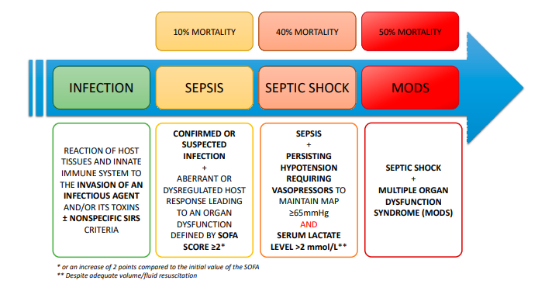
Szindróma spektruma
Bevezetés
Szepszis: infekcióra adatt diszregulált immunválasz, mely idődependens kórkép, életveszélyes szervdiszfunkciót okoz, többszervi elégtelenséghez vezet
Szeptikus sokk: diszregulált immunválasz hatására kialakuló oxigén kereslet-kínálat közötti imbalansz
Notes:
2016. JAMA Sepsis-3 definíció
2021. Surviving Sepsis Campaign
The World Health Organization’s first global report on sepsis finds that the effort to tackle millions of deaths and disabilities due to sepsis is hampered by serious gaps in knowledge, particularly in low- and middle-income countries
Sepsis disproportionately affects vulnerable populations: newborns, pregnant women and people living in low-resource settings. Approximately 85.0% of sepsis cases and sepsis-related deaths occur in these settings.
Almost half of the 49 million cases of sepsis each year occur among children, resulting in 2.9 million deaths, most of which could be prevented through early diagnosis and appropriate clinical management. These deaths are often a consequence of diarrhoeal diseases or lower respiratory infections.
Obstetric infections, including complications following abortion or infections following caesarean section, are the third most common cause of maternal mortality. Globally, it is estimated that for every 1000 women giving birth, 11 women experience infection-related, severe organ dysfunction or death.
The report also finds that sepsis frequently results from infections acquired in health care settings. Around half (49%) of patients with sepsis in intensive care units acquired the infection in the hospital. An estimated 27% of people with sepsis in hospitals and 42% of people in intensive care units will die.
Antimicrobial resistance is a major challenge in sepsis treatment as it complicates the ability to treat infections, especially in health-care associated infections.
Improving the prevention, diagnosis and treatment of sepsis

Slide 3
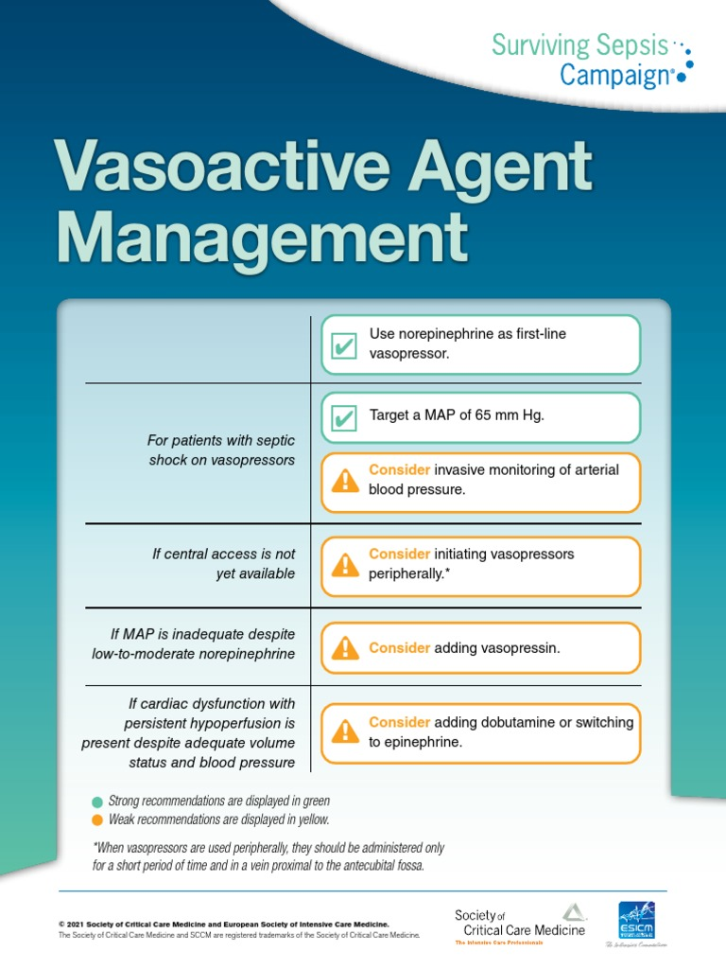
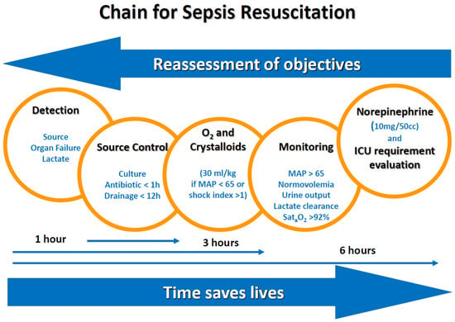
Aktuális irányelv
Bevezetés
Notes:
Argipresszin nem tachycardizál.
A resuscitation chain for sepsis was developed by investigators and was used to spread general recommendations for sepsis management.
Catecholamine receptor upregulation and excessive catecholamine release is a core pathophysiological feature in critical illness. Sustained catecholamine β-adrenergic induction produces adverse effects relevant to critical illness management. β-blockers (βB) have proposed roles in various critically ill disease states, including sepsis, trauma, burns, and cardiac arrest.
The catecholamine cascade is a defining element of critical illness. Although, prolonged exposure to high levels of catecholamines in these altered states may evoke detrimental metabolic and hemodynamic effects.
Surviving Sepsis Guidelines do not make recommendations regarding βB continuation or initiation in septic patients.
As early as 1972, a case series in refractory septic shock patients documented the hemodynamic effects of propranolol Berk et al., 1972. The cases conceptualized hyperdynamic vs. hypodynamic shock, given the observation that three patients dying after propranolol use had severely reduced CO compared to those who survived.
The seminal Morelli et al. Morelli et al., 2013 phase 2 study of esmolol in septic shock patients requiring high-dose vasopressors revived discussion of βB in sepsis.
Since the publication of these systematic reviews and meta-analyses there has been an increased focus on the treatment of tachyarrhythmias in sepsis. Initial evidence garnering support for βB use in septic patients with atrial fibrillation resulted from a 2016 propensity-matched cohort study. his analysis concluded that βB were associated with lower hospital mortality when compared to calcium channel blockers (CCBs), digoxin, and amiodarone Walkey et al., 2016. While these studies included a variety of βB agents, newer evidence has shifted to solely focus on the use of ultra-short-acting βB, esmolol and landiolol – USA + Japan.

Slide 4
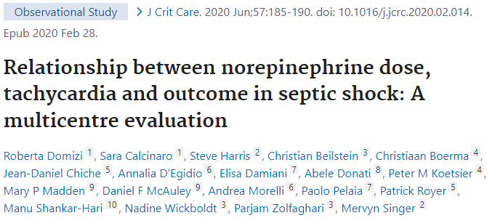
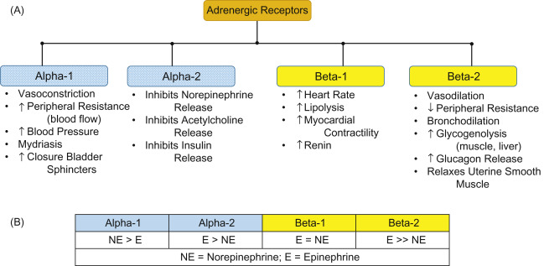
Szimpatikus diszautonómia szindróma
Szimpatikus idegrendszer aktivációja (masszív katekolamin kiáramlás) kulcsfontosságú, iniciális adaptív válasz, homeosztázis fenntartására irányuló fiziológiás folyamat
Perzisztáló magas fokú aktiváció: SDAS (<24h)
súlyosság, mortalitás ↑
Szeptikus „kardiomiopátia”: novum SVTc – Afib (23-40%)
Relatív mellékvese elégtelenség
Adrenerg receptor upreguláció: 20x ↑
NA – vazoplégia kezelése (argipresszinnel kiegészítve) – tahikardizál
Perifériás adrenerg stresszválasz csökkentése:
adrenerg re-equilibrium / dekatekolaminizáció
Notes:
Adrenergic system serves as an initial adaptive response to maintain homeostasis. However, excessive catecholamine surge can cause adverse effects such as persistent tachycardia, which worsens the prognosis in patients with sepsis. Therefore, the use of β-blockers in sepsis recently has attracted attention especially in patients with tachycardia.
Tachycardia seen in sepsis is usually secondary to hypovolemia, fever, or pain. However, even without these conditions, we often encounter persistent tachycardia, which is likely to be non-compensatory tachycardia due to sympathetic overstimulation.
Of these various effects, the oxygen utilization has been focused on given that β-stimulants such as epinephrine are well-known to increase lactate level, implying that β1-blockers may, in contrast, improve the oxygen utilization in patients with sepsis.
Metabolic effect: Impaired oxygen use has been proposed as a more reasonable explanation of hyperlactatemia in sepsis. It is well-known that the stimulation of the β2-receptor increases the production of cyclic adenosine monophosphate, accelerating glycolysis. Therefore, the β2-blockade is likely to result in a reduction of lactate production. On the other hand, the patients’ ability to accelerate glycolysis and lactate production in response to epinephrine administration is reported to be associated with a better prognosis .
- catabolism
- glycolysis
β-blockers (βB) may be administered to manipulate the adrenergic response during critical illness
G protein kapcsolt receptorok (Gq , Gi , Gs )
• α1 - IP3 /DAG/Ca2+ rendszerhez kapcsolt jellemző lokalizáció: simaizmok, szerep: kontrakció
• α2 - negatívan kapcsolt az adenilcikláz/cAMP rendszerhez jellemző lokalizáció és szerep: preszinaptikus gátlás (posztszinaptikusan: érösszehúzás)
• β1 - pozitívan kapcsolt az adenilcikláz/cAMP rendszerhez jellemző lokalizáció: szív, szerep: pozitív hatások
• β2 - pozitívan kapcsolt az adenilcikláz/cAMP rendszerhez jellemző lokalizáció: simaizmok, szerep: relaxáció
• β3 - pozitívan kapcsolt az adenilcikláz/cAMP rendszerhez jellemző lokalizáció: zsírsejtek, szerep: lipolízis
Adrenerg receptor aktiváció hatásai:
• Szem: pupillatágulat (α1 ), csarnokvíz termelése (β)
• Szív: pozitív inotrop, chronotrop, dromotrop, bathmotrop hatások (β1 )
• Erek: vasokonstrikció (α1 ), vasodilatáció (β2 )
• Tüdő: bronchodilatáció (β2 )
• Gasztrointesztinális r.: csökkent motilitás (α2 , β2 ), sphincterek összehúzása (α1 )
• Genitourinális r.: csökkent motilitás (β2 ), sphincterek összehúzása (α1 ), uterus elernyesztése (β2 ), ejaculatio (α1 )
• Bőr: pilomotor simaizomzat kontrakciója (α), apocrin mirigyek - szekréció fokozódása (α)
• Máj: glükoneogenezis, glükogenolízis (α1 és β2 )
• Zsírsejtek: lipolízis (β3 )
• Vese: renin felszabadulás (β1 )
Posztszinaptikus receptor gátlás:
A β receptor blokád legfontosabb következményei: • negatív chronotrop és inotrop hatások a szíven (β1 ) • vérnyomáscsökkenés (többek között a perctérfogat csökkenése, és a renin felszabadulás gátlása miatt - β1 ) • bronchokonstrikció (β2 ) • lokális érszűkület veszélye - főleg a végartériákon, vagy károsodott perifériés ereken manifesztálódhat (β2 ) • a csarnokvíz termelésének a csökkenése • hipoglikémiás hatások fokozása, tünetek elfedése (β2 ) • VLDL szint emelkedése, HDL szint csökkenése
A szelektív β1 blokkolók kevésbé hajlamosítanak pl. bronchokonstrikcióra, hipoglikémiára és perifériás keringési zavarokra A β1 szelektivitás azonban soha nem abszolút!
Hemodynamic effect:
Persistent tachycardia 24 h after adequate fluid resuscitation is an independent risk factor for mortality in patients with sepsis https://doi.org/10.1016/j.jcrc.2020.02.014: use of high-dose norepinephrine and concurrent tachycardia are associated with poor outcomes in septic shock
Ultrashort-acting β1-blockers increased stroke volume index (SVI), while it reduced HR, resulting in unchanged cardiac index (CI), mean arterial pressure (MAP), and norepinephrine requirement at 24h. Tachycardia in sepsis can decrease stroke volume, resulting in an increased Ea and V-A decoupling. Because β1-blocker affects not only cardiac systolic function but also the afterload, it is important to know how β1-blocker affects an afterload-independent cardiac systolic function.
- (LVEF) was similar between landiolol and control groups https://doi.org/10.1016/j.chest.2021.01.009
- esmolol increased left ventricular stroke work index while it did not affect the right ventricular stroke work index, as well as right atrial pressure and mean pulmonary arterial pressure https://doi.org/10.1001/jama.2013.278477
Mortality benefit of ultrashort-acting β1-blocker might be explained by suppression of hyperkinetic status by improving cardiovascular efficiency.
This study suggests that ultrashort-acting β1-blockers should be initiated only after completing initial resuscitation.

Slide 5
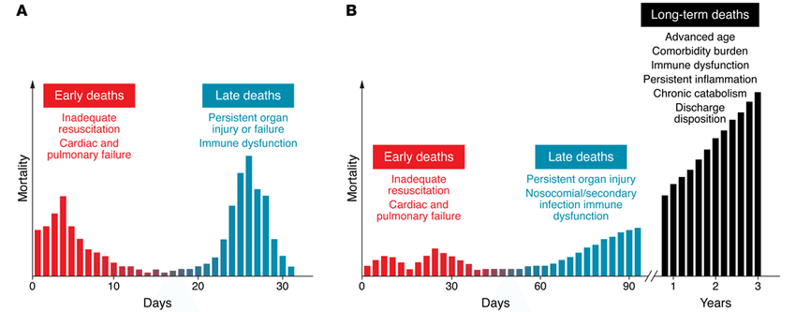
Szimpatikus diszautonómia szindróma következményei
Post-sepsis syndrome
Notes:
Historical and current sepsis mortality distribution. (A) Historically, sepsis deaths have occurred in a biphasic distribution, with an initial early peak at several days due to inadequate resuscitation, resulting in cardiac and pulmonary failure, and a late peak at several weeks due to persistent organ injury and failure. Considering the recent trend in sepsis outcomes, the elderly population, and mounting long-term mortality, a trimodal distribution may be more indicative of the current sepsis-associated death distribution. (B) The two early peaks in mortality exist, albeit with much lower magnitude than in the past. The third upswing occurs approximately 60 to 90 days after sepsis and continues to soar as time progresses. This delay in sepsis mortality is thought to be the consequence of the more sophisticated ICU care that keeps elderly and comorbidly challenged patients alive longer in spite of ongoing immune, physiologic, and biochemical aberrations.
Catecholamine mediated the hypermetabolic response in septic shock caused increase in resting energy expenditure, extensive protein, and fat catabolism and hyperglycemia. β2-blockers effects include lowering gluconeogenesis, hyperglycemia, proteolysis and resting energy expenditure.

Slide 6
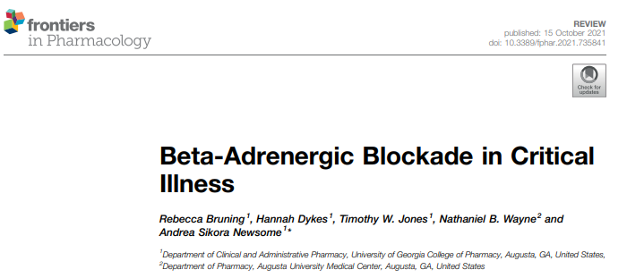
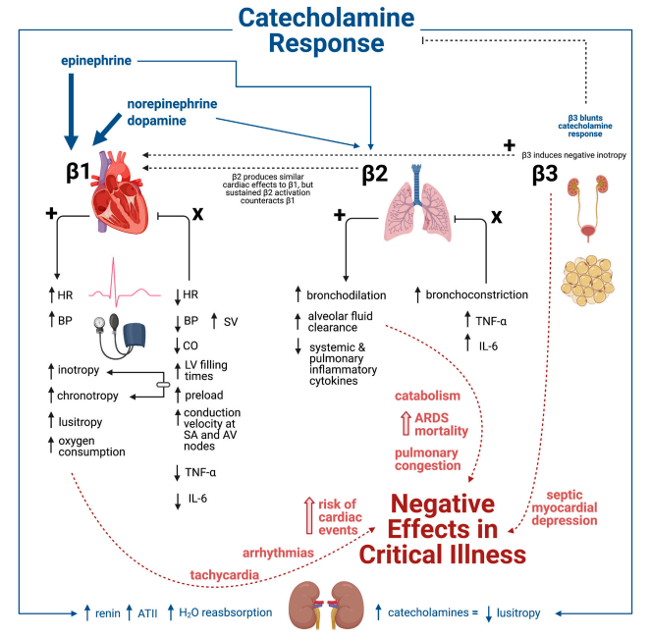
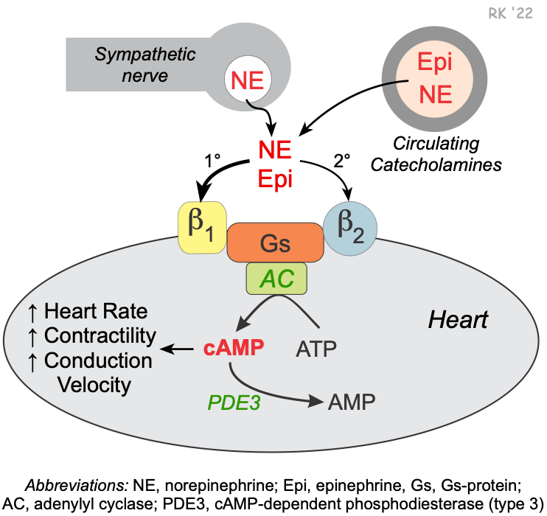
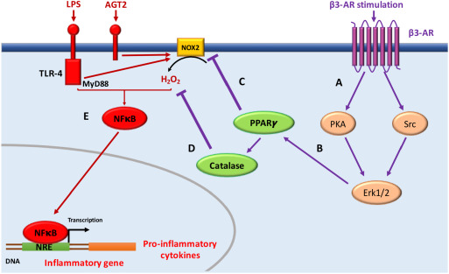
Adrenerg re-equlibrium
Notes:
Adrenergic system serves as an initial adaptive response to maintain homeostasis. However, excessive catecholamine surge can cause adverse effects such as persistent tachycardia, which worsens the prognosis in patients with sepsis. Therefore, the use of β-blockers in sepsis recently has attracted attention especially in patients with tachycardia.
Catecholamine response characterized by epinephrine, norepinephrine, and dopamine release result in stimulation of β1 (majorly) and β2 (minorly). In contrast, β3 agonism blunts the catecholamine response. The physiologic response to β1, β2, and β3 agonism culminates in numerous negative effects within critical illness that can ultimately lead to negative clinical outcomes including increased mortality.
β-adrenergic pathways extensively regulate cardiac function and function and, specifically, hemodynamics due to extensive cardiac expression. β1 comprises 80% of cardiac β-receptors and mediates inotropy, chronotropy, lusitropy (i.e. relaxation rate), and dromotropy (i.e. conduction speed). High concentrations of catecholamines, the lusitropic effect is overwhelmed by tachycardia and increased contractility. β1 predominates cardiac expression over β2 (4 to 1), but states such as HF can tip the balance nearly even through β1 downregulation by sustained adrenergic stimulation /ntagonism of β2 increases TNF-α and IL-6inflammation and may exacerbate the physiologic changes seen in sepsis further supporting β1 selective benefits.
The increased β3 expression may prime the heart for consequences like septic myocardial depression Yang et al., 2018
Preclinical studies have suggested positive effects as beta-blockade with agents selective for β1 agents may reduced tumor necrosis factor alpha (TNF-α) and interleukin 6 (IL-6) in the serum and myocardiumsystemic and cardiac inflammation + enhanced ventricular-arterial (V-A) coupling
Prescribing of βB typically warrants caution in pulmonary pathologies, most notably chronic obstructive pulmonary disease (COPD) and asthma, as βB can reverse the benefits of β2-mediated bronchodilation, although cardioselectivity β1 blocking agents eliminates some concern MacNee, 2019. Additionally, continuing cardioselective βB for patients with underlying cardiac indications hospitalized for COPD exacerbations appears safe Stefan et al., 2012. The ultra-rapid βB, landiolol, suppressed lung injury and reduced lung injury associated protein, high-mobility group box 1 (HMGB-1), in a rat lipopolysaccharide sepsis model Hagiwara et al., 2009
Insulin resistance is a well-known consequence of sepsis, it seems that nonselective β-blockade can offer benefits for glucose modulation in sepsis-mainly mediated by β2 blockade.
Tachycardia seen in sepsis is usually secondary to hypovolemia, fever, or pain. However, even without these conditions, we often encounter persistent tachycardia, which is likely to be non-compensatory tachycardia due to sympathetic overstimulation.
Of these various effects, the oxygen utilization has been focused on given that β-stimulants such as epinephrine are well-known to increase lactate level, implying that β1-blockers may, in contrast, improve the oxygen utilization in patients with sepsis.
Metabolic effect: Impaired oxygen use has been proposed as a more reasonable explanation of hyperlactatemia in sepsis. It is well-known that the stimulation of the β2-receptor increases the production of cyclic adenosine monophosphate, accelerating glycolysis. Therefore, the β2-blockade is likely to result in a reduction of lactate production. On the other hand, the patients’ ability to accelerate glycolysis and lactate production in response to epinephrine administration is reported to be associated with a better prognosis .
- catabolism
- glycolysis
Hemodynamic effect:
Persistent tachycardia 24 h after adequate fluid resuscitation is an independent risk factor for mortality in patients with sepsis https://doi.org/10.1016/j.jcrc.2020.02.014: use of high-dose norepinephrine and concurrent tachycardia are associated with poor outcomes in septic shock
Ultrashort-acting β1-blockers increased stroke volume index (SVI), while it reduced HR, resulting in unchanged cardiac index (CI), mean arterial pressure (MAP), and norepinephrine requirement at 24h. Tachycardia in sepsis can decrease stroke volume, resulting in an increased Ea and V-A decoupling. Because β1-blocker affects not only cardiac systolic function but also the afterload, it is important to know how β1-blocker affects an afterload-independent cardiac systolic function.
- (LVEF) was similar between landiolol and control groups https://doi.org/10.1016/j.chest.2021.01.009
- esmolol increased left ventricular stroke work index while it did not affect the right ventricular stroke work index, as well as right atrial pressure and mean pulmonary arterial pressure https://doi.org/10.1001/jama.2013.278477
Mortality benefit of ultrashort-acting β1-blocker might be explained by suppression of hyperkinetic status by improving cardiovascular efficiency.
This study suggests that ultrashort-acting β1-blockers should be initiated only after completing initial resuscitation.

Slide 7
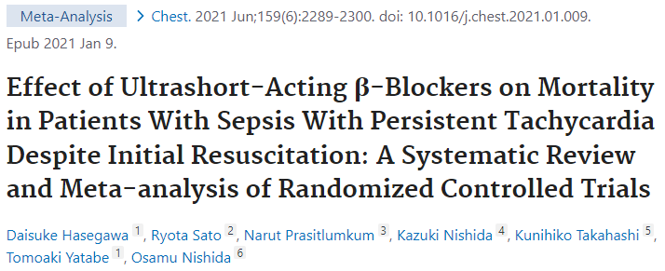
Béta blokkolók alkalmazása
Paradigmaváltás
Áldás?
diastole ideje nyúlik
preload nő
coronaria telődés optimalizálása
oxigénfelhasználás csökken
Átok?
negatív inotróp
negatív kronotróp
negatív dromotróp
hypotensio
bronchospazmus
Notes:
β₁-selective beta blockers are also known as cardioselective beta blockers - the function of cAMP as a second messenger in the cardiac cell is that it phosphorylates the LTCC and the ryanodine receptor to increase intracellular calcium levels and cause contraction. Beta-blockade of the B1 receptor will inhibit cAMP from phosphorylating, and it will decrease the ionotrophic and chronotropic effect. Note that drugs may be cardioselective, or act on B1 receptors in the heart only, but still have instrinsic sympathomimetic activity. Eg. Nebivolol, metorpolol, bisoporolol, labetalol
BB have been proposed to reduce sepsis-induced cardiac dysfunction, improve the sepsis-induced hypermetabolic state, and play a role in immunomodulation by preventing lymphocyte apoptosis prevalent within inflammatory mechanisms of sepsis Suzuki et al., 2017)
Beta-blockers have become ubiquitous in the treatment of patients with heart failure and ischemic heart disease. During critical illness, the initial adrenergic stimulation may be beneficial; however, sympathetic overactivity, if persistent, may become deleterious, leading to further oxygen consumption, catabolism, hyperglycemia, hypercoagulability, cardiac dysfunction, modulation of systemic inflammatory cytokines, and ensuing multiorgan failure
Historically, β-blockers have been considered to be relatively contraindicated for septic shock because they may cause cardiac suppression. On the other hand, there is an increasing interest in the use of β-blockers for treating patients with sepsis with persistent tachycardia despite initial resuscitation.
https://doi.org/10.1016/j.chest.2021.01.009: This was a systematic review and meta-analysis - compared the mortality of patients with sepsis and septic shock treated with esmolol or landiolol. Seven RCTs with a pooled sample size of 613 patients were included. Of these, six RCTs with 572 patients reported 28-day mortality. Esmolol or landiolol use in patients with sepsis and septic shock was significantly associated with lower 28-day mortality (risk ratio, 0.68; 95% CI, 0.54-0.85; P < .001). Unimportant heterogeneity was observed (I² = 31%). The absolute risk reduction and number of patients to be treated to prevent one death were 18.2% and 5.5, respectively. The use of ultrashort-acting β-blockers such as esmolol and landiolol in patients with sepsis with persistent tachycardia despite initial resuscitation was associated with significantly lower 28-day mortality.
https://doi.org/10.1093/bja/aex231: This was a prospective observational single centre trial compared patient and treatment characteristics, length of stay and mortality rates between adult patients with severe sepsis or septic shock, in whom chronic beta-blocker therapy was continued or discontinued, respectively. A total of 296 patients with severe sepsis or septic shock and pre-existing, chronic oral beta-blocker therapy were included. Continuation of beta-blocker therapy was significantly associated with decreased hospital (P=0.03), 28-day (P=0.04) and 90-day mortality rates (40.7% vs 52.7%; P=0.046) in contrast to beta-blocker cessation. The differences in survival functions were validated by a Log-rank test (P=0.01). Multivariable analysis identified the continuation of chronic beta-blocker therapy as an independent predictor of improved survival rates (HR = 0.67, 95%-CI (0.48, 0.95), P=0.03).

Slide 8
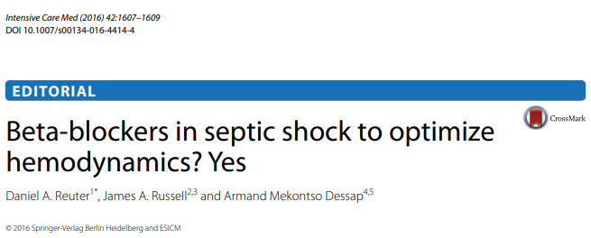
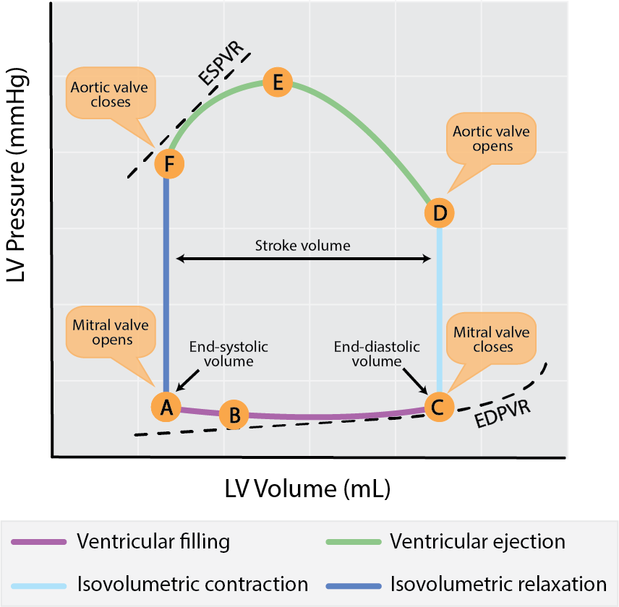
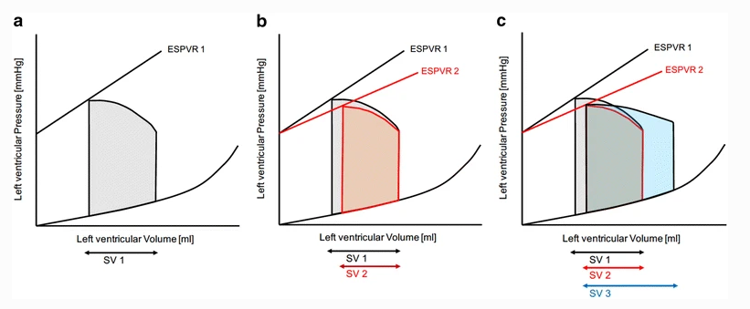
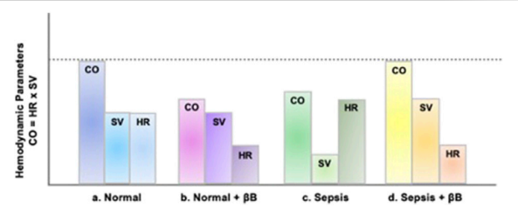
Hemodinamika optimalizálása
prior to BB
after BB administration
Inotropy ↓
Angle of ESPVR2 ↓
If preload is enough HR ↓ - Tdia $↑$ - SV $↑$
CO/CI maintained
Notes:
Pressure volumen loops of the left ventricle are depicted.
press-vol prior to BB
B) BB leads to decrease of inotropy, which is reflected by the reduced angle of the ESPVR (end systolic pressure volume relation) 2. Accordngky tge reszktubg SV2 is diminished
C) uf venous retzrn to the left ventricle is high enough, the prolonged duration of diastole caused by heart rate reduction will allow increased left ventricular filling, shich, in combination with decreased afterload, will result in an increased SV3
Hemodynamic effects of sepsis and β-Blockade.
the stroke volume (SV) and cardiac output (CO), stroke volume (SV), and heart rate (HR) of a normal, healthy individual are presented
due to the negative inotropy associated with βB, which causes reduced HR, the overall CO is reduced despite normal SV
sepsis results in tachycardia, due to excessive sympathetic activation. This increase in HR does not allow for adequate ventricular filling causing a decrease in CO secondary to a decrease in SV
given that venous return (i.e., preload) is adequate, then βB-induced HR reduction allows for more left ventricular filling time, subsequently decreasing afterload and increasing SV enough to overcome decreased HR and improved CO

Slide 9
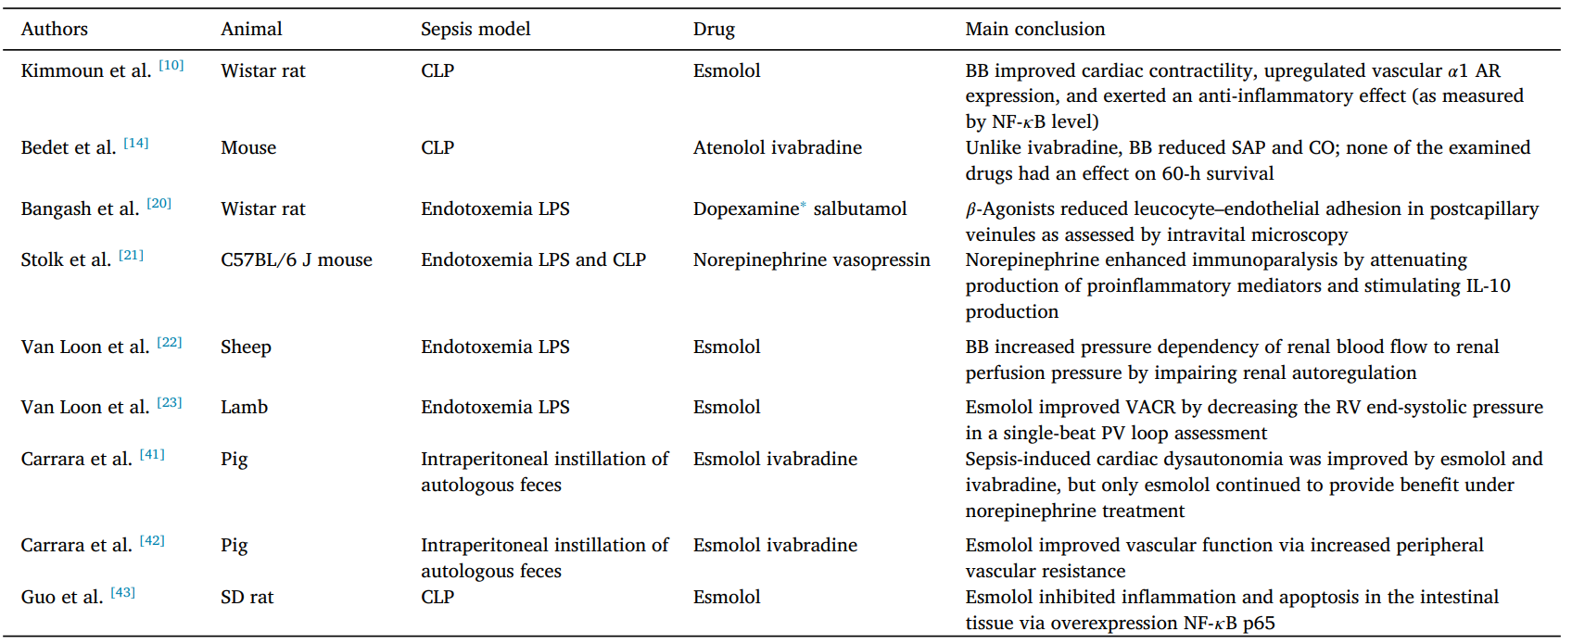
Mit ír az irodalom?
2019-2022
Prelinikai vizsgálatok
Notes:
⁎β-Agonist. Esmolol improved VACR by decreasing the RV end-systolic pressure.
AR: Adrenergic receptor; BB: β-blocker; CLP: Cecal ligation and puncture; CO: Cardiac output; IL-10: Interleukin 10; LPS: Lipopolysaccharide; NF-κB: Nuclear factor κB; PV: Pressure–volume; RV: Right ventricle; SAP: Systolic arterial pressure; SD: Sprague–Dawley; VACR: Ventriculo-arterial coupling ratio.

Slide 10
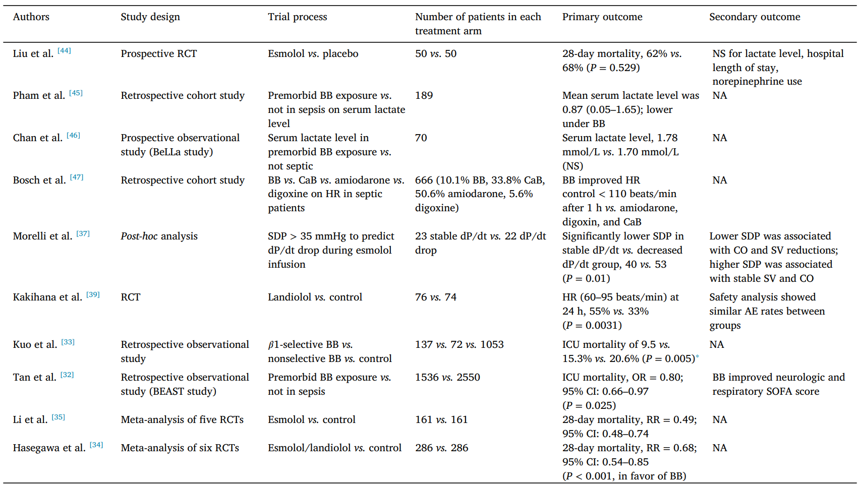
Mit ír az irodalom?
2019-2022
Klinikai vizsgálatok
Notes:
⁎β-Agonist. Esmolol improved VACR by decreasing the RV end-systolic pressure.
AR: Adrenergic receptor; BB: β-blocker; CLP: Cecal ligation and puncture; CO: Cardiac output; IL-10: Interleukin 10; LPS: Lipopolysaccharide; NF-κB: Nuclear factor κB; PV: Pressure–volume; RV: Right ventricle; SAP: Systolic arterial pressure; SD: Sprague–Dawley; VACR: Ventriculo-arterial coupling ratio.
Hasagewa, 2021: his was a systematic review and meta-analysis. We searched MEDLINE, Cochrane Central Register of Controlled Trials, and Embase for randomized controlled trials (RCTs) that compared the mortality of patients with sepsis and septic shock treated with esmolol or landiolol. We updated our search on April 20, 2020. Two independent reviewers assessed whether titles and abstracts met the following eligibility criteria: (1) RCT, (2) patients with sepsis and septic shock ≥ 18 years of age, and (3) treatment with either esmolol/landiolol or placebo/no interventions. Two authors independently extracted selected patient and study characteristics and outcomes. The results of all analyses are presented using random effect models. Seven RCTs with a pooled sample size of 613 patients were included. Of these, six RCTs with 572 patients reported 28-day mortality. Esmolol or landiolol use in patients with sepsis and septic shock was significantly associated with lower 28-day mortality (risk ratio, 0.68; 95% CI, 0.54-0.85; P < .001). Unimportant heterogeneity was observed (I² = 31%). The absolute risk reduction and number of patients to be treated to prevent one death were 18.2% and 5.5, respectively.
After adequate fluid resuscitation, patients with sepsis who remain tachycardic carry a poor prognosis. Therefore, adequate heart rate control may help improve outcomes in managing sepsis.
β-blockers were regarded as a relative contraindication for septic shock because of the cardiac suppression. The effect of β-blocker treatment on the clinical outcome of sepsis and septic shock is still unclear. Previous clinical studies have mainly focused on the roles of short-acting β-blockers (esmolol or landiolol) in septic patients with tachycardia because these agents are recognized as relatively safer than other longer-acting β-blockers. almost all those studies were limited by their small sample sizes (less than 155), and significant heterogeneity in the baseline characteristics of patients, leading to inconsistency in the findings. In addition, previous reviews have mainly focused on short-acting β-blockers leaving out studies on long-acting β-blockers. Propensity score matching (PSM) can largely reduce baseline differences between groups in observational studies and is referred to as retrospective randomization
ORIGINAL RESEARCH article
Front. Cell. Infect. Microbiol., 28 March 2023 Sec. Clinical Microbiology Volume 13 - 2023 | https://doi.org/10.3389/fcimb.2023.1121444
Effect of β-blockers on mortality in patients with sepsis: A propensity-score matched analysis:
Patients diagnosed with sepsis, according to the Sepsis-3 definition, were enrolled in the study. All sepsis patients who needed vasopressors to maintain a mean arterial pressure (MAP) ≥ 65 mmHg within 24 hours (h) of ICU admission were defined as septic shock.- Patients aged less than 17 years and those who were discharged or died within 48 h of ICU admission were excluded.
2 groups: β-blocker group (intervention) and the non-β-blocker group (control). The primary outcome was the 28-day mortality. The secondary outcomes were 90-day mortality and length of stay (LOS) in the hospital.

Slide 11
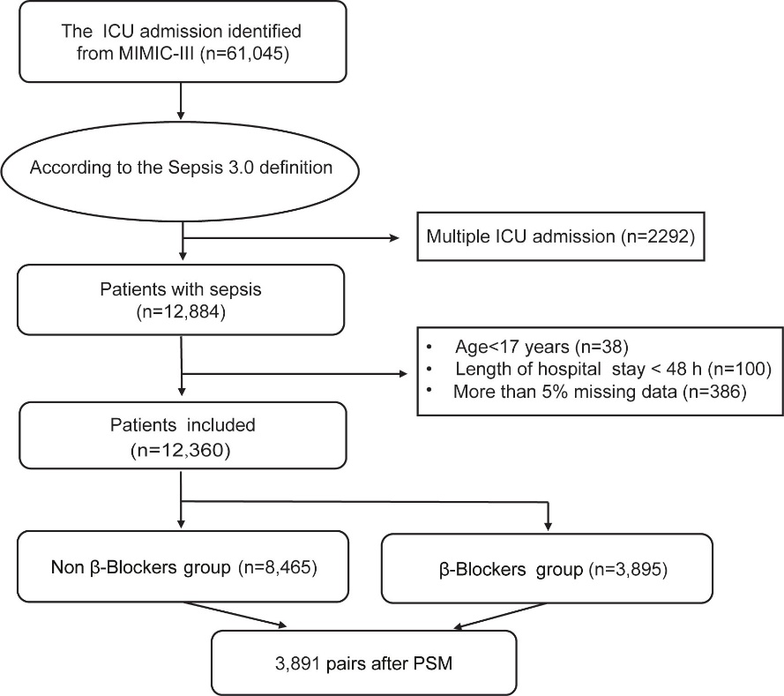
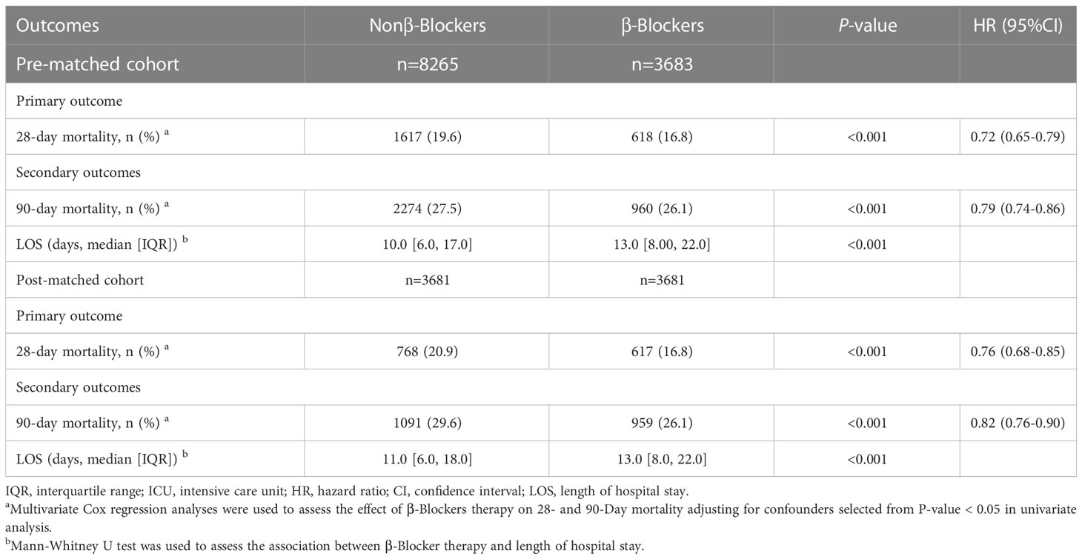
Mit ír az irodalom?
Notes:
Flowchart of the patients screened in the study. ICU, intensive care unit; MIMIC-III, Multiparameter Intelligent Monitoring in Intensive Care Database III; SOFA, sequential organ failure assessment; PSM, propensity-score matching.
Long acting β-blocker therapy may improve short- and long-term survival for patients with sepsis and septic shock. However, short-acting β-blockers (esmolol) treatment did not reduce the mortality in sepsis.
The association between β-blockers therapy and 28-day mortality in subgroups. HR, hazard ratio; CI, confidence interval. After propensity-score matching (PSM), multivariate Cox regression analyses were used to assess the effect of β-blockers therapy on 28-Day mortality adjusting for confounders selected from P-value < 0.05 in univariate analysis. For data analysis the R package both ‘survival’ and ‘forestplot’ were used.
The sample size of 6830 cases in this study is the largest in the literature on the association of β-blocker therapy and sepsis. Moreover, we eliminated the potential confounding effect of baseline factors using PSM to balance the baseline characteristics among the two groups. In addition, our studies are the first to suggest that short- and long-acting β-blockers have different therapeutic profiles on sepsis.

Slide 12
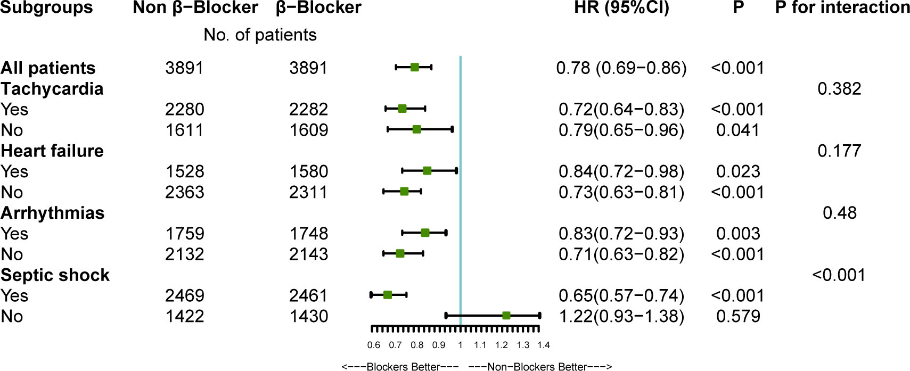
Mit ír az irodalom?
Limitations:
- Firstly, this study is based on a clinical database containing missing variables
- No doses of BBs
- inherent limitation of the retrospective research, a cause-effect relationship between the β-blocker therapy and mortality cannot be established
Notes:
There was a significant interaction between β-blocker therapy and septic shock after PSM (P < 0.001, without adjustment for multiple comparisons). The results indicate a significant association between β-blocker therapy and improved 28-day survival among patients with septic shock.
Propensity score match analysis
Data suggest that β-blockers were associated with improved 28- and 90-day mortality in patients with sepsis and septic shock. Long-acting β-blocker therapy may have a protective role in patients with sepsis, reducing the 28-day and 90-day mortality.
Limitation of the study:
- Firstly, this study is based on a clinical database containing missing variables.
- No doses of BBs
- Due to the inherent limitation of the retrospective research, a cause-effect relationship between the β-blocker therapy and mortality cannot be established

Slide 13
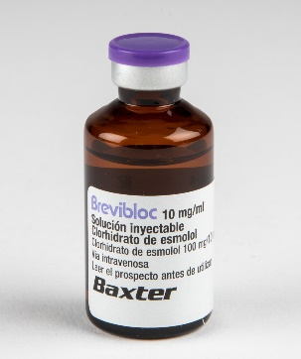
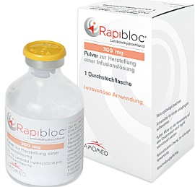
Farmakológia
ESMOLOL
1-2min
9min
33
plazma észterázok
i.v.
LANDIOLOL
1min
2-4min
255
pszeudokolinészteráz/máj karboxiészteráz
i.v.
Hatáskezdet
Felezési idő
Hatékonyság (β1:β2 affinity ratio)
Elimináció
Beadás módjai
BISOPROLOL
2-6h
12-19h
CYP2D6
p.o.
NEBIVOLOL
1-2h
9-12h hepatikus – vese elim. 50-50%
p.o.
METOPROLOL
2h
3-7h
CYP2D6, CYP3A4
p.o. /i.v.
Notes:
Landiolol: easily controllable side effect, eg. Hypotension, bradycardia – cardioselective beta blockers
Landiolol is an ultra short-acting selective beta-blocker used for rapid ventricular rate control in cases of supraventricular tachycardia, szuperszelektív B1 receptorok iránt
Esmolol, commonly marketed under the trade name Brevibloc, is a cardioselective beta-1 receptor blocker. It has a rapid onset but short duration of action without causing significant intrinsic sympathomimetic or membrane stabilizing activities at recommended therapeutic doses. It works by blocking beta-adrenergic receptors in the heart, which leads to decreased force and rate of heart contractions. Esmolol prevents the action of two naturally occurring substances: epinephrine and norepinephrine. Rapid distribution half-life of about 2 minutes and an elimination half-life of about 9 minutes. The acid metabolite has an elimination half-life of about 3.7 hours. The FDA withdrew its approval for the use of all parenteral dosage form drug products containing esmolol hydrochloride that supply 250 milligrams/milliliter of concentrated esmolol per 10-milliliter ampule.

Slide 14
Összefoglalás
Ismeretes, hogy az anamnesztikusan is (főként a kardioszelektív) BB-t szedők mortalitása alacsonyabb Tan et al. 2019 & Guz et al. 2021 – hatásmechanizmus nem tisztázott
(Ultra)rövid hatású, (szuper)szelektív béta blokkolók alkalmazásáról szóló tanulmányok – gyenge evidenciával - támogatják a paradigma váltást: adjunk BB-t szeptikus sokkban
Esmolol/landiolol nem használható a szeptikus sokk korai fázisában Bruning et al. 2021 - elfedheti a kompenzációt, rontja a kardiális teljesítményt, sokkállapot további súlyosbodásához vezet
Nincs optimális időzítés, de megfelelő primer reszuszcitációt követően (optimális preload), 12h fennálló vazopresszor terápia mellett perzisztáló tahikardia esetén BB indítása megfontolandó – mikor álljon le?
Lassú dózistitrálás: lehető legkisebb, de még effektív dózis alkalmazandó Gangl et al. 2021 - landiolol ~1-10mcg/kg/min; esmolol 0.05-0.2mg/kg/min (cél: kiindulási HR -20%)
Notes:
A recent observational cohort study by Guz et al. found that antecedent cardioselective βB were associated with a stronger protective effect on 30-days mortality rate reduction than noncardioselective βB for patients admitted with sepsis . Continuation of beta-blockade therapy was also associated with decreased crystalloid requirements during the first 24 h (p = 0.049) without increases in need for vasopressor, inotropic support, or low-dose steroids Tan et al. 2019
The available low quality evidence supports this paradigm shift in crictical care towards casutious beta-blockade in treatment of sepsis and septic shock, when complicated by tachyarrythmias
There are numerous retrospective studies that have investigated premorbid βB exposure prior to admission to the ICU with a diagnosis for sepsis that have conferred mortality benefit.
The use of beta-blockade in septic patients remains controversial especially with regard to timing of initiation. Tachycardia in the early stages of un-resuscitated sepsis is a major compensatory mechanism to ensure cardiac output, oxygen delivery, and perfusion. The use of beta-blockade, specifically with esmolol and landiolol, has been shown to reduce heart rate in the septic patients without deleterious effects on end-organ perfusion and may be associated with improved survival rates.
In summary, Tthe hemodynamic evidence for βB use in sepsis has been proven as there are numerous studies demonstrating decreased HR without significant change in MAP, CVP, or ScVO₂. Further, the recent evidence for ultra-short-acting βB, esmolol and landiolol, especially with regard to decreased incidence of arrhythmias and 28-days mortality benefit is clinically significant.
There is a need to stratify subgroups within septic cohorts based on the potential benefit of cardiovascular intervention to decrease the negative consequences of tachyarrhythmias (Morelli et al., 2020)

Slide 15
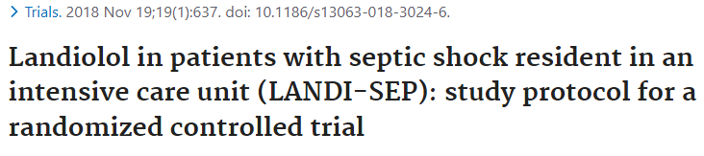
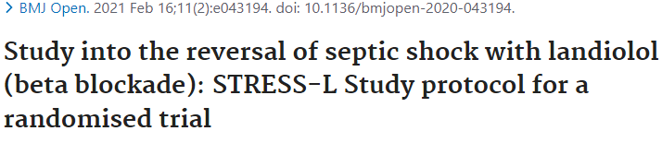
Összefoglalás
Invazív hemodinamikai monitorozás javasolt, indítás előtt tájékozódó echocardiographia szükséges
Landiolol: frekvencia csökkenés mellett novum arritmiák kialakulási esélyét is csökkenti Fuchs et al. 2021
β1 receptor blokád immunmoduláns hatása is kihasználható (TNF-α, IL-6) Chacko et al. 2015
További jól vezetett, megfelelő statisztikai erővel bíró randomizált kontrollált vizsgálatok szükségesek - melyek egyértelmű mortalitás csökkenést mutatnak / a többszervi elégtelenség incidenciáját, idejének csökkenését eredményezik - egyelőre váratnak magukra
Notes:
A recent observational cohort study by Guz et al. found that antecedent cardioselective βB were associated with a stronger protective effect on 30-days mortality rate reduction than noncardioselective βB for patients admitted with sepsis . Continuation of beta-blockade therapy was also associated with decreased crystalloid requirements during the first 24 h (p = 0.049) without increases in need for vasopressor, inotropic support, or low-dose steroids Tan et al. 2019
The available low quality evidence supports this paradigm shift in crictical care towards casutious beta-blockade in treatment of sepsis and septic shock, when complicated by tachyarrythmias
There are numerous retrospective studies that have investigated premorbid βB exposure prior to admission to the ICU with a diagnosis for sepsis that have conferred mortality benefit.
The use of beta-blockade in septic patients remains controversial especially with regard to timing of initiation. Tachycardia in the early stages of un-resuscitated sepsis is a major compensatory mechanism to ensure cardiac output, oxygen delivery, and perfusion. The use of beta-blockade, specifically with esmolol and landiolol, has been shown to reduce heart rate in the septic patients without deleterious effects on end-organ perfusion and may be associated with improved survival rates.
In summary, Tthe hemodynamic evidence for βB use in sepsis has been proven as there are numerous studies demonstrating decreased HR without significant change in MAP, CVP, or ScVO₂. Further, the recent evidence for ultra-short-acting βB, esmolol and landiolol, especially with regard to decreased incidence of arrhythmias and 28-days mortality benefit is clinically significant.
There is a need to stratify subgroups within septic cohorts based on the potential benefit of cardiovascular intervention to decrease the negative consequences of tachyarrhythmias (Morelli et al., 2020)

Slide 16
Köszönöm a figyelmet!

Slide 17
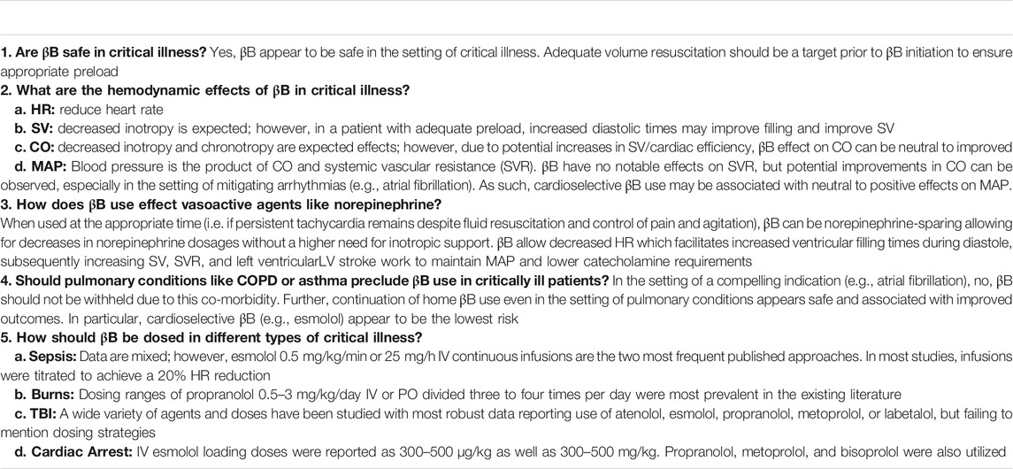
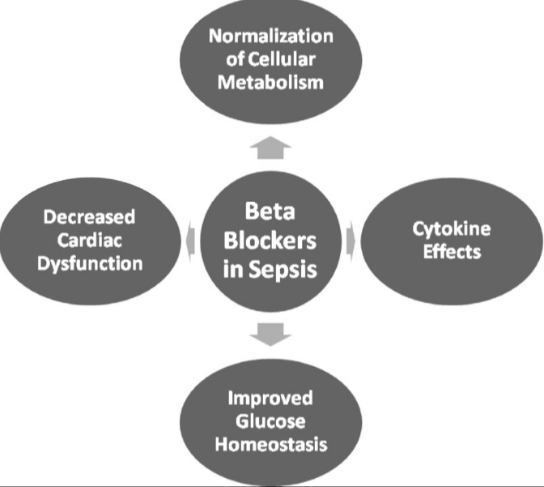

Slide 18
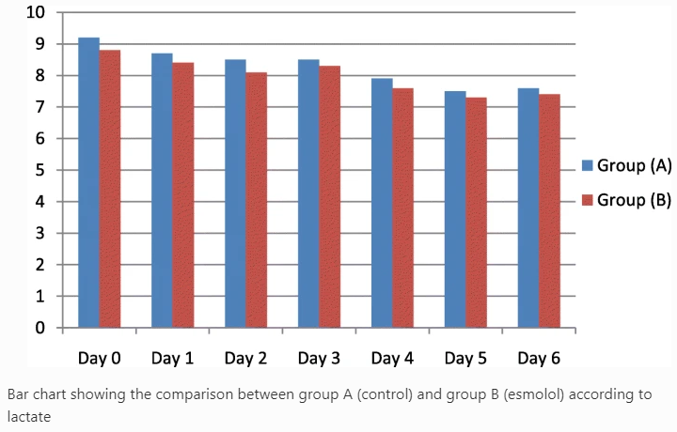
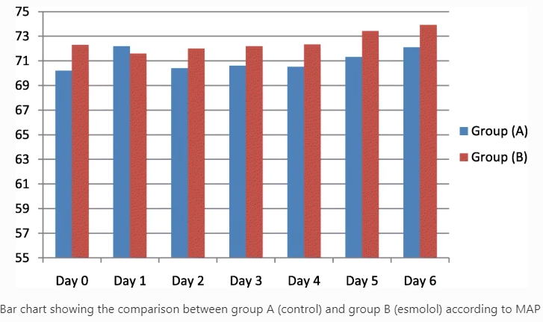
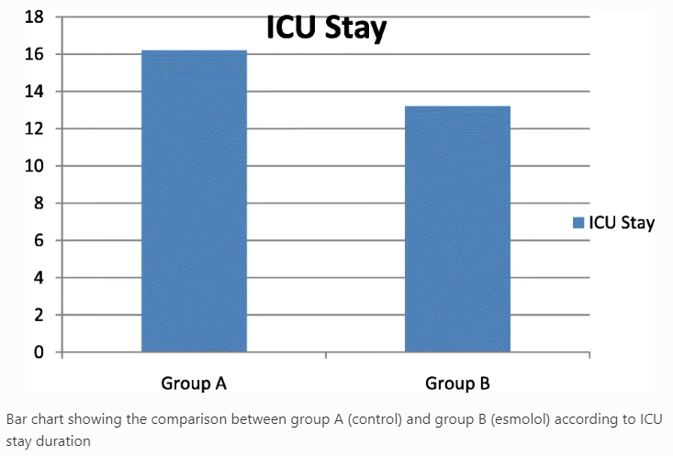
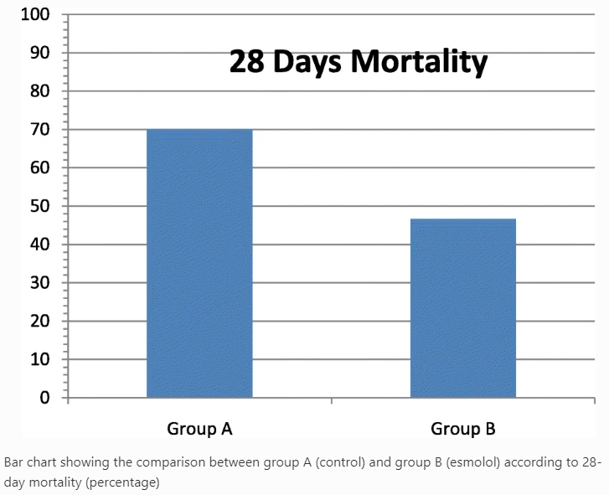
Notes:
https://doi.org/10.1186/s42077-020-00107-5:
60 patients of age 18–60 years of both sexes and randomly divided them into 2 groups, 30 patients each. The primary outcome was the heart rate. Secondary outcomes were MAP, central venous oxygen saturation measured from the central venous line, central venous pressure, serum lactate, APACHE II score (on admission), SOFA recorded daily for the first week beside ICU stays (in days), and 28-day mortality.
A received the standard care of sepsis in addition to esmolol intravenous infusion by starting dose of 0.05–0.2 mg/kg/min and the dose was titrated every 20 min, and in group B, patients received the standard care of sepsis.
This study supports the role of intravenous beta blockers in sepsis patients by decreasing heart rate without affecting the hemodynamics, in addition to decreasing 28-day mortality and ICU stay.

Slide 19
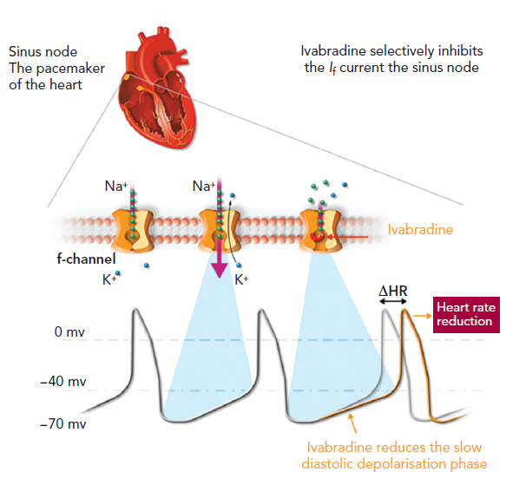
Ivabradin?
I_{f} gátló: lassú diasztolés repolarizációt nyújtja
NA adása mellett nem igazán effektív
Izolált HRR elérhető, mortalitást nem befolyásolja
Érdekességek
Esmolol (n=4)/ivabradin (n=5)/control (n=3)
Cardiac automony: HRV: heart rate variability, BRS: baroreflex sensivity
Oxygenation efficency: Buckberg index
Favourable condition was preserved only in esmolol group
Ivabaradin is not as affective when administered adjunction to NA
60 patient (HR>95/min): group S (standard therapy for septic shock), group I (ivabradin)
SVI + EF higher in group I
CI and lactate, ScvO2 remain similar to group S
No difference in 30-day mortality or incidence of SAE
Isolated HRR: heart rate reduction
Echocardiography / ex vivo vasoreactivity (myography)
ELISA: TNF-α, IL-6, and IL-10
WB: NF-κB/IκBα/iNOS and Akt/eNOS
Isolated HRR, but no other effect
No negative inotropic effect
Notes:
Carrara et al.:
Persisting tachycardia is often observed in resuscitated septic shock patients, and it is an independent risk factor for increased mortality. The esmolol-treated group (n=4), the ivabradine-treated group (n=5) and the control group (n=3).
Cardiac automony: HRV: heart rate variability, BRS: baroreflex sensivity
Oxygenation efficency: Buckberg index
Favourable condition was preserved only in esmolol group
Ivabaradin is not as affective when administered adjunction to NA
Datta et al.:
This study sought to investigate the effect of the cardiac pacemaker current inhibitor ivabradine on heart rate and cardio-circulatory function in patients with septic shock. 60 patients with septic shock and persistent tachycardia (heart rate >95 /minute) were prospectively randomly assigned to receive either standard therapy for septic shock (group S) or standard therapy along with enteral ivabradine (group I) for the initial 96 hours after enrolment.
Primary outcome was the difference in heart rate between the two groups during the first 96 hours.
Secondary outcomes included the effect of ivabradine on haemodynamic, oxygenation, myocardial function and organ function parameters, incidence of adverse events and 30-day overall survival.
Stroke volume index and ejection fraction were higher in group I while cardiac index and oxygen delivery parameters were maintained similar to group S.
There was no difference in 30-day mortality or in the incidence of serious adverse events. Enteral ivabradine is effective in reducing heart rate and improving hemodynamic parameters and cardiac function in patients with septic shock and persistent tachycardia, without increasing the incidence of adverse events.
Wei et al.:
Randomized animal study, university research laboratory. Elective β1-blockers improves sepsis-induced cardiac and vascular dysfunction primarily by decreasing proinflammatory pathways. However, the impact of isolated heart rate reduction (HRR) on hemodynamics and inflammatory pathways remains unknown.
Assessment at 18 h included hemodynamics, in vivo cardiac function by echocardiography, and ex vivo vasoreactivity by myography. Circulating cytokine levels (TNF-α, IL-6, and IL-10) were measured by ELISA, whereas cardiac and vascular protein expressions of NF-κB/IκBα/iNOS and Akt/eNOS were assessed by Western blotting.
CLP induced tachycardia, hypotension, decreased cardiac output, hyperlactatemia, and vascular hyporesponsiveness to vasopressors.
Adjunction of ivabradine to CLP rats had no impact on TNF-α, IL-6, and IL-10 cytokines, or on the protein expression levels of phosphorylated forms of NF-κB, Akt, eNOS, and degradation of IκBα in cardiac and vascular tissues. Moreover, in this setting, ivabradine does not alter the circulating levels of selected pro/anti-inflammatory cytokines or cardiac and vascular NF-κB/IκBα protein expression levels.

Slide 20
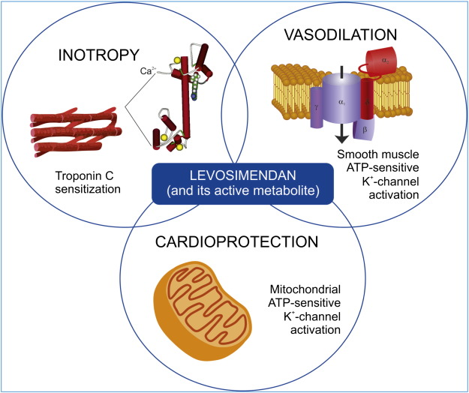
Levosimendan
Pozitív inotróp szer (kalcium-sensitizer), mely nem okoz frekvencia emelkedés
Ino-, venodilatatív hatásai miatt nem terjedt el szeptikus sokkban
Súlyos myocardium deplécióban (alacsony EF) mellett megfontolandó, szoros dózistitrálás mellett
Érdekességek
levosimendan > dobutamin: significant improvement of CI, LVSWI, decrease of lactate in septic patients with myocardial
no impact on mortality nor LVEF
levosimendan: no benefit in mortality and ICU stay
better lactate clearance and higher CI
NA requirements were similar in both groups
Levosimendan group: CI, LVEF, SVI, SVV were higher, lower NA requirements
no differences in 28-day mortality, ICU stay
Notes:
Liu et al.: Levosimendan and dobutamine are extensively used to treat sepsis-associated cardiovascular failure in ICU.
Outcomes included changes in cardiac function, lactic acid, mortality and length of hospital stay. A total of 6 randomized controlled trials were included in this study, including 192 patients
Compared with dobutamine, patients treated with levosimendan had a greater improvement of cardiac index (ΔCI) (random effects, SMD = 0.90 [0.20,1.60]; I² = 76%, P < 0.01) and left ventricular stroke work index (ΔLVSWI) (random effects, SMD = 1.56 [0.90,2.21]; I² = 65%, P = 0.04), a significant decrease of blood lactate (Δblood lactate) (random effects, MD = − 0.79 [− 1.33, − 0.25]; I² = 68%, P < 0.01) at 24-h after drug intervention, respectively. There was no significant difference between levosimendan and dobutamine on all-cause mortality in ICU (fixed effect, OR = 0.72 [0.39,1.33]; I² = 0%, P = 0.99).
Septic patients with myocardial dysfunction may partly benefit from levosimendan than dobutamine, mainly embodied in cardiac function improvement.
Bhattacharjee et al.:
Data from 7 randomized trials have been included in this meta-analysis. Levosimendan has no benefit in terms of mortality at longest follow up in comparison to dobutamine (Odds ratio 0.77, 95% CI 0.45, 132; p=0.34) and length of ICU stay (MD -4.7days, 95% CI -10.3, 0.9days, p=0.10). Patients received levosimendan had less blood lactate level (standardized mean difference -0.95; 95% CI -1.64, -0.27; p=0.006) and higher cardiac index (mean difference 0.44; 95% CI 0.17, 0.71; p=0.001). Noradrenaline requirements are similar in both the groups.
Tao Sun et al.:
Left ventricular ejection fraction [LVEF] ≤35%. At the 24th hour after treatment, CI, LVEF, SVI, and fluid volume were found to be higher in the levosimendan group than in the dobutamine group, whereas the dose of norepinephrine was lower in the former rather than the latter group, cardiac troponin I in the levosimendan group was lower

Slide 21
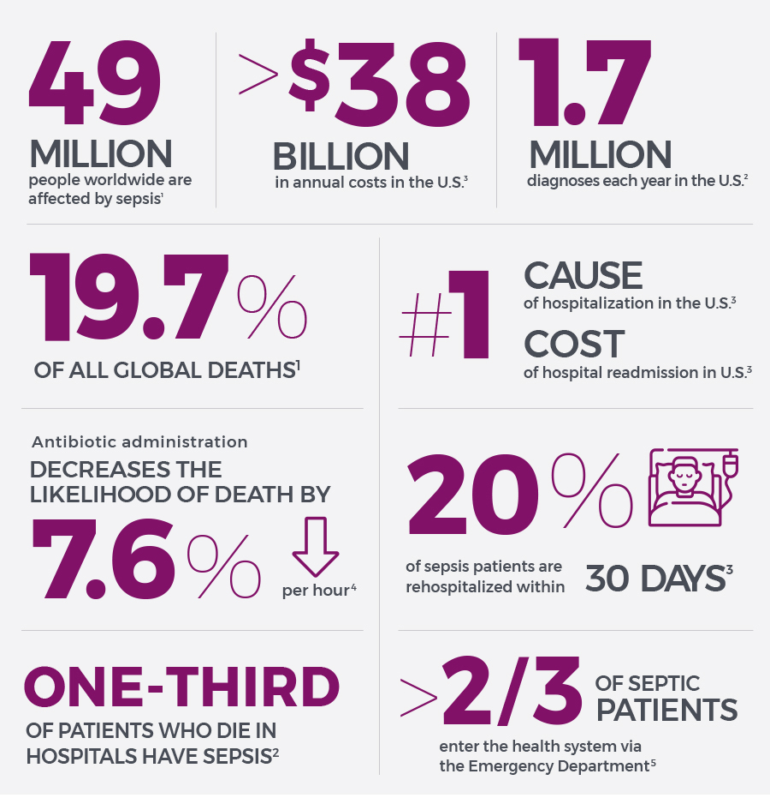

Slide 22
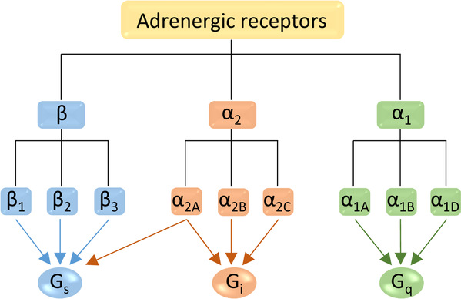
Notes:
β-Adrenergic receptors are seven transmembrane/G protein-coupled receptors that use G_{s} to activate adenylate cyclase which, in turn, increases cyclic adenosine monophosphate-activating protein kinase A
Protein kinase A regulates several key cellular processes such as glycogen and lipid metabolism. β1-Adrenergic receptors are found on cardiomyocytes, causing a positive inotropic effect; in the kidney, causing renin release; and on adipocytes, causing lipolysis. In contrast, β2-adrenergic receptors are found in smooth muscle sites, including bronchi, causing relaxation; in β-islet cells in the pancreas, causing insulin secretion; and in hepatocytes, causing glycogenolysis and gluconeogenesis. With such a variety of actions, β-adrenergic receptors play a vital role in modulation of the physiological response to sepsis.
Actions of the β₁ receptor include:
increase cardiac output by increasing heart rate (positive chronotropic effect), conduction velocity (positive dromotropic effect), stroke volume (by enhancing contractility – positive inotropic effect), and rate of relaxation of the myocardium, by increasing calcium ion sequestration rate (positive lusitropic effect), which aids in increasing heart rate
increase renin secretion from juxtaglomerular cells of the kidney
increase ghrelin secretion from the stomach
smooth muscle relaxation throughout many areas of the body, e.g. in bronchi, GI tract (decreased motility), veins (vasodilation of blood vessels), especially those to skeletal muscle (although this vasodilator effect of norepinephrine is relatively minor and overwhelmed by α adrenoceptor-mediated vasoconstriction)
lipolysis in adipose tissue
anabolism in skeletal muscle
glycogenolysis and gluconeogenesis
stimulates insulin secretion
Actions of the β₃ receptor include:
increase of lipolysis in adipose tissue

Slide 23
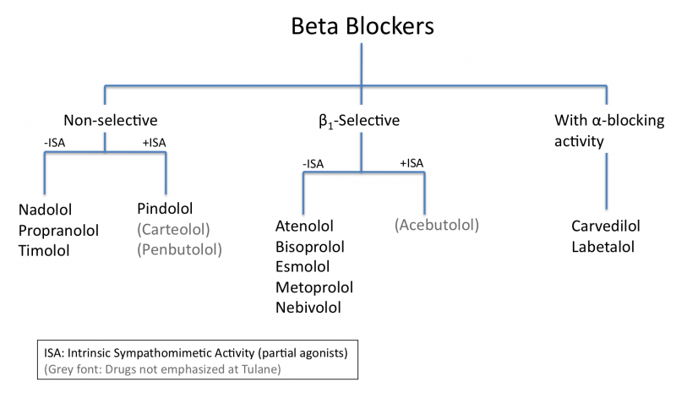
Notes:
ISA: intrinsic sympathomimetic activity – this term is used particularly with beta blockers that can show both agonism and antagonism at a given beta receptor, depending on the concentration of the agent (beta blocker) and the concentration of the antagonized agent (usually an endogenous compound, such as norepinephrine) // beta-blockers with ISA are beta-blockers that exert a partial agonism at the adrenergic receptor while simultaneously blocking the endogenous catecholamines from binding to the receptor
Beta-blockers with ISA are beta-blockers that exert a partial agonism at the adrenergic receptor while simultaneously blocking the endogenous catecholamines from binding to the receptor.
Az ISA hatással rendelkező β blokkolók kevésbé okoznak bradycardiát és kedvezőtlen plazmalipid eltéréseket.
Laabetalol: alfa1 blokkoló hatással is rendelkezik
Nebivolol: NO mediált vazodilatáció révén csökkenti a tenziót
The 2007 National Heart, Lung, and Blood Institute (NHLBI) asthma guidelines recommend against the use of non-selective beta blockers in asthmatics, while allowing for the use of cardio selective beta blockers!

