Slide 1
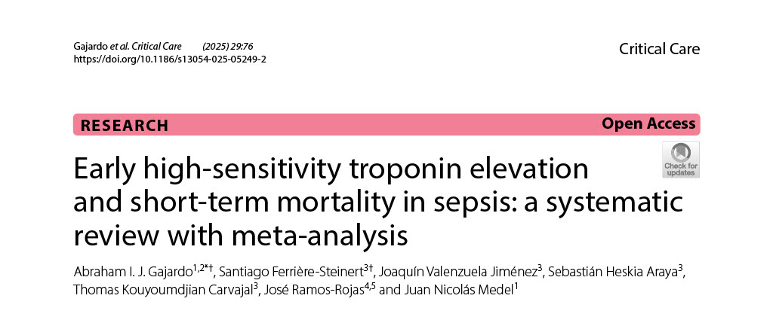

Slide 2
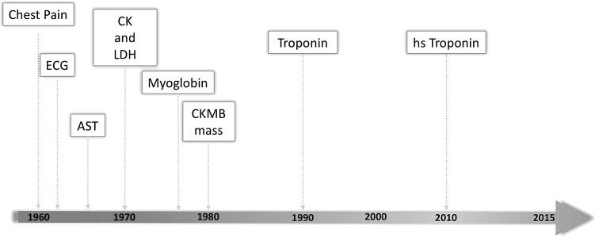
Garg, P., Morris, P., Fazlanie, A. L., Vijayan, S., Dancso, B., Dastidar, A. G., Plein, S., Mueller, C., & Haaf, P. (2017). Cardiac biomarkers of acute coronary syndrome: from history to high-sensitivity cardiac troponin. Internal and Emergency Medicine, 12(2), 147. https://doi.org/10.1007/S11739-017-1612-1

Slide 3
Biomarker | Rise/Peak/Duration | Era of Use | Clinical Utility and Notes
AST (SGOT) | Rises ~6–12 h; peaks ~18–24 h; normal by 3–5 days​ | 1950s–1970s (historical). | First enzyme used for MI (1950s. Non-specific – also elevated in liver, muscle, hemolysis​ Abandoned as cardiac marker.
LDH (total) | Rises ~12 h; peaks 2–3 days; normal by 8–14 days​ | 1960s–1980s (historical). | Early marker (with AST). LDH1 isoenzyme (heart) > LDH2 (“flipped LDH”) was specific for MI​ Non-specific overall; now obsolete except in late-presenting MI when CK-MB is normal​
CK (Total CK) | Rises ~4–8 h; peaks ~24 h; normal by ~3 days​ | 1970s–1990s (with CK-MB). | Higher sensitivity than AST/LDH, but not specific (skeletal muscle injury elevates CK)​ . Used with CK-MB for decades; now replaced by troponin.
CK-MB | Rises ~4–6 h; peaks ~18–24 h; normal by 48–72 h | 1970s–2000s (gold standard pre-troponin). | Cardiac-specific isoenzyme (~20% of myocardial CK)​Main MI diagnostic enzyme in 1980s–90s​Good specificity but misses small MIs. Now largely replaced by troponin; used occasionally for reinfarction detection (new rise after 2 days)​
Myoglobin | Rises ~1–2 h; peaks ~6–12 h; normal by 24 h​ | 1980s–2000s (adjunct marker). | Very early release (earliest of all markers)​. High sensitivity for early MI, but poor specificity (elevated in any muscle injury)​. Formerly used for early rule-out; now not recommended as troponin assays improved​
Troponin I/T | Rises ~3–6 h (can be <3 h with hs-cTn); peaks ~18–36 h; remains elevated 7–10+ days | 1990s–present (current gold standard). | Cardiac-specific proteins not normally in blood​. Highest sensitivity for myocardial necrosis – detects even microinfarcts Now the primary diagnostic biomarker for MI per global guidelines​. High-sensitivity troponin assays (2010s) allow earlier detection and rule-out protocols

Slide 4
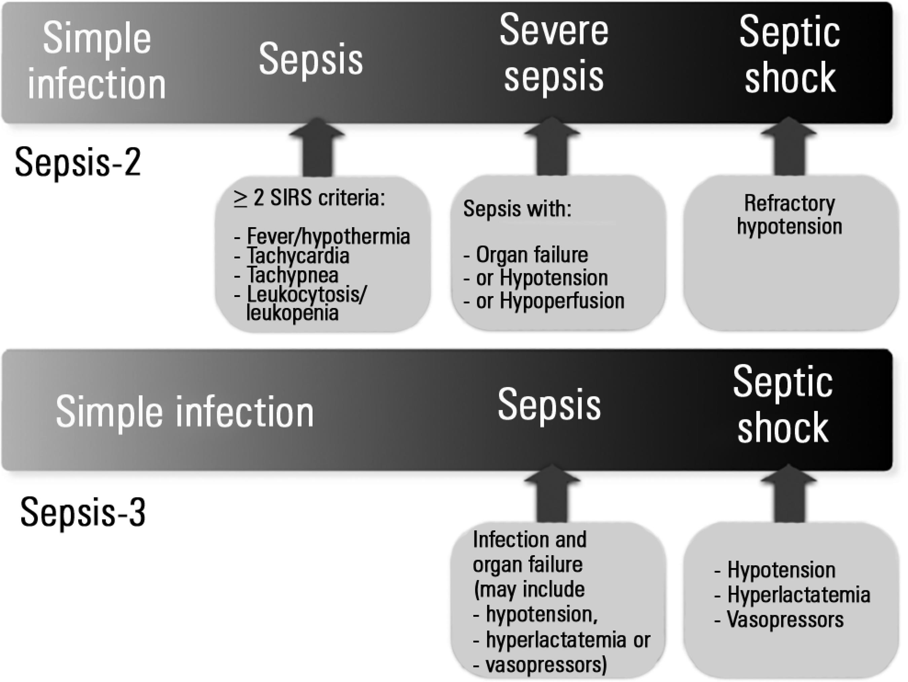
SEPSIS
SEPSIS 1 1991
SEPSIS 2 2001
SEPSIS 3 2016 (ESICM-SCCM)
https://www.acepnow.com/article/acep-endorses-latest-surviving-sepsis-campaign-recommendations/acep_0317_pg6a/

Slide 5
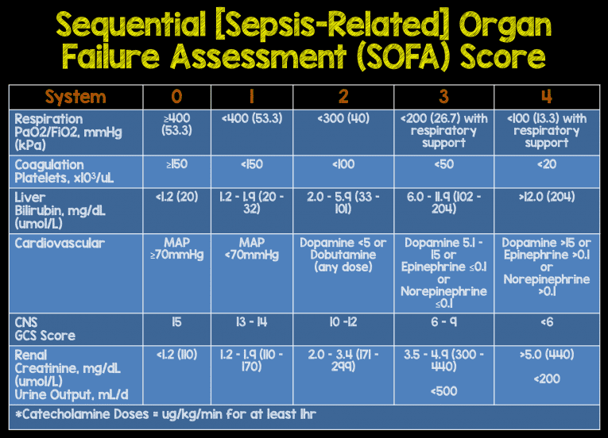
https://rebelem.com/episode-37-definitions-identification-sepsis-sepsis-2-0-vs-sepsis-3-0/

Slide 6
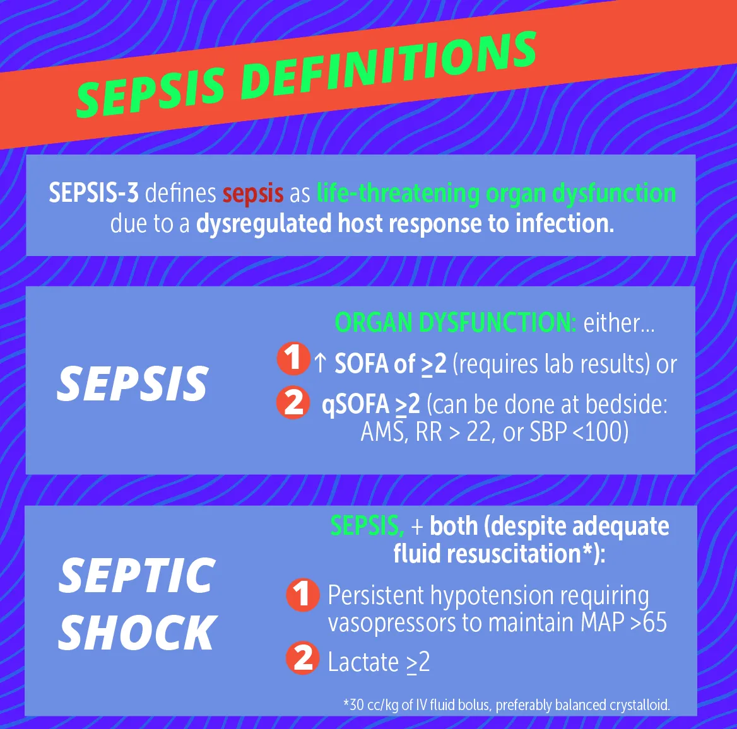
https://rebelem.com/episode-37-definitions-identification-sepsis-sepsis-2-0-vs-sepsis-3-0/

Slide 7
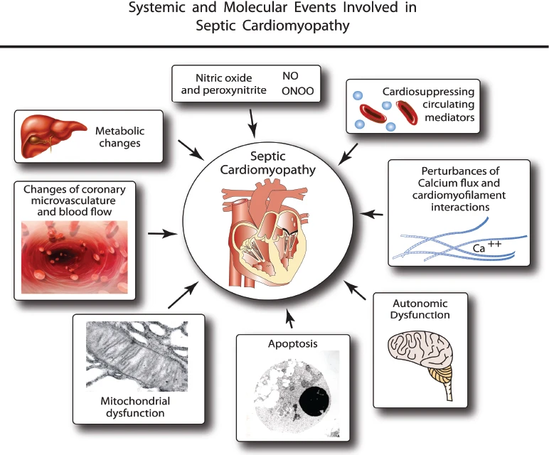
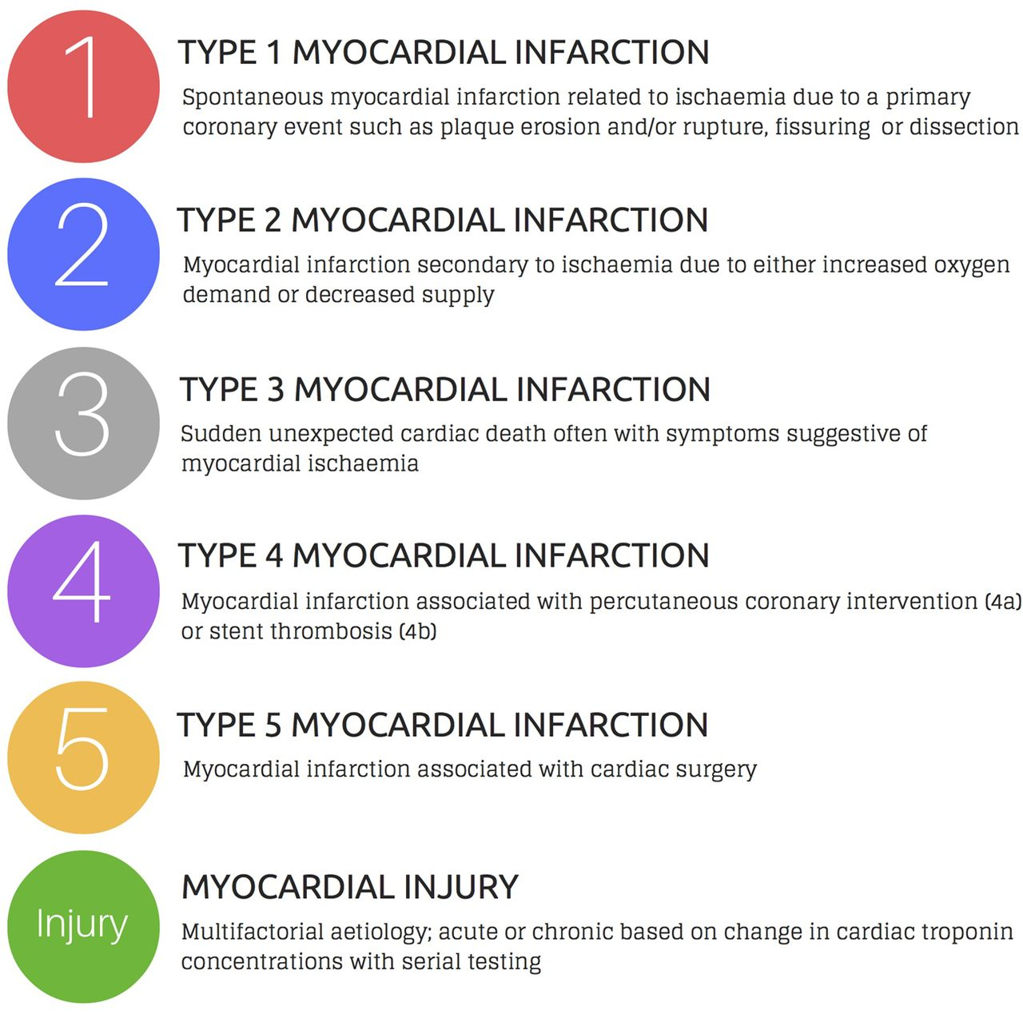
SEPSIS-Troponin
Flierl, M.A., Rittirsch, D., Huber-Lang, M.S. et al. Molecular Events in the Cardiomyopathy of Sepsis. Mol Med 14, 327–336 (2008). https://doi.org/10.2119/2007-00130.Flierl
Chapman AR, Adamson PD, Mills NLAssessment and classification of patients with myocardial injury and infarction in clinical practiceHeart 2017;103:10-18.

Slide 8
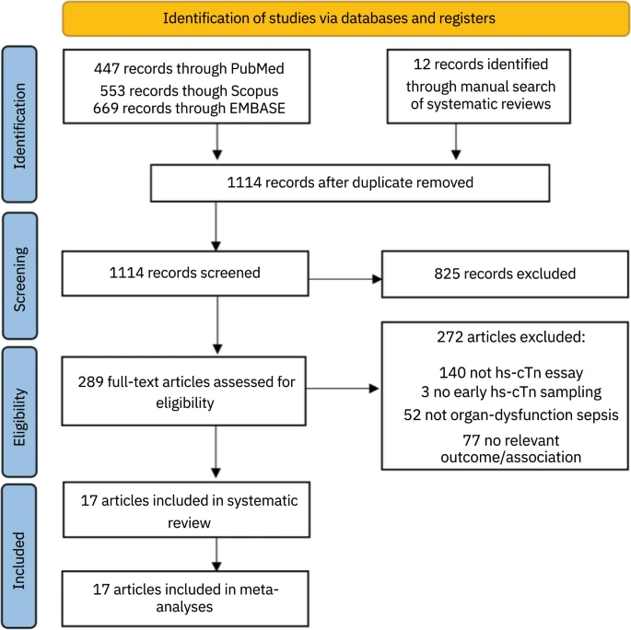
N _{(cTnT)} =12
N _{(cTnI)} = 5

Slide 9
Author, year | Patients (n) | Setting, Country | Excluded comorbidities | Study design | Sepsis criteria, % Shock | Mortality Rate, Follow-up Mortality | Troponin type and cut-off | Variables in multivariate analysis | Reported associations
Innocenti et al. (2022) [21] | 164 | ED, Italy | Cardiovascular | Prosp. | Sepsis and septic shock (Sepsis-3), 41% shock | 29.5%, 28-day | cTnI (100 ng/L) | NA | Contingency table, Mean difference (a)
Landesberg et al. (2012) [35] | 262 | ICU, NR | Cardiovascular | Prosp. | Severe sepsis and septic shock (Sepsis-1), 62% shock | 36%, In-hospital | cTnT (30 ng/L) | NA | Mean difference
Røsjø et al. (2011) [7] | 204 | ICU, Finland | None | Prosp. | Severe sepsis and septic shock (Sepsis-1), % shock NR | 22,70%, In-hospital | cTnT (14 ng/L) | cTnT, Age, CVD, eGFR, Lactate, SAPS II, SOFA | Contingency table, Mean difference, Multivariate regression
Vallabhajosyula et al. (2017) [24] | 944 | ICU, USA | None | Retro | Severe sepsis and septic shock (sepsis-2), 66% shock | 25,90%, In-hospital | cTnT (10 ng/L) | log10(cTnT), age, sex, BMI, Charlson index, AKI, Resp. failure | Contingency table, Multivariate regression
Landesberg et al. (2015) [36] | 105 | ICU, NR | Cardiovascular | Prosp. | Severe sepsis and septic shock (sepsis-1), 71% shock | 42%, In-hospital | cTnT (NA) | NA | Mean difference
Masson et al. (2016) [30] | 955 | UCI, Italy | Traumatic, Cardiovascular, Hepatic, Renal | RCT | Severe sepsis and septic shock (sepsis-1), 56% shock | 26,40%, ICU | cTnT (26 ng/L) | cTnT, Age, sex, BMI, reason for admission to ICU, MV, SAPS II, SOFA, COPD, CKD, immunodeficiency, HF, Pao2/FIO2, platelet count, bilirubin, lactate, diuresis | Multivariate logistic regression
Antcliffe et al. (2019) [23] | 442 | ICU, UK | Renal, Hepatic, Cardiovascular | RCT | Septic shock (sepsis-2), 100% shock | 27,10%, 28-day | cTnI (34 ng/l) | NA | Contingency table
Sasko et al. (2015) [22] | 50 | ICU, Germany | None | Prosp. | septic shock (Sepsis-2), 100% shock | 53,80%, 28-day | cTnI (15 ng/L) | cTnT > 15 (ng/L), sex, age, CAD, MAP < 65, CVP < 12, SvO2 < 70%, HTC < 30%, LVEF < 40% | Contingency table, Mean difference, multivariate logistic regression
De Geer et al. (2015) [34] | 50 | ICU, Sweden | None | Prosp. | septic shock (Sepsis-2), 100% shock | 30%, 30-day | cTnT (NA) | NA | Mean difference
Sirvent et al. (2015) [39] | 42 | ICU, Spain | None | Prosp. | sepsis and septic shock (sepsis-2), 69% shock | 35,70%, 28-day | cTnT (NA) | NA | Mean difference

Slide 10
Author, year | Patients (n) | Setting, Country | Excluded comorbidities | Study design | Sepsis criteria, % Shock | Mortality Rate, Follow-up Mortality | Troponin type and cut-off | Variables in multivariate analysis | Reported associations
Kim et al. (2020) [29] | 778 | ED, South Korea | Cardiovascular | Retro | Septic shock (Sepsis-2), 100% shock | 28,70%, 28-day | cTnI (40 ng/L) | cTnI, hypertension, DM, CKD, malignancy, gastrointestinal infection, unknown site infection, RV dysfunction | Multivariate logistic regression
Lundberg et al. (2016) [40] | 53 | ICU, Sweden | Hematological, Immunological | Prosp. | Septic shock (Sepsis-2), 100% shock | 28,30%. 28-day | cTnT (14 ng/L) | NA | Mean difference
Landesberg et al. (2014) [41] | 106 | ICU, Israel | Cardiovascular | Prosp. | Severe sepsis and septic shock (sepsis-2), 61% shock | 38.6%, In-hospital | cTnT (14 ng/L) | cTnT, RVESV, longitudinal SRe’ | Univariate and Multivariate logistic regression, Mean difference
Wang et al. (2020) [28] | 98 | ICU, China | Cardiovascular, Immunosuppression | Prosp. | Sepsis and septic shock (Sepsis-3), 43% shock | 26.5%, 28-day | cTnT (100 ng/L) | cTnT > 100 (ng/L), hs-CRP, APACHE-II, SVI, APN, Cardiac index | Univariate and Multivariate logistic regression
Jendoubi et al. (2019) [26] | 75 | ICU, NR | Cardiovascular | Prosp. | Septic shock (Sepsis-1), 100% shock | 54.6%, 28-day | cTnI (34 ng/L for men and 16 ng/L for women) | NA | Contingency table, Mean difference
Vallabhajosyula et al. (2018) [25] | 602 | ICU, US | Renal, Cardiovascular | Retro | Severe sepsis and septic shock (Sepsis-2), 69% shock | 17.4%, ICU | cTnT (10 ng/L) | NA | Contingency table, Mean difference (b)
Xu et al. (2023) [27] | 1312 | ICU, China | Cardiovascular | Retro | Sepsis and septic shock (sepsis-3), 59% shock (c) | 29,30%, 28-day | cTnT (10 ng/L) | cTnT > 10 (ng/L), Hypertension, DM, CKD, SOFA, mechanical ventilation, CRRT, Vasoactive support, SIMI, creatinine | Contingency table, univariate Cox regression, multivariate Cox regression

Slide 11
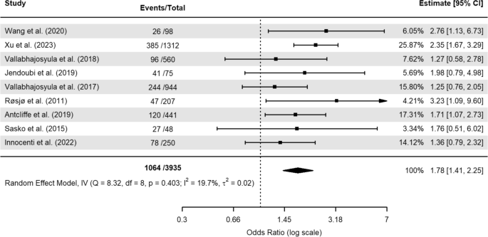
Unadjusted OR = 1.78

Slide 12
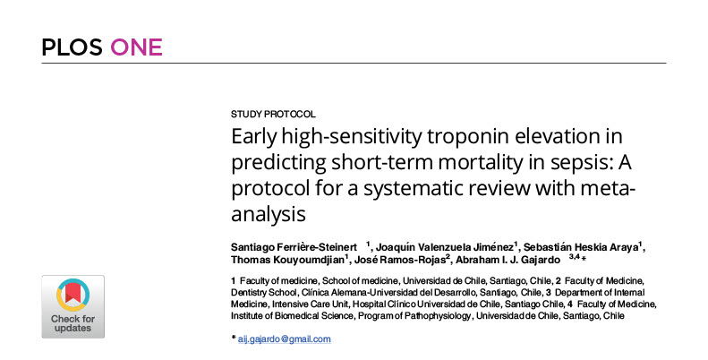
severity of sepsis, age, and comorbidities (any cardiac or renal).

Slide 13
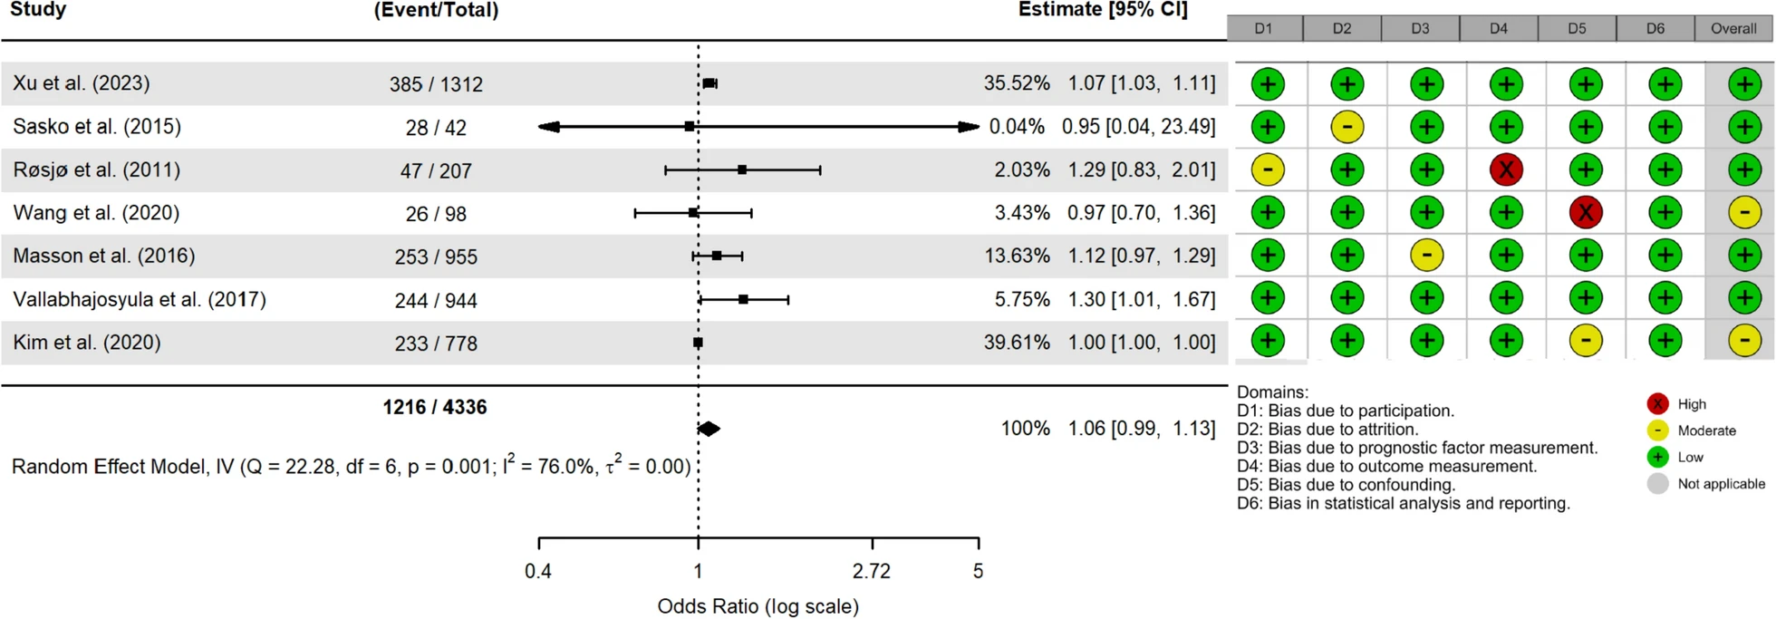
Adjusted OR = 1.06

Slide 14
Conclusion
Non-survivors of sepsis exhibited significantly elevated hs-cTn levels. While elevated hs-cTn levels are associated with an increased risk of mortality, they are not independently associated with this outcome in sepsis.

Slide 15
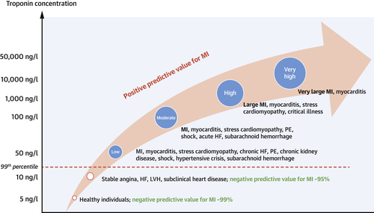
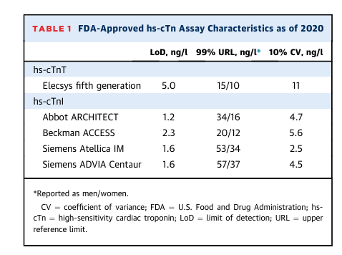
Hs-cTn assays
Raber, I., McCarthy, C. P., & Januzzi, J. L. (2021). A Test in Context: Interpretation of High-Sensitivity Cardiac Troponin Assays in Different Clinical Settings. Journal of the American College of Cardiology, 77(10), 1357–1367. https://doi.org/10.1016/J.JACC.2021.01.011

