Slide 1

Angiotenzin II refrakter vazodilatációs sokkban
Csontos Csaba
PTE KK AITI

Slide 2

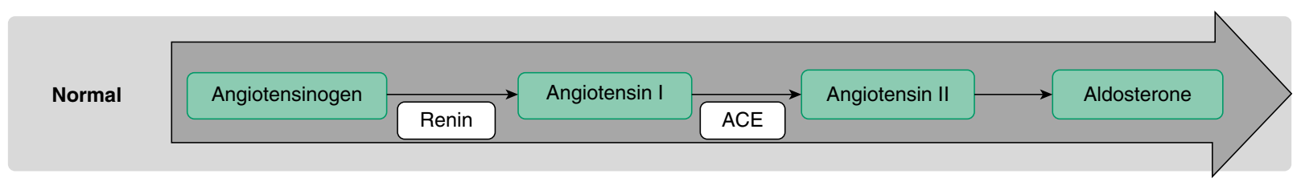
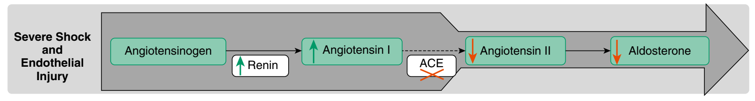

Angiotenzin II szepszisben

Slide 3
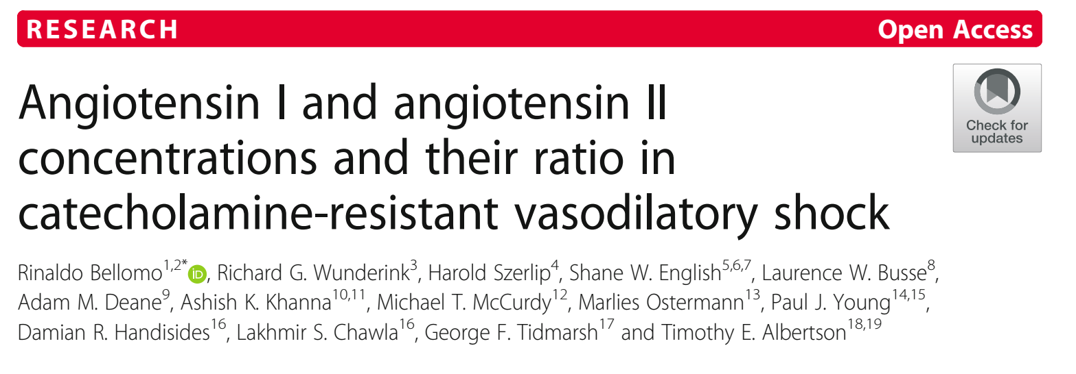
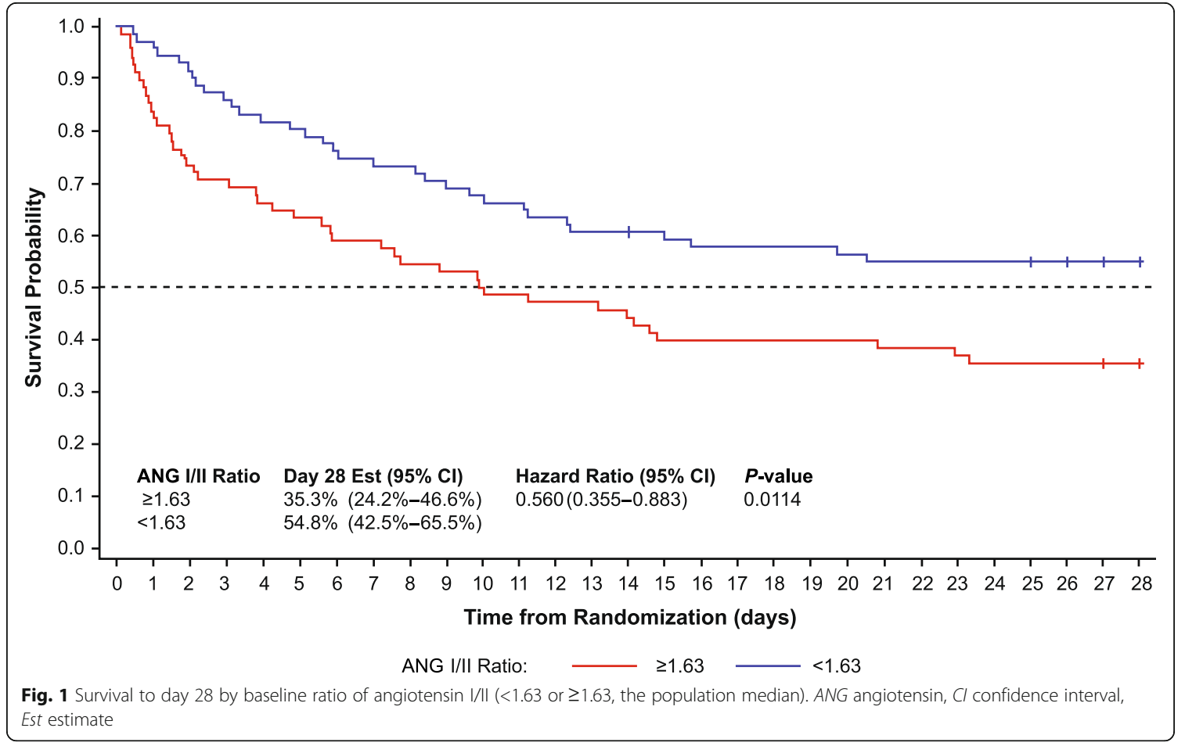

Slide 4
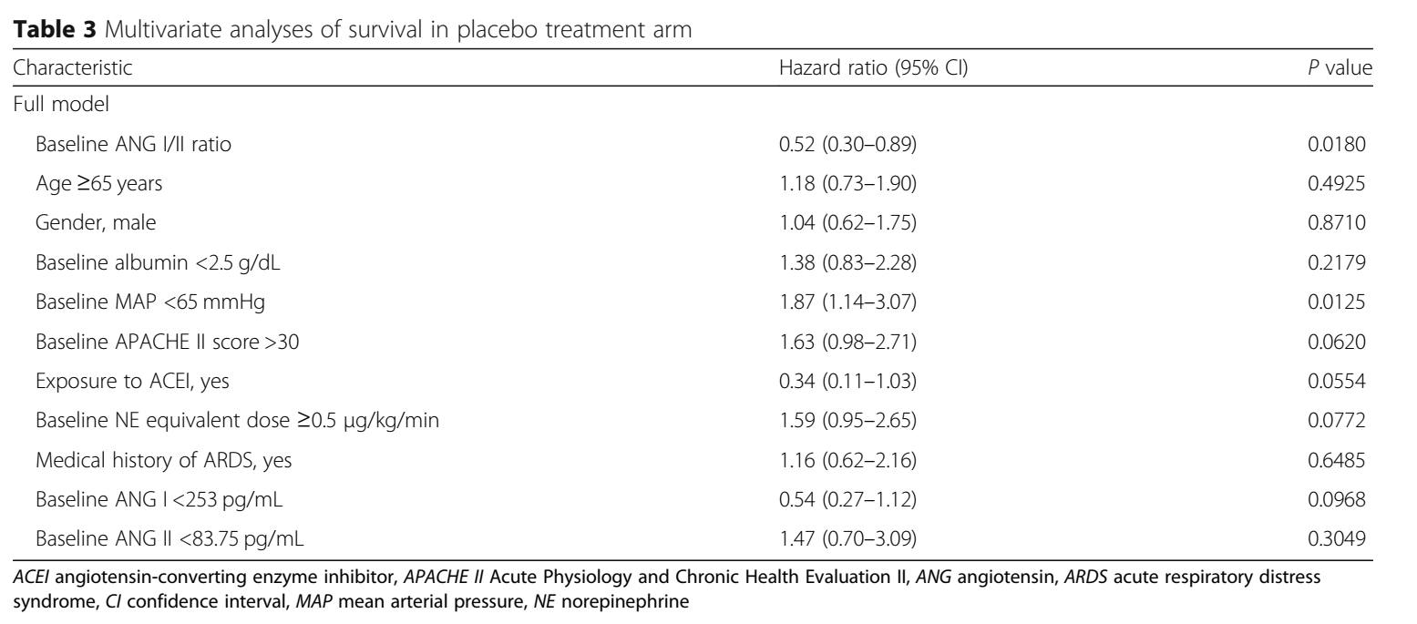

Slide 5
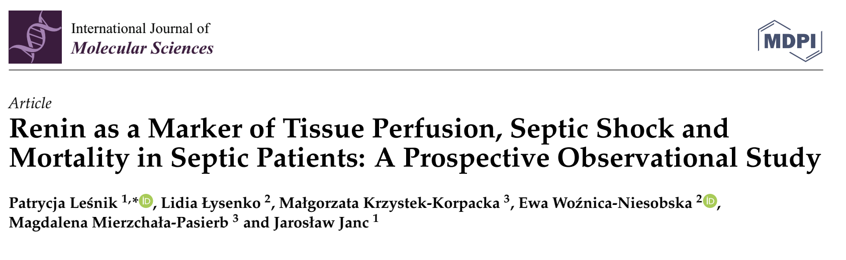
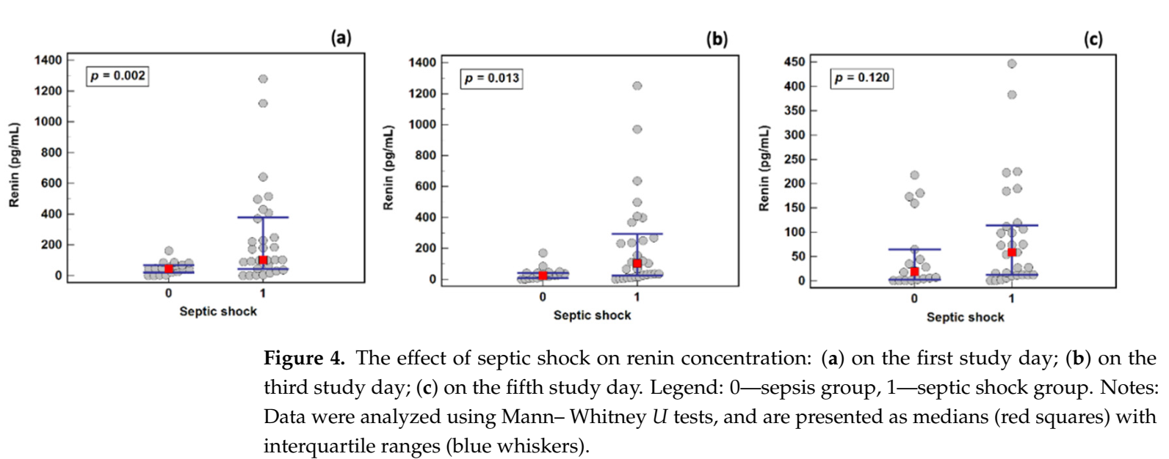
Az 1. és 3. napon a plazma renin szint szignifikánsan magasabb sokkban

Slide 6
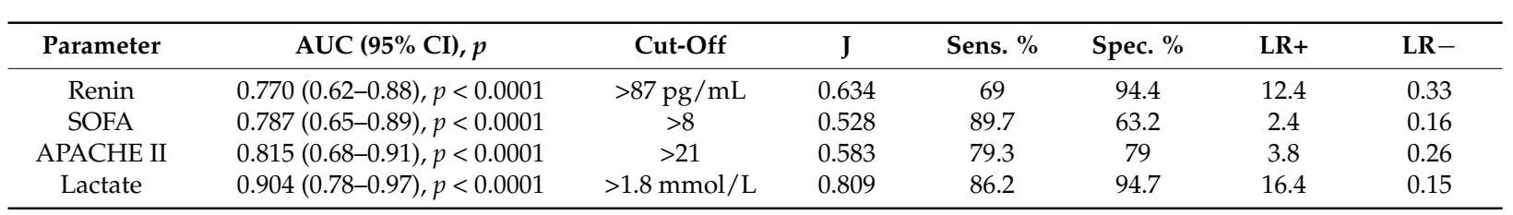
Plazma renin szint a szeptikus sokk markere?

Slide 7
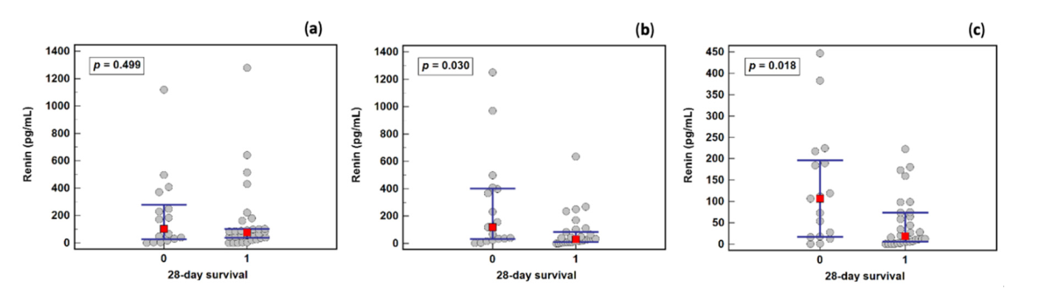
A 3. és 5. napon a plazma renin szint szignifikánsan magasabb a meghaltaknál

Slide 8
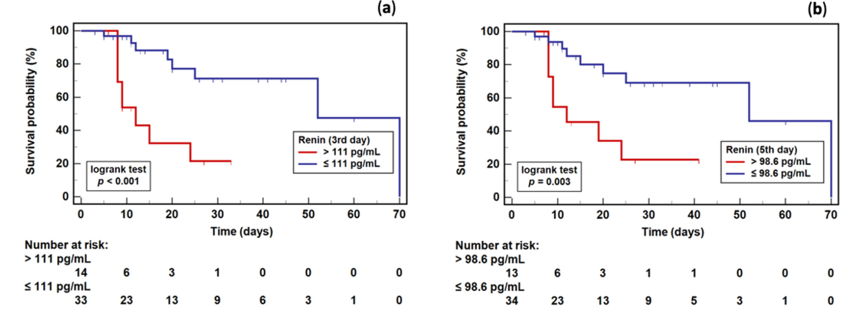

Slide 9
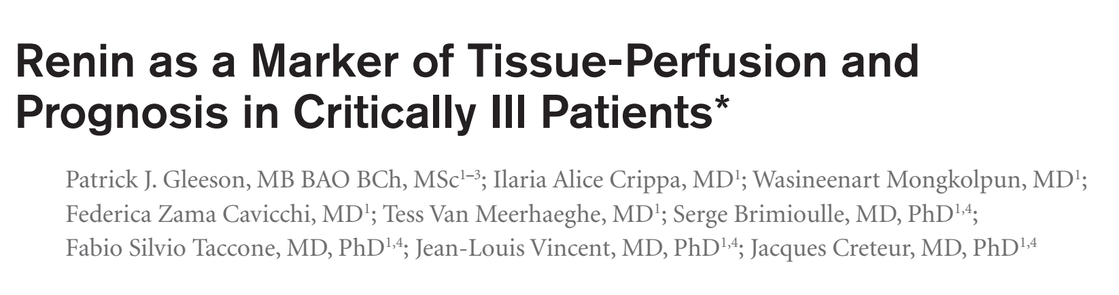
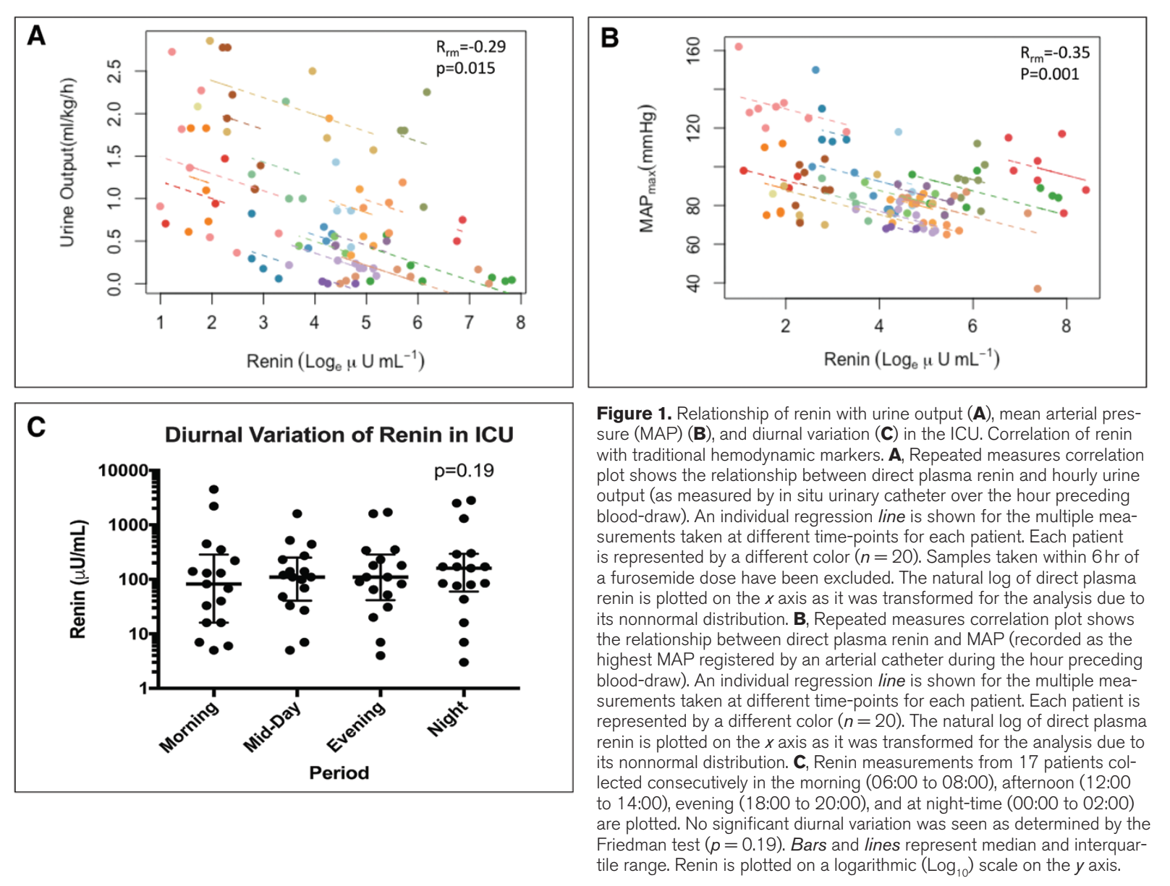

Slide 10
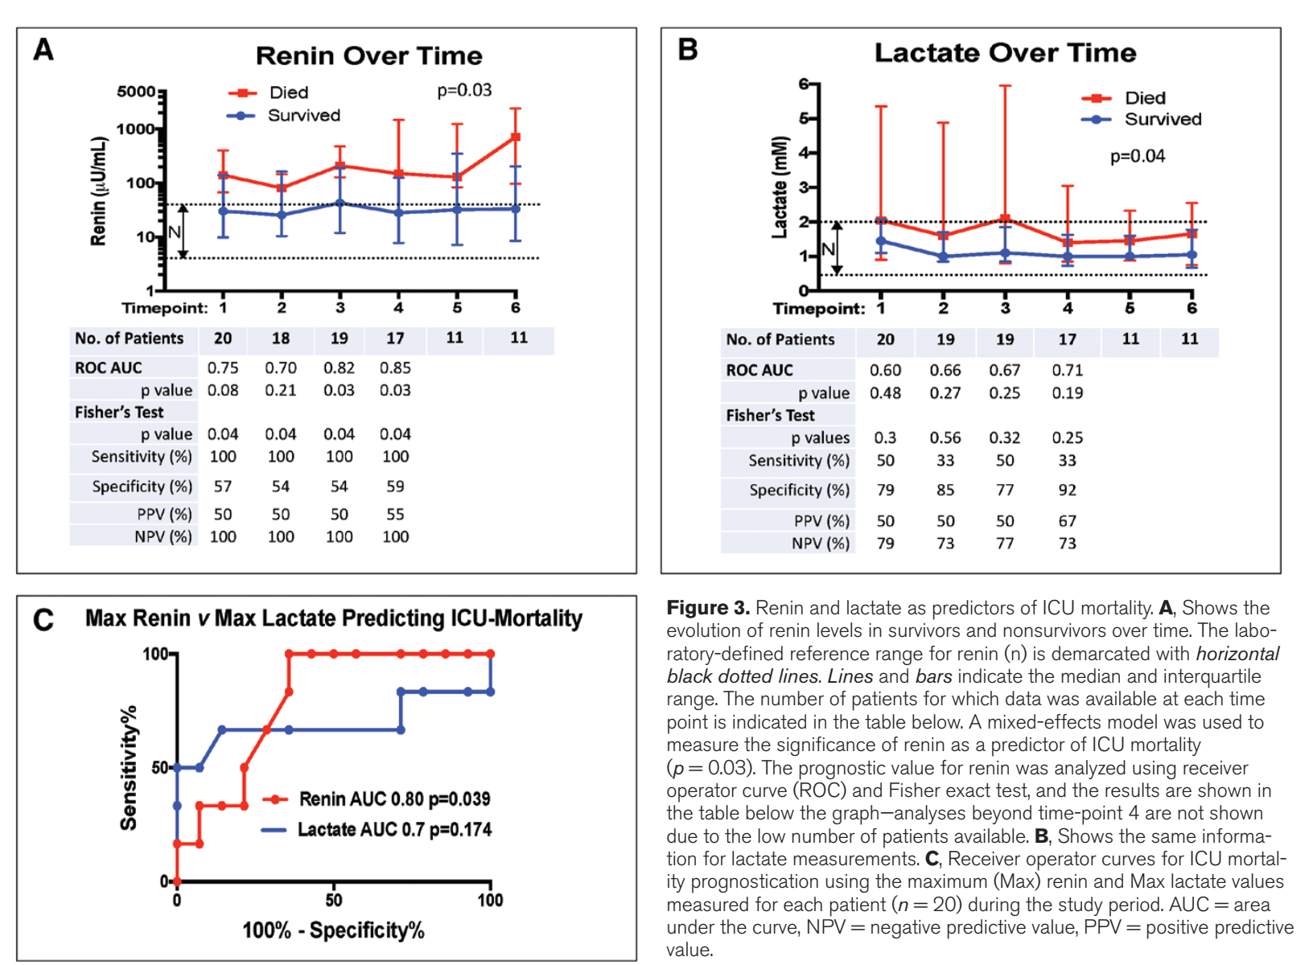

Slide 11

Angiotensin II nem hemodinamikai hatásai

Slide 12
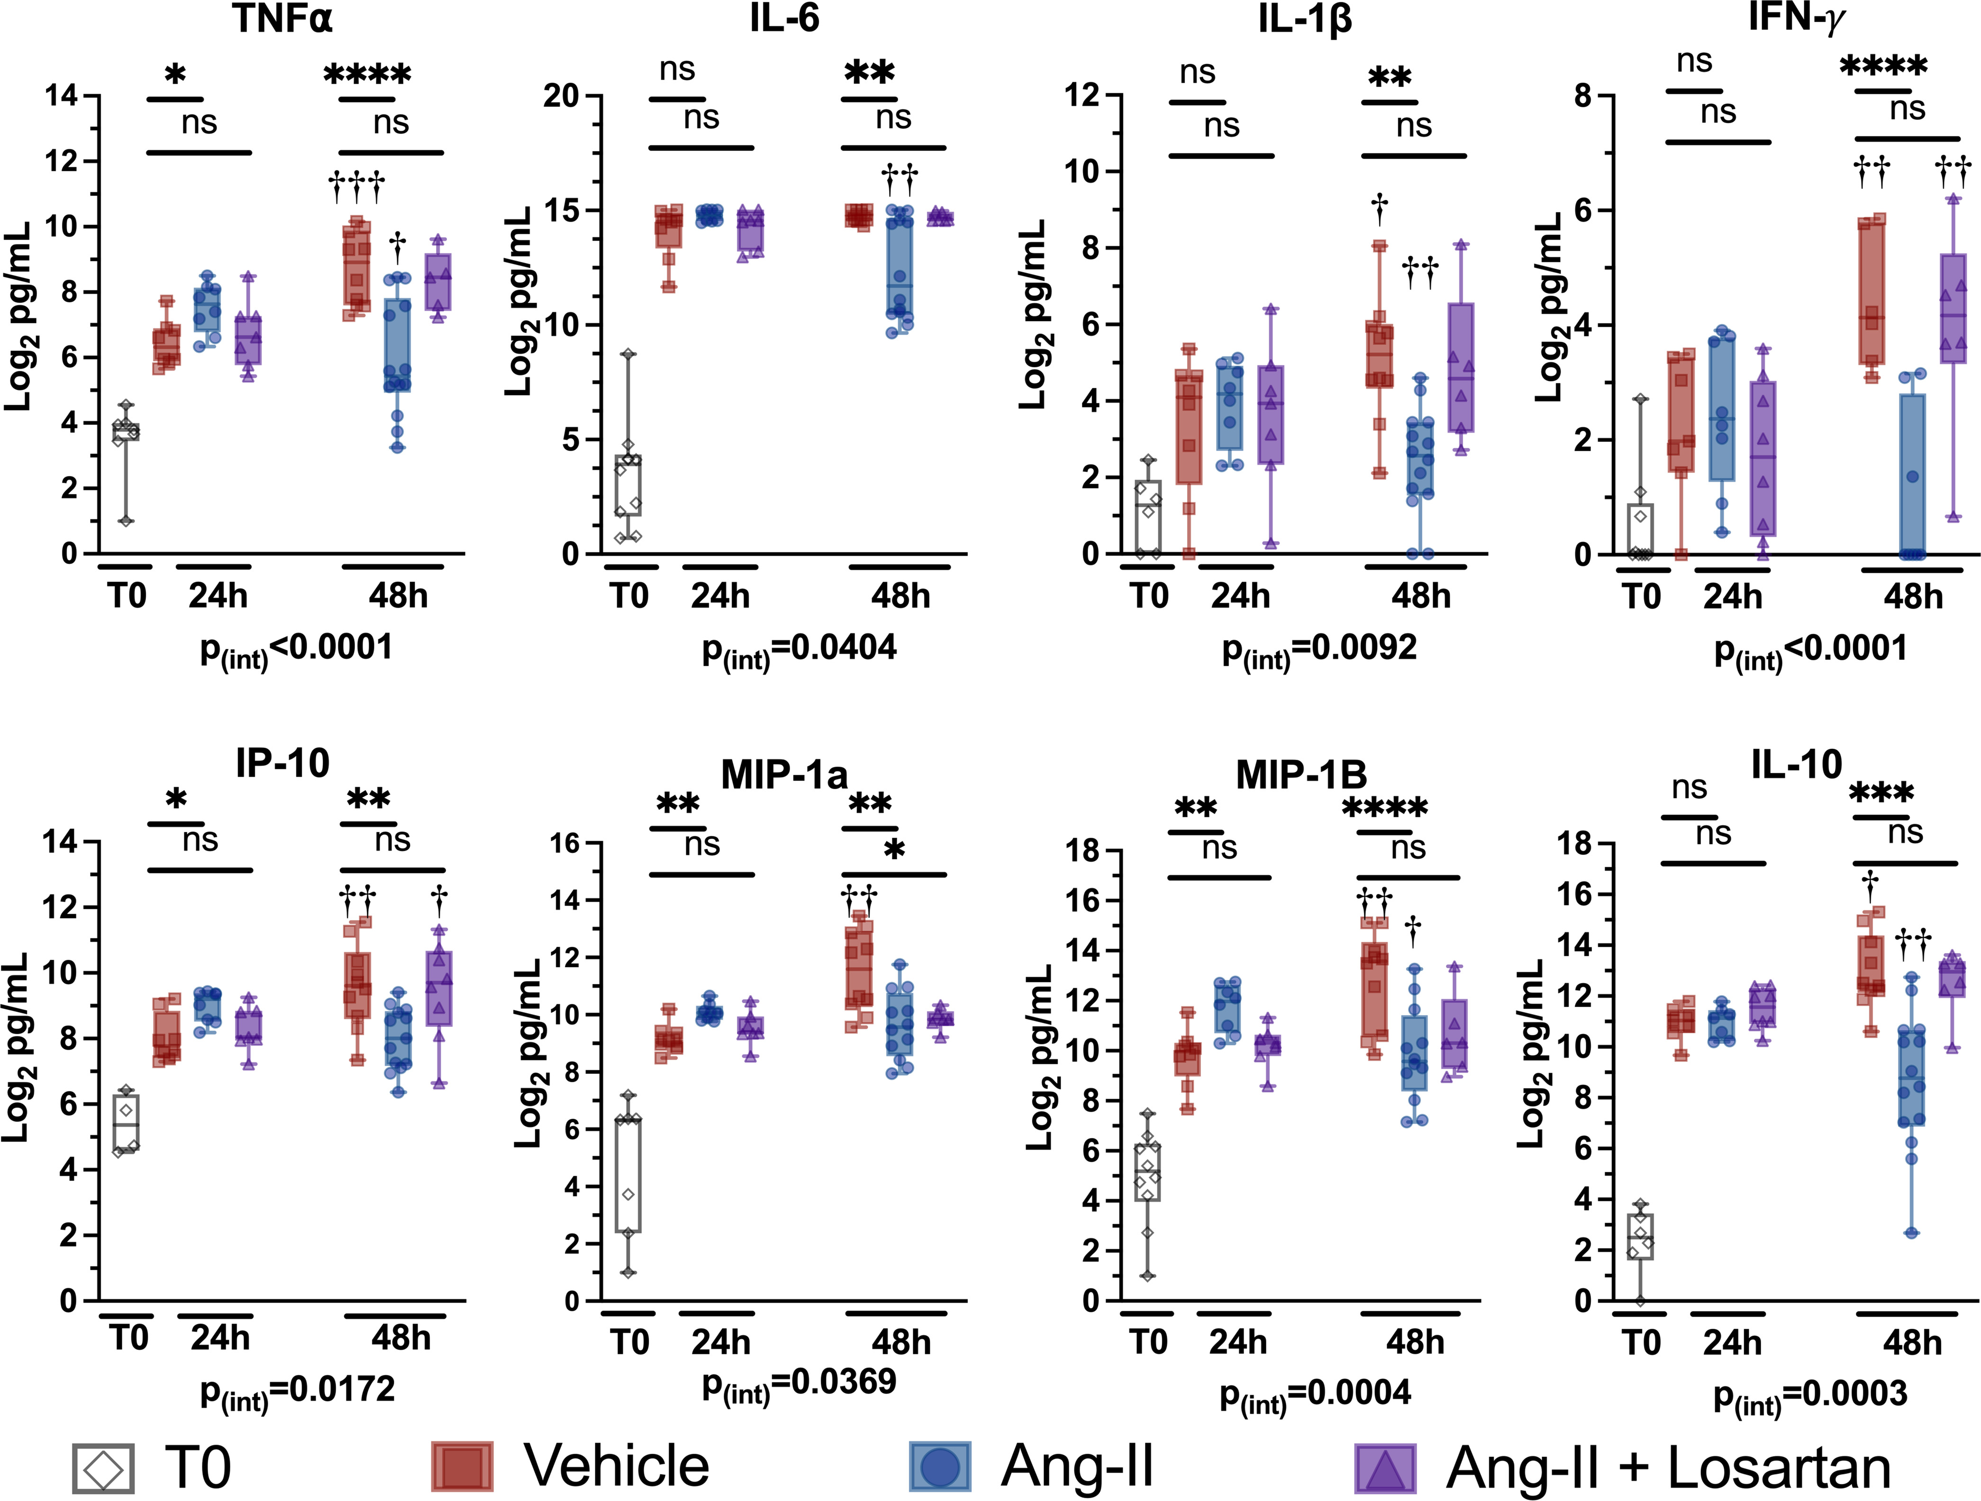
Angiotensin II enhances bacterial clearance via myeloid signaling in a murine sepsis model Daniel E. Leismana,b,c,1 , Jamie R. Privratskyd , Jake R. Lehmanc,e , Mabel N. Abrahamc,e, Omar Y. Yaipanc,e, Mariana R. Brewerc,e, Ana Nedeljkovic-Kurepac,e, Christine C. Caponec,e, Tiago D. Fernandesc,e, Robert Griffithsf , William J. Steinc,e, Marcia B. Goldbergg,h,i,j , Steven D. Crowleyf , Rinaldo Bellomoj,k,l,m,n, Clifford S. Deutschmanc,e, and Matthew D. Taylorc,e Edited by Carl Nathan, Weill Medical College of Cornell University, New York, NY; received July 4, 2022; accepted July 19, 2022
Angiotensin II és gyulladásos citokinek
Angiotensin-II treatment modulates the systemic inflammatory response to CLP in a biphasic manner. Cytokine levels at T₀ and at 24 and 48 h post-CLP. The y axis displays cytokine concentrations on a log₂ scale. Dots represent individual mice, horizontal bars represent group median, box height represents interquartile range, error bars represent range. Asterisks indicate the (multiple comparison-adjusted) P values vs. the control (vehicle) group at the indicated time point as follows: ns, P > 0.05; *P < 0.05. **P < 0.005; ***P < 0.0005; ****P < 0.0001. Daggers indicate the (multiple comparison adjusted) P values for the indicated treatment group at 48 h vs. the respectively treated group at 24 h post-CLP as follows: †P < 0.05, ††P < 0.005; †††P < 0.0005, ††††P < 0.0001. The P value for the overall interaction effect of time with treatment group is displayed below each graph.

Slide 13
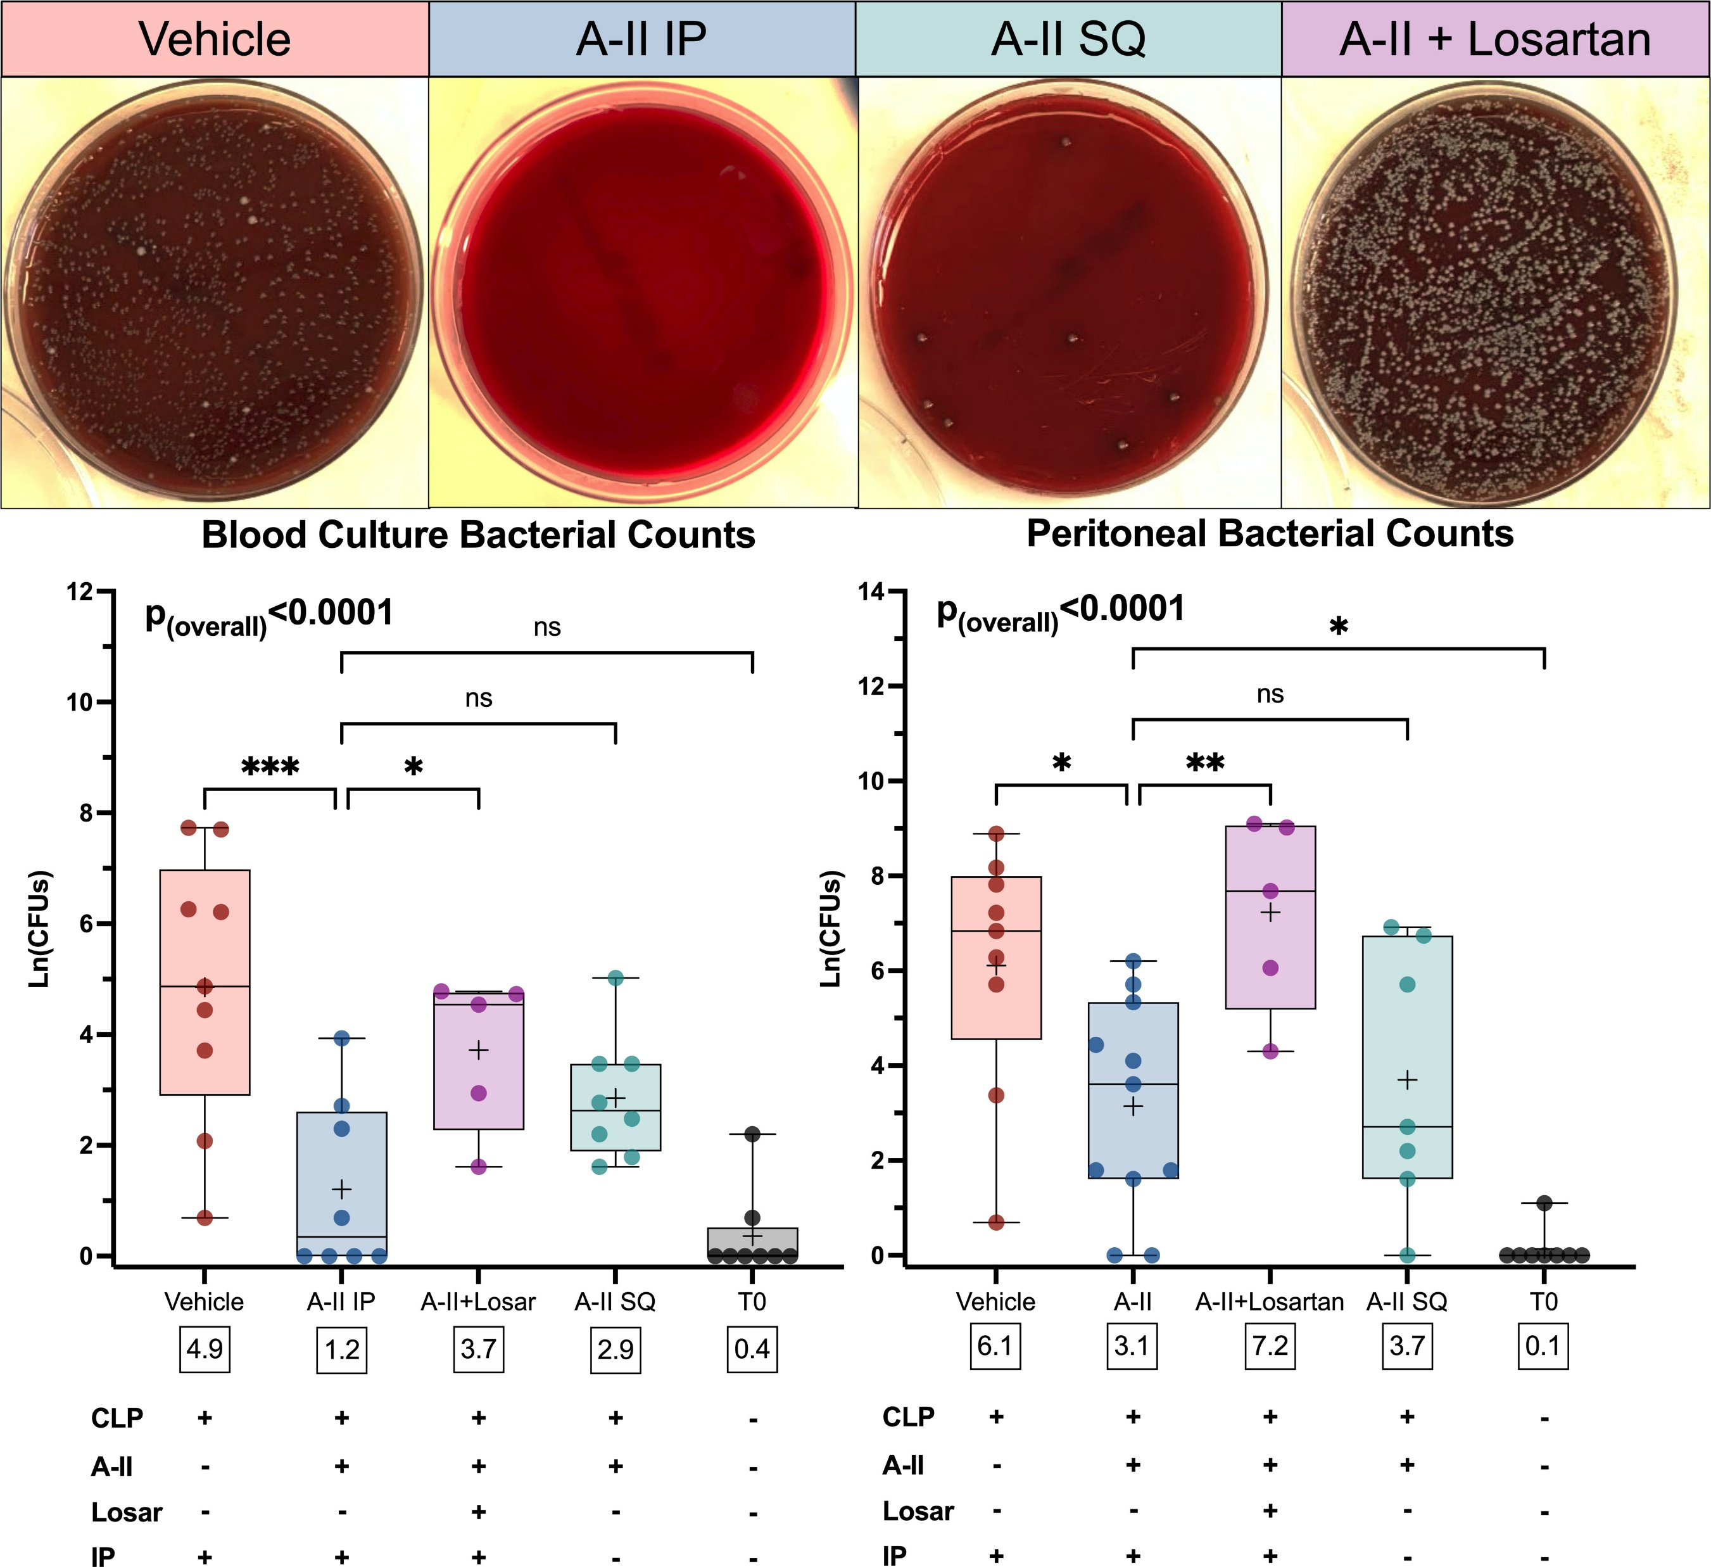
Angiotensin II enhances bacterial clearance via myeloid signaling in a murine sepsis model Daniel E. Leismana,b,c,1 , Jamie R. Privratskyd , Jake R. Lehmanc,e , Mabel N. Abrahamc,e, Omar Y. Yaipanc,e, Mariana R. Brewerc,e, Ana Nedeljkovic-Kurepac,e, Christine C. Caponec,e, Tiago D. Fernandesc,e, Robert Griffithsf , William J. Steinc,e, Marcia B. Goldbergg,h,i,j , Steven D. Crowleyf , Rinaldo Bellomoj,k,l,m,n, Clifford S. Deutschmanc,e, and Matthew D. Taylorc,e Edited by Carl Nathan, Weill Medical College of Cornell University, New York, NY; received July 4, 2022; accepted July 19, 2022
Angiotensin-II decreases bacterial growth in peritoneal and blood cultures in an AT1R-dependent manner 48-h after CLP. (Top) Images display representative peritoneal culture plates from each of the treatment groups. (Middle) Graphs display bacterial counts in treatment groups and T₀ mice. The y axis displays bacterial counts on a natural log scale. Dots represent individual mice, horizontal bars represent group median, box height represents interquartile range, error bars represent range. Asterisks indicate the (multiple comparison-adjusted) P values vs. the control (vehicle) group as follows: ns, P > 0.05; *P < 0.05; **P < 0.005; ***P < 0.0005. White boxes below each box display the overall group mean. (Bottom) Table summarizes interventions for each graph column. Abbreviations: A-II, angiotensin-II; IP, intraperitoneal; Ln(CFUs), natural log of colony forming units; Losar, losartan.

Slide 14
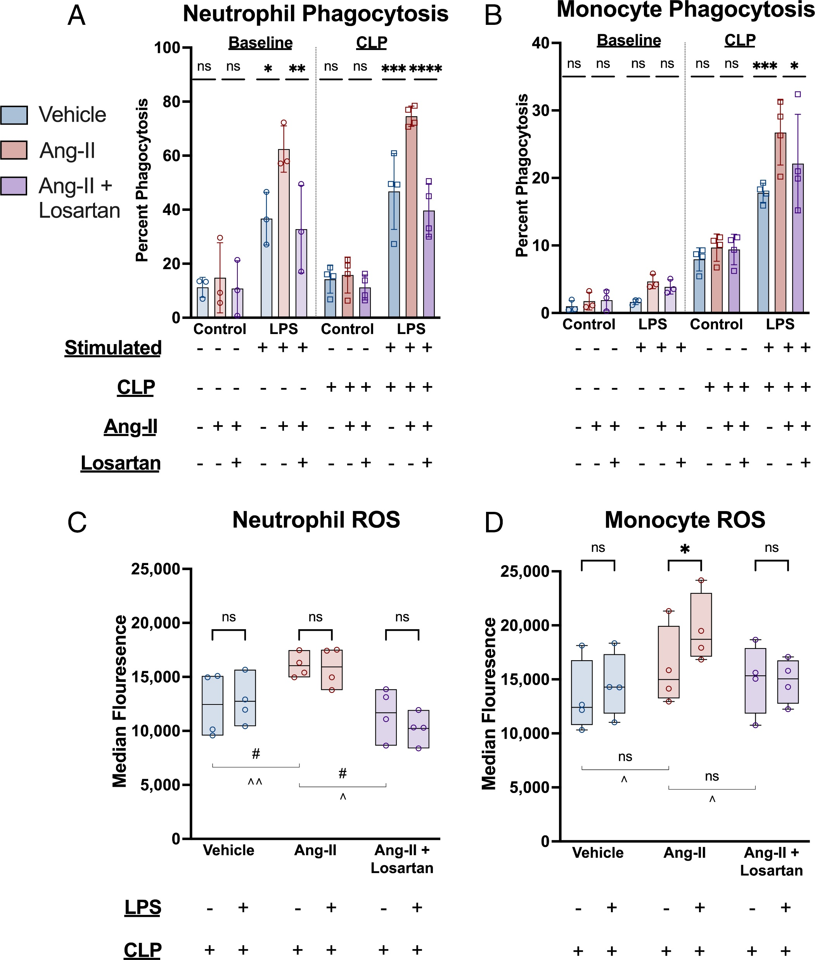
Angiotensin II enhances bacterial clearance via myeloid signaling in a murine sepsis model Daniel E. Leismana,b,c,1 , Jamie R. Privratskyd , Jake R. Lehmanc,e , Mabel N. Abrahamc,e, Omar Y. Yaipanc,e, Mariana R. Brewerc,e, Ana Nedeljkovic-Kurepac,e, Christine C. Caponec,e, Tiago D. Fernandesc,e, Robert Griffithsf , William J. Steinc,e, Marcia B. Goldbergg,h,i,j , Steven D. Crowleyf , Rinaldo Bellomoj,k,l,m,n, Clifford S. Deutschmanc,e, and Matthew D. Taylorc,e Edited by Carl Nathan, Weill Medical College of Cornell University, New York, NY; received July 4, 2022; accepted July 19, 2022
Angiotensin-II enhances ex vivo phagocytosis and ROS production in response to LPS stimulation after CLP via AT1R. (A and B) Ex vivo phagocytosis with and without LPS stimulation. They y axis indicates the proportion of the indicated cell type positive for having phagocytized fluorescent-tagged IgG-conjugated beads. Bar height indicates mean, error bars the SD. Individual dots represent the average of the technical replicates for each biological replicate. Asterisks indicate the (multiple comparison adjusted) P values vs. the angiotensin-II group as follows: ns, P > 0.05; *P < 0.05; **P < 0.005; ***P < 0.0005; ****P < 0.0001. (C and D) Ex vivo ROS levels with and without LPS stimulation in splenic cells isolated post-CLP. Bar height indicates interquartile range, error bar height indicates the range. The horizontal black lines indicate the median. Each dot represents the average of the technical replicates for an individual biological replicate. Asterisks above the bars indicate the (multiple comparison-adjusted) P values for LPS stimulated vs. unstimulated as follows: ns, P > 0.05; *P < 0.05. The “#” symbols indicates P values for the difference between the indicated treatment groups without LPS stimulation (#P < 0.05) while “^” symbols indicate P values for the difference between the indicated treatment groups with LPS stimulation (^P < 0.05; ^^P < 0.005).

Slide 15
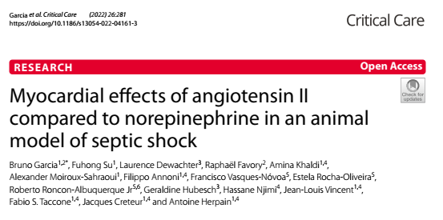
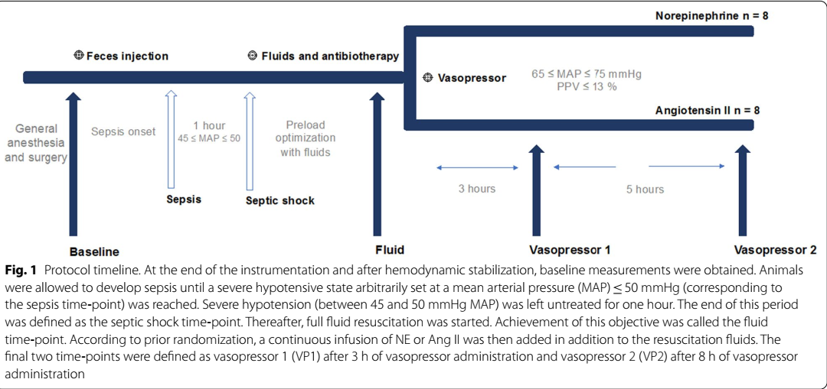

Slide 16
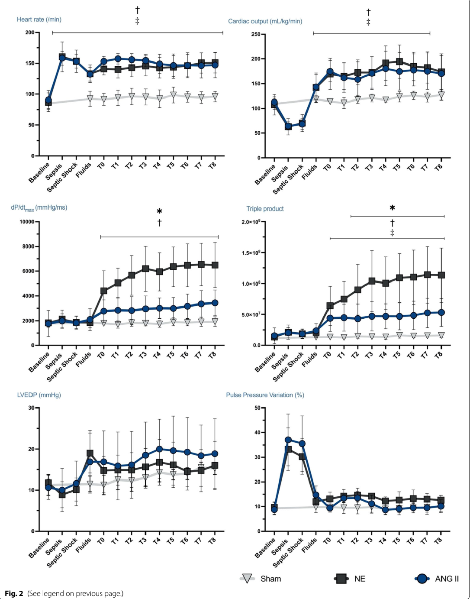
Csökkent myocardium O2 igény AT II mellett

Slide 17
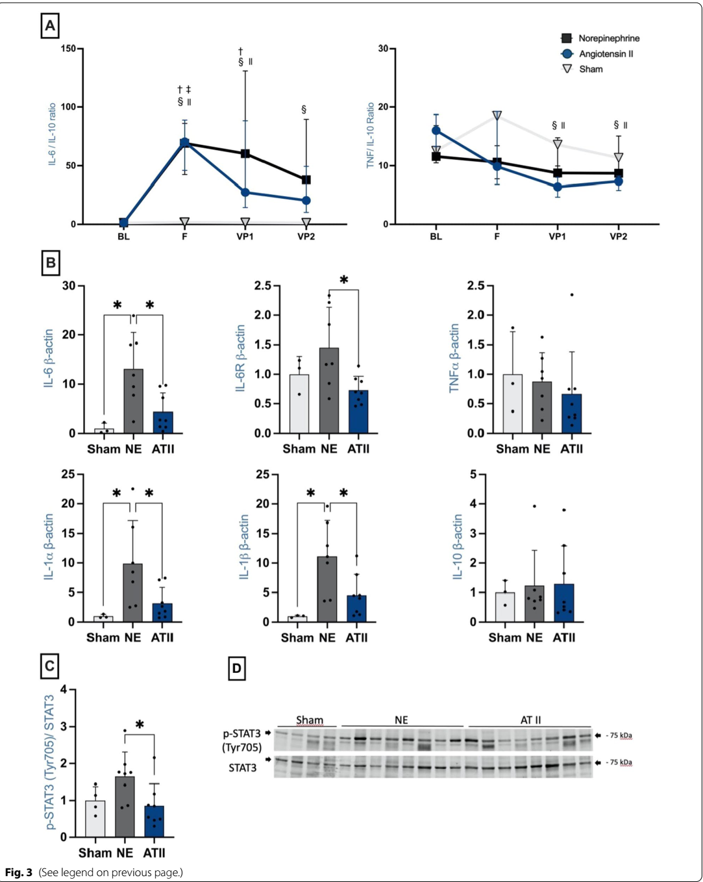
IL 1 és 6 szintek alacsonyabbak az AII csoportban illetve kevésbé kifejezett a receptor upreguláció

Slide 18
Angiotensin II klinikum

Slide 19
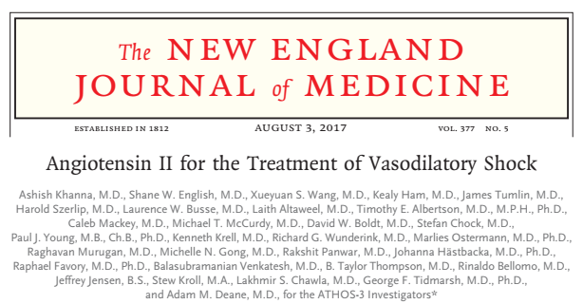
A vazoplég sokk definíciója
  2,3 liter/perc/négyzetméternél nagyobb szívindex vagy 70%-nál nagyobb ScVO2
  CVK > 8 Hgmm
  MAP 55 és 70 Hgmm között
Magas vazopresszor dózis definíciója
  noradrenalin 0,2 μg per kilogramm per perc, vagy egy másik vazopreszor egyenértékű dózisa
  legalább 6, de legfeljebb 48 órán keresztül.

Slide 20
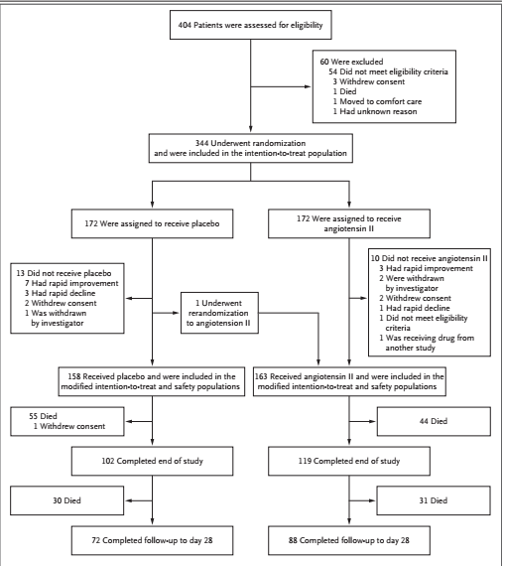

Slide 21
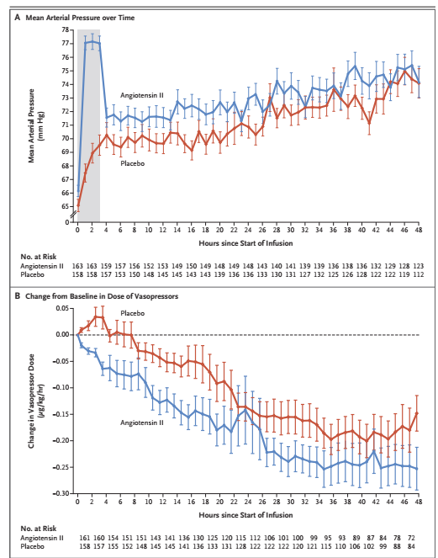

Slide 22
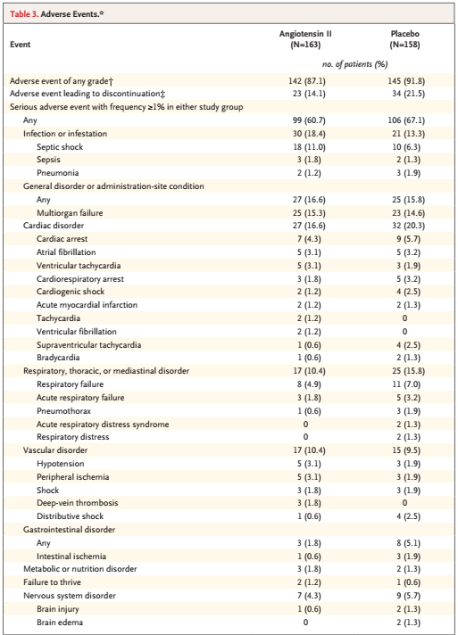

Slide 23
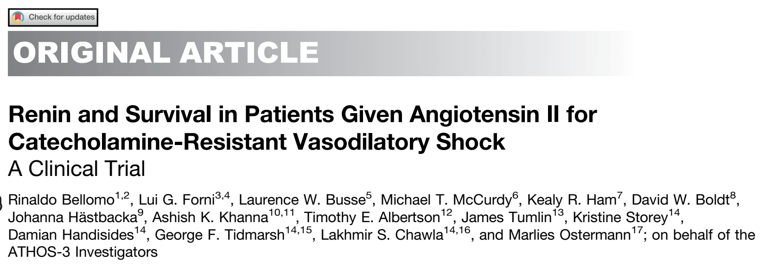
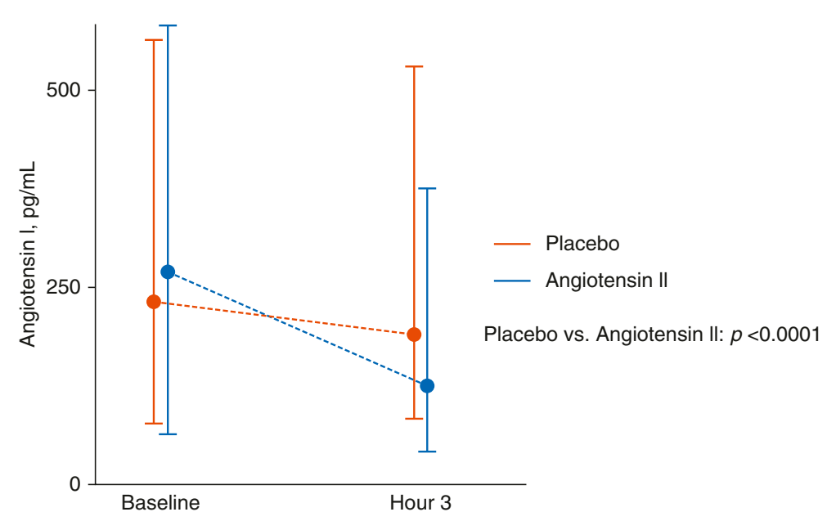
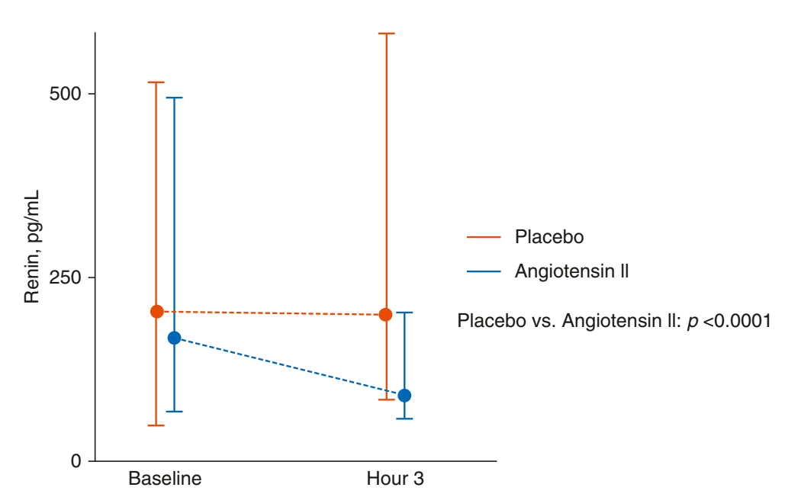

Slide 24
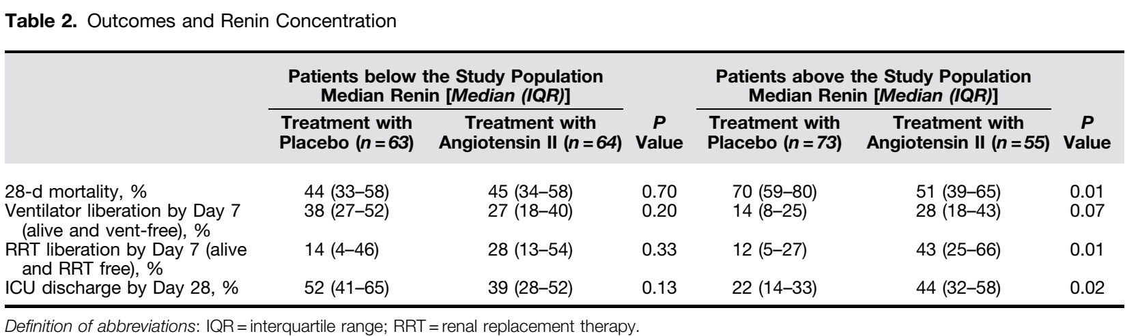
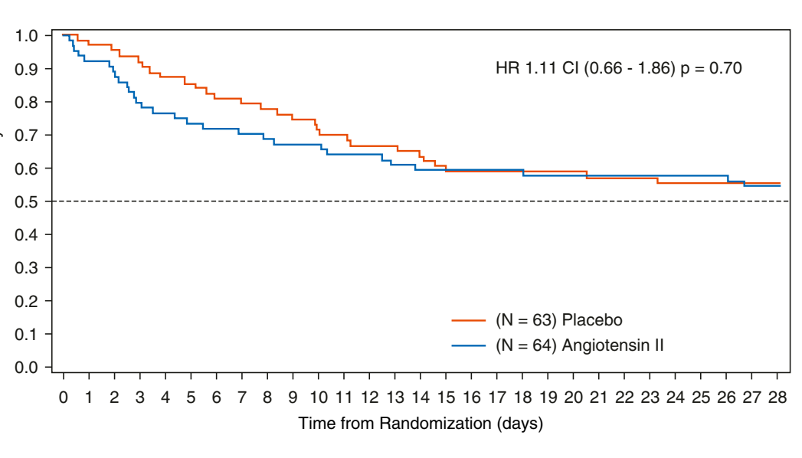
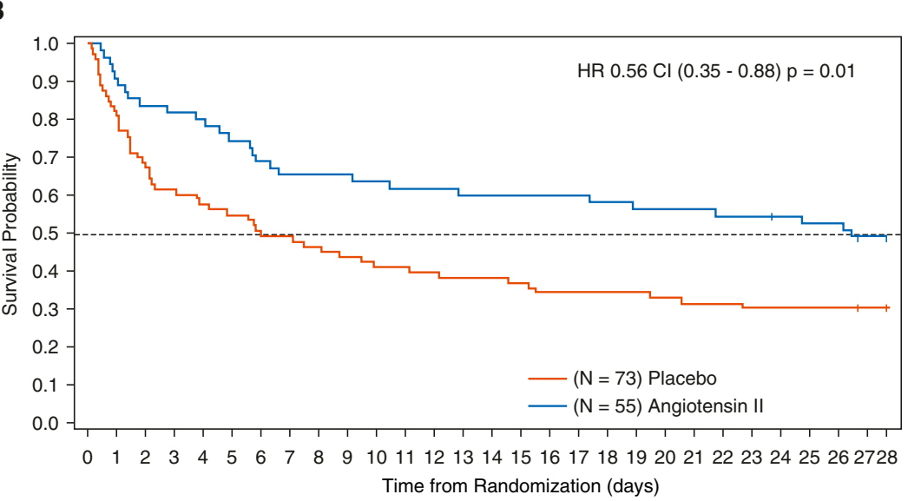
Medián alatti betegek
Medián feletti betegek

Slide 25
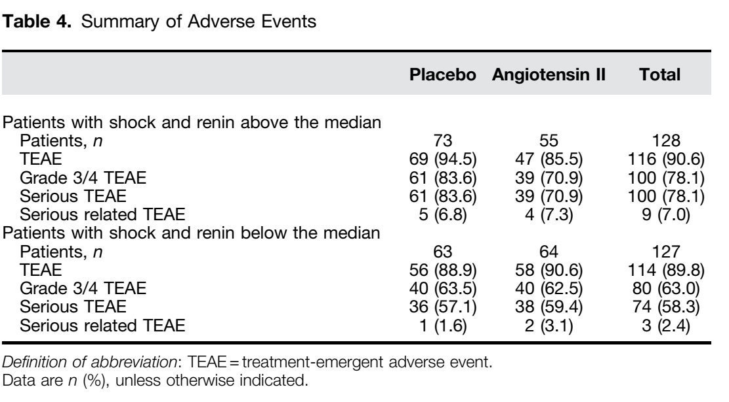

Slide 26
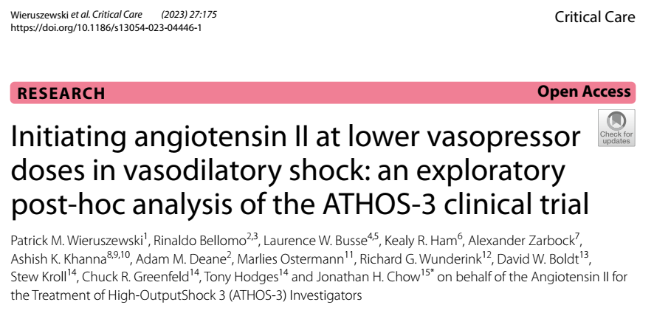
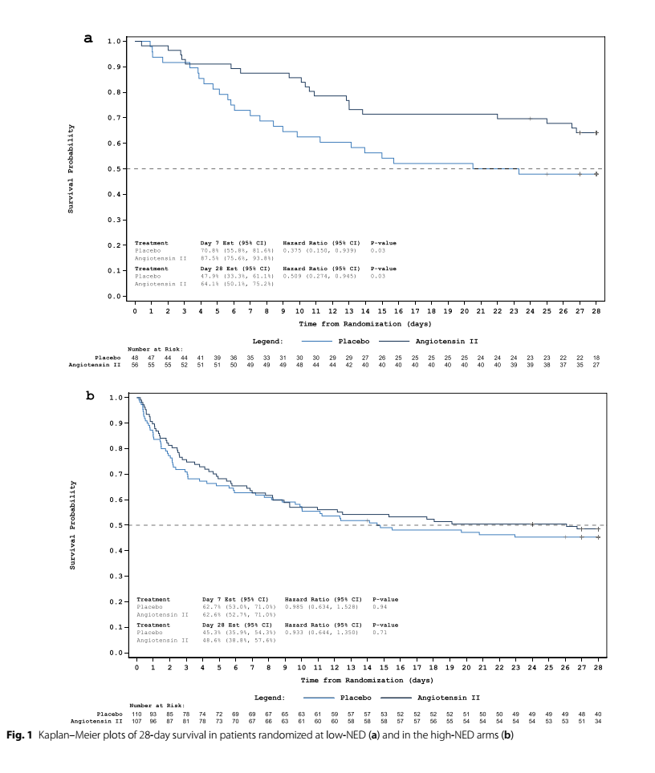

Slide 27
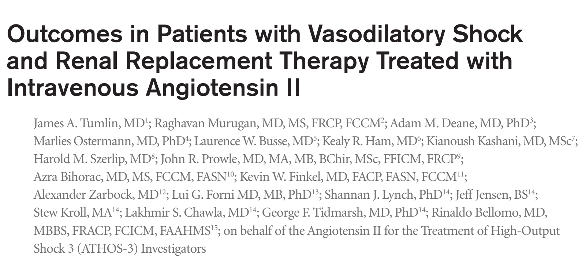
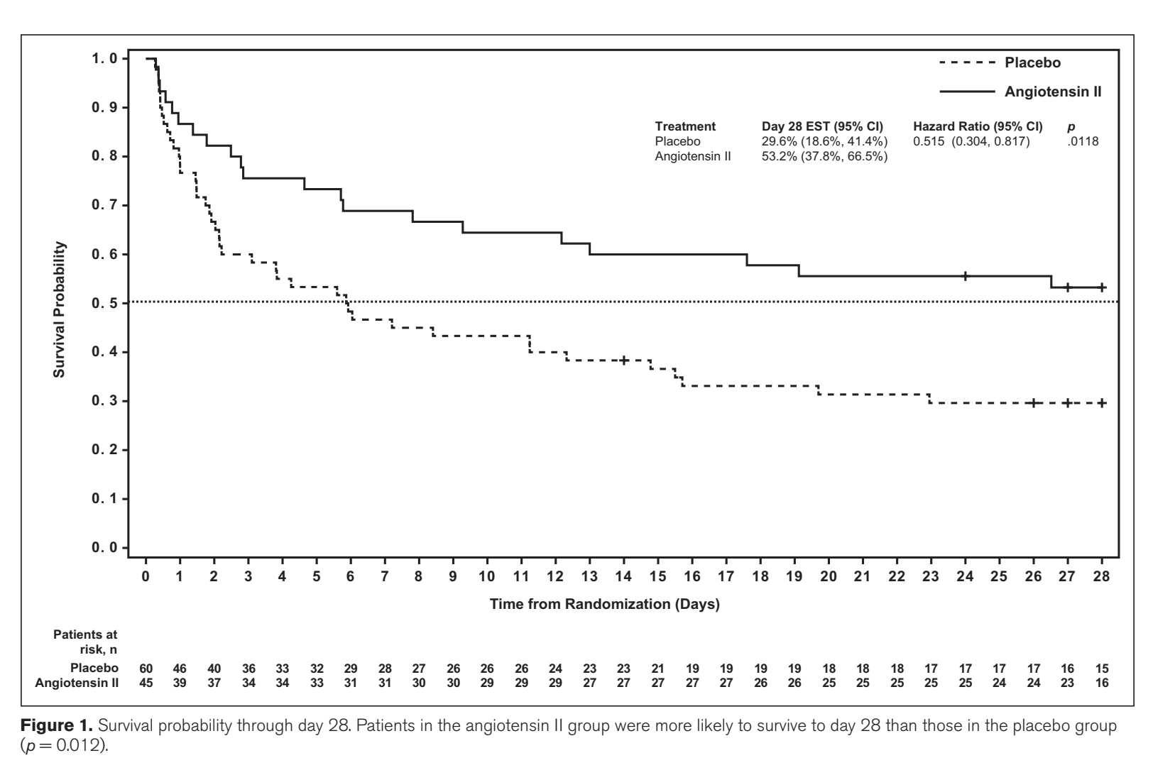

Slide 28
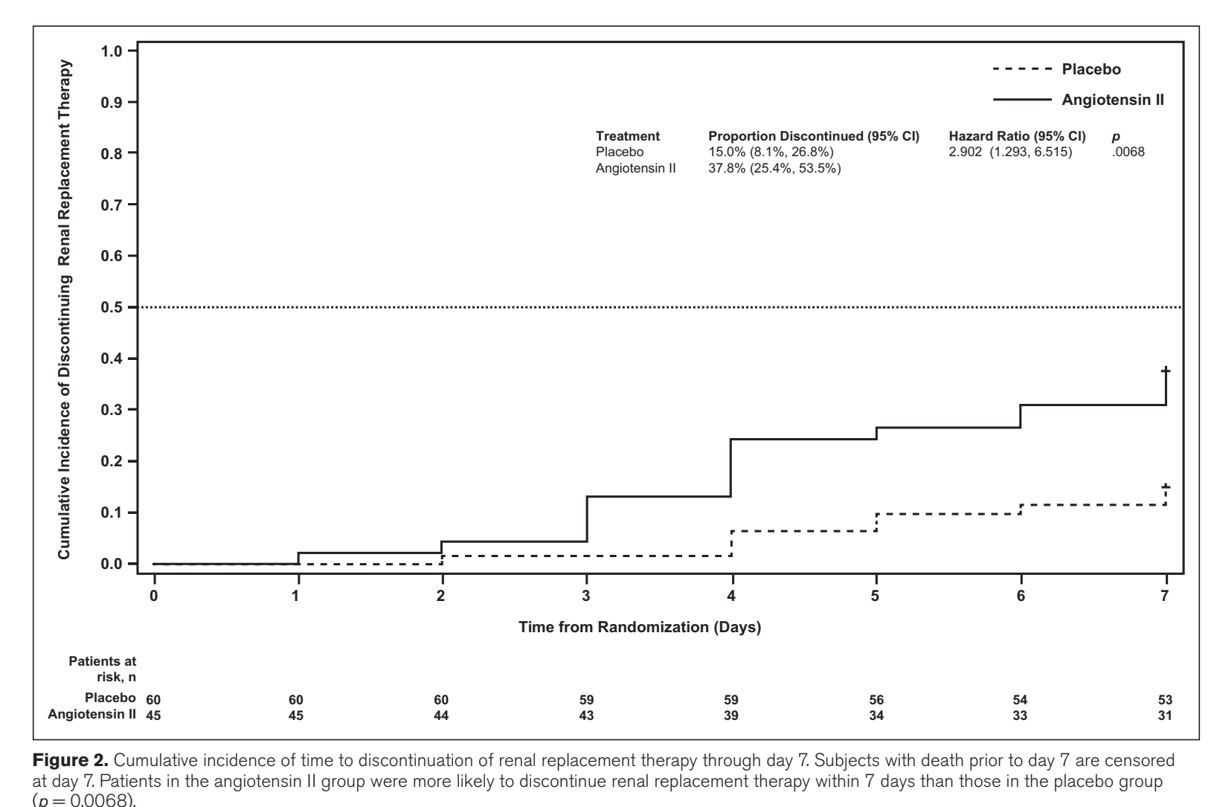

Slide 29
Összefoglalás
Szeptikus sokban az ACE aktívitás csökken, renin aktivitás emelkedik.
A renin szint emelkedése korrelál az állapot súlyosságával.
Az Ag II számos nem direkt ér tónusára gyakorolt hatással is rendelkezik.
  Baktériumok növekedése
  Gyulladás
  Miokardium
Klinikailag a magas renin szintű betegeknél volt pozitív hatása
ACEI vs ARB
CRRT-t igénylő betegek

Slide 30
Angiotensin II - MAP

Slide 31
Angiotensin II - noradrenalin

Slide 32
Angiotensin II

Slide 33

Köszönöm a figyelmet
.

