Slide 1


Béta blokkolók az intenzív osztályon
Schrick Diana, MD, PhD
PTE KK AITI, Intenzív Terápiás Tanszék & Neurointenzív Tanszék
Mediterrán Intenzíves Randevú
Pécs, 2025.09.26.

Slide 2

Intenzív terápia napjainkban
Bevezetés
Kritikus állapototú beteg: életveszélyes állapot, amely az életfontosságú szervek farmakológiai és/vagy mechanikus támogatását igényli, ami nélkül halál gyorsan következik be
Heterogén betegpopuláció, heterogén koreloszlás:
  Légzési elégtelenség
  Szeptikémia/szeptikus sokk
  TBI, politrauma, égés
  Szívelégtelenség/kardiogén sokk
  Veseelégtelenség (komorbiditás, komplikáció?)
  Stroke, intracranialis vérzés,
  Metabolikus eltérések
  Intoxikációk
  Posztreszuszcitációs ellátás
  Posztoperatív obszerváció (high-risk betegek)
Notes:
Nincs konzeszus a definícióban

Slide 3
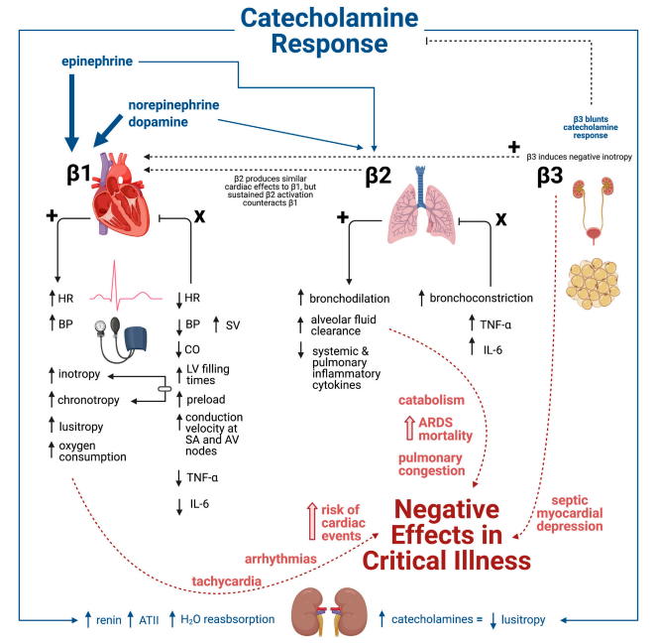
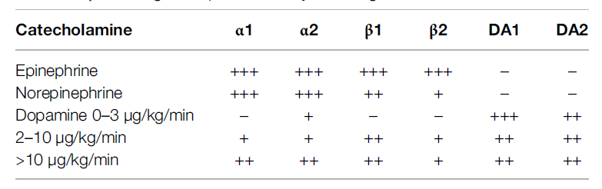
Mi a közös a betegekben?
Bevezetés
Szimpatikus idegrendszer aktivációja (masszív katekolamin kiáramlás + extrinsic) – adrenerg receptor upreguláció
Kulcsfontosságú, iniciális adaptív válasz, homeosztázis fenntartására irányuló fiziológiás folyamat
Notes:
Ahogy az előző dián láttuk ez egy igen heterogén betegpopuláció, mégis mi a közös bennük?
Catecholamine receptor upregulation and excessive catecholamine release is a core pathophysiological feature in critical illness. Sustained catecholamine β-adrenergic induction produces adverse effects relevant to critical illness management. β-blockers (βB) have proposed roles in various critically ill disease states, including sepsis, trauma, burns, and cardiac arrest.

Slide 4
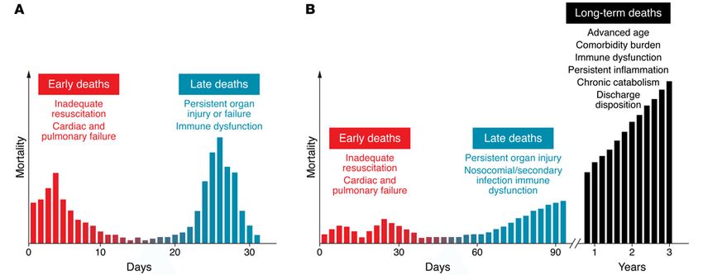
Tartós szimpatikotónia hatásai
Adrenerg receptor upreguláció: 20x ↑
DO2-VO2 arány felborul, MODS rizikó ↑
Fokozott β₁ receptor aktiváció – kardiális szövődmények ↑
pl. tahiarritmia (SVTc, Afib 23-40% - exogén katekolaminok adása tovább rontja)
Tako-Tsubo kardiomiopátia
szeptikus kardiomiopátia
Fokozott β₂ receptor aktiváció – pulmonális szövődmények ↑
  pl. PVPI ↑, alveolaris oedemaképződés
Fokozott β₃ receptor aktiváció – metabolikus stresszválasz ↑
pl. perifériás inzulinrezisztencia, lipolízis, glükogenolízis - szövődményráta ↑
Relatív mellékvese elégtelenség
Perzisztáló magas fokú szimpatikus aktiváció (<24h)
morbiditás, kórházi tartózkodás, mortalitás ↑
Perifériás adrenerg stresszválasz csökkentése:
adrenerg re-equilibrium / dekatekolaminizáció
Notes:
Adrenergic system serves as an initial adaptive response to maintain homeostasis. However, excessive catecholamine surge can cause adverse effects such as persistent tachycardia, which worsens the prognosis in patients with sepsis. Therefore, the use of β-blockers in sepsis recently has attracted attention especially in patients with tachycardia.
Tachycardia seen in sepsis is usually secondary to hypovolemia, fever, or pain. However, even without these conditions, we often encounter persistent tachycardia, which is likely to be non-compensatory tachycardia due to sympathetic overstimulation.
Of these various effects, the oxygen utilization has been focused on given that β-stimulants such as epinephrine are well-known to increase lactate level, implying that β1-blockers may, in contrast, improve the oxygen utilization in patients with sepsis.
Metabolic effect: Impaired oxygen use has been proposed as a more reasonable explanation of hyperlactatemia in sepsis. It is well-known that the stimulation of the β2-receptor increases the production of cyclic adenosine monophosphate, accelerating glycolysis. Therefore, the β2-blockade is likely to result in a reduction of lactate production. On the other hand, the patients’ ability to accelerate glycolysis and lactate production in response to epinephrine administration is reported to be associated with a better prognosis .
- catabolism
- glycolysis
β-blockers (βB) may be administered to manipulate the adrenergic response during critical illness
G protein kapcsolt receptorok (Gq , Gi , Gs )
• α1 - IP3 /DAG/Ca2+ rendszerhez kapcsolt jellemző lokalizáció: simaizmok, szerep: kontrakció
• α2 - negatívan kapcsolt az adenilcikláz/cAMP rendszerhez jellemző lokalizáció és szerep: preszinaptikus gátlás (posztszinaptikusan: érösszehúzás)
• β1 - pozitívan kapcsolt az adenilcikláz/cAMP rendszerhez jellemző lokalizáció: szív, szerep: pozitív hatások
• β2 - pozitívan kapcsolt az adenilcikláz/cAMP rendszerhez jellemző lokalizáció: simaizmok, szerep: relaxáció
• β3 - pozitívan kapcsolt az adenilcikláz/cAMP rendszerhez jellemző lokalizáció: zsírsejtek, szerep: lipolízis
Adrenerg receptor aktiváció hatásai:
• Szem: pupillatágulat (α1 ), csarnokvíz termelése (β)
• Szív: pozitív inotrop, chronotrop, dromotrop, bathmotrop hatások (β1 )
• Erek: vasokonstrikció (α1 ), vasodilatáció (β2 )
• Tüdő: bronchodilatáció (β2 )
• Gasztrointesztinális r.: csökkent motilitás (α2 , β2 ), sphincterek összehúzása (α1 )
• Genitourinális r.: csökkent motilitás (β2 ), sphincterek összehúzása (α1 ), uterus elernyesztése (β2 ), ejaculatio (α1 )
• Bőr: pilomotor simaizomzat kontrakciója (α), apocrin mirigyek - szekréció fokozódása (α)
• Máj: glükoneogenezis, glükogenolízis (α1 és β2 )
• Zsírsejtek: lipolízis (β3 )
• Vese: renin felszabadulás (β1 )
Posztszinaptikus receptor gátlás:
A β receptor blokád legfontosabb következményei: • negatív chronotrop és inotrop hatások a szíven (β1 ) • vérnyomáscsökkenés (többek között a perctérfogat csökkenése, és a renin felszabadulás gátlása miatt - β1 ) • bronchokonstrikció (β2 ) • lokális érszűkület veszélye - főleg a végartériákon, vagy károsodott perifériés ereken manifesztálódhat (β2 ) • a csarnokvíz termelésének a csökkenése • hipoglikémiás hatások fokozása, tünetek elfedése (β2 ) • VLDL szint emelkedése, HDL szint csökkenése
A szelektív β1 blokkolók kevésbé hajlamosítanak pl. bronchokonstrikcióra, hipoglikémiára és perifériás keringési zavarokra A β1 szelektivitás azonban soha nem abszolút!
Hemodynamic effect:
Persistent tachycardia 24 h after adequate fluid resuscitation is an independent risk factor for mortality in patients with sepsis https://doi.org/10.1016/j.jcrc.2020.02.014: use of high-dose norepinephrine and concurrent tachycardia are associated with poor outcomes in septic shock
Ultrashort-acting β1-blockers increased stroke volume index (SVI), while it reduced HR, resulting in unchanged cardiac index (CI), mean arterial pressure (MAP), and norepinephrine requirement at 24h. Tachycardia in sepsis can decrease stroke volume, resulting in an increased Ea and V-A decoupling. Because β1-blocker affects not only cardiac systolic function but also the afterload, it is important to know how β1-blocker affects an afterload-independent cardiac systolic function.
- (LVEF) was similar between landiolol and control groups https://doi.org/10.1016/j.chest.2021.01.009
- esmolol increased left ventricular stroke work index while it did not affect the right ventricular stroke work index, as well as right atrial pressure and mean pulmonary arterial pressure https://doi.org/10.1001/jama.2013.278477
Mortality benefit of ultrashort-acting β1-blocker might be explained by suppression of hyperkinetic status by improving cardiovascular efficiency.
This study suggests that ultrashort-acting β1-blockers should be initiated only after completing initial resuscitation.

Slide 5
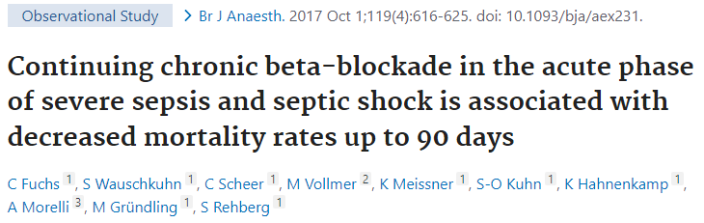
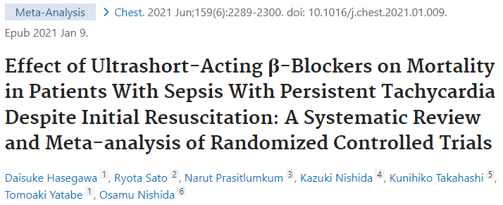

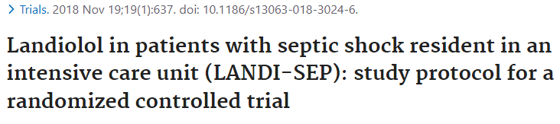
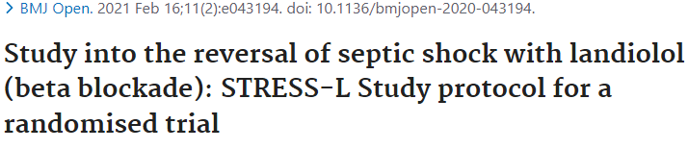
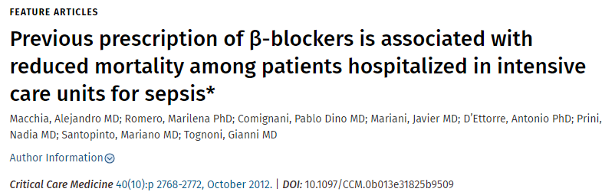
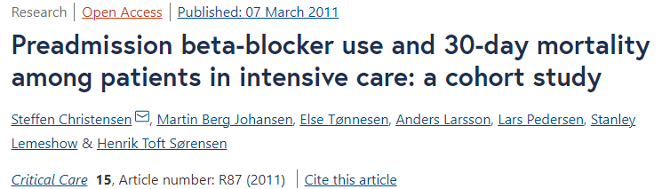
Adrenerg re-equilibrium elérése béta blokkolók alkalmazásával?
Paradigmaváltás
ÁLDÁS?
diasztolé ideje nyúlik
preload nő
koronária telődés optimalizálása
oxigénfelhasználás csökken
ÁTOK?
negatív inotróp
negatív kronotróp
negatív dromotróp
hipotenzió fokozása
bronchospazmus
CO = HR x SV
CO/CI megtartott
Notes:
β₁-selective beta blockers are also known as cardioselective beta blockers - the function of cAMP as a second messenger in the cardiac cell is that it phosphorylates the LTCC and the ryanodine receptor to increase intracellular calcium levels and cause contraction. Beta-blockade of the B1 receptor will inhibit cAMP from phosphorylating, and it will decrease the ionotrophic and chronotropic effect. Note that drugs may be cardioselective, or act on B1 receptors in the heart only, but still have instrinsic sympathomimetic activity. Eg. Nebivolol, metorpolol, bisoporolol, labetalol
BB have been proposed to reduce sepsis-induced cardiac dysfunction, improve the sepsis-induced hypermetabolic state, and play a role in immunomodulation by preventing lymphocyte apoptosis prevalent within inflammatory mechanisms of sepsis Suzuki et al., 2017)
Beta-blockers have become ubiquitous in the treatment of patients with heart failure and ischemic heart disease. During critical illness, the initial adrenergic stimulation may be beneficial; however, sympathetic overactivity, if persistent, may become deleterious, leading to further oxygen consumption, catabolism, hyperglycemia, hypercoagulability, cardiac dysfunction, modulation of systemic inflammatory cytokines, and ensuing multiorgan failure
Historically, β-blockers have been considered to be relatively contraindicated for septic shock because they may cause cardiac suppression. On the other hand, there is an increasing interest in the use of β-blockers for treating patients with sepsis with persistent tachycardia despite initial resuscitation.
https://doi.org/10.1016/j.chest.2021.01.009: This was a systematic review and meta-analysis - compared the mortality of patients with sepsis and septic shock treated with esmolol or landiolol. Seven RCTs with a pooled sample size of 613 patients were included. Of these, six RCTs with 572 patients reported 28-day mortality. Esmolol or landiolol use in patients with sepsis and septic shock was significantly associated with lower 28-day mortality (risk ratio, 0.68; 95% CI, 0.54-0.85; P < .001). Unimportant heterogeneity was observed (I² = 31%). The absolute risk reduction and number of patients to be treated to prevent one death were 18.2% and 5.5, respectively. The use of ultrashort-acting β-blockers such as esmolol and landiolol in patients with sepsis with persistent tachycardia despite initial resuscitation was associated with significantly lower 28-day mortality.
https://doi.org/10.1093/bja/aex231: This was a prospective observational single centre trial compared patient and treatment characteristics, length of stay and mortality rates between adult patients with severe sepsis or septic shock, in whom chronic beta-blocker therapy was continued or discontinued, respectively. A total of 296 patients with severe sepsis or septic shock and pre-existing, chronic oral beta-blocker therapy were included. Continuation of beta-blocker therapy was significantly associated with decreased hospital (P=0.03), 28-day (P=0.04) and 90-day mortality rates (40.7% vs 52.7%; P=0.046) in contrast to beta-blocker cessation. The differences in survival functions were validated by a Log-rank test (P=0.01). Multivariable analysis identified the continuation of chronic beta-blocker therapy as an independent predictor of improved survival rates (HR = 0.67, 95%-CI (0.48, 0.95), P=0.03).

Slide 6
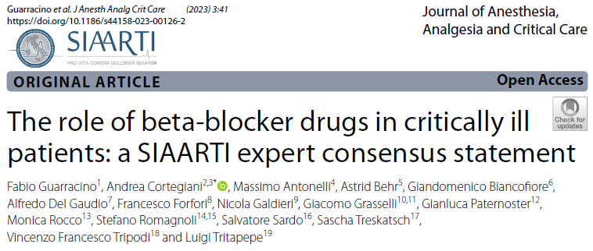
Farmakológia – iv. készítmények
Béta blokkolók az ITO-n
 | Receptorok | Kardioszelektivitás (β₁ - β₂ affinity ratio) | Hatáskezdet (min) | Maximális eliminációs féléletidő (min) | Metabolizmus | HR | MAP
LANDIOLOL | β₁ | 255 | 1 | 4 | pseudoChE | ↓↓ | - /↓
ESMOLOL | β₁ | 33 | 1-2 | 9 | plazmaE | ↓↓ | ↓
METOPROLOL | β₁ | 3 | 1-3 | 420 | CYP2D6 | ↓ | ↓
LABETALOL | β₁ - β₂ - α₁ | ₋ | 2-5 | 120-480 | glukoronid-konjugáció | ↓ | ↓↓
PROPRANOLOL | β₁ - β₂ | - | <5 | 360-600 | CYP2D6 | ↓ | ↓
Notes:
Landiolol: easily controllable side effect, eg. Hypotension, bradycardia – cardioselective beta blockers
Landiolol is an ultra short-acting selective beta-blocker used for rapid ventricular rate control in cases of supraventricular tachycardia, szuperszelektív B1 receptorok iránt
Esmolol, commonly marketed under the trade name Brevibloc, is a cardioselective beta-1 receptor blocker. It has a rapid onset but short duration of action without causing significant intrinsic sympathomimetic or membrane stabilizing activities at recommended therapeutic doses. It works by blocking beta-adrenergic receptors in the heart, which leads to decreased force and rate of heart contractions. Esmolol prevents the action of two naturally occurring substances: epinephrine and norepinephrine. Rapid distribution half-life of about 2 minutes and an elimination half-life of about 9 minutes. The acid metabolite has an elimination half-life of about 3.7 hours. The FDA withdrew its approval for the use of all parenteral dosage form drug products containing esmolol hydrochloride that supply 250 milligrams/milliliter of concentrated esmolol per 10-milliliter ampule.
ICU Practical Points:
Best for titration: Esmolol, Landiolol (ultra-short acting, predictable, easy to stop).
Chronic/step-down therapy: Bisoprolol, Nebivolol, Carvedilol, Metoprolol, Atenolol.
Hemodynamic stability: Landiolol > Esmolol (less MAP drop).
Alpha-blocking agents (Carvedilol, Labetalol): reduce BP more significantly → not suitable for unstable shock, but useful in hypertensive emergencies.
Propranolol: niche role in TBI/sympathetic storm.

Slide 7
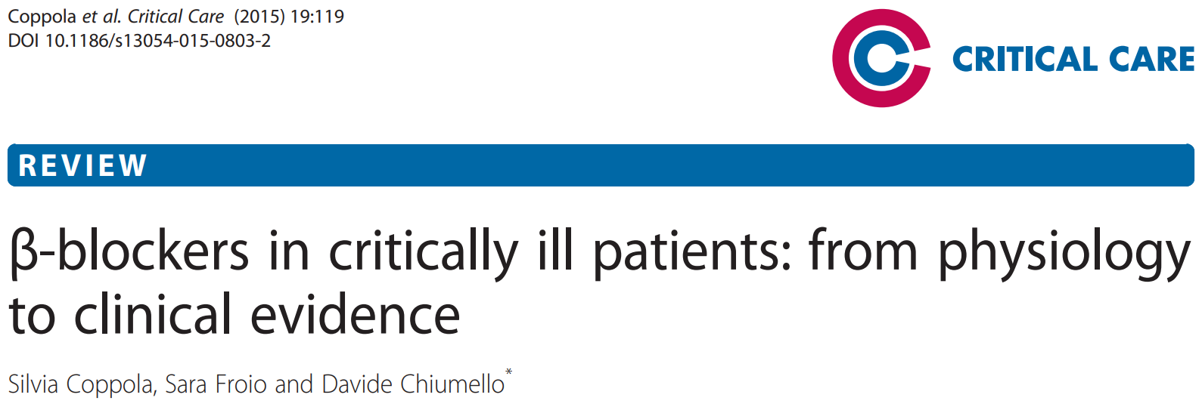
Farmakológia – per os készítmények
Béta blokkolók az ITO-n
 | Receptorok | Kardioszelektivitás (β₁ - β₂ affinity ratio) | Hatáskezdet (min) | Maximális eliminációs féléletidő (h) | Metabolizmus | HR | MAP
BISOPROLOL | β₁ | 255 | 60-120 | 10-12 | máj+vese | ↓↓ | ↓
NEBIVOLOL | β₁ + NO mediált vazodilatáció | 33 | 20-120 | 9 | plazmaE | ↓↓ | -/↓
METOPROLOL | β₁ | 3 | 90-120 | 3-4 | CYP2D6 | ↓ | ↓
CARVEDILOL | β₁ - β₂ - α₁ | ₋ | 5-10 (60-90) | 6-10 | CYP2D6, CYP2C9 | ↓ | ↓↓
PROPRANOLOL | β₁ - β₂ | - | 60-120 | 360-600 | CYP2D6 | ↓↓ | ↓
Notes:
This table is now focused on the “longer-acting, oral beta-blockers” — more relevant for cardiac patients in ICU step-down care or chronic therapy rather than acute titratable ICU agents.
Would you like me to also make a separate smaller table just for the ultra–short-acting ICU agents (esmolol, landiolol) so your audience sees the contrast between acute vs chronic beta-blocker use?

Slide 8
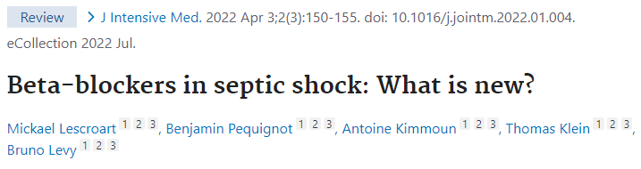
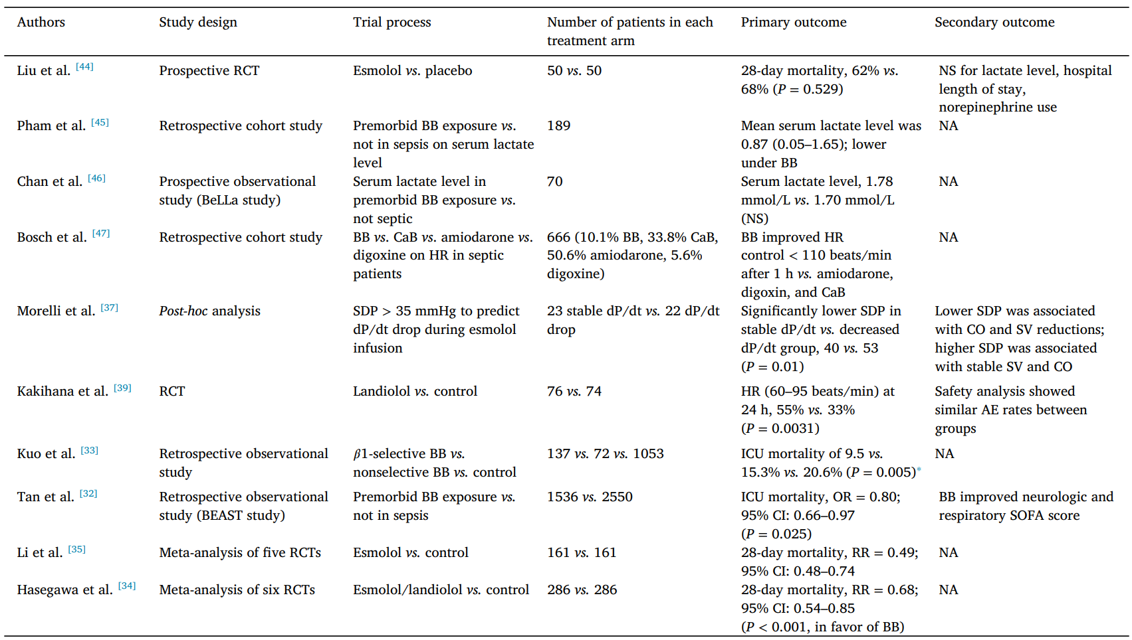
Szeptikus sokk
Speciális kórállapotok
Klinikai vizsgálatok
2019-2022
Notes:
Argipresszin nem tachycardizál.
A resuscitation chain for sepsis was developed by investigators and was used to spread general recommendations for sepsis management.
Catecholamine receptor upregulation and excessive catecholamine release is a core pathophysiological feature in critical illness. Sustained catecholamine β-adrenergic induction produces adverse effects relevant to critical illness management. β-blockers (βB) have proposed roles in various critically ill disease states, including sepsis, trauma, burns, and cardiac arrest.
The catecholamine cascade is a defining element of critical illness. Although, prolonged exposure to high levels of catecholamines in these altered states may evoke detrimental metabolic and hemodynamic effects.
Surviving Sepsis Guidelines do not make recommendations regarding βB continuation or initiation in septic patients.
As early as 1972, a case series in refractory septic shock patients documented the hemodynamic effects of propranolol Berk et al., 1972. The cases conceptualized hyperdynamic vs. hypodynamic shock, given the observation that three patients dying after propranolol use had severely reduced CO compared to those who survived.
The seminal Morelli et al. Morelli et al., 2013 phase 2 study of esmolol in septic shock patients requiring high-dose vasopressors revived discussion of βB in sepsis.
Since the publication of these systematic reviews and meta-analyses there has been an increased focus on the treatment of tachyarrhythmias in sepsis. Initial evidence garnering support for βB use in septic patients with atrial fibrillation resulted from a 2016 propensity-matched cohort study. his analysis concluded that βB were associated with lower hospital mortality when compared to calcium channel blockers (CCBs), digoxin, and amiodarone Walkey et al., 2016. While these studies included a variety of βB agents, newer evidence has shifted to solely focus on the use of ultra-short-acting βB, esmolol and landiolol – USA + Japan.

Slide 9
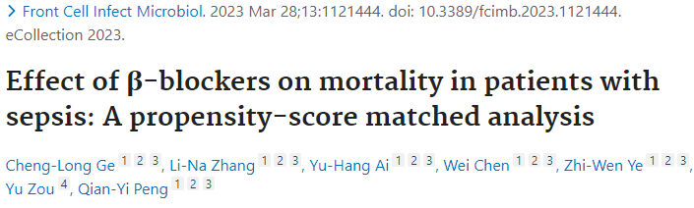
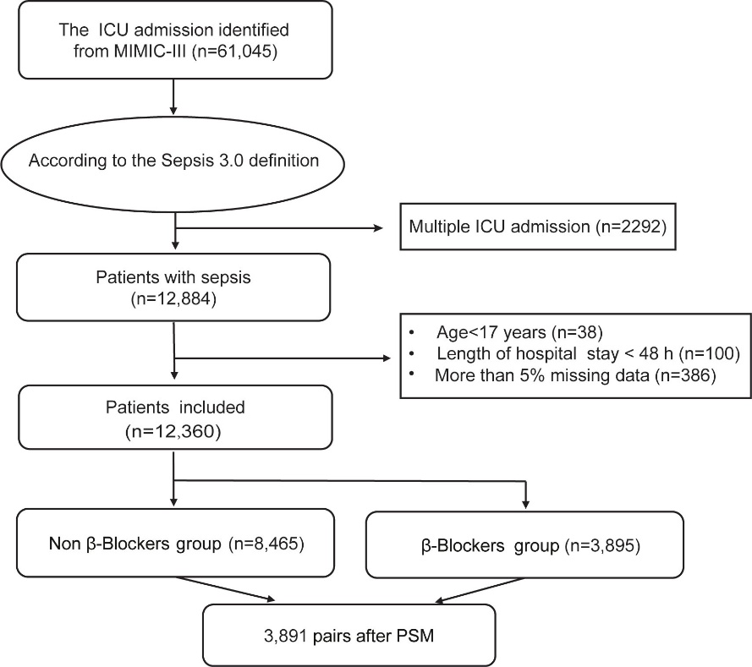
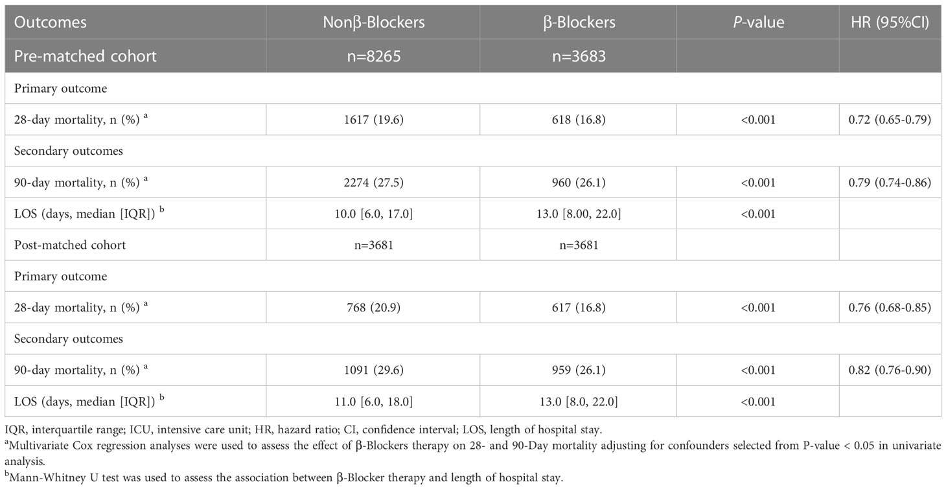
Szeptikus sokk
Speciális kórállapotok
Notes:
Flowchart of the patients screened in the study. ICU, intensive care unit; MIMIC-III, Multiparameter Intelligent Monitoring in Intensive Care Database III; SOFA, sequential organ failure assessment; PSM, propensity-score matching.
Long acting β-blocker therapy may improve short- and long-term survival for patients with sepsis and septic shock. However, short-acting β-blockers (esmolol) treatment did not reduce the mortality in sepsis.
The association between β-blockers therapy and 28-day mortality in subgroups. HR, hazard ratio; CI, confidence interval. After propensity-score matching (PSM), multivariate Cox regression analyses were used to assess the effect of β-blockers therapy on 28-Day mortality adjusting for confounders selected from P-value < 0.05 in univariate analysis. For data analysis the R package both ‘survival’ and ‘forestplot’ were used.
The sample size of 6830 cases in this study is the largest in the literature on the association of β-blocker therapy and sepsis. Moreover, we eliminated the potential confounding effect of baseline factors using PSM to balance the baseline characteristics among the two groups. In addition, our studies are the first to suggest that short- and long-acting β-blockers have different therapeutic profiles on sepsis.
PSMA is to reduce selection bias and estimate the causal effect of a treatmen or intervention when randomized experiment is not possible.
Forest plot: graphycal display used in meta-analyses to visualize the results from multiple scientific studies adressing the same question

Slide 10
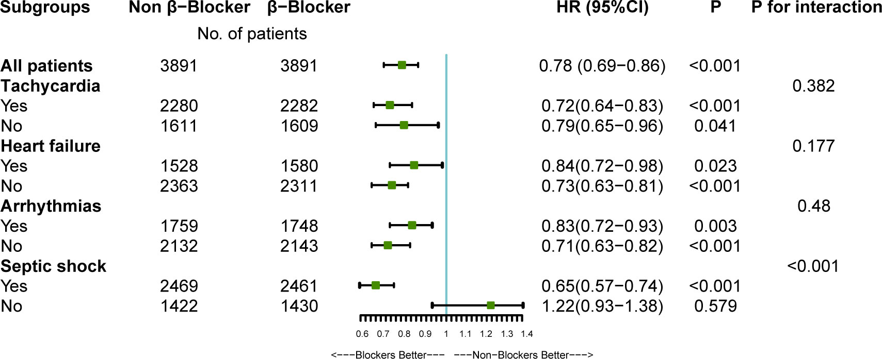
Szeptikus sokk
Speciális kórállapotok
Limitations:
- Firstly, this study is based on a clinical database containing missing variables
- No doses of BBs
- Inherent limitation of the retrospective research, a cause-effect relationship between the β-blocker therapy and mortality cannot be established
Notes:
There was a significant interaction between β-blocker therapy and septic shock after PSM (P < 0.001, without adjustment for multiple comparisons). The results indicate a significant association between β-blocker therapy and improved 28-day survival among patients with septic shock.
Propensity score match analysis
Data suggest that β-blockers were associated with improved 28- and 90-day mortality in patients with sepsis and septic shock. Long-acting β-blocker therapy may have a protective role in patients with sepsis, reducing the 28-day and 90-day mortality.
Limitation of the study:
- Firstly, this study is based on a clinical database containing missing variables.
- No doses of BBs
- Due to the inherent limitation of the retrospective research, a cause-effect relationship between the β-blocker therapy and mortality cannot be established

Slide 11
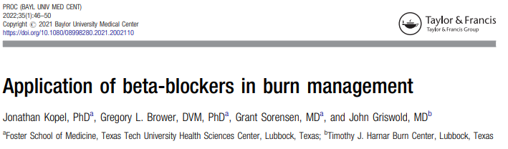
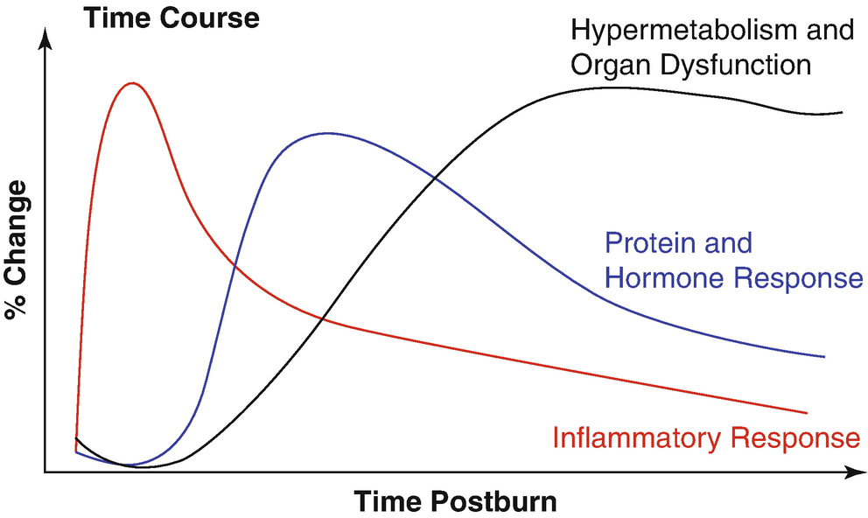
Égésbetegség
Speciális kórállapotok
TBSA >20% okozta proinflammatorikus citokin felszabadulása miatt kialakuló MODS/MOF, morbiditást és mortalitást növelő tényező
Mortalitást és a kórházi tartózkodás idejét és a költségeket nem csökkenti
Hipermetabolizmus csökkentése
- lipolízis csökkentése
- izomveszteség csökkentése
- javuló perifériás inzulin szenzitivitás (PK3/Akt)
Notes:
Proc (Bayl Univ Med Cent). 2021 Nov 22;35(1):46–50. doi: 10.1080/08998280.2021.2002110

Slide 12
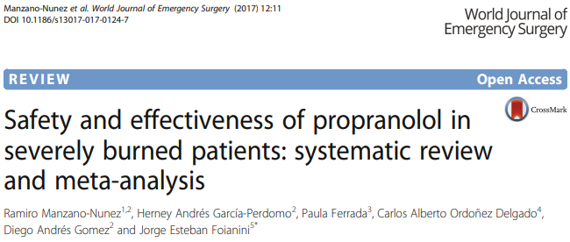
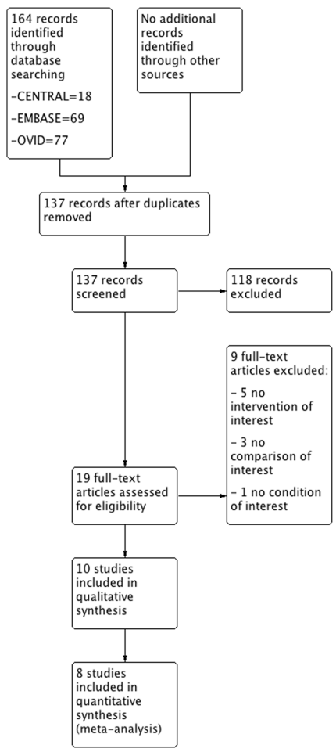
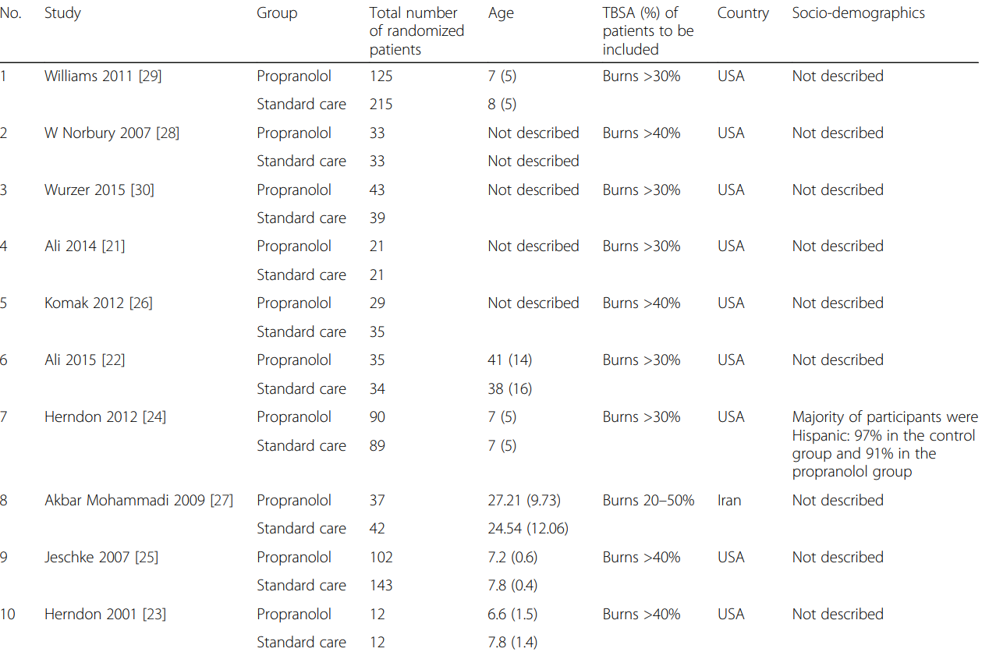
Égésbetegség
Speicális kórállapotok
1236pts
Notes:
Included trials were published between 2001 and 2015. These trials randomized a total of 1236 participants with a sample size ranging from 25 to 406 (median, 76; interquartile range, 58.5–195.5). Five trials (50%) [22–25, 27] were single-center trials. Of the ten RCTs included, nine recruited participants from the USA and one trial recruited patients from Iran [27].
Six RCTs were done in adults and four were done in children [23–25, 29].

Slide 13
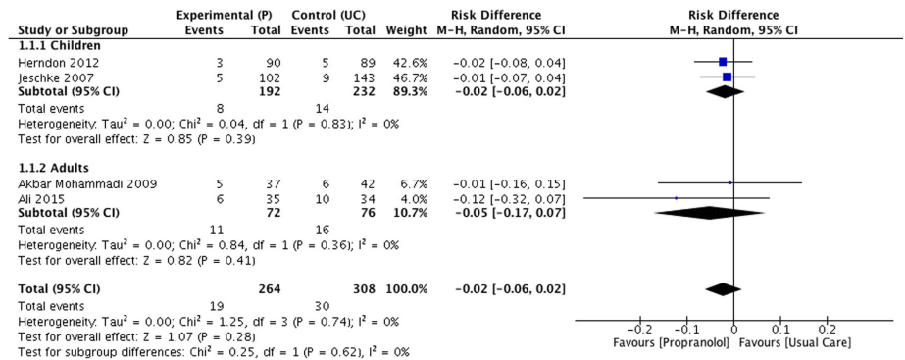
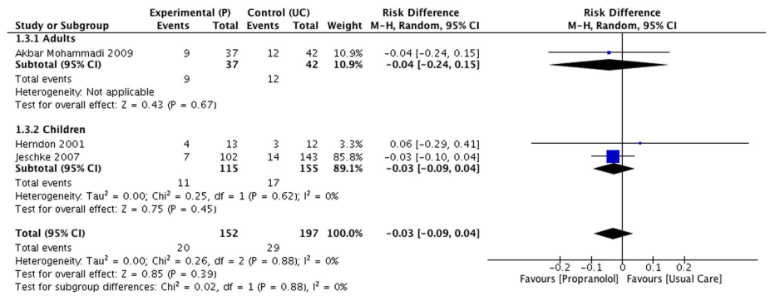
Égésbetegség
Speciális kórállapotok
Forest plot for sepsis
(proporanolol vs standard care NS)
Forest plot for mortality (proporanolol vs standard care NS)
Alacsonyabb szívfrekvencia
Transzfúziós igény ↓
Felnőtteknél rövidebb hospitalizáció
Notes:
Included trials were published between 2001 and 2015. These trials randomized a total of 1236 participants with a sample size ranging from 25 to 406 (median, 76; interquartile range, 58.5–195.5). Five trials (50%) [22–25, 27] were single-center trials. Of the ten RCTs included, nine recruited participants from the USA and one trial recruited patients from Iran [27].
Six RCTs were done in adults and four were done in children [23–25, 29].
There were no significant differences between propranolol and placebo/usual care with respect to mortality (RD −0.02 [95% CI −0.06 to 0.02]), and also, no differences were found in the sub-group analysis when assessing this outcome in children (RD −0.02 [95% CI −0.06 to 0.02]) and adults (RD −0.05 [95% CI −0.17 to 0.07])
RD=risk difference – absolute risk reduction

Slide 14
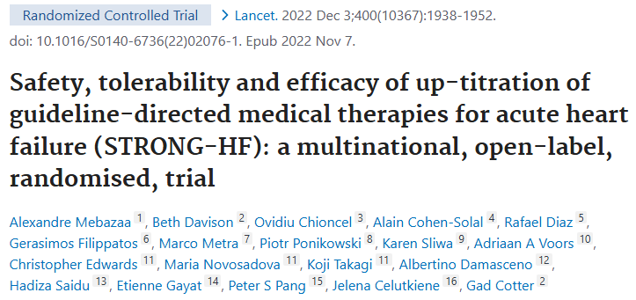
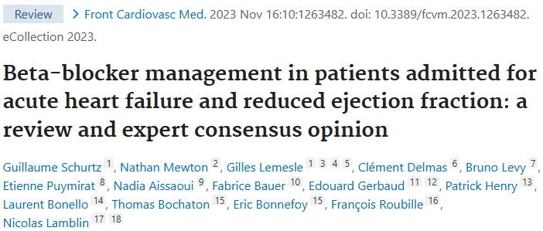
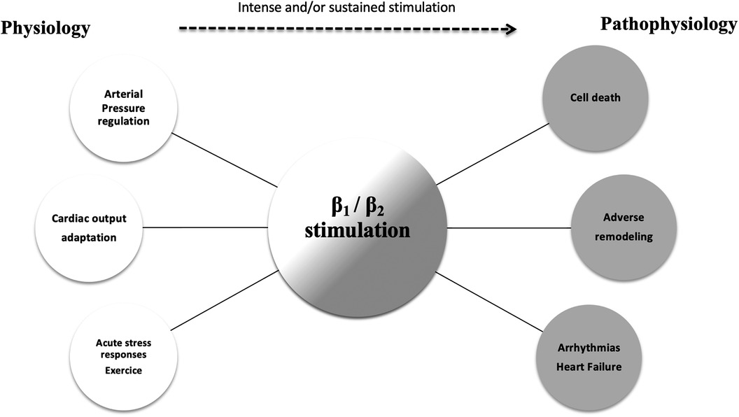
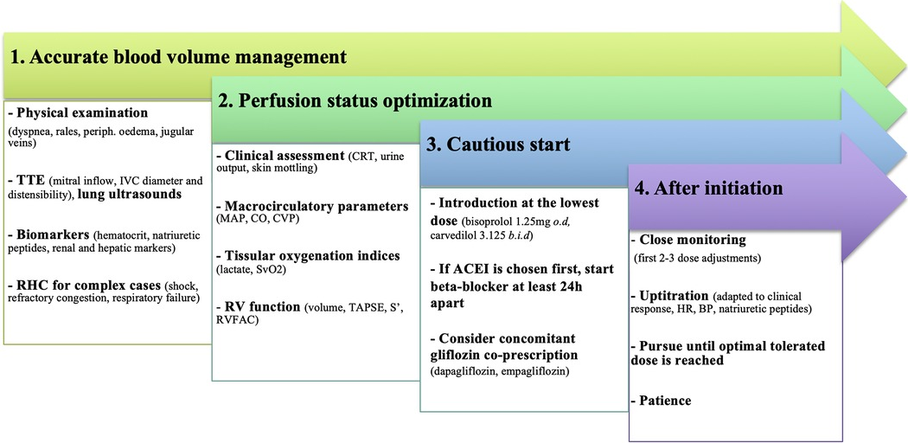
Szívelégtelenség
Speciális kórállapotok
Notes:
Severe RV dysfunction could probably influence the choice of BB; a preferable choice would be an agent without vasodilatory effects, but this statement is purely speculative and based on pathophysiological data.
The benefits of ultra-short acting BB are inconclusive. Due to their attractive pharmacologic profiles, especially for landiolol (which is β1 selective), impact on cardiac function would be minimal. Landiolol might be useful as a “tolerance test” or a bridge for usual recommended oral BB. However, the precise hemodynamic response remains unclear in the setting of severe HFrEF and landiolol administration should be limited to unstable situations, where rapid control of supra-ventricular arrhythmias is needed and is suspected to be responsible for LV dysfunction.

Slide 15
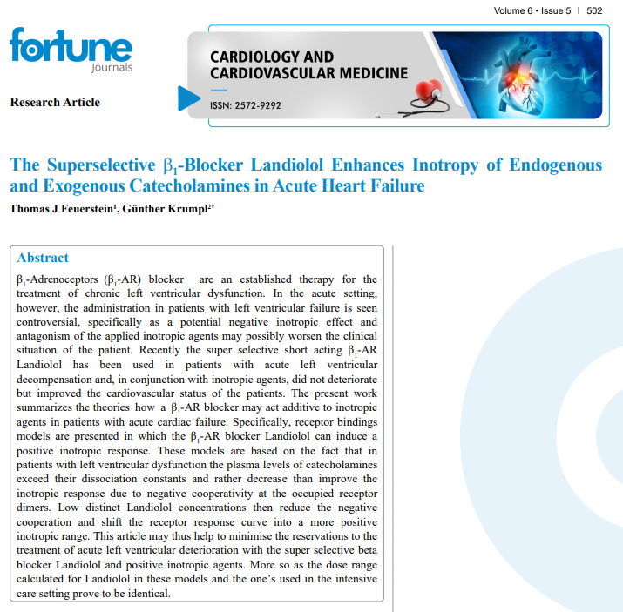

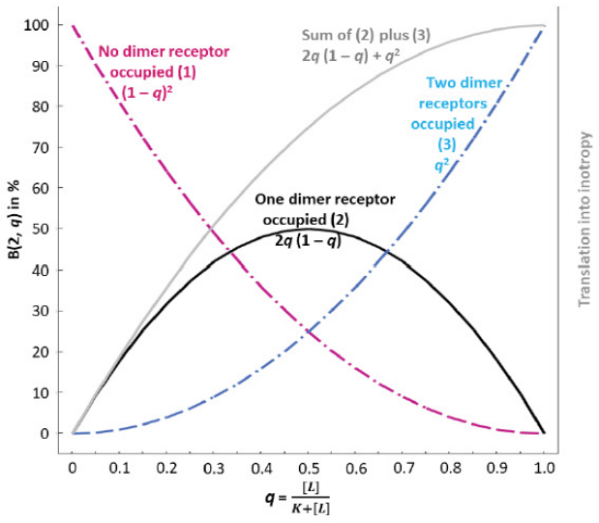
Szívelégtelenség
Speciális kórállapotok
1-10mcg/kg/min, válaszkészségnek megfelelően titrálva
Binomial Distribution
mathemathical model
Notes:
One of the mainstay treatments for cardiovascular issues is the administration of β-adrenoceptor blockers. Approximately 30 million adults in the United States use these beta-blockers for cardiovascular conditions such as angina, heart failure, atrial fibrillation, heart attacks and high blood pressure. These drugs target β-adrenoceptors (β-AR) which are found on the surface of cells and are subcategorised as β₁, β₂ and β₃ receptors, depending on their function.
In healthy cardiovascular cells, β₁-receptors represent 75–80% of all beta receptors while β₂-receptors represent only 15–18%. But when the heart starts to fail the receptors reach a 50/50 balance. These receptors work together to mediate increases in heart chronotropy (rate), inotropy (power of contraction), dromotropy (rate of electrical impulse) and bathmotropy (influence of a stimulus on excitability). Therefore, blocking these receptors can have several benefits for patients with chronic heart failure, including a reduction in heart rate and arrhythmia (abnormal heart rhythm) management.
Though initial studies in patients with reduced cardiac function raised concerns about the functionality of beta-blockers as a treatment for those with contractile problems, a series of low-dose studies with several different beta-blockers found that β₁-AR blockade can improve contractility and prolong survival when administered long-term. But despite their acceptance for use in chronic treatment, their benefits are not currently acknowledged in relation to acute heart failure. This is in part due to their potential to inhibit the effects of other drugs that are used to help treat patients experiencing acute heart failure. It may be thought that β-blockers inhibit the effects of positive inotropic agents used intravenously for the treatment in the acute situation. With regards to unwanted side effects of usual β-blockers, their longer duration of action may also lead to significant difficulties in acute situations.
Earlier studies have already shown that extremely short-acting beta-blockers can provide significant advantages in patients with acute heart failure by helping to preserve blood pressure. This was true despite the absence of a convincing rationale for the use of short-acting beta-blockers which are assumed to act in a negative inotropic fashion (i.e. they decrease the force of heart contractions at rather low concentrations of the endogenous agonists, noradrenaline and adrenaline, at the β1-AR in the heart). However, their negative inotropic effect may be reversed with high concentrations of endogenous agonists. The condition of highly elevated concentrations of endogenous agonists is typical for heart failure.
Currently, Landiolol is the most effective β₁-blocker given intravenously for acute heart failure and is now used alongside so-called positive inotropic agents to increase the force of heart contractions in intensive care patients.
Basing their work on ‘receptor theory’ of the interaction between an agonist or antagonist and a receptor, Professor Feuerstein and Dr Krumpl mathematically modelled the impact of agonist and antagonist binding to β₁-AR in the real world. The Binomial Distribution describes the occupancy of dimeric β₁-AR best: This distribution reflects the number of successes, i.e., binding to one or two protomer(s), in a sequence of n independent experiments, each asking a ‘yes–no’ question, where ‘yes’ means ‘bound protomer’ and ‘no’ means ‘unbound protomer’. The number n of independent binding events is two in our case (a dimer is composed of two protomers).

Slide 16
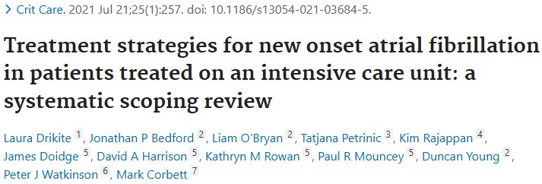
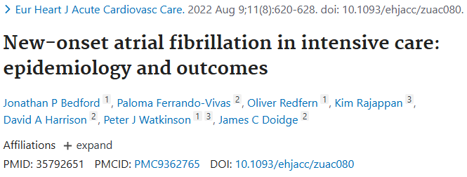
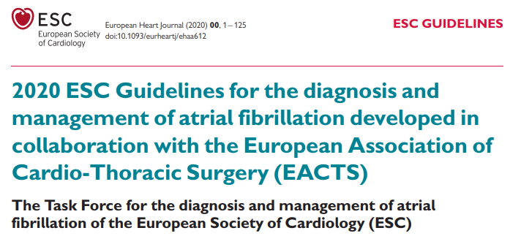
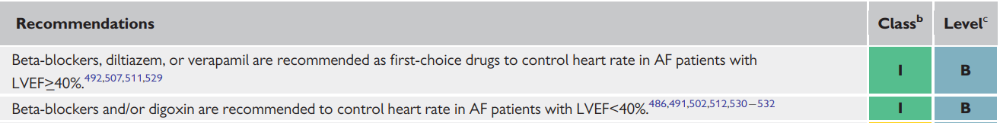
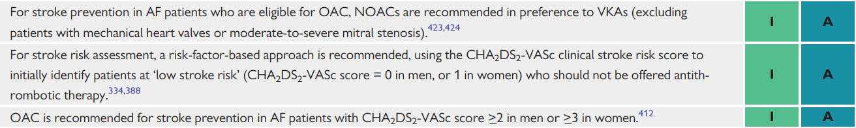
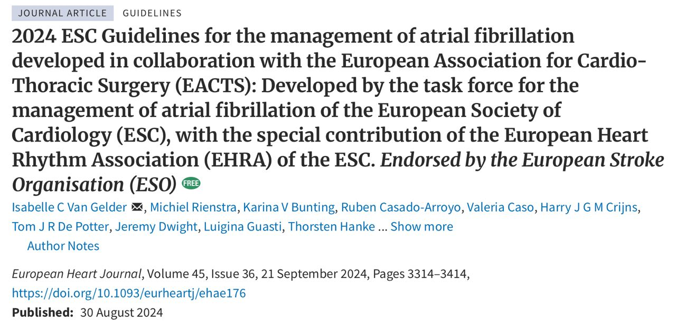
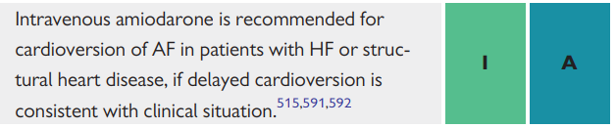
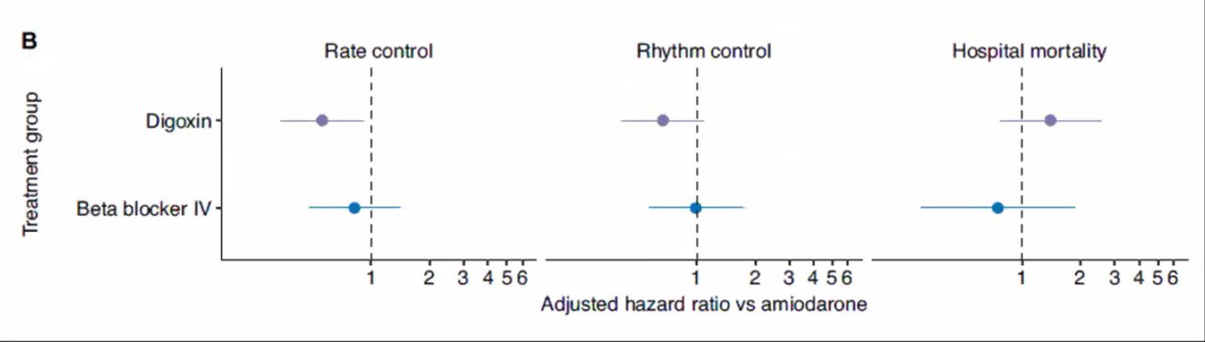
Pitvarfibrilláció
Speciális kórállapotok

Slide 17
Összefoglalás
Az anamnesztikusan is (főként a kardioszelektív) BB-t szedők mortalitása alacsonyabb kritikus állapot esetén Tan et al. 2019 & Guz et al. 2021
Perioperatív ellátásban megtartandóak – perioperatív AFib hajlamot csökkenti, mely független rizikófaktora a perioperatív morbiditásnak, mortalitásnak Morelli et al. 2020
Ultrarövid hatású, szuperszelektív béta blokkolók alkalmazásáról szóló tanulmányok – még gyenge evidenciával, de támogatják a paradigma váltást: adjunk béta receptor blokkolót a kritikus állapotú betegeknek Liefeng Xie et al. 2025
Nincs optimális időzítés, de megfelelő primer reszuszcitációt követően (optimális preload), 12h fennálló vazopresszor terápia mellett perzisztáló tahikardia esetén BB indítása megfontolandó – mikor álljon le?
Invazív hemodinamikai monitorozás javasolt, indítás előtt tájékozódó echocardiographia szükséges, ventriculo-atrialis coupling meghatározás is megfontolandó Guarracino et al. 2013
Lassú dózistitrálás: lehető legkisebb, de még effektív dózis alkalmazandó
- landiolol ~1-10mcg/kg/min; esmolol ~0,05-0,2mg/kg/min (cél: kiindulási HR -20%)
Gangl et al. 2021
Notes:
L-type Ca2+ channel
A recent observational cohort study by Guz et al. found that antecedent cardioselective βB were associated with a stronger protective effect on 30-days mortality rate reduction than noncardioselective βB for patients admitted with sepsis . Continuation of beta-blockade therapy was also associated with decreased crystalloid requirements during the first 24 h (p = 0.049) without increases in need for vasopressor, inotropic support, or low-dose steroids Tan et al. 2019
The available low quality evidence supports this paradigm shift in crictical care towards casutious beta-blockade in treatment of sepsis and septic shock, when complicated by tachyarrythmias
There are numerous retrospective studies that have investigated premorbid βB exposure prior to admission to the ICU with a diagnosis for sepsis that have conferred mortality benefit.
The use of beta-blockade in septic patients remains controversial especially with regard to timing of initiation. Tachycardia in the early stages of un-resuscitated sepsis is a major compensatory mechanism to ensure cardiac output, oxygen delivery, and perfusion. The use of beta-blockade, specifically with esmolol and landiolol, has been shown to reduce heart rate in the septic patients without deleterious effects on end-organ perfusion and may be associated with improved survival rates.
In summary, Tthe hemodynamic evidence for βB use in sepsis has been proven as there are numerous studies demonstrating decreased HR without significant change in MAP, CVP, or ScVO₂. Further, the recent evidence for ultra-short-acting βB, esmolol and landiolol, especially with regard to decreased incidence of arrhythmias and 28-days mortality benefit is clinically significant.
There is a need to stratify subgroups within septic cohorts based on the potential benefit of cardiovascular intervention to decrease the negative consequences of tachyarrhythmias (Morelli et al., 2020)

Slide 18
Összefoglalás
Landiolol: frekvencia csökkenés mellett novum arritmiák kialakulási esélyét is csökkenti
Fuchs et al. 2021
BB nem javasolt a szeptikus sokk korai fázisában, mert elfedheti a kompenzációt, rontja a kardiális teljesítményt, sokkállapot további súlyosbodásához vezethet Bruning et al. 2021
Elhúzódó adrenerg stresszválasz mérséklése rövidhatású, szuperszelektív BB választandó, mortalitás csökkentő hatása miatt Cheng-Long Ge et al. 2023
β1 receptor blokád immunmoduláns hatása is kihasználható (TNF-α, IL-6) Chacko et al. 2015
Égett betegnél hipermetabolizmus csökkentése révén javuló graftfunkció, alacsonyabb transzfúziós igény, rövidebb kórházi tartózkodás; javasolt dózis: 0,5-3mg/kg/nap – 3-4 részletben elosztva Manzano-Nunez et al. 2017
TAA/NOAF esetén frekvenciakontroll céljából elsődlegesen választandók Dritike et al. 2022
Szívelégtelenségben a fenotípustól (LVEF) illetve a korábbi gyógyszereléstől függően, dekompenzáció esetén szuperszelektív, rövid hatású szerek választandók Schurtz et al. 2023
További jól vezetett, megfelelő statisztikai erővel bíró randomizált kontrollált vizsgálatok szükségesek kritikus állapotú betegeken
Notes:
A recent observational cohort study by Guz et al. found that antecedent cardioselective βB were associated with a stronger protective effect on 30-days mortality rate reduction than noncardioselective βB for patients admitted with sepsis . Continuation of beta-blockade therapy was also associated with decreased crystalloid requirements during the first 24 h (p = 0.049) without increases in need for vasopressor, inotropic support, or low-dose steroids Tan et al. 2019
The available low quality evidence supports this paradigm shift in crictical care towards casutious beta-blockade in treatment of sepsis and septic shock, when complicated by tachyarrythmias
There are numerous retrospective studies that have investigated premorbid βB exposure prior to admission to the ICU with a diagnosis for sepsis that have conferred mortality benefit.
The use of beta-blockade in septic patients remains controversial especially with regard to timing of initiation. Tachycardia in the early stages of un-resuscitated sepsis is a major compensatory mechanism to ensure cardiac output, oxygen delivery, and perfusion. The use of beta-blockade, specifically with esmolol and landiolol, has been shown to reduce heart rate in the septic patients without deleterious effects on end-organ perfusion and may be associated with improved survival rates.
In summary, Tthe hemodynamic evidence for βB use in sepsis has been proven as there are numerous studies demonstrating decreased HR without significant change in MAP, CVP, or ScVO₂. Further, the recent evidence for ultra-short-acting βB, esmolol and landiolol, especially with regard to decreased incidence of arrhythmias and 28-days mortality benefit is clinically significant.
There is a need to stratify subgroups within septic cohorts based on the potential benefit of cardiovascular intervention to decrease the negative consequences of tachyarrhythmias (Morelli et al., 2020)

Slide 19

Köszönöm a figyelmet!
schrick.diana@pte.hu

