Slide 1
Delírium kezelés
MIRA - 2025
Dr. Fogas János
2025.09.26.

Slide 2
Delírium
Jelentőség
Definíció
Terápia
Prevenció

Slide 3
A delírium incidenciája
Nem lélegeztetett ITO beteg: 50%
Lélegeztetett ITO beteg: 80%
Thomason JWW. Intensive care unit delirium is an independent predictor of longer hospital stay. Crit Care 2005; 9:R375–R381.
Ely EW. Delirium in mechanically ventilated patients. JAMA 2001; 286:2703–2710.

Slide 4
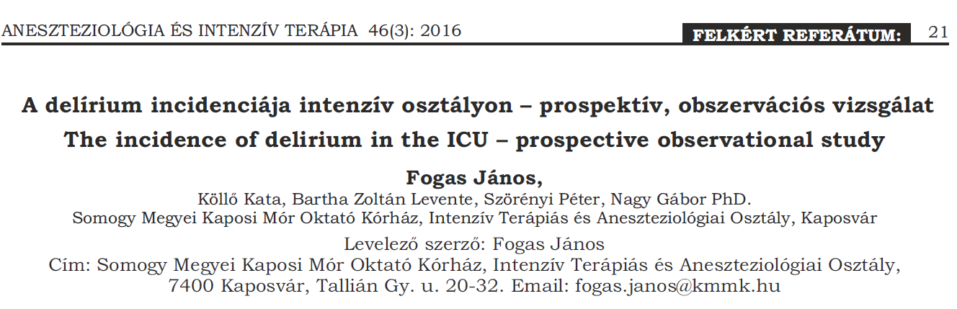
Teljes populáció: 19.9%
Lélegeztetett beteg: 43%
Nem lélegeztetett: 9.5%
Postoperatív beteg: 29.4%

Slide 5
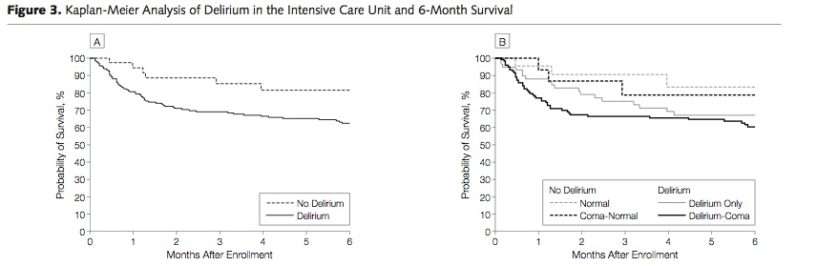
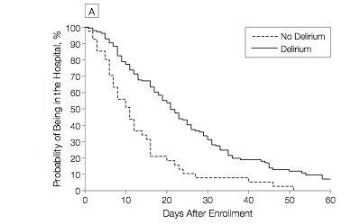
A delírium lélegeztetett betegben
A halálozás független prediktora (3 x ↑) és LOS ↑
A költségek 33%-os növekedéséhez vezet
Eli EW et al. Delirium as a predictor of mortality in mechanically ventilated patients in the ICU. JAMA 2004; 291: 1753-62
Milbrandt EB et al. Costs Associated with Delirium in Mechanically Ventilated Patients. Crit Care Med 2004; 32: 955-962, 2004
Notes:
Vandebilt: 275 consecutive patients on ventilator, 6 month mortality: 15% w/o delirium compared to 34% w/ delirium
Kaplan Maiar

Slide 6
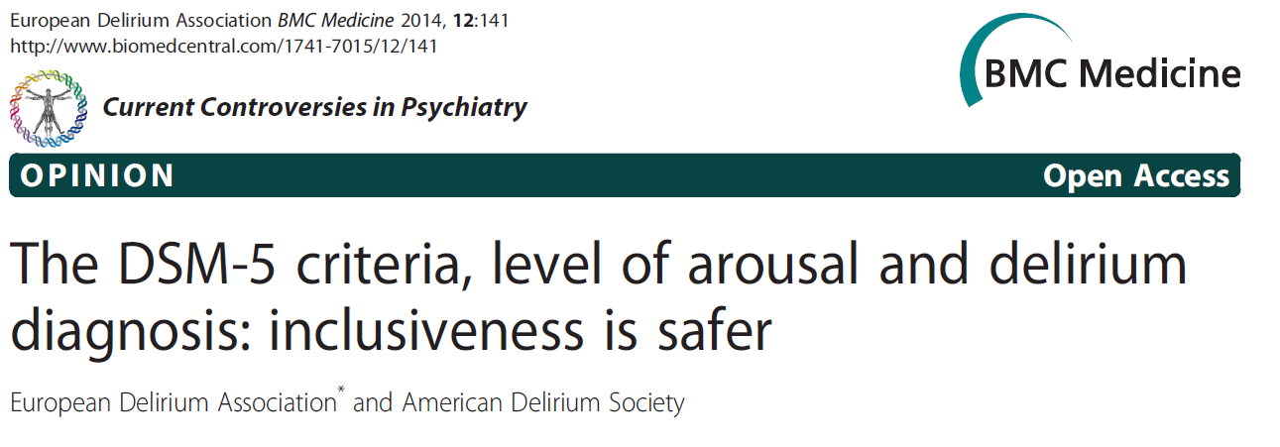
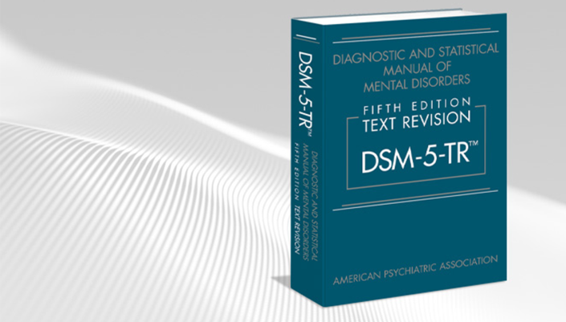
Diagnostic and Statistical Manual of Mental Disorders

Slide 7
DMS-5
Disturbance in attention (i.e., reduced ability to direct, focus, sustain, and shift attention) and awareness (reduced orientation to the environment).
The disturbance develops over a short period of time (usually hours to a few days), represents an acute change from baseline attention and awareness, and tends to fluctuate in severity during the course of a day.
An additional disturbance in cognition (e.g.memory deficit, disorientation, language, visuospatial ability, or perception).

Slide 8
DMS-5
D. The disturbances in criteria A and C are not better explained by a pre-existing, established or evolving neurocognitive disorder and do not occur in the context of a severely reduced level of arousal such as coma.
E. There is evidence from the history, physical examination or laboratory findings that the disturbance is a direct physiological consequence of another medical condition, substance intoxication or withdrawal (i.e. due to a drug of abuse or to a medication), or exposure to a toxin, or is due to multiple etiologies.

Slide 9
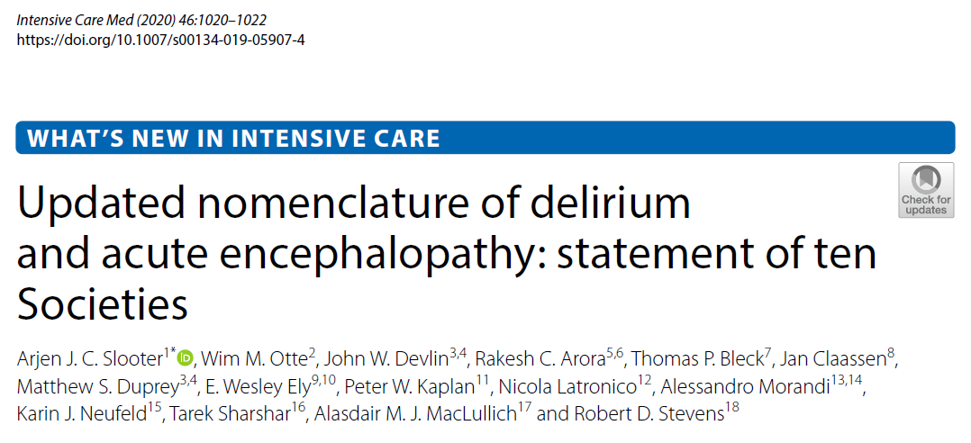
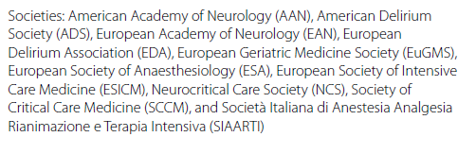

Slide 10
1. The term acute encephalopathy refers to a rapidly developing (over less than 4 weeks, but usually within hours to a few days) pathobiological process in the brain. This is a preferred term
2. Acute encephalopathy can lead to a clinical presentation of subsyndromal delirium, delirium, or in case of a severely decreased level of consciousness, coma; all representing a change from baseline cognitive status.

Slide 11
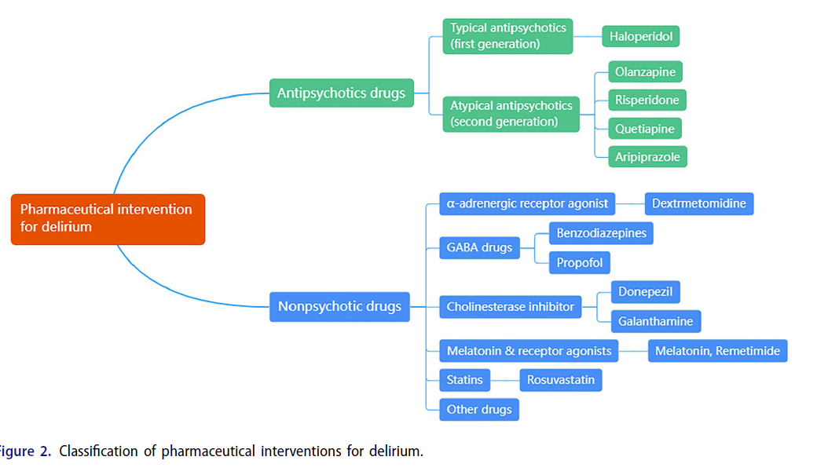
Delírium gyógyszeres kezelése

Slide 13
Haloperidol
Dopamin (D2) receptor antagonista
Hyperaktív delírium
Hosszú QT – torsade de pointes
Hypotenzió
Extrapyramidális tünetek
Malignus neurolept sy

Slide 14
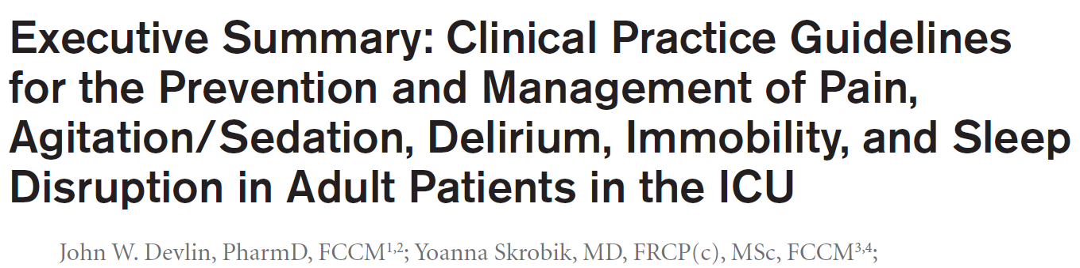
We suggest not routinely using haloperidol, an atypical antipsychotic, or a HMG-CoA reductase inhibitor (i.e., a statin) to treat delirium.
Crit Care Med 2018; 46:1532–1548

Slide 15
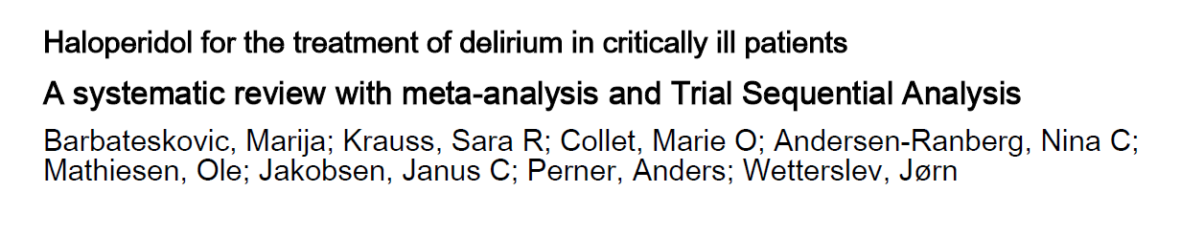
8 RCT, összesen 951 beteg
The evidence for the use of haloperidol to treat critically ill patients with delirium is sparse, of low quality, and inconclusive. We therefore have no certainty regarding any beneficial, harmful or neutral effects of haloperidol in these patients.
Acta Anaesthesiologica Scandinavica, 64(2), 254-266. 2020

Slide 16
Atipusos antipsychotikumok

Slide 17
We suggest not routinely using haloperidol, an atypical antipsychotic, or a HMG-CoA reductase inhibitor (i.e., statin) to treat delirium.
Crit Care Med 2018; 46:1532–1548

Slide 18
Antipsychotics in the Treatment of Delirium in Critically Ill Patients: A Systematic Review and Meta-Analysis of Randomized Controlled Trials*
Carayannopoulos, Kallirroi Laiya MD, FRCPC^{1,2}; at al.
Ovid MEDLINE, EMBASE, APA PsycInfo, and Wiley’s Cochrane Library - 2023 novemberig
5 RCT (n = 1750)
Az antipsychotikumok alkalmazása nem növelte a delírium nélküli napok számát, nem csökkentette a lélegezetett napok, az ITO, a kórházi napok számát és a halálozást placebóval összehasonlítva. Az antipsychotikumok alkalmazása, nem vezetett gyógyszer advers hatás növekedéséhez.
Critical Care Medicine 52(7):p 1087-1096, july 2024

Slide 19
Dexmedetomidine
Szedatív hatás
Analgetikus hatás
Kardiovaszkuláris hatás
Respiratórikus hatás

Slide 20
We suggest using dexmedetomidine for delirium in mechanically ventilated adults where agitation is precluding weaning/extubation.
Crit Care Med 2018; 46:1532–1548

Slide 21
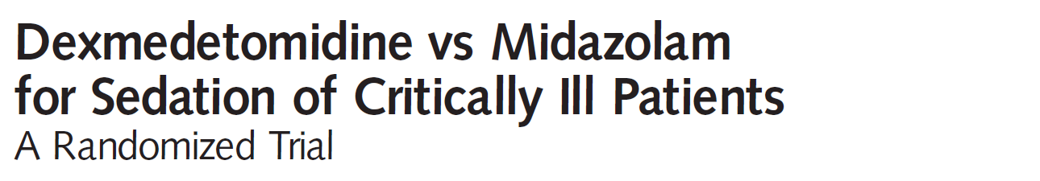

Prospektív, kettős vak, randomizált
5 ország, 68 centrum, 375 intenzív osztály
366 beteg – gépi lélegeztetett > 24 óra
JAMA, February 4, 2009—Vol 301, No. 5

Slide 22
Lélegeztetett napok száma
Delírium prevalencia
JAMA, February 4, 2009—Vol 301, No. 5

Slide 23
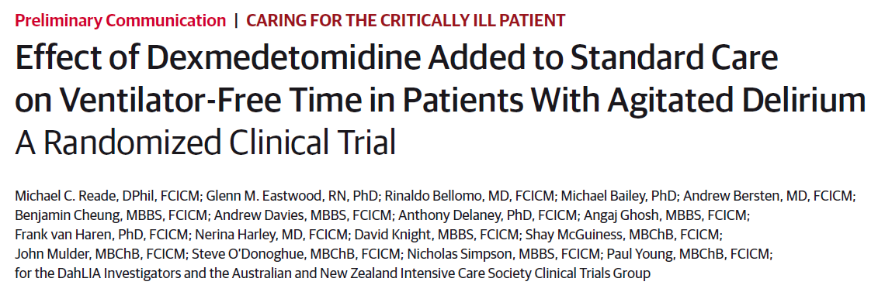
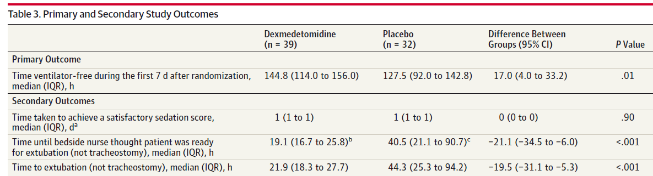
JAMA. 2016;315(14):1460-1468.

Slide 24
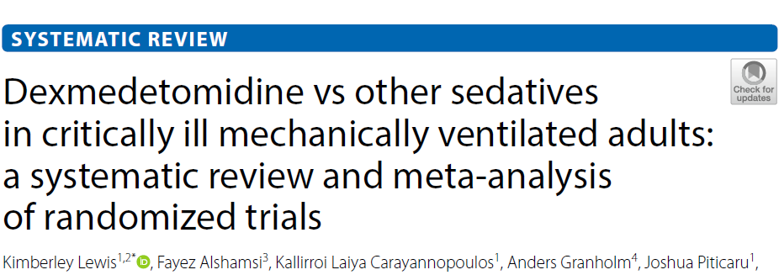
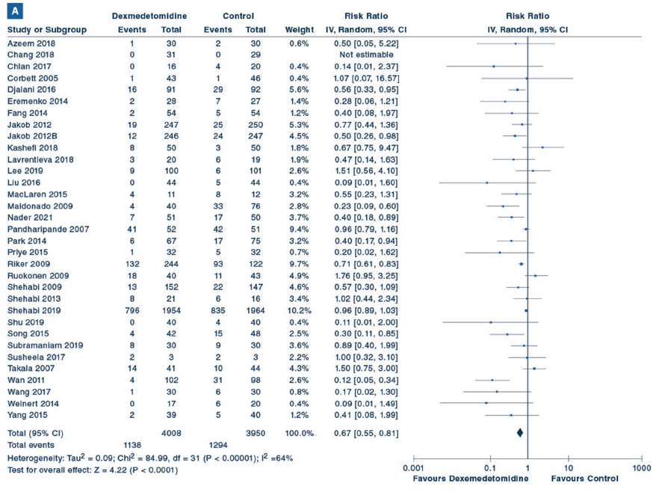
Delirium rizikó - ↓
ITO napok - ↓
Lélegeztetett napok - ↓
Mellékhatás - ↑
Intensive Care Med (2022) 48:811–840

Slide 25
We suggest using either propofol or dexmedetomidine over benzodiazepines for sedation in critically ill, mechanically ventilated adults.
Crit Care Med 2018; 46:1532–1548

Slide 26
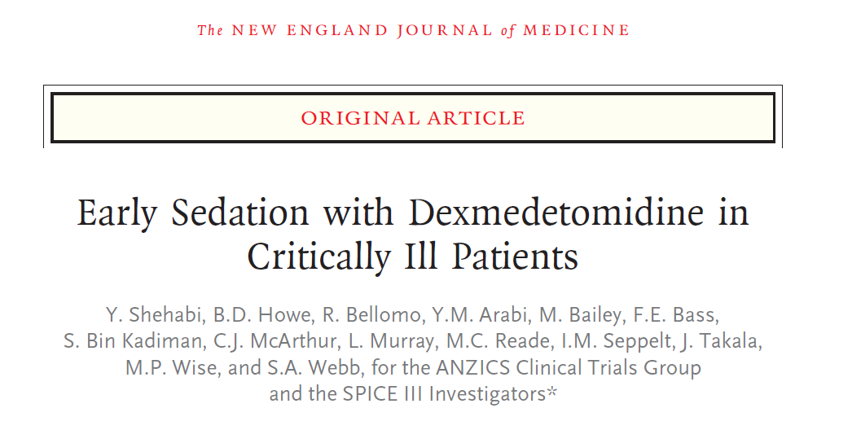
„Open label”, prospektív, randomizált
8 ország, 74 ITO
Dexdor – 1954 beteg / szokásos szedatívum – 1964 beteg
≥ 18 év, randomizálás 12 órán belül
N Engl J Med 2019;380:2506-17.

Slide 27
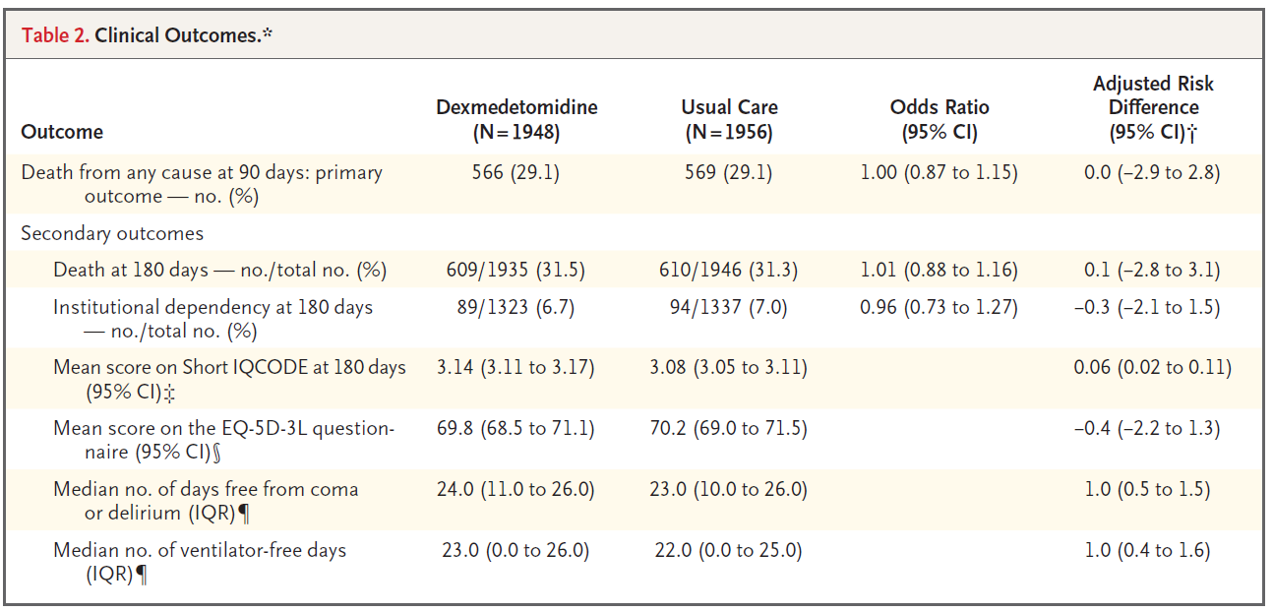
N Engl J Med 2019;380:2506-17.

Slide 28

16th June 2022
Dexmedetomidine: clinical trial finds increased risk of mortality in intensive care unit (ICU) patients aged 65 years or younger
The SPICE III study was a randomised clinical trial comparing the effect of sedation with dexmedetomidine on all-cause mortality with the effect of “usual standard of care” in 3904 ventilated critically ill adult intensive care unit (ICU) patients.
Dexmedetomidine was associated with an increased risk of mortality in the age group 65 years or younger, compared with alternative sedatives (odds ratio 1.26; 95% credibility interval 1.02 to 1.56).
This heterogeneity of effect on mortality from age was most prominent in patients admitted for reasons other than post-operative care, and increased with increasing APACHE II scores and with decreasing age. The mechanism is not known.

Slide 29
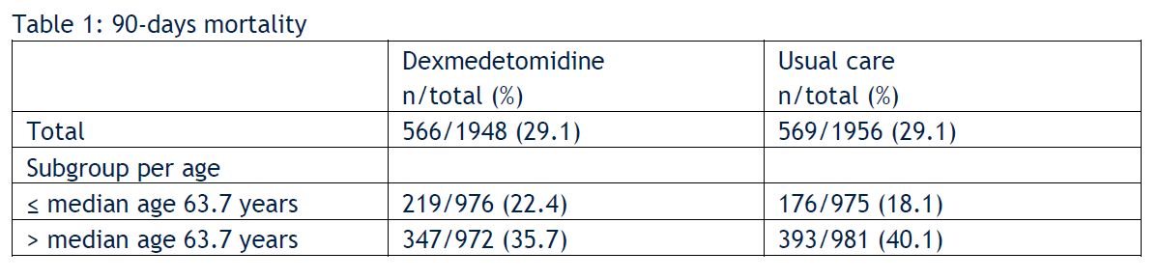
16th June 2022
Dexmedetomidine: clinical trial finds increased risk of mortality in intensive care unit (ICU) patients aged 65 years or younger
odds ratio 1.26 [95% CrI 1.02-1.56]

Slide 30
Összefoglalás
A dexmedetomidine az elsőnek választandó gyógyszer a hiperaktív delírium kezelésében.
Óvatosság az antipsychotikumokkal.
Az alap a nem farmakológiai megelőzés/kezelés.

