Slide 1
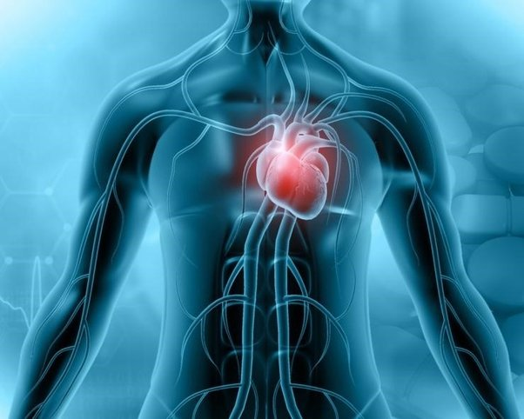


Septic cardiomyopathy?
Prof. Gál János
Rektori biztos, Tanszékvezető
Semmelweis Egyetem
Medizinische Universitat Wien
MIRA, 2025. szeptember 27.

Slide 2

The problem in focus
No conflict of interest
Incidence of sepsis is increasing
Septic patients developing myocardial dysfunction have significantly higher mortality (70%) than those without cardiovascular impairment (20%).
Prevalence of septic cardiomyopathy is 10-70%
  A definition/diagnosis problem?
  CAUSE OR CONSEQUENCE? A target for treatment or a severity marker?
Blanco j et al. Crit Care 2008;12:R158
Beesley, S. J. et al. Crit. Care Med 2018; 46, 625–634

Slide 3
What we see in septic cardiomyopathy
A not adequately enhanced cardiac output
  Decreased contractility
  Impaired response to fluid therapy
  Impaired ventricular dilation
Autonomic dysfunction
Reduced heart rate variability
Impaired baro- and chemoreflex sensitivity

Slide 4
Reversible form of septic cardiomyopathy
Changes in myocardial function and necroenzymes are reversible in survivors in 7-10 days
Bouhemad B et al. Crit Care Med 2009;37:2:441-447

Slide 5
Irreversible form of septic cardiomyopathy:
Chronic cardiac effects of SARS-CoV2
J Am Coll Cardiol Basic Trans Science 2022;7:294–308
Nat Rev Cardiol. 2022 May;19(5):332-341.
Notes:
Most patients with cardiac involvement do fully recover, either with or without scarring (as evident in some follow-up studies). Some patients
with persistent infection can develop post-COVID-19 syndrome. The cardiac presentation of this includes pericardial effusion, perimyocarditis
(early) or myocardial edema, embolism, and interstitial fibrosis with heart failure with preserved ejection fraction (HFpEF) (late).

Slide 6
Understanding the pathophysiology of septic cardiomyopathy: direct/indirect, functional/anatomical myocardial damage
Direct damage to cardiomyocytes and endothelial cells by infection
Indirect damage by dysregulated host response to infection
Hollenberg SM, et al. Nat Rev Cardiol. 2021. PMID: 33473203

Slide 7
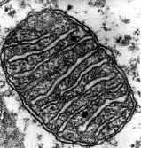
Reversible nature of myocardial dysfunction in sepsis supports the rather functional than anatomical characteristic of the underlying pathophysiology
Zanotti-Cavazzoni SL et al. Curr Opin Crit Care 2009;15:392-397
Notes:
Reversible nature of myocardial dysfunction in sepsis supports the rather functional than anatomical characteristic of the underlying pathophysiology. While initial hypothesis suggested the role of global myocardial ischemia, present findings emphasize the role of circulating myocardial depressant factors, nitric oxide, impaired cellular calcium homeostasis, mitochondrial dysfunction and apoptosis.

Slide 8
Cytopathic hypoxia: myocardial depression in sepsis can be an adaptive protection that trades off short-term cellular dysfunction for the maintenance of long term cellular viability → CO should be raised not to optimize contractile function but to avoid organ perfusion insufficiency – inotropic therapy with caution!
Reversible NO inhibition
Irreversible shut down by peroxynitrit (ONOO• )

Slide 9
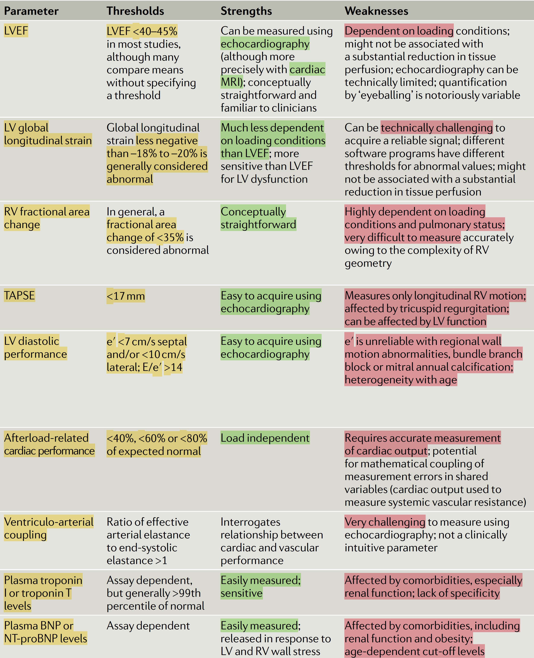
Diagnostic complexity of septic cardiomyopathy
Echocardiography
MRI
Biomarkers (hs troponin, NT-proBNP)

Slide 10
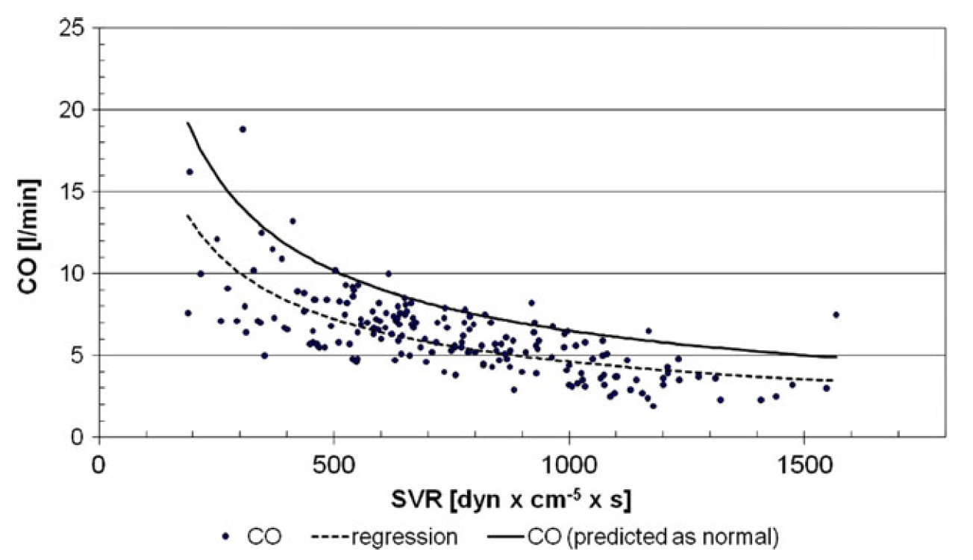
Diagnostic complexity of septic cardiomyopathy
An example: afterload-related cardiac performance
Werdan K et al. Clin Res Cardiol (2011) 100:661–668
Notes:
Echocardiography regularly underestimates cardiac pump failure because all applied reference ranges are standardized for a normal afterload with a SVR of about 1.100 dynes 9 cm-5 9s and not of that of 200–300 dynes 9 cm-5 9 s as seen in septic shock

Slide 11
Questions
Should we treat numbers? Eg. EF, CO, contractility?
  We treat diseases and target sufficient haemodynamics
Should we treat septic cardiomyopathy per se?
  Uncertainty about whether it is pathogenic or is simply reflective of the severity of the disease process
Can we treat septic cardiomyopathy per se?
  Symptomatic treatment targets the macrocirculation and organ perfusion
  Causative treatment targets the infection source control
  Septic cardiomyopathy seems to be rather a syndrome, than a disease. Treatments targeting the disease are usually ineffective or even harmful

Slide 12
Treatments targeting the dysregulated host response instead of the infective cause:
HA-1A; Centoxin; monoclonal antibody; withdrawn 1993
Drotrecogin alfa; Xigris; activated protein C; withdrawn 2011
AZD9773; CytoFab; TNF-antibody; withdrawn 2012 (F IIb)
ASEPSIS Trial; atorvastatin 40 mg; sepsis progression↓? 2012
EUPHRATES Trial; polimyxinB HP endotoxine elim. 2013
OASIS Trial; talactoferrin alfa; immunmodulant protein 2014 Trial stopped due to increased mortality
Notes:
AZ handed the antibody back to BTG, which added that it will take a charge of about £28 million ($43.8 million) in the current financial year, of which £25 million ($39.1 million) relates to a noncash impairment of intangible and tangible fixed assets, since no further development is planned for AZD9773, also known as CytoFab™.
Had CytoFab worked, it might have generated £1 billion ($1.6 billion) in annual sales, with BTG getting a royalty of around 25%, Deutsche Bank analyst Richard Parkes told Reuters.

Slide 13
By antagonizing and eliminating pertinent proinflammatory mediators, septic vasculopathy is more treatable than septic cardiomyopathy
Blocking myocardial suppressant factors (TNF-α, IL-1β), the same as attempts to inhibit NO production could not prove any benefit
Muller-Werdan U et al.Exp Clin Cardiol 2006;11(3):226-236.
Notes:
Causal therapeutic strategies – aiming at an interruption of mediator cascades – to alleviate septic cardiomyopathy and vasculopathy are being tested, but do not form part of the standard regimens. Table summarizes data that convey the notion that by antagonizing and eliminating pertinent proinflammatory
mediators, septic vasculopathy is more treatable than septic cardiomyopathy.

Slide 14
Interventions targeting the dysregulated immune response in sepsis have adverse or at least no benefitial effect on relative mortality risk
(activated rec.protein C (Xigris®)
What works is source control and supportive treatment (15 strong recommendations of SSC 2021 guidelines)
Luhr R, et al. Crit Care. 2019 Jul 3;23(1):241.
Notes:
A subgroup analysis of intervention efficacy, grouped by type of intervention, revealed a significantly higher relative mortality risk for the intervention in trials studying modulation of coagulation and inflammation. All these trials investigated the effect of activated recombinant protein C (Xigris®).

Slide 15
Conclusion
Septic patients with myocardial dysfunction have higher mortality (70%) than those without (20%)
Septic cardiomyopathy (SCM) is a multifactorial complex syndrome due to
  Direct damage of cardiomyocytes by the infective agent
    Which is frequently irreversible
  Indirect damage caused by dysregulated host response to infection
    Which is sometimes adaptive, remission is frequent in survivors
Diagnostics is based on echocardiography, MRI and biomarkers and has to take into consideration the complex haemodynamic interactions
SCM may be pathognomic (hypoperfusion), adaptive (protective) and marker of disease severity
Treatment is
  Symptomatic: haemodynamic support targeting adequate organ perfusion, inotrops with caution!
  Causative: infection source control

Slide 16
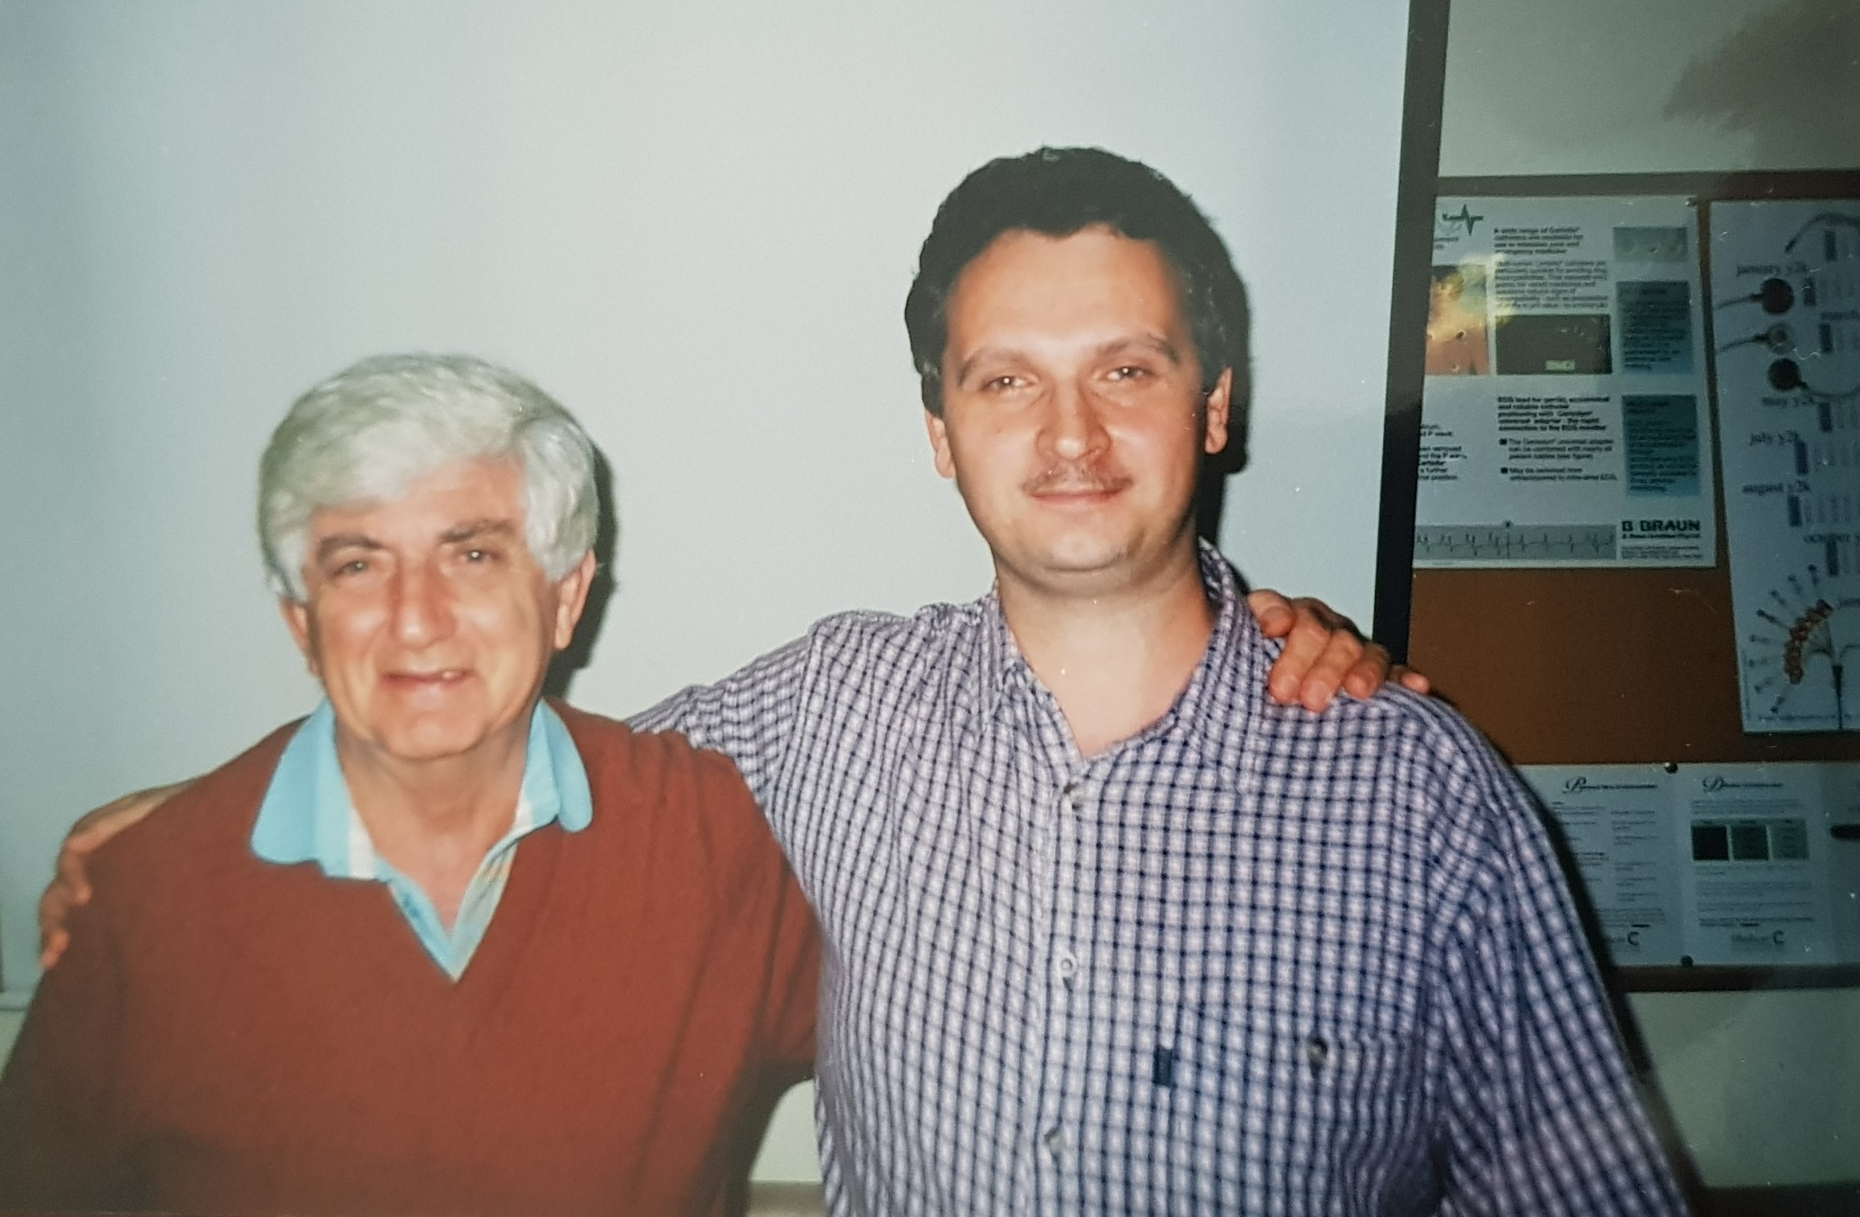
Cape Town,
South Africa
2000

Slide 17
Thank you for your attention

Slide 18
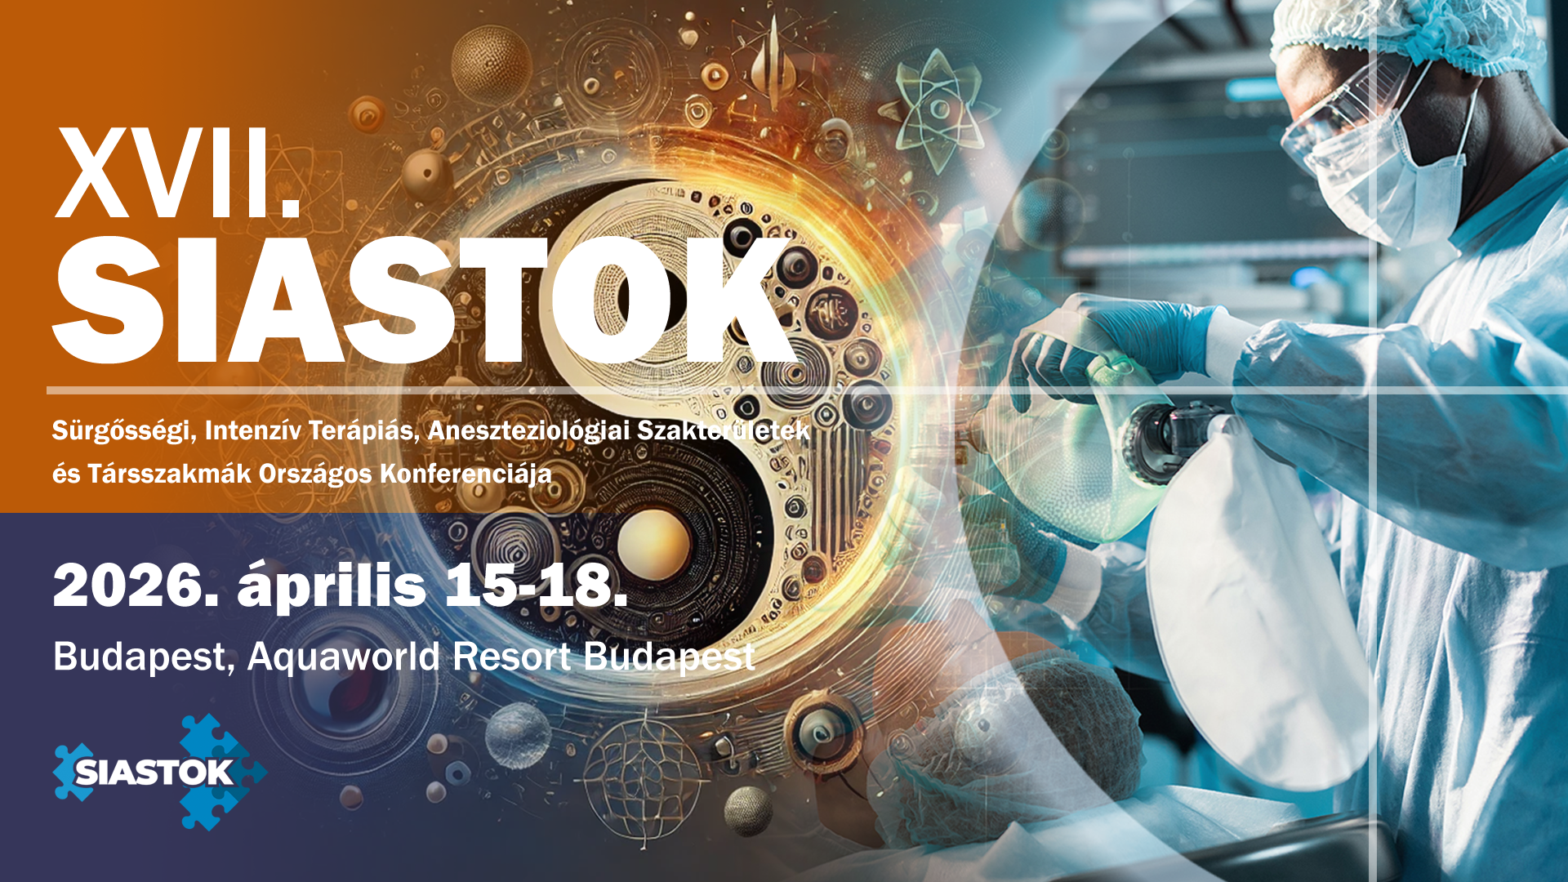
A medicina (ki)fejlődése

