Slide 1










NEM BETEGSÉGET – BETEGET KEZELÜNK
I.
II.
III.
IV.
AZONNALI RESZUSZCITÁCIÓ ÉLETET MENT
CÉL:
ADEKVÁT VO₂/DO₂ BIZTOSÍTÁSA
KÜLÖNBÖZŐ
MONITOTOROK/
CÉLÉRTÉKEK
MEGOLDÁS:
HOLISZTIKUS, INDIVIDUALIZÁLT KONCEPCIÓ

Slide 2
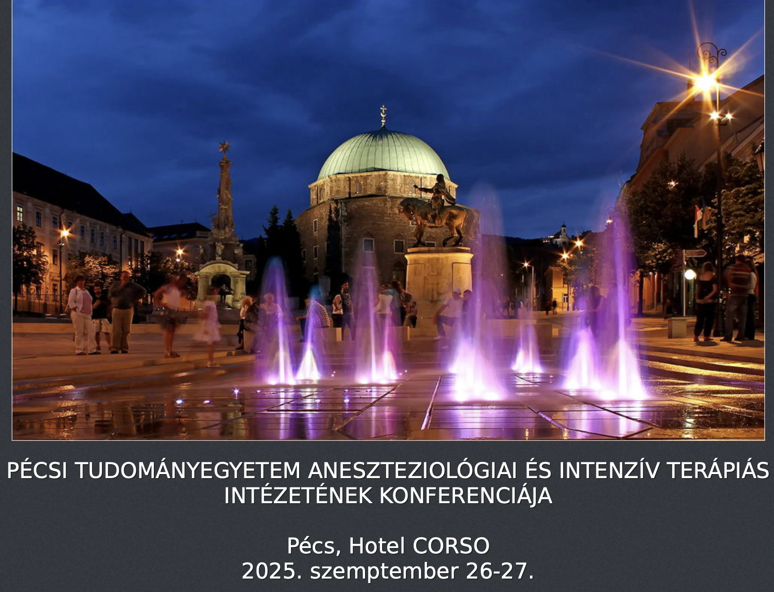
Individualizált hemodinamikai monitorozás
Prof. Dr. Zsolt Molnar
Department of Anesthesiology and Intensive Therapy, Semmelweis University, Budapest, Hungary
Centre for Translational Medicine, Semmelweis University, Budapest, Hungary
Department of Anaesthesiology and Intensive Therapy, Poznan University of Medical Sciences, Poznan, Poland

Slide 3
Basics

Slide 4
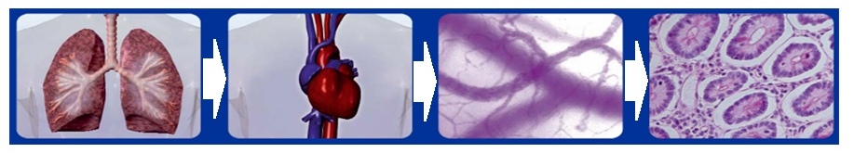
Understand VO₂/DO₂
Fluid
Blood
Oxygen
DO₂= (SV•HR) • (Hb•1.39•SaO₂+0.003•PaO₂)
VO₂ = CO • (CaO₂ - CvO₂)
CO
CaO₂
Analgesia, sedation

Slide 6
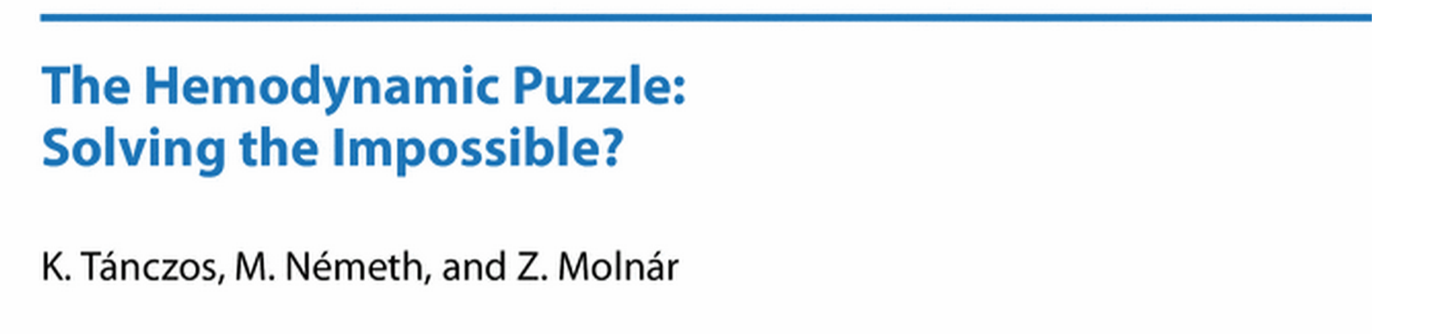
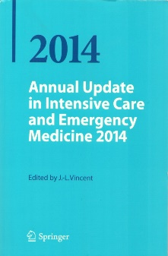
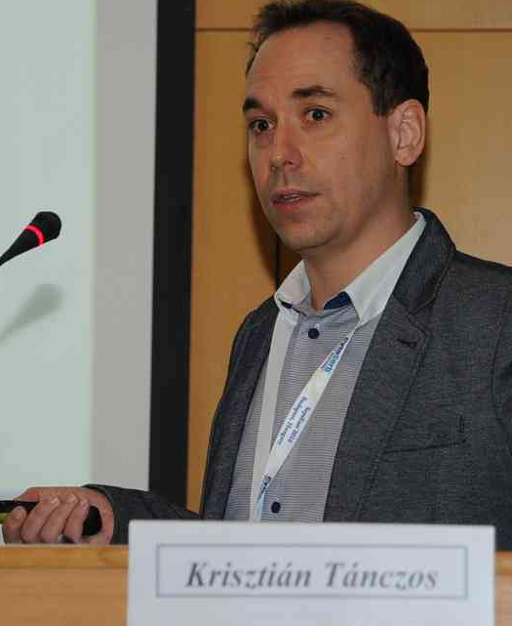
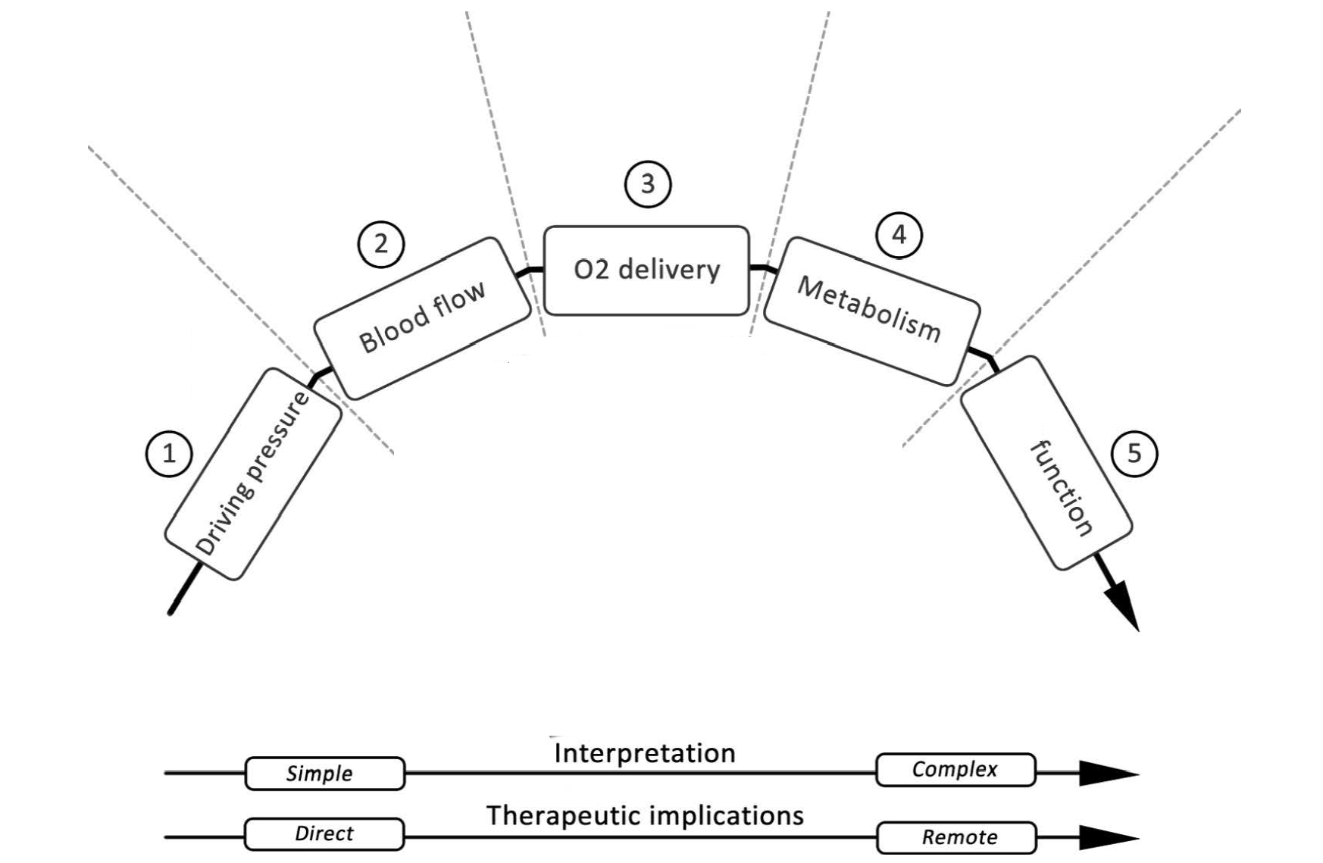

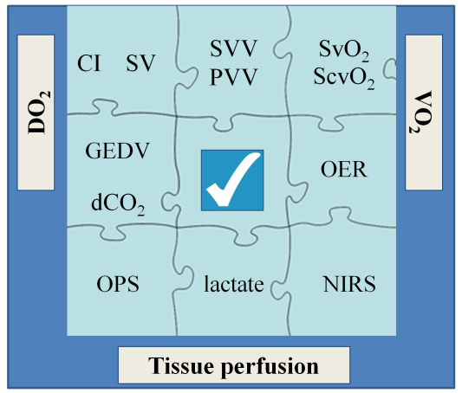

2014, pp 355-365
CI
SVI
GEDVI
GEF
Hb
SpO₂
Lactate
ScvO₂
MAP
CVP
Diuresis, etc.
Organ

Slide 7
How to do it at the bedside?

Slide 8
Case history
63 year old man
    Admitted to A&E with abdominal pain
    Acute abdomen – free i. abd. air
    PMh: Hypertension, IHD
    Transfer to theatre for laparoscopy/laparotomy
In theatre:
    O_{2,} peripheral+Art. Line
    RSI
Heart rate (min⁻¹) | 105
MAP (mmHg) | 70 (110/50)
Hb (g/dl) | 12.5

Slide 9
As we went along...
Potential causes
Heart rate (min⁻¹) | 115
MAP (mmHg) | 58 (95/40)
CVP (mmHg) | 10

Slide 10
As we went along...
Potential causes
Heart rate (min⁻¹) | 115
MAP (mmHg) | 58 (95/40)
CVP (mmHg) | 10
Vasoplegia/Hypovolemia?
?
Fluid
Dobutamine
Fluid+Dobutamine
Noradrenaline
Fluid+NA

Slide 11
As we went along...
Potential causes
Heart rate (min⁻¹) | 115
MAP (mmHg) | 58 (95/40)
CVP (mmHg) | 10
Vasoplegia/Hypovolemia?
?
Fluid
Dobutamine
Fluid+Dobutamine
Noradrenaline
Fluid+NA
Fluid bolus (ml) | 500
Noradrenaline (µg/min) | 5-10
Why both?

Slide 12
Avoid hypotension, or treat it ASAP!

Slide 13
After fluid + NA
Potential causes
Potential therapy
Heart rate (min⁻¹) | 115
MAP (mmHg) | 75 (110/60)
CVP (mmHg) | 11
10 µg/min NA
?
Are you happy?

Slide 14
59%

Slide 15
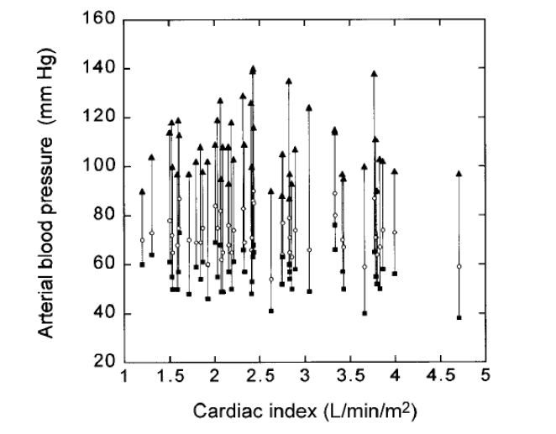
BP and CO
One cannot estimate CO from BP
Linton RA, et al. J Cardiothorac Vasc Anesth 2002; 16: 4-7.

Slide 16
After fluid + NA
Potential causes
Potential therapy
Heart rate (min⁻¹) | 115
MAP (mmHg) | 75 (110/60)
CVP (mmHg) | 11
10 µg/min NA
Is this MAP associated with adequate perfusion?
?
I don’t know!
Are you happy?

Slide 17
Assessing perfusion
Brain
Heart
Lungs
Kidneys
Periphery
Global
GCS/consciousness
ECG-ST
ET_{CO2}
VD/VT
UO/h
CRT
Temp
MiC-perfusion
Lactate, pH, HCO₃
ScvO₂
pCO₂-gap

Slide 18
Physiology
Critical point
DO₂
ScvO₂
VO₂ (ml/min)
Shock
DO₂ (ml/min)

Slide 19
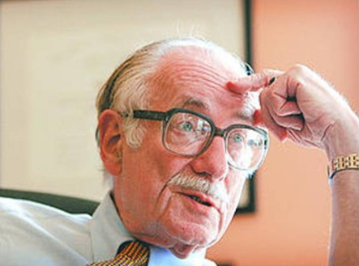
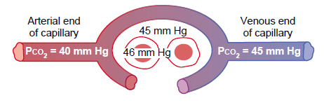
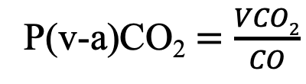
pCO₂-gap
Dr. Max Harry Weil
1927-2011
Fick equation:
Total CO₂ production (VCO₂) =
CO x (CvCO₂ – CaCO₂)
dCO₂: 42 mmHg
(pCO₂ = k x CCO₂)
Increased pCO₂-gap = „low” CO
P(v-a)CO₂ $=\frac{VCO2}{CO}$

Slide 20
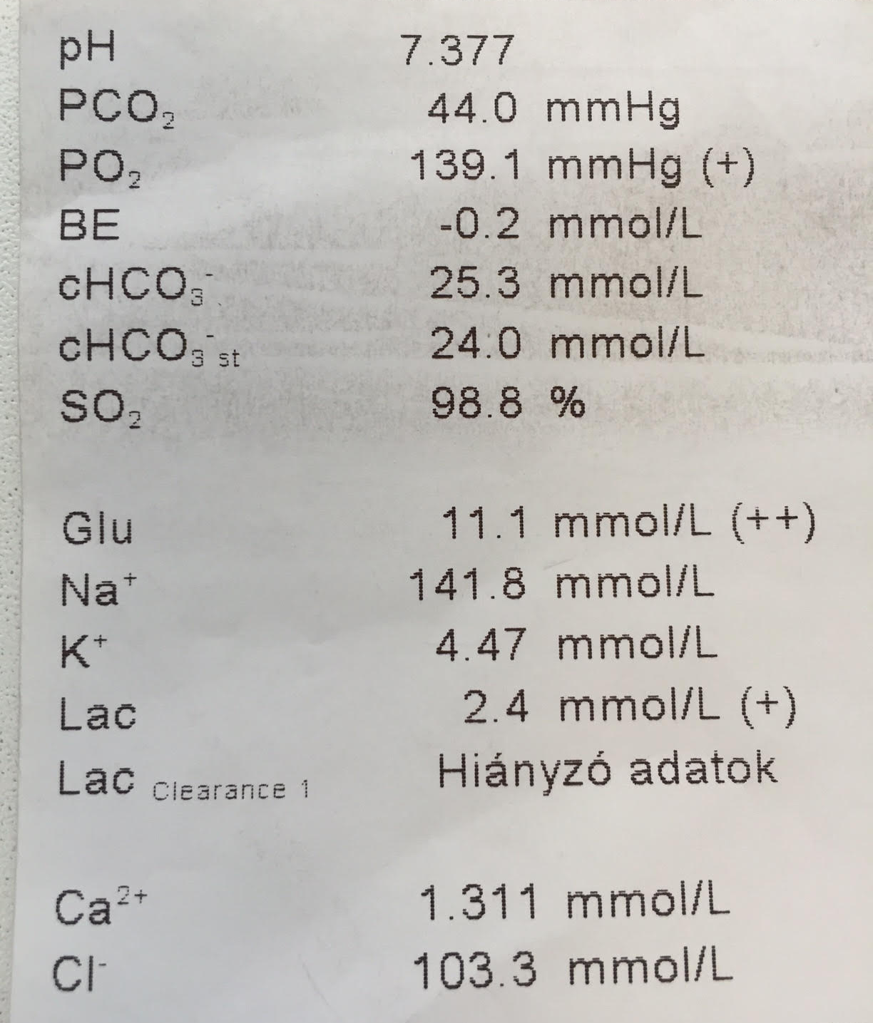
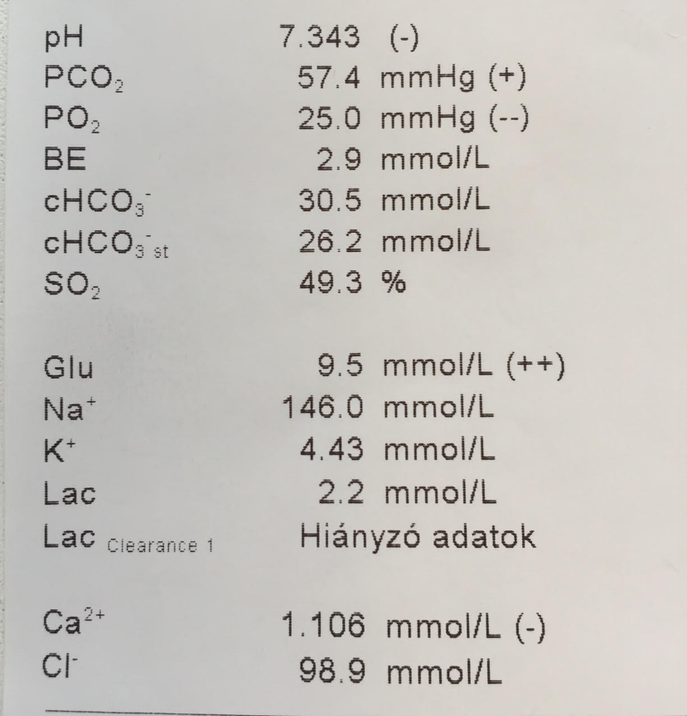
Blood gases
Arterial
Central venous
dCO₂: 13mmHg
ScvO₂: 49 %

Slide 21
With blood gases
Potential causes
Potential therapy
Heart rate (min⁻¹) | 115
MAP (mmHg) | 75 (110/60)
CVP (mmHg) | 10
Lactate (mmol/l) | 2.4
ScvO₂ (%) | 49
dCO₂ (mmHg) | 13
10 µg/min NA
Anaerob met.
Fluid
Blood
Dob
Inadequate DO₂
Inadequate CO
?
Fluid
Dobutamine
Fluid+Dobutamine
Noradrenaline
Fluid+NA

Slide 22
With blood gases
Potential causes
Potential therapy
Heart rate (min⁻¹) | 115
MAP (mmHg) | 75 (110/60)
CVP (mmHg) | 10
Lactate (mmol/l) | 2.4
ScvO₂ (%) | 49
dCO₂ (mmHg) | 13
10 µg/min NA
Anaerob met.
Fluid
Blood
Dob
Inadequate DO₂
Inadequate CO
?
Fluid
Dobutamine
Fluid+Dobutamine
Noradrenaline
Fluid+NA

Slide 23
After 2 boluses of fluid
Potential causes
Potential therapy
Heart rate (min⁻¹) | 115
MAP (mmHg) | 75 (110/60)
CVP (mmHg) | 10
Lactate (mmol/l) | 2.3
ScvO₂ (%) | 55
dCO₂ (mmHg) | 12
10 µg/min NA
Anaerob met.
Fluid
Blood
Dob
Inadequate DO₂
Inadequate CO
?
Fluid
Dobutamine
Fluid+Dobutamine
Blood
More information

Slide 24
After 2 boluses of fluid
Potential causes
Potential therapy
Heart rate (min⁻¹) | 115
MAP (mmHg) | 75 (110/60)
CVP (mmHg) | 10
Lactate (mmol/l) | 2.3
ScvO₂ (%) | 55
dCO₂ (mmHg) | 12
10 µg/min NA
Anaerob met.
Fluid
Blood
Dob
Inadequate DO₂
Inadequate CO
?
Fluid
Dobutamine
Fluid+Dobutamine
Blood
More information

Slide 25
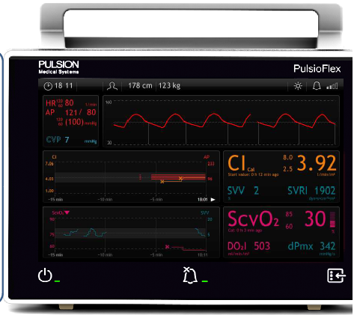
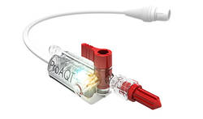
Less invasive HD monitoring
Heart rate (min⁻¹) | 115
MAP (mmHg) | 77
Noradrenaline (µg/min) | 15
CI (> 2.5 L/m²) | 2.50
SVI (30-60 ml/m²) | 20
PPV (<10-12 %) | 16
Low
Volume responsiveness
High
?
Fluid
Dobutamine
Fluid+Dobutamine
More information
ScvO₂ (%) | 55
dCO₂ (mmHg) | 12
Lactate (mmol/l) | 2.3

Slide 26
Less invasive HD monitoring
Heart rate (min⁻¹) | 115
MAP (mmHg) | 77
Noradrenaline (µg/min) | 15
CI (> 2.5 L/m²) | 2.50
SVI (30-60 ml/m²) | 20
PPV (<10-12 %) | 16
Low
Volume responsiveness
High
?
Fluid
Dobutamine
Fluid+Dobutamine
More information
ScvO₂ (%) | 55
dCO₂ (mmHg) | 12
Lactate (mmol/l) | 2.3

Slide 27
30 min+500 ml RF later:
Heart rate (min⁻¹) | 108
MAP (mmHg) | 68
Noradrenaline (µg/min) | 12
CI (> 2.5 L/m²) | 2.52
SVI (30-60 ml/m²) | 23
PPV (<10-12 %) | 9
Low
Fluid
Dobutamine
Fluid+Dobutamine
More information
?
ScvO₂ (%) | 65
dCO₂ (mmHg) | 9
Lactate (mmol/l) | 2.0
Low
High

Slide 28
30 min+500 ml RF later:
Heart rate (min⁻¹) | 108
MAP (mmHg) | 68
Noradrenaline (µg/min) | 12
CI (> 2.5 L/m²) | 2.52
SVI (30-60 ml/m²) | 23
PPV (<10-12 %) | 9
Low
Contractility
Fluid
Dobutamine
Fluid+Dobutamine
More information
?
ScvO₂ (%) | 65
dCO₂ (mmHg) | 9
Lactate (mmol/l) | 2.0
Low
High

Slide 29
After starting dobutamine:
Heart rate (min⁻¹) | 110
MAP (mmHg) | 70
Noradrenaline (µg/min) | 10
Dobutamine(µg/min/kg) | 5-8
CI (> 2.5 L/m²) | 3.22
SVI (30-60 ml/m²) | 28
PPV (<10-12 %) | 9

Slide 30
A bit later:
Heart rate (min⁻¹) | 110
MAP (mmHg) | 70
Noradrenaline (µg/min) | 10
Dobutamine(µg/min/kg) | 5-8
CI (> 2.5 L/m²) | 3.20
SVI (30-60 ml/m²) | 27
PPV (<10-12 %) | 15
Volume responsiveness
High
?
Fluid
Dobutamine
Blood
ScvO₂ (%) | 70
dCO₂ (mmHg) | 8
Lactate (mmol/l) | 1.3
Hb (g/dl) | (12.5) 8.2
Low?
Low

Slide 31
A bit later:
Heart rate (min⁻¹) | 110
MAP (mmHg) | 70
Noradrenaline (µg/min) | 10
Dobutamine(µg/min/kg) | 5-8
CI (> 2.5 L/m²) | 3.20
SVI (30-60 ml/m²) | 27
PPV (<10-12 %) | 15
Volume responsiveness
High
?
Fluid
Dobutamine
Blood
ScvO₂ (%) | 70
dCO₂ (mmHg) | 8
Lactate (mmol/l) | 1.3
Hb (g/dl) | (12.5) 8.2
Low?
Low

Slide 32
After 1 U blood:
Heart rate (min⁻¹) | 105
MAP (mmHg) | 74
Noradrenaline (µg/min) | 5
Dobutamine(µg/min/kg) | 3
CI (> 2.5 L/m²) | 3.42
SVI (30-60 ml/m²) | 32
PPV (<10-12 %) | 8
I was ☺
?
ScvO₂ (%) | 74
dCO₂ (mmHg) | 8
Lactate (mmol/l) | 1.3
Hb (g/dl) | 9.7
Are you happy?

Slide 33
Towards the end of surgery…:
Heart rate (min⁻¹) | 110
MAP (mmHg) | 85
Noradrenaline (µg/min) | ---
Dobutamine(µg/min/kg) | ---
CI (> 2.5 L/m²) | 4.18
SVI (30-60 ml/m²) | 38
PPV (<10-12 %) | 8
Depth of anaesthesia monitoring
?
ScvO₂ (%) | 70
dCO₂ (mmHg) | 8
Lactate (mmol/l) | 1.3
Hb (g/dl) | 9.7
What is the missing link?

Slide 34
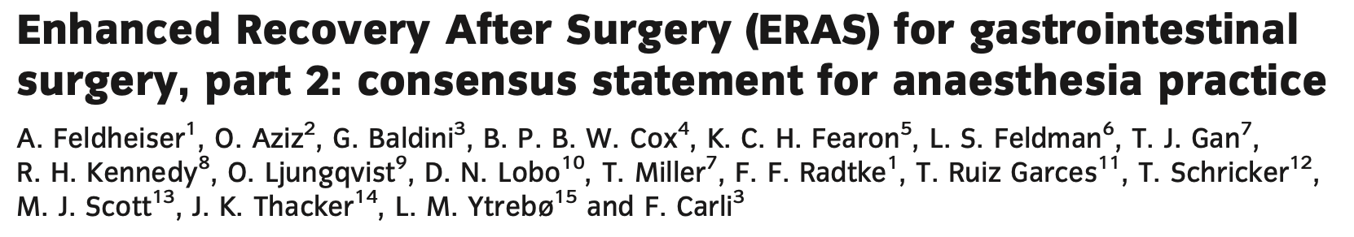
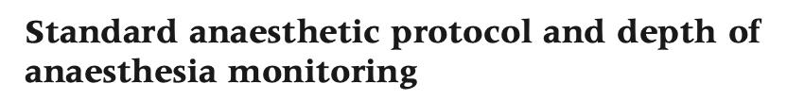
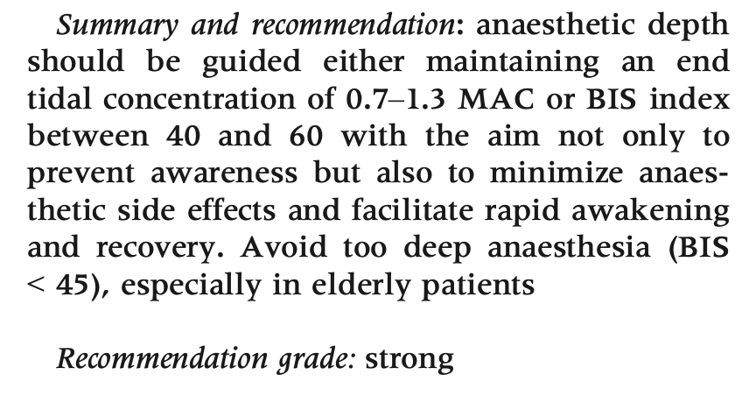

Slide 35
Final thoughts

Slide 36
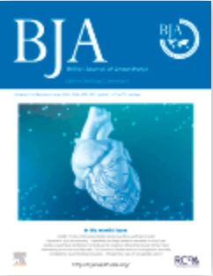
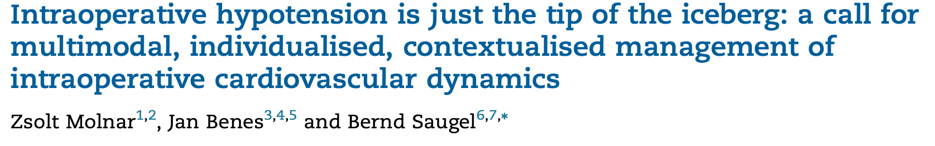
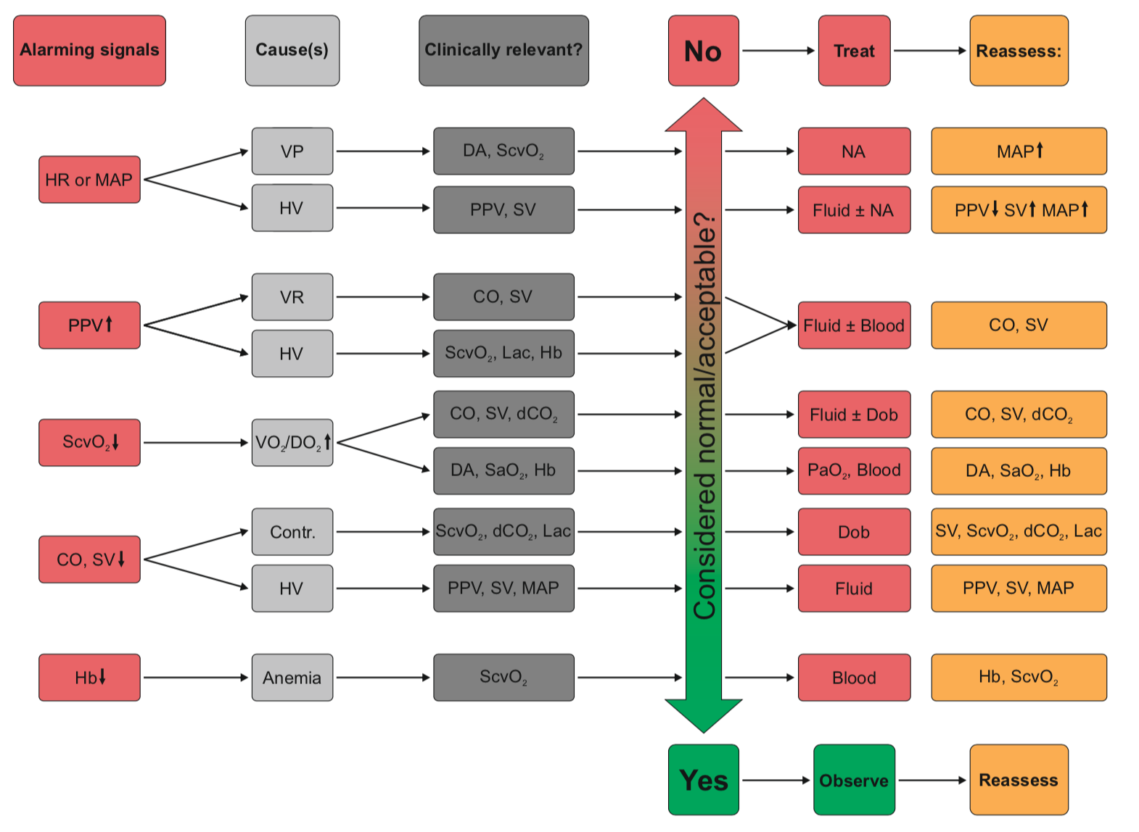

Slide 37
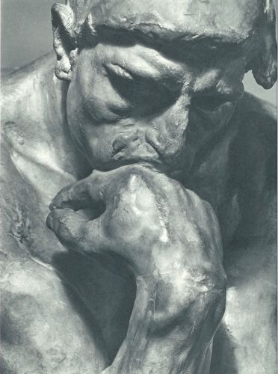
There is no replacement (yet)...
Auguste Rodin: The Thinker

Slide 38
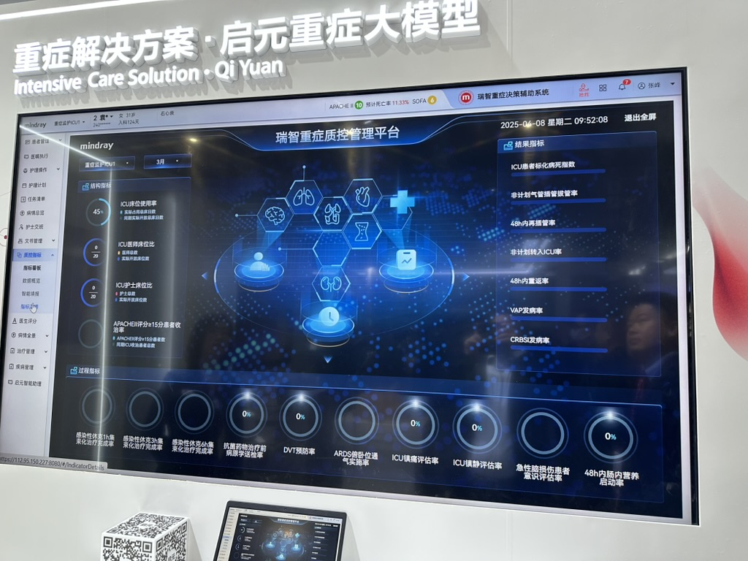
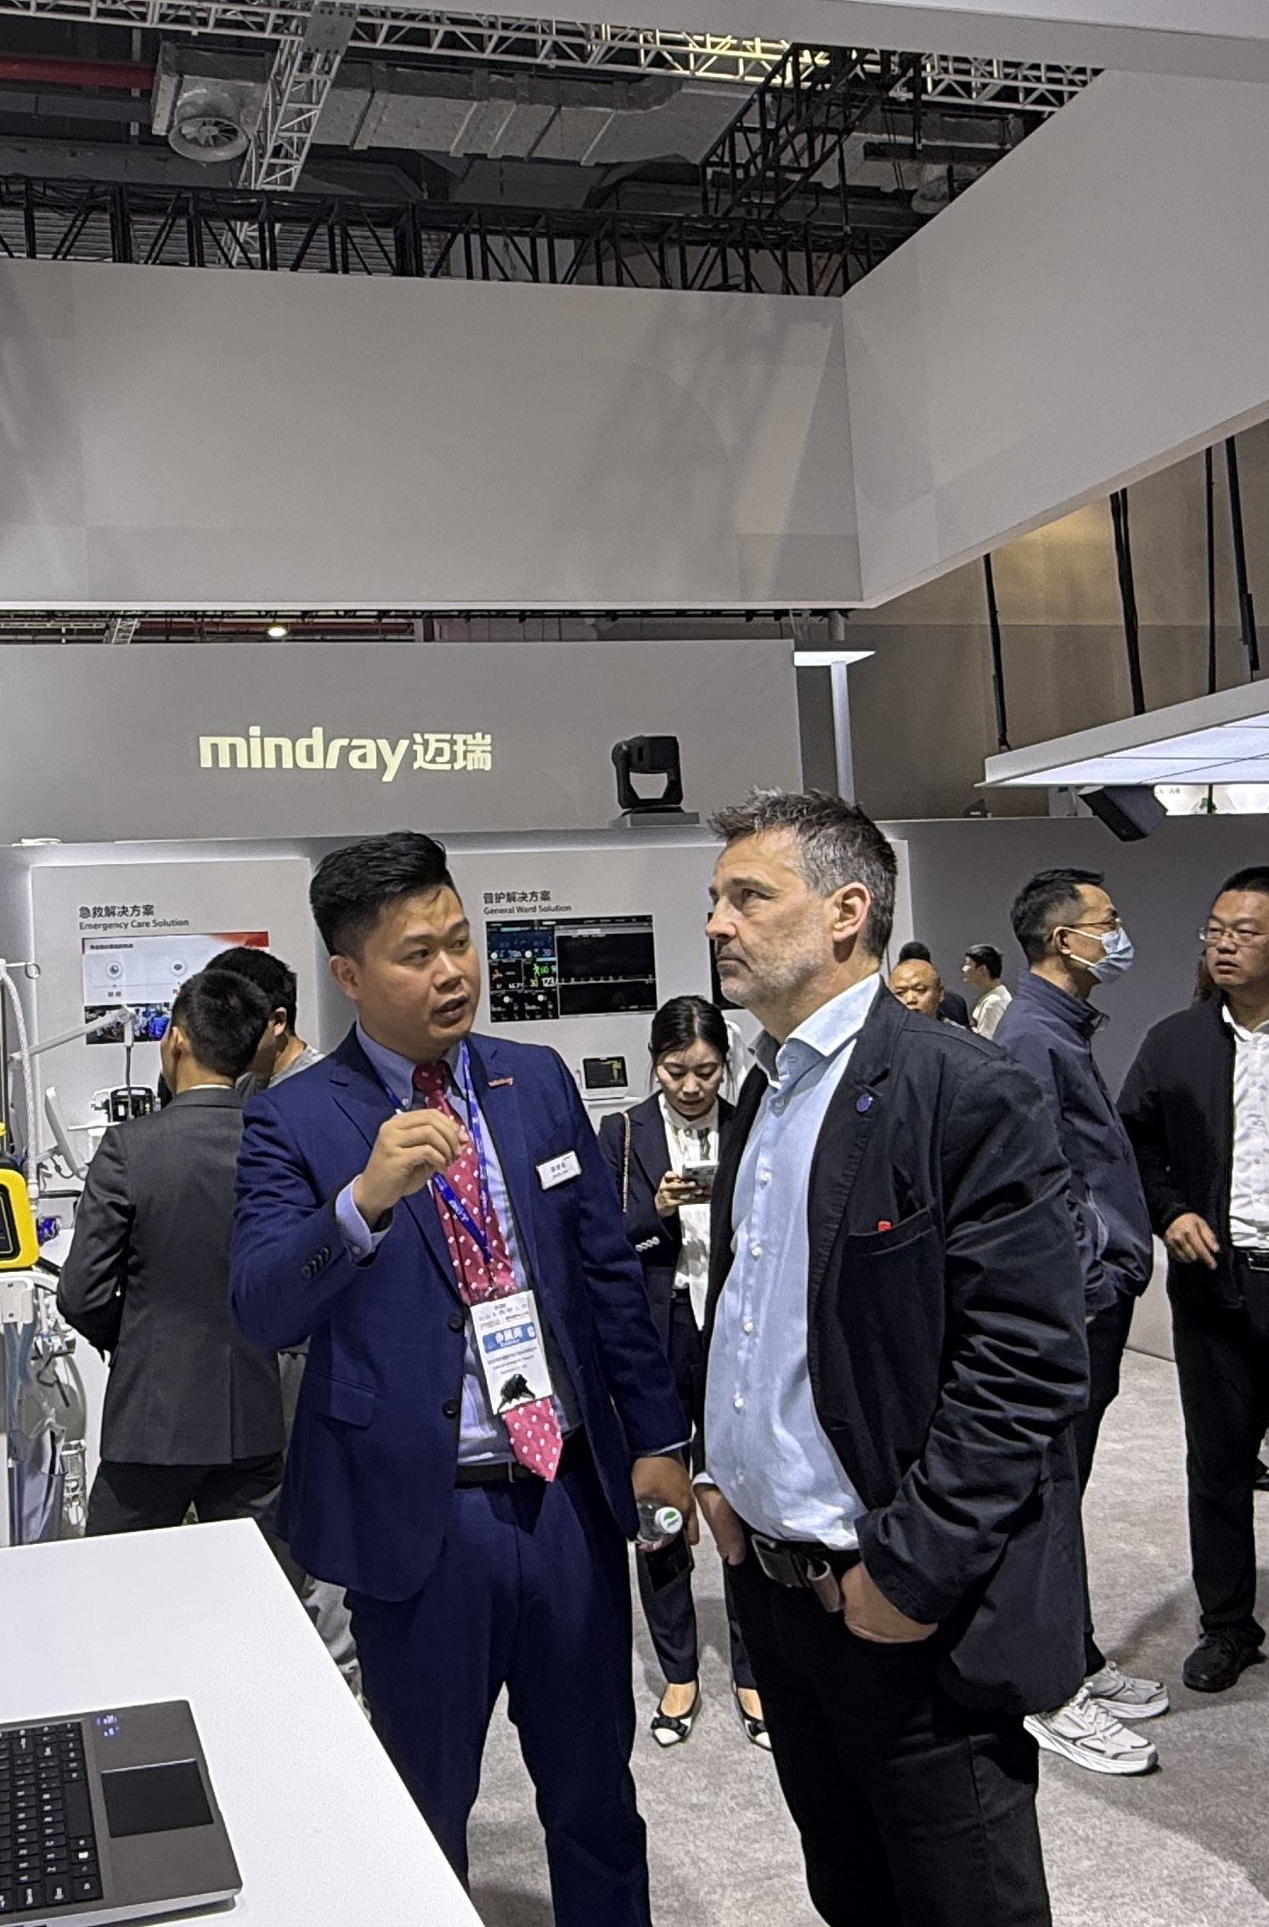
Or is there?
AI is here!

Slide 39

Mark it in your calendar!

