Slide 1

Mikrobiom és táplálás
Madách Krisztina
Semmelweis Egyetem
Aneszteziológiai és Intenzív Terápiás Tanszék

Slide 2

Szemléletváltások a gyógyításban
(I.e.6000-napjainkig)
Vallás alapú gyógyítás
Humorálpatológia
  szanguinikus, kolerikus, melankolikus, flegmatikus
Betegség specifikus
  antibakteriális megszállottság
Evidencia alapú
Precíziós medicina
  Genetika – HGP 2003
  Mikrobiom (ökoszisztéma tudatos) - HMP 2008»
Notes:
sanguine (optimistic and social), choleric (short-tempered or irritable), melancholic (analytical and quiet), and phlegmatic (relaxed and peaceful). Most formulations include the possibility of mixtures of the types.
The Greek physician Hippocrates (c. 460 – c. 370 BC) incorporated the four temperaments into his medical theories as part of the ancient medical concept of humorism, that four bodily fluids affect human personality traits and behaviors.
Human genom projekt 2003-ral lezárult, a Humán Mikrobiom Projekt pedig 2008-cal indult

Slide 3
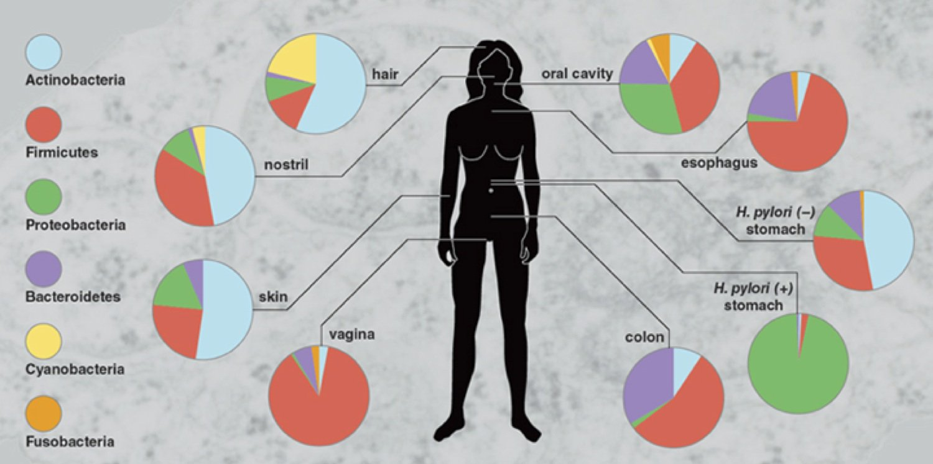
A mirobialis összetétel lokalizáció – niche specifikus
Dorit RL. American Scientist. 2014 Sept-Oct 102;5,330.

Slide 4
A mikrobialis összetétel idő és noxa függő
Noora Ottman et al.Front Cell Infect Microbiol. 2012; 2: 104.
Proteobacteria: pseudomonas, enterobacteriaceae
Firmicutes: streptococcus, staphylococcus, enterococcus, clostridium
16S rRNS meghatározás metagenomika
Notes:
Proteobacteria: pseudomonas, enterobacteriaceae
Firmicutes: streptococcus, staphylococcus, enterococcus, clostridium

Slide 5

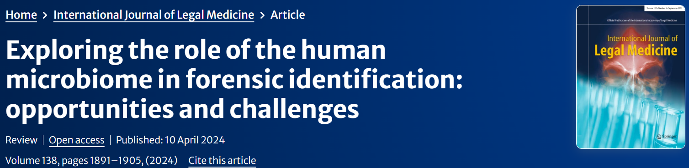

Slide 6
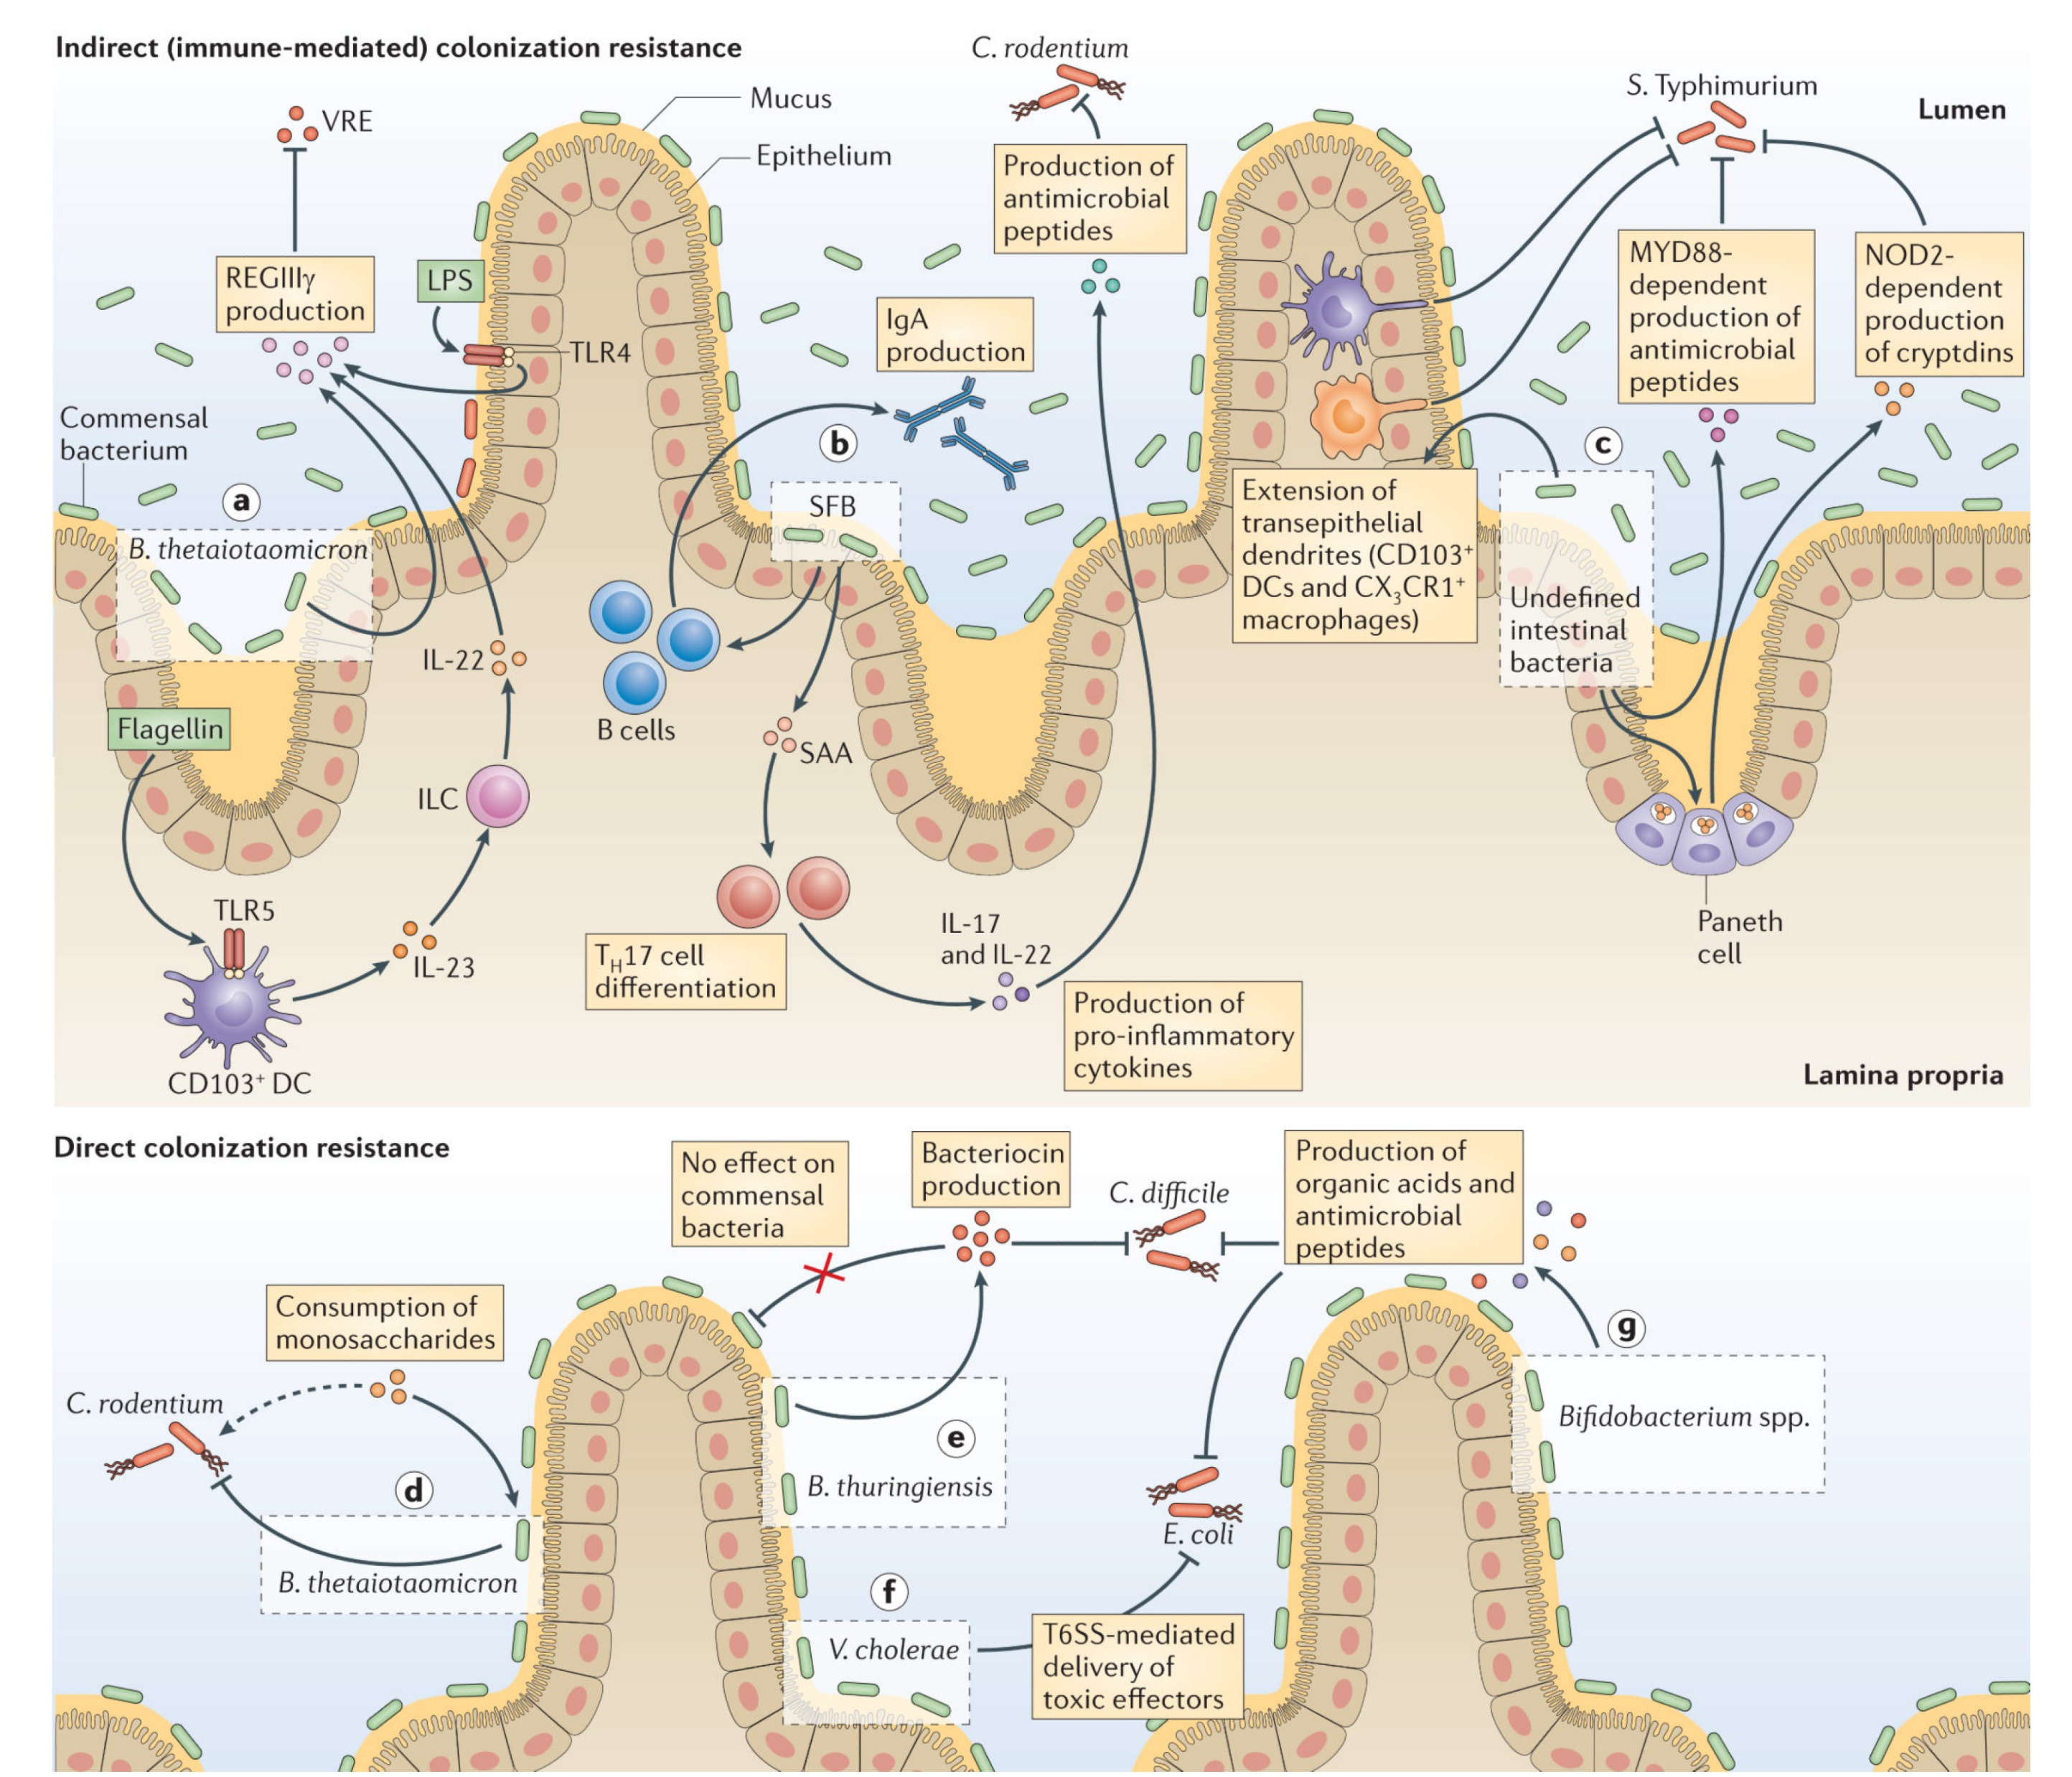
A bélbaktériumok direkt és indirekt védelmet biztosítanak az enteralis pathogének kolonizációjával szemben
Buffie CG et al. Nat Rev Immunol. 2013 Nov ; 13(11): 790–801
Notes:
Bacillus thuringiensis

Slide 7
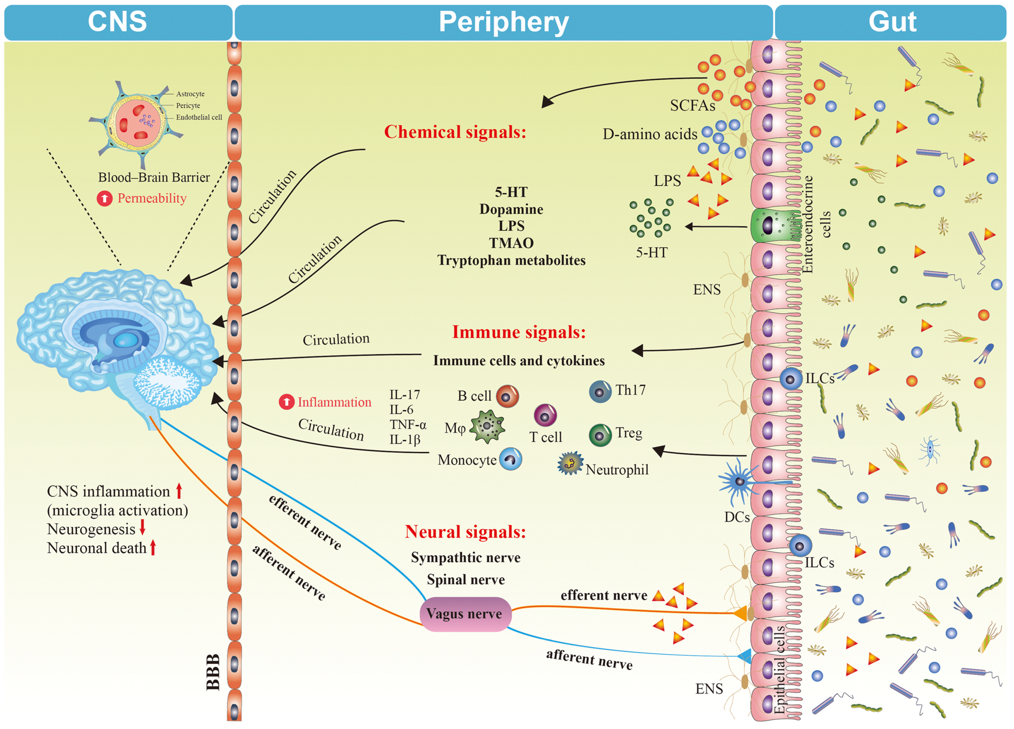
Bél <> Agy tengely
Human>egér FMT:
Parkinson sy
Skizofrénia
Autizmus
Depresszió
Chang L. Brain Research Bulletin 182 (2022) 44–56
Notes:
The role of the brain–gut–microbiota axis in the body. The major pathways of the brain–gut–microbiota axis are shown among the central nervous system (CNS), periphery, and gut. The network of neural signals, immune signals, and chemical signals constitutes a major part of the brain–gut–microbiota axis. Alterations in this network involves complex interactions across organs by direct (nerves) and indirect (systemic circulation) pathways, contributing to altered homeostasis in the body. Changes in the gut microbiota composition and microbiome-derived SCFAs, D-amino acids and metabolites can alter neural signals, immune signals, and chemical signals to cause depression. The CNS works through neural regulation, neurotransmitters, immune signals, and other factors that target peripheral organs and tissue in response to different signal reflexes, thereby contributing to normal bidirectional brain–gut axis signaling. When this balance is destroyed by stress, depression or other diseases may occur. CNS: central nervous system, DCs dendritic cells, ENS: enteric nerveus system, 5-HT: 5-hydroxytryptamine, IL-6: interleukin 6, IL-17: interleukin 17, IL-1β: interleukin 1β, ILC: innate lymphoid cells, LPS: lipopolysaccharide, SCFA: short chain fatty acid, TMAO: trimethylamine N-oxide, TNF-α: tumor necrosis factor α

Slide 8
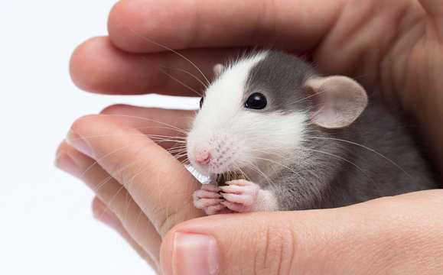
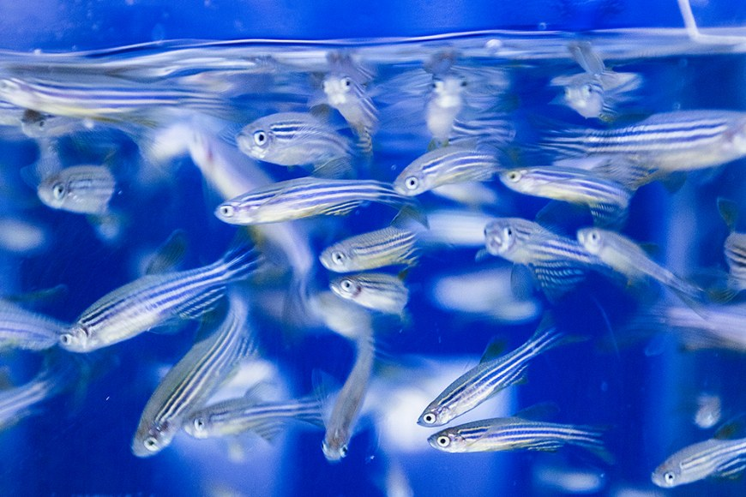
A bél mikrobióta szerepe a depresszióban
Lachnospiracea, Lactobacillus, Bifidobacterium, Saccharomyces
Septicus, stresszelt, csíramentes egerek
Kiegyensúlyozott viselkedés
Depressziós viselkedés
Valles-Colomer M et al. Int. J. Mol. Sci. 2022, 23, 8493
Notes:
Zebra halak rajba tömörült

Slide 9
Bifidobacterium abundance plus SOFA (AUC, 0.882; 95% CI, 0.774-0.950) outperformed
Bifidobacterium abundance alone (AUC, 0.718; 95% CI, 0.588-0.826; P = 0.007) and
SOFA (AUC, 0.649; 95% CI, 0.516-0.767; P = 0.012) N=61

Slide 10
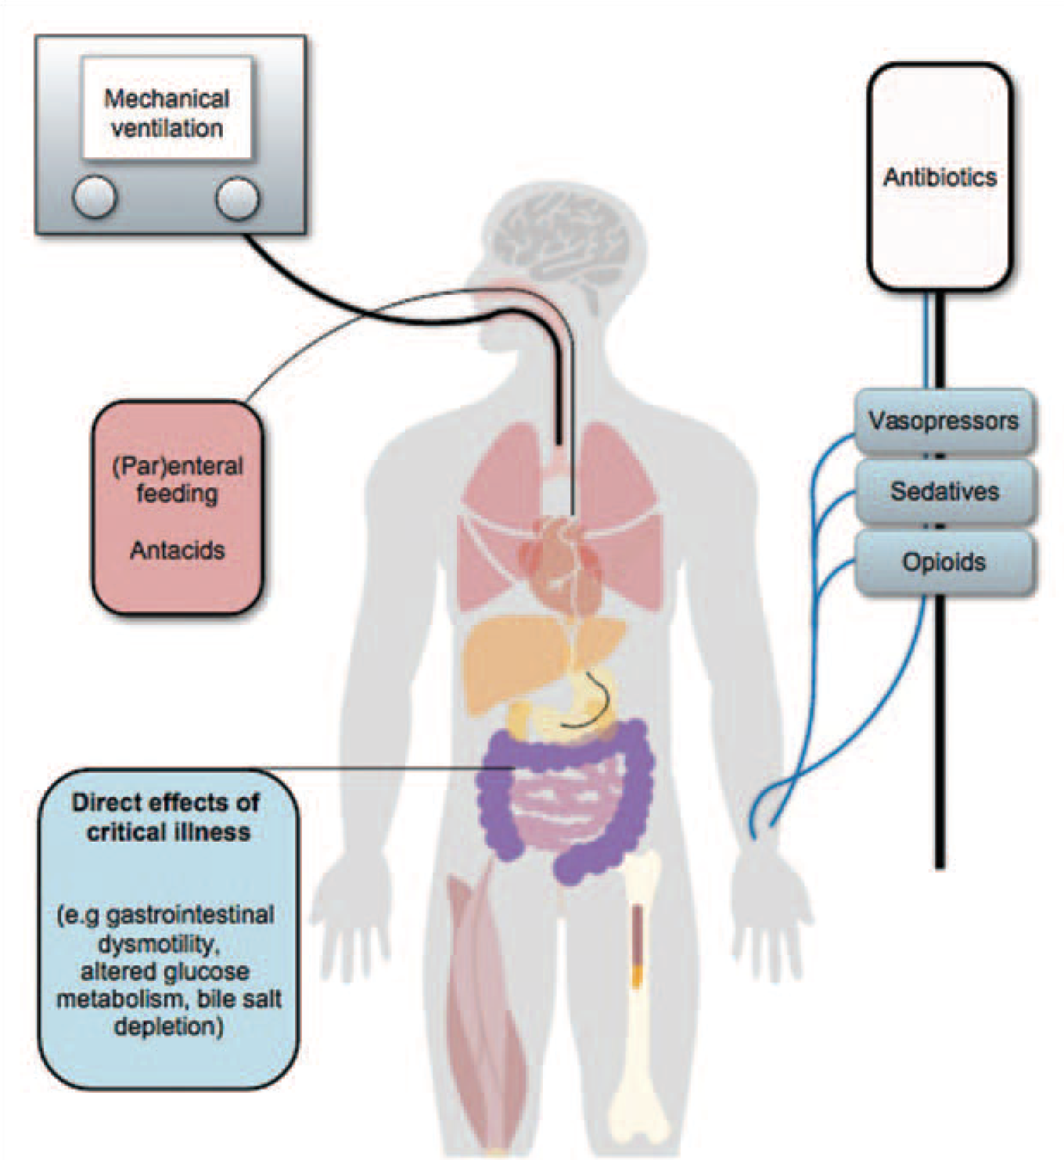
„Etesd és védd mikrobiotát!” koncepció
Haak BW, et al. Curr Opin Crit Care 2017; 00:000–000.

Slide 11
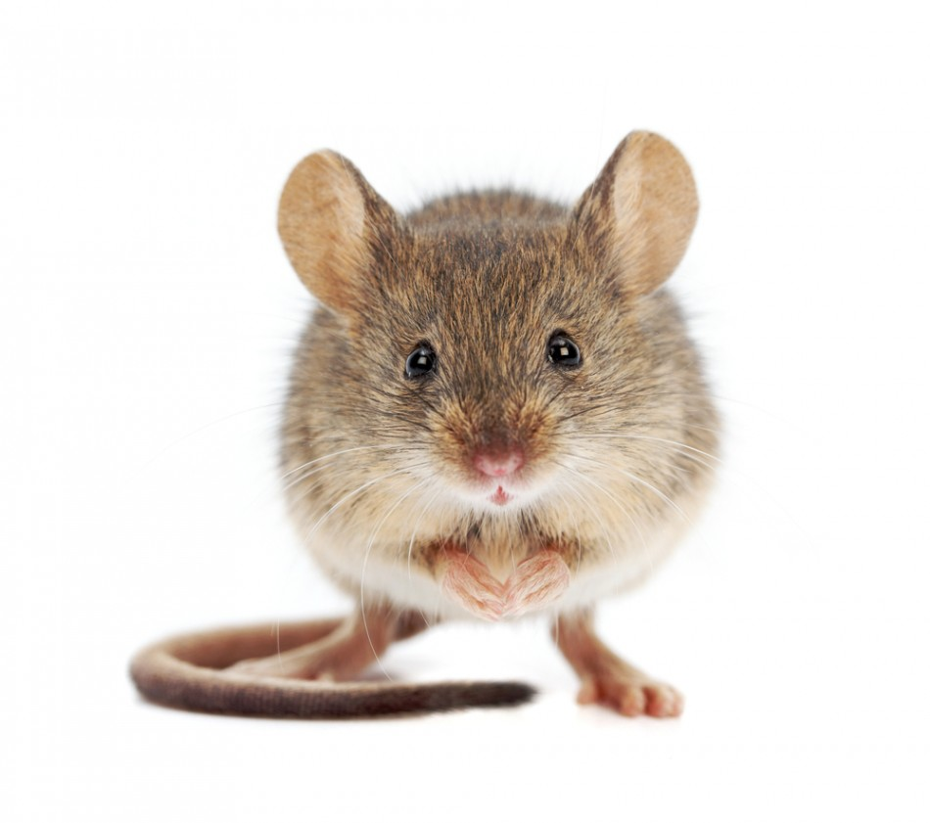
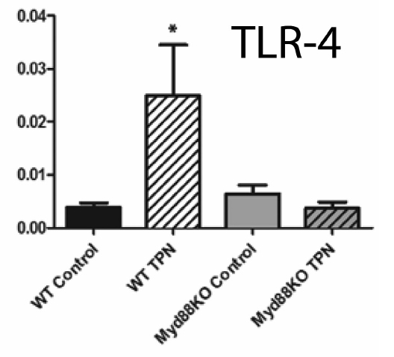
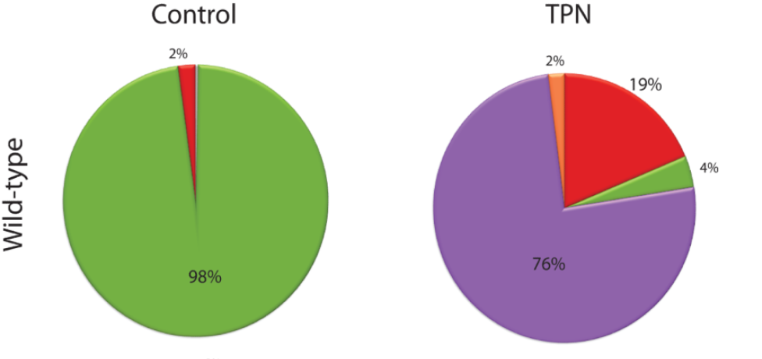
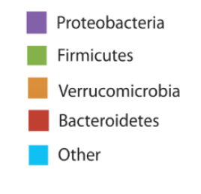
A teljes parenteralis táplálás dysbacteriosissal és bélmucosa gyulladással jár
Mucosa-asszociált mikrobiota
Eiichi A. Miyasaka et al. J Immunol. 2013 June 15; 190(12): 6607–6615.
Notes:
Background—Enteral nutrient-deprivation, via total parenteral nutrition (TPN) administration
leads to local mucosal inflammatory responses, but the underlying mechanisms are unknown.
Methods—Wild-type (WT) and MyD88-/- mice underwent jugular vein cannulation. One group
received TPN without chow and controls received standard chow. After 7days, we harvested
intestinal mucosally-associated bacteria, and isolated small-bowel lamina propria (LP) cells.
Bacterial populations were analyzed using 454-pyrosequencing. LP cells were analyzed using
quantitative PCR and multi-color flow cytometry.
Results—WT, control mucosally-associated microbiota were Firmicutes-dominant while WT
TPN mice were Proteobacteria-domiant. Similar changes were observed in MyD88-/- mice with
TPN administration. Unifrac analysis showed divergent small bowel and colonic bacterial
communities in controls, merging towards similar microbiota (but distinct from controls) with
TPN. The percentage of LP T-regulatory cells significantly decreased with TPN in WT mice.
F4/80+CD11b+CD11cdull-neg macrophage derived pro-inflammatory cytokines significantly
increased with TPN. These pro-inflammatory immunologic changes were significantly abrogated
in MyD88-/- TPN mice.
Conclusions—TPN administration is associated with significant expansion of Proteobacteria
within the intestinal microbiota and increased pro-inflammatory LP cytokines. MyD88 signaling
blockade abrogated this pro-inflammatory response.
MyD88 (Myeloid differentiation factor 88) is a crucial adapter protein that links Toll-like Receptors (TLRs) and IL-1 receptors to downstream inflammatory pathways, like NF-κB.

Slide 12
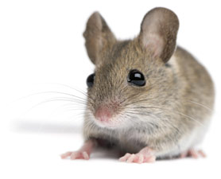
Parenterális táplálás asszociált máj sérülés
Harris JK et al. PLoS One. 2014 Oct 20;9(10): e110396.
Notes:
dextran sulfate sodium (DSS)-induced intestinal inflammation
Figure 5. Proposed pathways involved in the pathogenesis of PNALI. Administration of PN and the associated absence of enteral feedings
are the primary drivers of intestinal dysbiosis, in addition to small bowel bacterial overgrowth caused by impaired intestinal motility. In the presence
of increased intestinal permeability secondary to injury and inflammation, microbe associated molecular patterns (MAMPs) derived from specific
bacterial populations that thrive in the dysbiotic environment are absorbed into the portal circulation and promote TLR signaling and activation of
hepatic Kupffer cells (KCs.) Soy lipid-derived plant sterols excreted into the gut via the enterohepatic circulation system in turn promote dysbiosis in
addition to their effect on activation of KCs and suppression of hepatocyte bile secretion. These two latter processes culminate in PNALI and
cholestasis.
Background: Parenteral nutrition (PN) has been a life-saving treatment in infants intolerant of enteral feedings. However, PN
is associated with liver injury (PN Associated Liver Injury: PNALI) in a significant number of PN-dependent infants. We have
previously reported a novel PNALI mouse model in which PN infusion combined with intestinal injury results in liver injury.
In this model, lipopolysaccharide activation of toll-like receptor 4 signaling, soy oil-derived plant sterols, and proinflammatory
activation of Kupffer cells (KCs) played key roles. The objective of this study was to explore changes in the
intestinal microbiome associated with PNALI.
Methodology and Principal Findings: Microbiome analysis in the PNALI mouse identified specific alterations within colonic
microbiota associated with PNALI and further association of these communities with the lipid composition of the PN
solution. Intestinal inflammation or soy oil-based PN infusion alone (in the absence of enteral feeds) caused shifts within the
gut microbiota. However, the combination resulted in accumulation of a specific taxon, Erysipelotrichaceae (23.8% vs. 1.7%
in saline infused controls), in PNALI mice. Moreover, PNALI was markedly attenuated by enteral antibiotic treatment, which
also was associated with significant reduction of Erysipelotrichaceae (0.6%) and a Gram-negative constituent, the S24-7
lineage of Bacteroidetes (53.5% in PNALI vs. 0.8%). Importantly, removal of soy oil based-lipid emulsion from the PN solution
resulted in significant reduction of Erysipelotrichaceae as well as attenuation of PNALI. Finally, addition of soy-derived plant
sterol (stigmasterol) to fish oil-based PN restored Erysipelotrichaceae abundance and PNALI.
Conclusions: Soy oil-derived plant sterols and the associated specific bacterial groups in the colonic microbiota are
associated with PNALI. Products from these bacteria may directly trigger activation of KCs and promote PNALI. Furthermore,
the results indicate that lipid modification of PN solutions may alter specific intestinal bacterial species associated with
PNALI, and thus suggest strategies for management of PNALI.

Slide 13

Van benne igazság, a diszbiózis terápiáját illetően is

Slide 14



Slide 15
Probiotikum
Az FDA és EMA mindeddig egyetlen probiotikus készítményt sem hagyott jóvá orvosi kezelésként vagy megelőzésként. (kiv.NGP)
A hatékonyság és biztonságosság meggyőző bizonyításának szükségessége ellenére néhány probiotikumot még mindig használnak a különböző betegségek elsődleges vagy másodlagos megelőzésére
  Alkalmazásukat olyan klinikai társaságok is támogatják, mint az European Society for Paediatric Gastroenterology, Hepatology and Nutrition (ESPGHAN), a United European Gastroenterology and European Society for Neurogastroenterology and Motility vagy az American Gastroenterological Association
Rateiner K et al. Nature Reviews Microbiology | Volume 22 | May 2024 | 291–308
Notes:
A széles körű népszerűség ellenére az Egyesült Államok (FDA) és az európai szabályozó ügynökségek mindeddig egyetlen probiotikus készítményt sem hagytak jóvá orvosi kezelésként vagy megelőzésként.
A heves viták, valamint a hatékonyság és biztonságosság meggyőző bizonyításának szükségessége ellenére néhány probiotikumot még mindig használnak a különböző betegségek elsődleges vagy másodlagos megelőzésére, és alkalmazásukat olyan klinikai társaságok is támogatták, mint az European Society for Paediatric Gastroenterology, Hepatology and Nutrition (ESPGHAN), a United European Gastroenterology and European Society for Neurogastroenterology and Motility vagy az American Gastroenterological Association

Slide 16
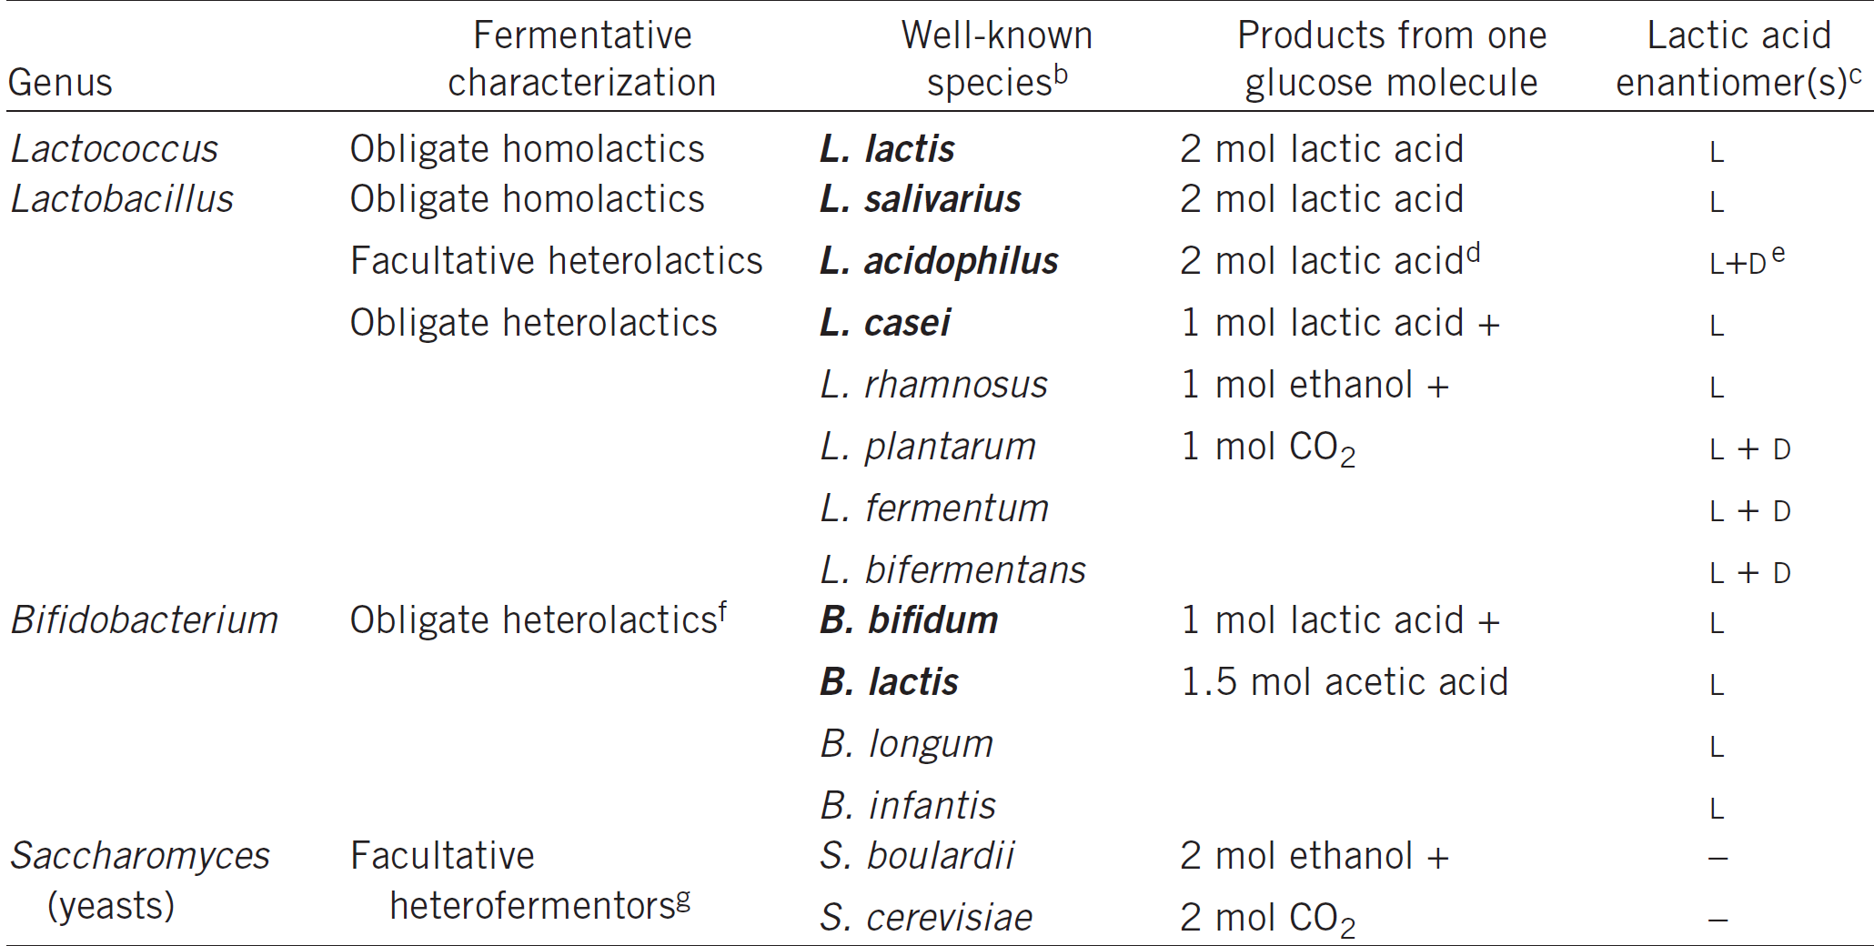
Probiotikumok: nem ismerjük a farmakokinetikát és -dinámiát
Akut pancreatitis: PROPATRIA study (2008)
  Több faj+ fermentálható szénhidrát NJ: bél ischaemia, mortalitás↑
Bongaerts GP, et al. Nat Biotechnol. 2016 Jan;34(1):55-63.

Slide 17
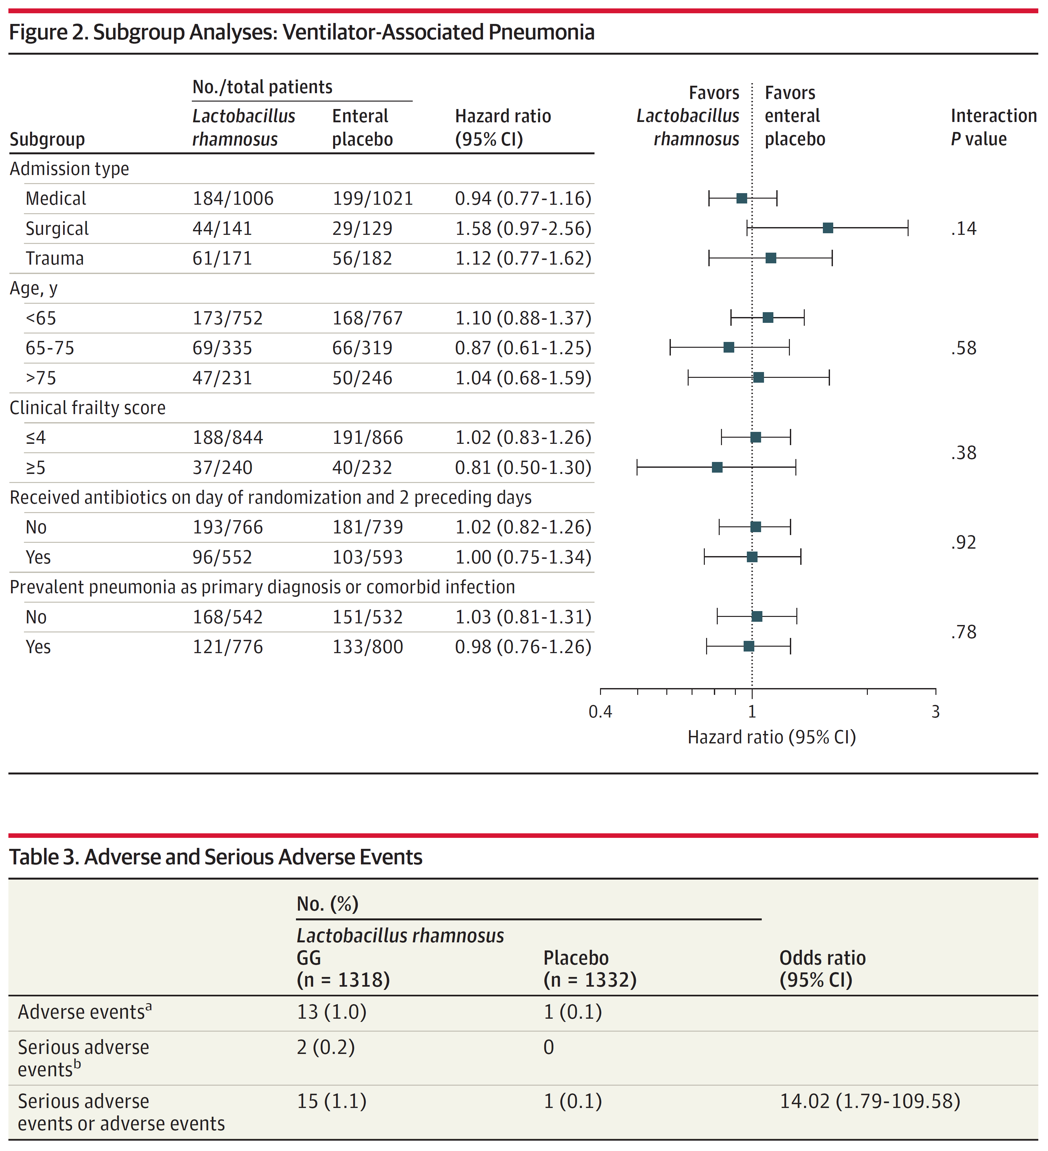
A probiotikumok nincs hatása VAP incidenciájára kritikus betegekben, ugyanakkor mellékhatása lehet
Johnston J et al. JAMA. 2021;326(11):1024-1033.

Slide 18
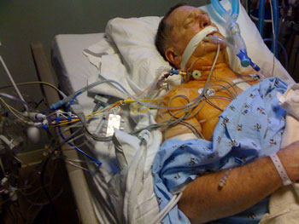
OGYEI biztonsági figyelmeztetés a probiotikumok alkalmazásáról kritikus betegekben
Kórházi környezet és katéterek kontaminációja
  A zacskókat vagy kapszulákat nem szabad a beteg kórházi szobájában kinyitni
  Saccharomyces boulardii – fungaemia
  Lactobacillus endocarditis
  Vulnerabilis betegben adása kontraindikált
    CVK
    Mechanikus szívbillentyű
    Immunszuppresszió
2017.dec.18. https://ogyei.gov.hu/dhpc_levelek__2017

Slide 19
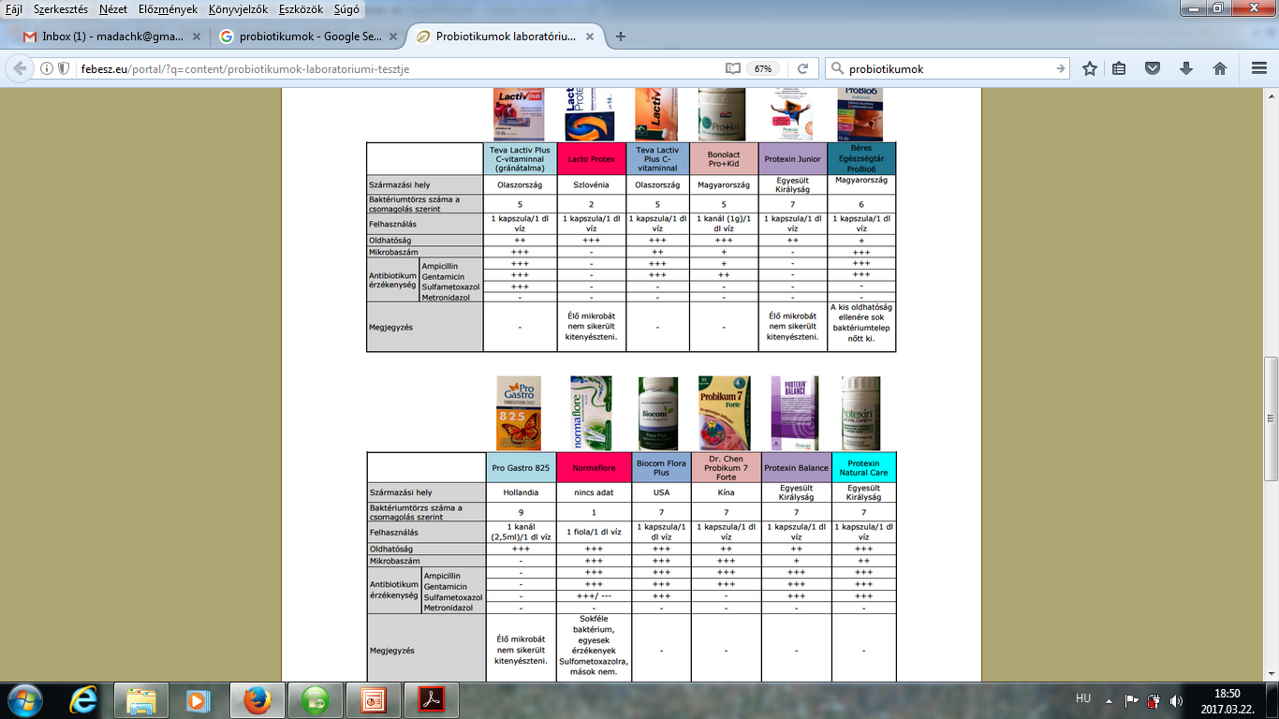
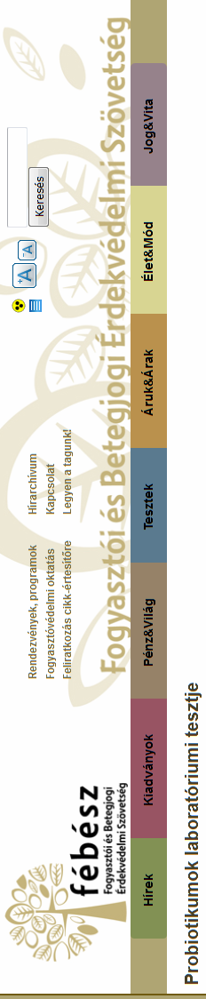
Probiotikumok:
Étrend kiegészítők
Alliance for Protection of Consumers and Patients Rights
https://www.blikk.hu/eletmod/egeszseg/mar-a-jo-bakteriumokban-sem-bizhatunk/c9h673h
https://www.febesz.eu/index.php?page=hirek&id=717 2015.12.11. és 2021.11.12.
Notes:
Egyáltalán mit tartalmaz??? Alliance for Protection of Consumers and Patients Rights

Slide 20
Antibiotics 2023, 12, 1281.
Notes:
Abstract: Probiotics are among those products, the use of which is increasing, and they are available
primarily as food/dietary supplements, as well as in the form of medicines. This study aims to
assess the attitudes and practices of health professionals and students of health sciences, give a short
overview of the probiotics currently on the market, and conduct a screening of five food supplements
and one drug with respect to antibiotic resistance. Nearly half of the respondents in our survey state
that probiotics have no side effects, while only 6.3% believe that the use of probiotics can lead to
antibiotic resistance. In addition, more than 40% of the participants throw unused probiotics into
municipal waste. The market analysis results indicate that probiotic products on the Serbian market
have highly variable CFU counts, while the declared health claims cover numerous beneficial health
effects, and they are sometimes even registered as medicines. Lactobacilli are frequently present in
probiotic supplements, and are sold in pharmacies and online. The experimental results showed that
antibiotic resistance is present in different types of lactobacilli in probiotic products. The risk of using
probiotics, regardless of their beneficial health effects, should be taken into account in the future. An
update to the regulations governing probiotics, including a stipulation for antimicrobial resistance
(AMR) testing, should be established, and guidelines for their proper use and disposal put into place.

Slide 21

Next generation probiotic
2023.04.26.
Napi 4
Ser-109 kapszula 3 napig
(élő, tisztított Firmicutes spórák)

Slide 22
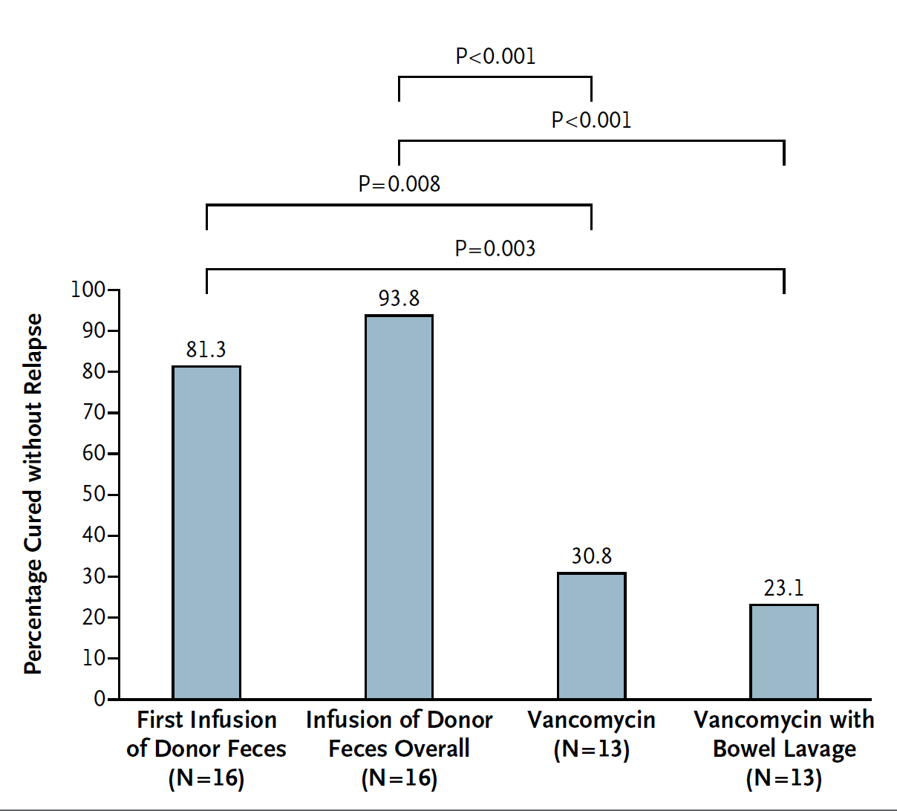
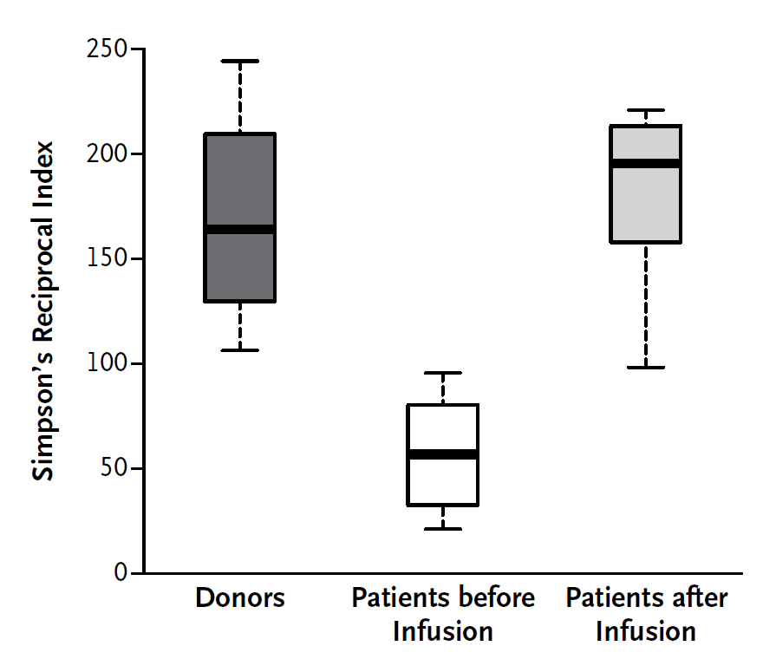
Faecalis mikrobióta transzplantáció (FMT)
Rekurráló CDI relapsusa nélküli gyógyulási arányok
A betegek mikrobióta diverzitása donor faeces infúziója előtt és után, az egészséges donorokéhoz hasonlítva
van Nood E et al. N Engl J Med. 2013 Jan 31;368(5):407-15.

Slide 23
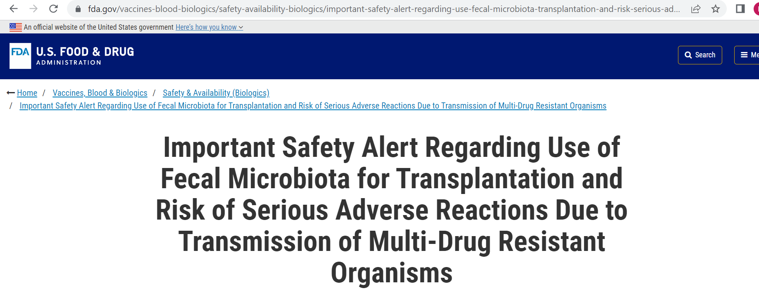
June 13, 2019
Two immunocompromised adults who received investigational FMT developed invasive infections caused by extended-spectrum beta-lactamase (ESBL)-producing Escherichia coli (E.coli). One of the individuals died.
Donor screening with questions that specifically address risk factors for colonization with MDROs, and exclusion of individuals at higher risk of colonization with MDROs.
MDRO testing of donor stool and exclusion of stool that tests positive for MDRO.

Slide 24
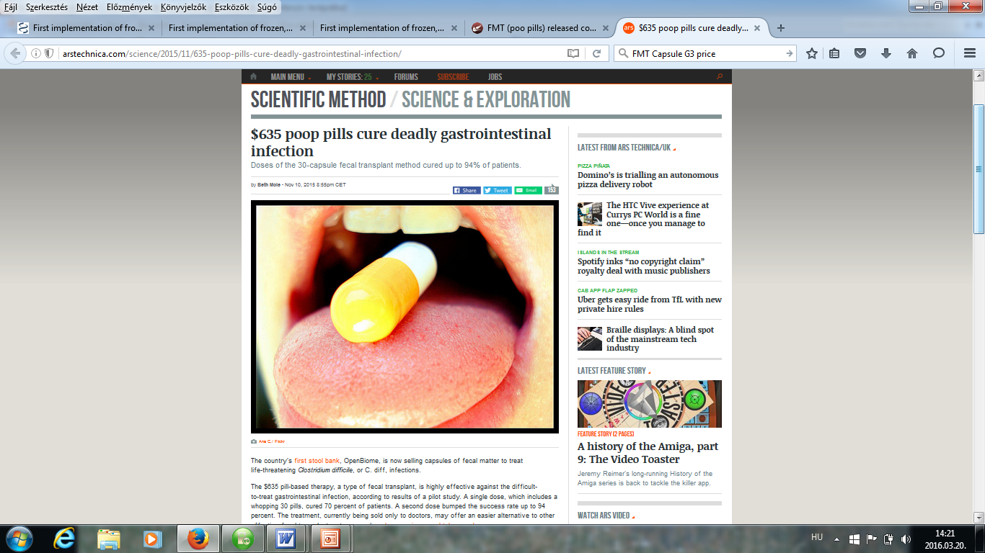
Faecalis mikrobióta transzplantáció (FMT)
Nehézségek:
  A donor szűrése
    széklet (paraziták, C. difficile, enteropathogen bacteria), vér (HIV, humanT-cell lymphotropicus virus 1 és 2 típus; hepatitis A, B, és C; CMV; EBV;Treponema pallidum; Strongyloides stercoralis; Entamoeba histolytica), antibiotikum rezisztencia
  „mindegyik mikrobiom saját személyiséggel rendelkezik”
A jövő:
  Új indikációk (IBD, diabetes, obezitás)
  Feldolgozott, szűrt, fagyasztott és potenciálisan tenyésztett?
  Optimális beviteli mód
Borody TJ et al. Curr Opin Gastroenterol. 2014 Jan;30(1):97-105.

Slide 25
7 nap ciprofloxacin és metronidazol
Suez J, et al.. Cell. 2018;174 (6):1406–23 e16.

Slide 26
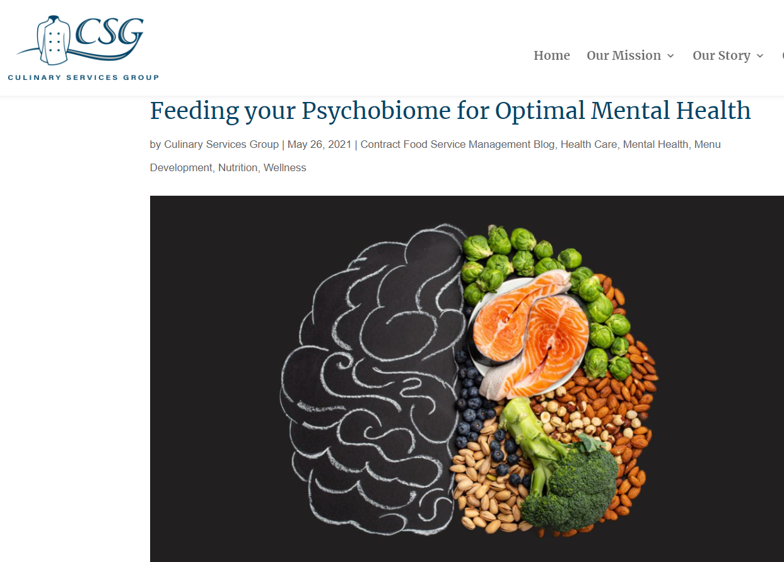
Táplálással befolyásolható a mikrobióta?

Slide 27
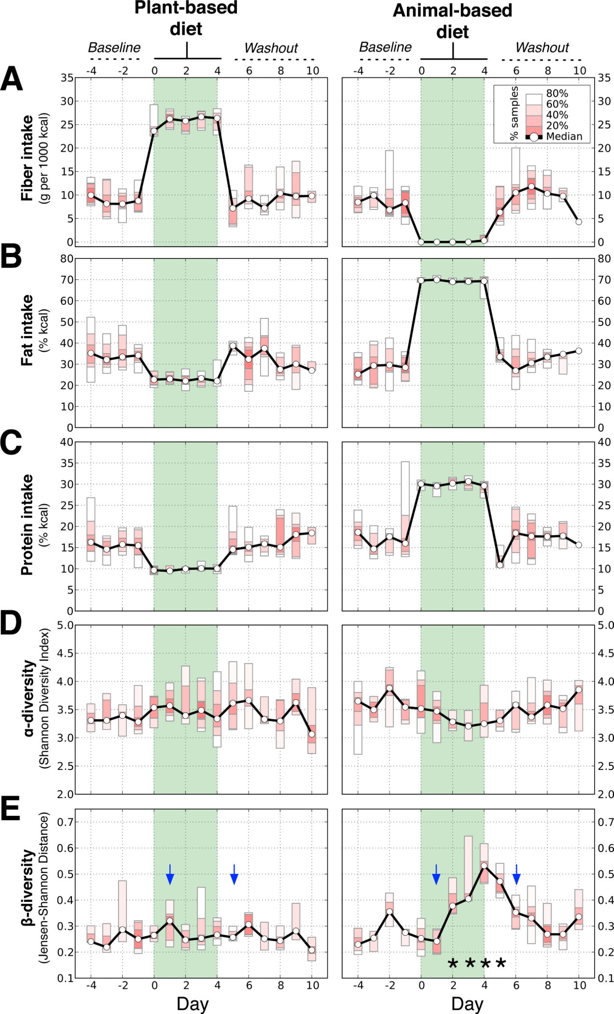
Az étrend gyorsan és reprodukálhatóan változtatja meg a humán bél mikrobiomot
Azon alanyok testsúlya, akik növényi étrenden voltak változatlan maradt, de az állati étrenden lévőké a 3. napra szignifikánsan csökkent (Firmicutes↓- növényi poliszacharidok metab.)
(q<0.05, Bonferroni-corrected Mann-Whitney U test)
A kalóriabevitel a növényi- és állati étrend esetén egyezett (1,695±172 kcal and 1,777±221 kcal; p=0.44)
David LA et al. Nature 2014 Jan 23;505(7484):559-63.
Notes:
Harvard diákjai 6 férfi 4 nő. NAture cikk. Each diet was consumed ad libitum for five consecutive days by six male and four female. We prepared two diets that varied according to their primary food source: a “plant-based diet”, which was rich in grains, legumes, fruits, and vegetables; and an “animal-based diet”, which was composed of meats, eggs, and cheeses
Alpha diversity
species richness (number of taxa) within a single microbial ecosystem.
How many different microbial species could be detected in one sample?
Beta diversity
diversity in microbial community between different environments (difference in taxonomic abundance profiles from different samples).
How different is the microbial composition in one environment compared to another?
The animal-based diet increased the abundance of bile-tolerant microorganisms (Alistipes, Bilophila, and Bacteroides) and decreased the levels of Firmicutes that metabolize dietary plant polysaccharides (Roseburia, Eubacterium rectale, and Ruminococcus bromii).
Subjects’ weights on the plant-based diet remained stable, but decreased significantly by day 3 of the animal-based diet (q<0.05, Bonferroni-corrected Mann-Whitney U test; Extended Data Fig. 3). Differential weight loss between the two diets cannot be explained simply by energy intake, as subjects consumed equal numbers of calories on the plant- and animal-based diets (1,695±172 kcal and 1,777±221 kcal, respectively; p=0.44).
The animal-based diet was associated with significant increases in gene expression (normalized to reads per kilobase per million mapped, or RPKM; n=13–21 datasets/diet arm) among beta-lactamases

Slide 28
Enterotípus - depresszió - obezitás
Obezitás
Jellemző az alacsony diverzitás, Bact2 magas szintje
Magas fehérjetartalmú, hypokalóriás diéta > 10% testsúlyvesztés > diverzitás nő Bact2 csökkent, Bifidobacterales nőtt
Kis mikrobialis denzitású Bacteroides enterotípus 2 (Bact2) és a depresszió kapcsolata
enterotípusok (B1, Bacteroides enterotype 1; B2, Bacteroides enterotype 2; P, Prevotella; R, Ruminococcaceae)
Valles-Colomer M et al. Nature Microbiology | VOL 4 | APRIL 2019 | 623–632
Alili R et al. Biomedicines 2022, 10, 16.
Notes:
Bacteroides enterotype 2 association with lower QoL and depression status in the FGFP cohort. a, Mean QoL (RAND) scores in the four DMM
enterotypes (B1, Bacteroides enterotype 1; B2, Bacteroides enterotype 2; P, Prevotella; R, Ruminococcaceae); Kruskal–Wallis test (FDR < 0.1 for all scores;
Supplementary Table 9) with post hoc Dunn’s test (FDR < 0.1 for associations between Bacteroides enterotype 2 and other enterotypes; Supplementary
Table 9) in the FGFP cohort (n = 1,054). MH, emotional well-being; SF, social functioning; VT, vitality; RE, role limitations caused by emotional
health problems; GH, general health perception; PF, physical functioning; RP, role limitations caused by physical health; BP, body pain. b, Enterotype
distribution in FGFP individuals with general practitioner-reported depression (n = 151) versus controls (n = 933) (χ2 test, χ2 = 16.77, P = 7.87 × 10−4).
Bacteroides enterotype 2 was the only one with a different distribution in cases versus controls (pairwise χ2 tests; χ2 = 5.21, FDR = 8.99 × 10−2; Background: Dietary intervention is a cornerstone of weight loss therapies. In obesity, a dysbiotic gut microbiota (GM) is characterized by high levels of Bacteroides lineages and low diversity. We examined the GM composition changes, including the Bacteroides 2 enterotype (Bact2), in a real-world weight loss study in subjects following a high-protein hypocaloric diet with or without a live microorganisms (LMP) supplement. Method: 263 volunteers were part of this real-world weight loss program. The first phase was a high-protein low-carbohydrate calorie restriction diet with or without LMP supplements. Fecal samples were obtained at baseline and after 10% weight loss for 163 subjects. Metagenomic profiling was obtained by shotgun sequencing. Results: At baseline, the Bact2 enterotype was more prevalent in subjects with aggravated obesity and metabolic alterations. After weight loss, diversity increased and Bact2 prevalence decreased in subjects with lower GM diversity at baseline, notably in LMP consumers. Significant increases in Akkermansia muciniphila and Parabacteroides distasonis and significant decreases of Eubacterium rectale, Streptococcus thermophilus and Bifidobacterial lineages were observed after weight loss. Conclusions: Baseline microbiome composition is associated with differential changes in GM diversity and Bact2 enterotype prevalence after weight loss. Examining these signatures could drive future personalized nutrition efforts towards more favorable microbiome compositions.

Slide 29
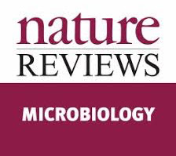
Rateiner K et al. Nature Reviews Microbiology | Volume 22 | May 2024 | 291–308
glucagon-like peptide 1
farnesoid-X receptor
Bdellovibrio bacteriovorus
Cholestatic liver disease
choline TMA-lyase
trimethylamine N-oxide
Mikrobiota derivált molekulák használata gyógyszerként
Notes:
Utilization of the microbiome in disease treatment. Harnessing the
microbiome in personalized medical interventions can be divided into three
major exploratory treatment avenues. A, Microorganism supplementation
or augmentation. Supplementation with exogenous next-generation
probiotics, dietary microbiome augmentation by prebiotic therapy or
data-driven personalized nutrition may enable correction of dysbiosis,
thereby influencing various microbiome-contributed diseases (panel Aa).
Administration of genetically engineered beneficial microorganisms may
enable degradation of toxic substances, modulate metabolite precursors or
generate bioactive molecules of interest such as short-chain fatty acids (SCFAs),
bile acids and tryptophan derivatives (panel Ab). Microbiome replacement
by faecal microbiota transplantation (FMT) is effective as treatment of
recurrent Clostridioides difficile infection (CDI), and potentially in other
microbiome-related disorders (panel Ac). B, Microorganism suppression.
Bacteriophage consortia can selectively suppress disease-contributing
pathobionts, such as specific strains of Klebsiella pneumoniae in patients
with inflammatory bowel disease (IBD) (panel Ba). Predatory bacteria such as
Bdellovibrio bacteriovorus feed on specific bacteria (panel Bb). RNA-guided
nucleases and their guide ribonucleic acid (gRNA) can silence specific
deleterious genes such as antibiotic resistance genes, thereby enabling increased
efficacy of previously ineffective antibiotic treatment (panel Bc). C, Metabolite
modulation. Supplementation of metabolites such as SCFAs can help manage
type 2 diabetes (T2D) by reducing the levels of haemoglobin A1c (HbA1c)
through glucagon-like peptide 1 (GLP-1) secretion (panel Ca). Manipulation of
metabolite pathways, as exemplified by farnesoid-X receptor (FXR) agonists,
which inhibit bile acid synthesis in the treatment of liver diseases such as
primary sclerosing cholangitis (panel Cb). Inhibition of metabolite pathways,
as exemplified by inhibition of bacterial trimethylamine (TMA) production.
The microbiome produces TMA from dietary choline, which is then converted into
trimethylamine N-oxide (TMAO) by the host hepatic enzyme flavin-containing
monooxygenase 3 (FMO3), resulting in increased risk of thrombosis. The
inhibition of key TMA-generating microbial enzymes, such as choline TMA-lyase
(CutC), can significantly decrease plasma TMAO levels, thereby reducing the risk
of ischaemic vascular events (panel Cc).

Slide 31
Konklúzió
Cél
haemodinamikai zavar (IHD/CRRT), infekció, toxin (AB, PPI), éhezés (PN)
A mikrobióta restitúció elősegítése
Mikroorganizmus szupplementáció/szubsztitúció
Mikroorganizmus szuppresszió
A kiváltó ok időbeni megszűntetése
az ökoszisztéma fenntartása és visszaállítása
Metabolikus moduláció, táplálásterápia
egészséges életmód, természetes táplálkozás

Slide 32

“Ne érezd magad magányosnak, …
az egész univerzum benned van.”
Jalāl ad-Dīn Muhammad Rūmī

